Slide 1

Unit 4: HOME
Lesson 3.1
Page 58

Slide 2
Lesson Outline
Warm-up
Vocabulary
Structure
Consolidation
Wrap-up

Slide 3
Objectives
By the end of this lesson, students will be able to ask where things are.
Vocabulary: mirror, picture, sofa, table, box, house.
Structure: Is the picture in the living room? Yes, it is.
Is the cat in the house? No, it isn’t.

Slide 4

WARM UP

Slide 5

In pairs, ask what people are doing.
What are they doing?
They are reading books.

Slide 6
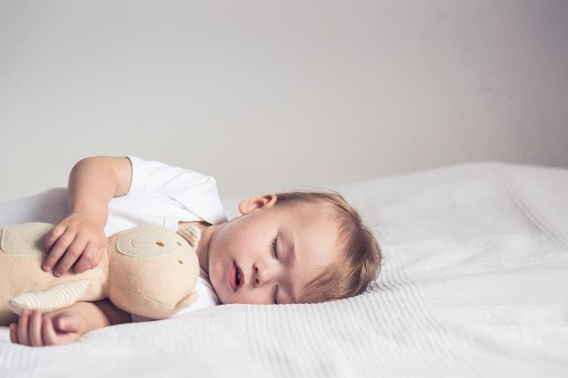
In pairs, ask what people are doing.
Where’s he?
He’s in the bedroom.
What’s he doing?
He’s sleeping.

Slide 7
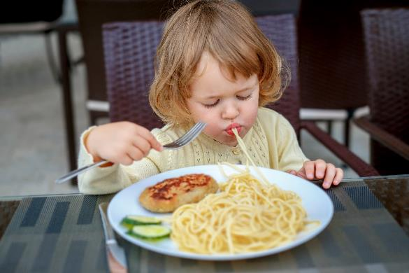
In pairs, ask what people are doing.
What’s she doing?
She’s eating.

Slide 8
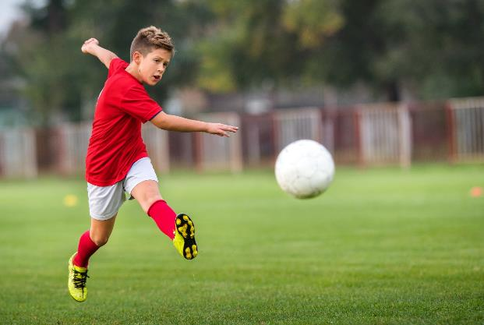
In pairs, ask what people are doing.
What’s he doing?
He’s playing football.

Slide 9

It’s time to learn …

Slide 10

Vocabulary

Slide 11
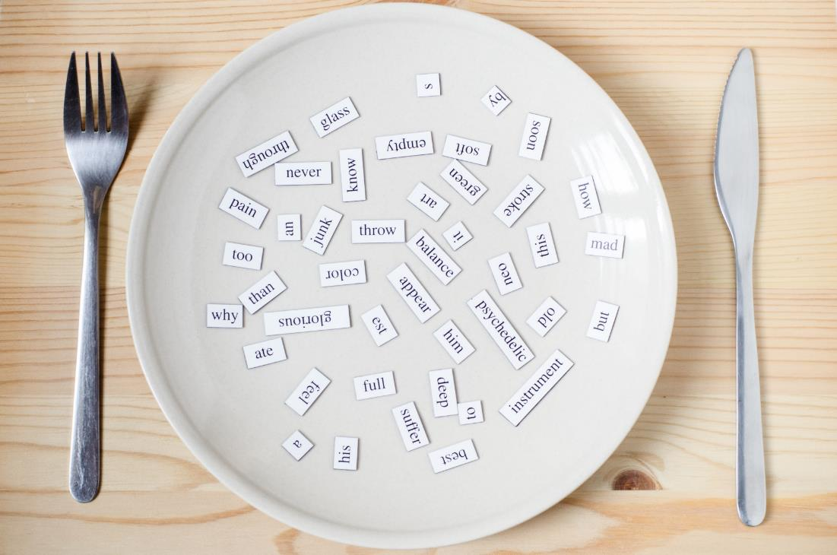
New words
mirror,
picture,
sofa,
table,
box,
house.

Slide 12

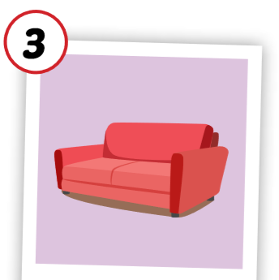
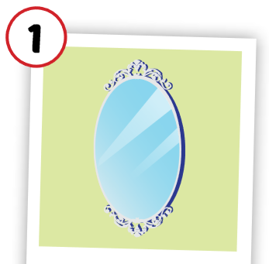
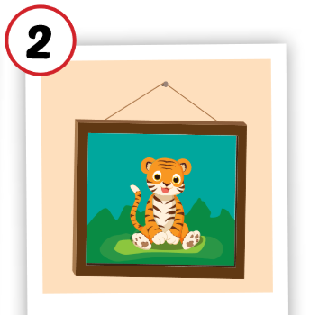
Click each English word to hear the sound.
mirror
picture
sofa
/ˈmɪrər/
cái gương
/ˈpɪktʃər/
bức tranh
/ˈsəʊfə/
ghế sô-pha

Slide 13
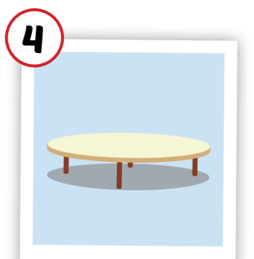
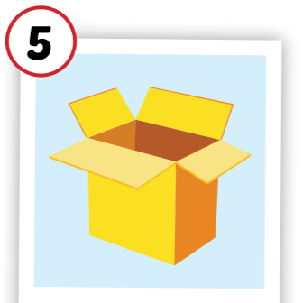
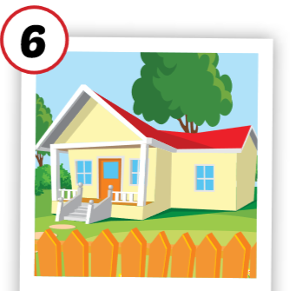
Click each English word to hear the sound.
table
box
house
/ˈteɪbl/
cái bàn
/bɑːks/
cái hộp
/haʊs/
ngôi nhà

Slide 14
Click each English word to hear the sound.
mirror
/ˈmɪrər/
cái gương

Slide 15
Click each English word to hear the sound.
picture
/ˈpɪktʃər/
bức tranh

