Slide 1

Unit 4: HOME
Lesson 4.1
Page 61

Slide 2
Lesson Outline
Warm-up
Vocabulary
Structure
Consolidation
Wrap-up

Slide 3
Objectives
By the end of this lesson, students will be able to say their address and what their house has.
Vocabulary: bed, closet, chair, desk, TV.
Structure: I live on La Thành Street in Hanoi.
My bedroom has a bed, a TV, and two chairs in it.

Slide 4

WARM UP

Slide 5



In pairs, ask and answer.
- Is the sofa in the living room?
- Yes, it is.
Sofa
- Is the picture in the living room?
- Yes, it is.
picture

Slide 6
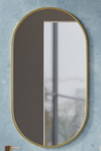

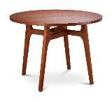
In pairs, ask and answer.
- Is the mirror in the bathroom?
- Yes, it is.
mirror
- Is the table in the bathroom?
- No, it isn’t.
table

Slide 7

It’s time to learn …

Slide 8

Vocabulary

Slide 9
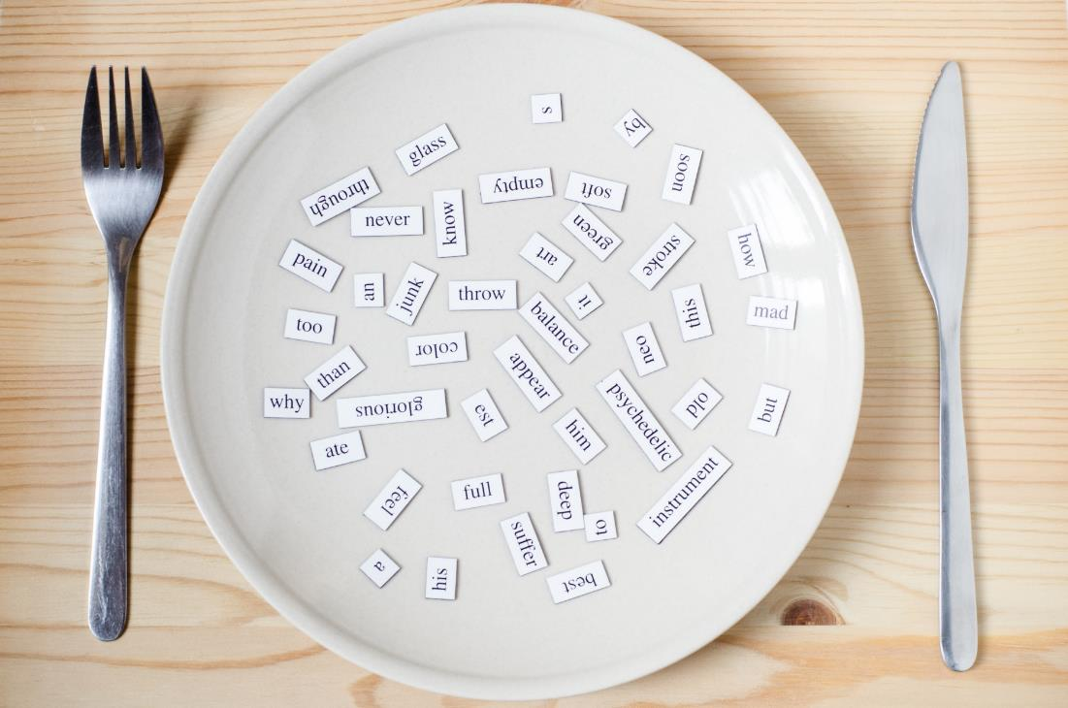
New words
bed,
closet,
chair,
desk,
TV.

Slide 10



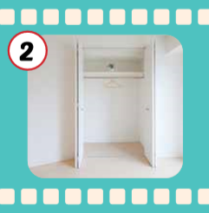
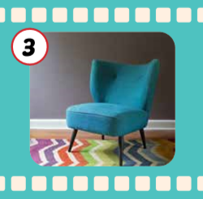
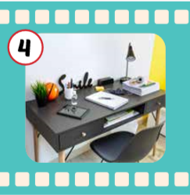
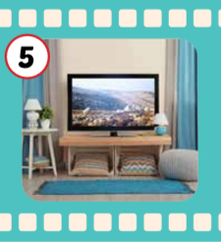
Click each English word to hear the sound.
bed
closet
chair
desk
TV
/bed/
Cái giường
/ˈklɑːzɪt/
Cái tủ quần áo
/tʃer/
Cái ghế
/desk/
Cái bàn
/ˌtiː ˈviː/
Cái ti-vi

Slide 11
Click each English word to hear the sound.
bed
/bed/
Cái giường

Slide 12
Click each English word to hear the sound.
closet
/ˈklɑːzɪt/
Cái tủ quần áo

Slide 13
Click each English word to hear the sound.
chair
/tʃer/
Cái ghế

Slide 14
Click each English word to hear the sound.
desk
/desk/
Cái bàn

Slide 15
Click each English word to hear the sound.
TV
/ˌtiː ˈviː/
Cái ti-vi

