Slide 1

Unit 4: HOME
Lesson 4.2
Page 62

Slide 2
Lesson Outline
Warm-up
Reading
Listening
Consolidation
Wrap-up

Slide 3
Objectives
By the end of this lesson, students will be able to talk about their homes and ask and answer about what in their house is.
Vocabulary: houseboat, canal.
Structure: Who do you live with? - I live with my mother.
What’s your home like? - It’s great.
What’s it like? - It’s orange.

Slide 4

WARM UP

Slide 5

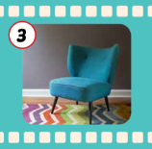
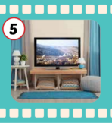
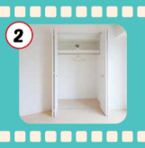
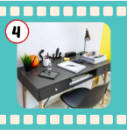
Matching.
1. bed
Cái ghế
2. closet
Cái bàn
3. chair
Cái ti-vi
4. desk
Cái tủ quần áo
Cái giường
5. TV
Notes:
Hoặc cháu cho thành bài làm mờ để học sinh đoán từ (giống bài của cái đứa mà anh Riêu gửi cho mình tham khảo đầu tiên ấy)

Slide 6


Make up sentences.
My bedroom has ______.

Slide 7
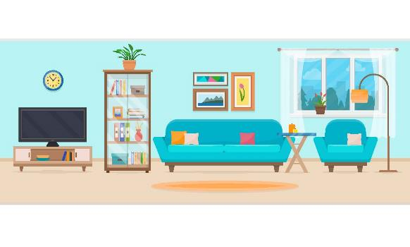
Make up sentences.
My living room has ______.

Slide 8

It’s time to learn …

Slide 9

Reading

Slide 10

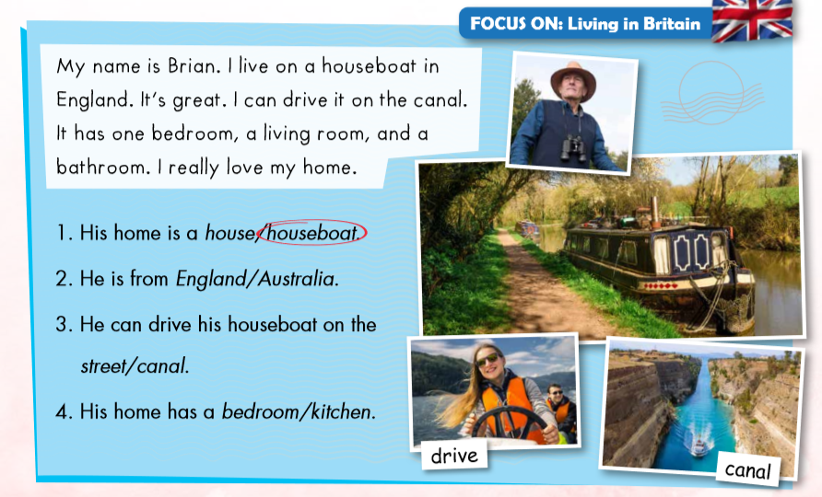

Slide 15

Listening

