Slide 1

Unit 5: Sports and hobbies
P.E. Lesson 4.2
Page 78

Slide 2
Lesson Outline
Warm-up
Reading
Listening
Consolidation
Wrap-up

Slide 3
Objectives
By the end of this lesson, students will be able to talk about what they can use in some sports, what they can / can’t do, using
Vocabulary: hand, arm, foot/feet, leg, head, body
Structure:
I use my legs and feet in soccer.
I can kick the ball in soccer.
I can't kick the ball in basketball.

Slide 4

WARM UP

Slide 5
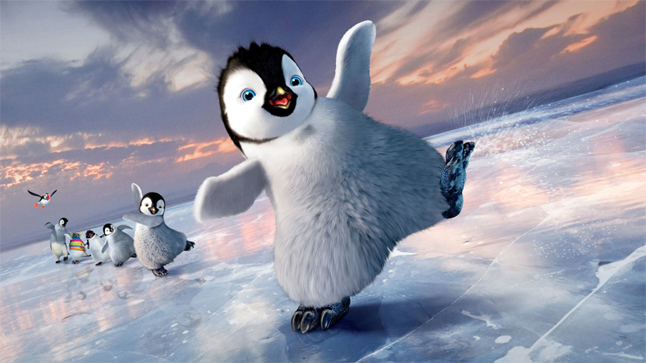

Play

Slide 6






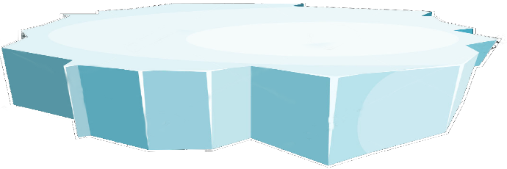









Choose 1 penguin.
Double click to open
end

Slide 7



arm
A: đầu | B: cánh tay
C: cơ thể | D: bàn tay
B
BACK

Slide 8

I use __ hands and arms in volleyball.
A: your | B: can’t
C: use | D: my
D
BACK

Slide 9
📢
A: đầu | B: cánh tay
C: cơ thể | D: bàn tay
A
BACK

Slide 10
hand
A: đầu | B: cánh tay
C: cơ thể | D: bàn tay
D
BACK

Slide 11
I __ my legs and feet in soccer
A: can | B: can’t
C: use | D: kick
C
BACK

Slide 12
f_et (đôi bàn chân)
A: o | B: a
C: e | D: i
C
BACK

Slide 13

Lost turn
☹
Back

Slide 14
📢
A: body | B: hand
C: arm | D: foot
A
BACK

Slide 15
I can kick __ in soccer.
A: the ball | B: can’t
C: use | D: arm
A
BACK

