Slide 1


Long Bien Primary School
Welcome to our class
Teacher: Duong Thi Hong Van

Slide 2










Slide 3
01
Activity 1: Fun time

Slide 4
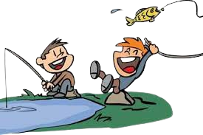
Let’s go fishing!

Slide 5
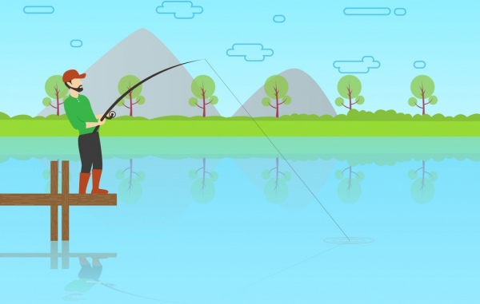









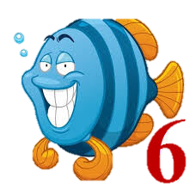








Team 1
Team 2
Next
Notes:
THIẾT KẾ HOẠT ĐỘNG TƯƠNG TÁC TỪ SLIDE 6-15: HS NGHE VÀ CHỌN CHỮ CÁI NGHE ĐƯỢC

Slide 6


R
B
M
b
d
+2

Slide 7
F
O
T
+3

Slide 8
G
V
C
+1

Slide 9
A
X
N
+2

Slide 10
Z
P
L
+3

Slide 11
Y
P
H
+1

Slide 12
D
I
W
+3

Slide 13
K
U
J
+2

Slide 14
B
I
N
+2

Slide 15
K
O
S
+3

Slide 16
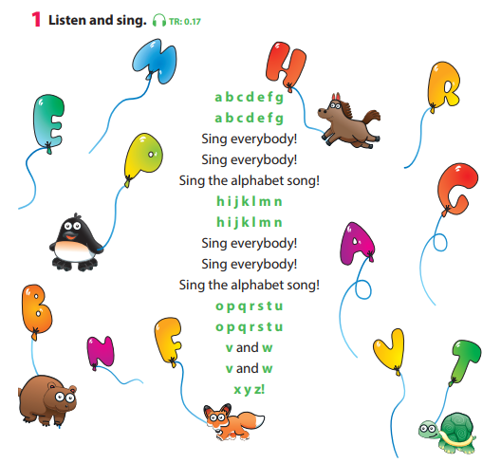
…
Notes:
- Ask sts to look at the balloon-letters.
- Ask questions about the letter and review the colors:
* What’s this? (a balloon)
* What color is it?
* What letter is this?

Slide 17
…

Slide 18
…
who can sing it?
Team 1
…
Team 2
…
…
…
…
…

Slide 19
02
Activity 2: Project

Slide 20
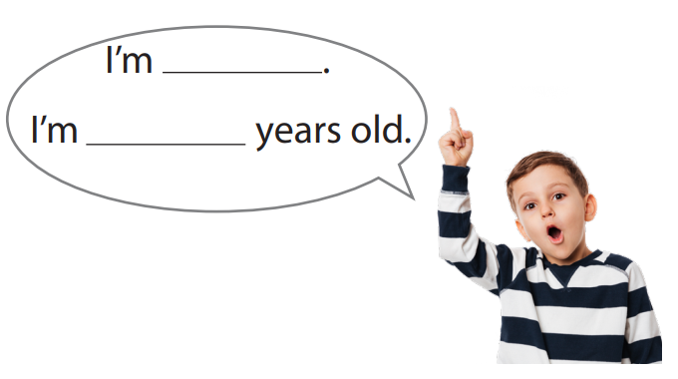

Slide 21

Let’s talk!
What’s your name?
Notes:
What’s your name?
How old are you?
Which class are you in?
Which school do you go to?

Slide 22

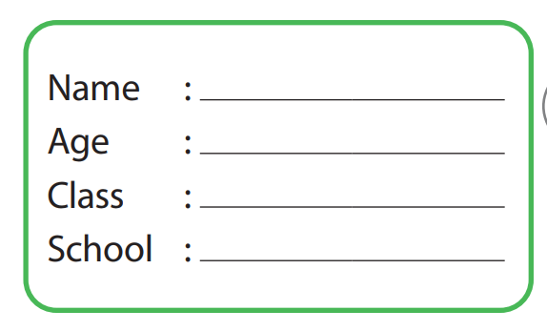

Slide 23

Group work
Hi! My name is…
I am ….
……
.........
………

Slide 24


Hi! My name is…
I am ….

Slide 25
Mini game!

Slide 26


Slide 27


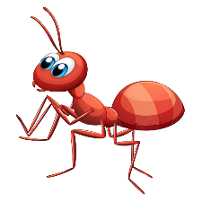

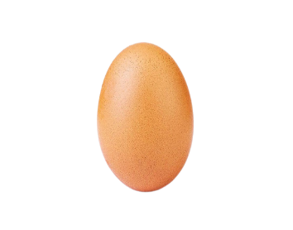


Slide 28


Goodbye

