Slide 1

Teacher: Le Thi Hau
Unit 1: My Friends
Lesson 3.3
Page 18

Slide 2
Lesson Outline
Warm-up
Structure
Consolidation
Wrap-up

Slide 3
Objectives
By the end of this lesson, students will be able to ask what their friends like doing, using:
Vocabulary: dancing, singing, drawing, reading, painting
Structure: Do your friends like dancing?
Yes, they do./No, they don't.

Slide 4

WARM UP

Slide 5
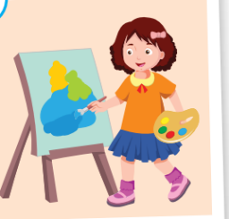


Save the animals!
Notes:
Click the sun so show picture.
Click the first box to drop them down.
Click the animal to let it go through the boxes.
Ask students to say the word, make question and answer.
Aim: review vocabs and structures.

Slide 6
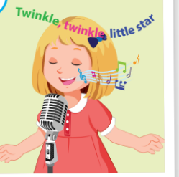


Save the animals!
Notes:
Click the sun so show picture.
Click the first box to drop them down.
Click the animal to let it go through the boxes.
Ask students to say the word, make question and answer.
Aim: review vocabs and structures.

Slide 7
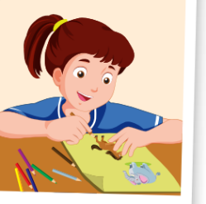


Save the animals!
Notes:
Click the sun so show picture.
Click the first box to drop them down.
Click the animal to let it go through the boxes.
Ask students to say the word, make question and answer.
Aim: review vocabs and structures.

Slide 8



Save the animals!
Notes:
Click the sun so show picture.
Click the first box to drop them down.
Click the animal to let it go through the boxes.
Ask students to say the word, make question and answer.
Aim: review vocabs and structures.

Slide 9
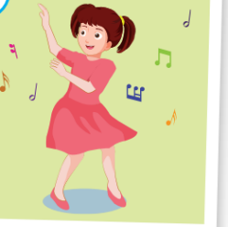


Save the animals!
Notes:
Click the sun so show picture.
Click the first box to drop them down.
Click the animal to let it go through the boxes.
Ask students to say the word, make question and answer.
Aim: review vocabs and structures.

Slide 10

It’s time to review …

Slide 11
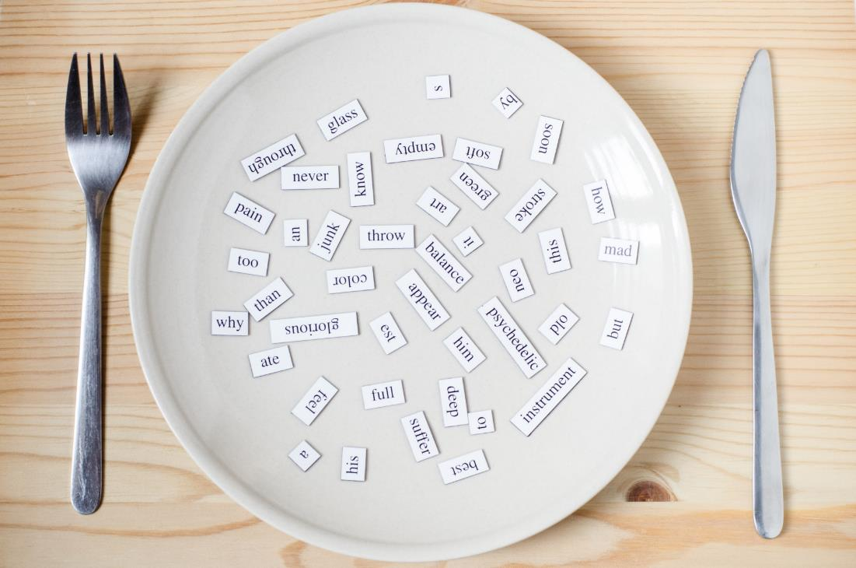
Structures
Do your friends like dancing?
Yes, they do.
Do your friends like singing?
No, they don’t.

Slide 12

Presentation

Slide 13







Let’s go to the beach!
1
2
3
4
5
Notes:
Click the numbers to lead to diffferent pictures

Slide 14

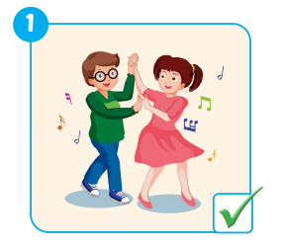
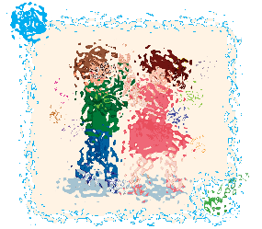

E
Point, ask and answer.
Do your friends like dancing?
Yes, they do.
Notes:
Click the cover picture to show
Click the ? And the answering icons to show question and answer,
Click the back button to go back the sea slide.

Slide 15
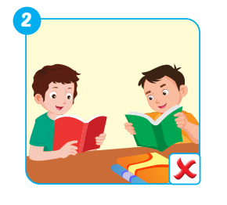
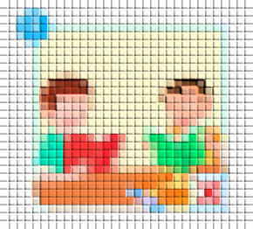
E
Point, ask and answer.
Do your friends like reading?
No, they don’t.
Notes:
Click the cover picture to show
Click the ? And the answering icons to show question and answer,
Click the back button to go back the sea slide.

Slide 16
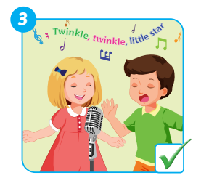
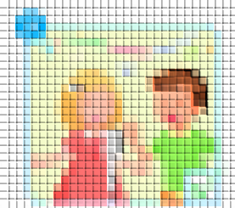
E
Point, ask and answer.
Do your friends like singing?
Yes, they do.
Notes:
Click the cover picture to show
Click the ? And the answering icons to show question and answer,
Click the back button to go back the sea slide.

Slide 17
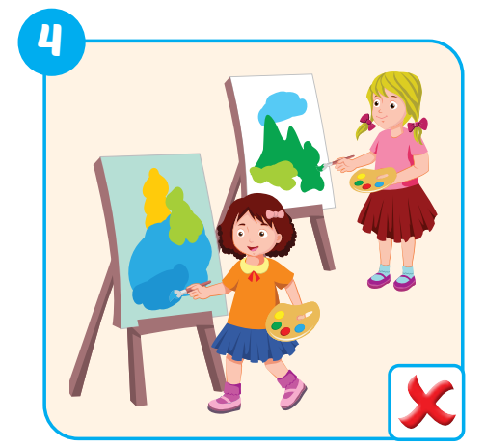
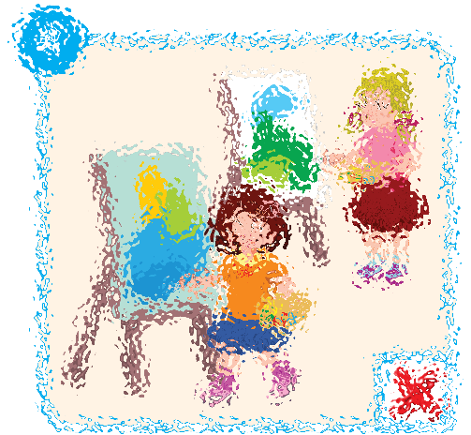
E
Point, ask and answer.
Do your friends like painting?
No, they don’t.
Notes:
Click the cover picture to show
Click the ? And the answering icons to show question and answer,
Click the back button to go back the sea slide.

Slide 18
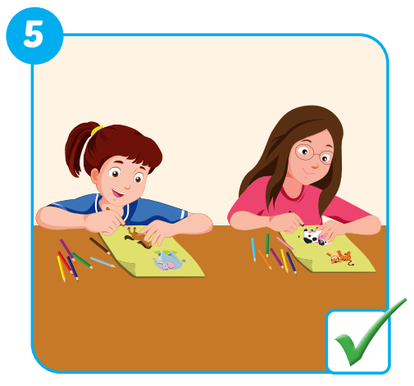
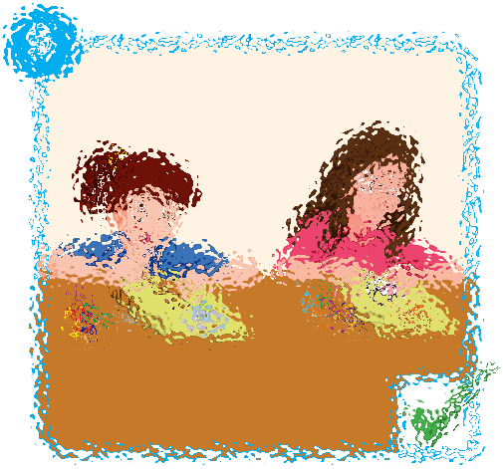
E
Point, ask and answer.
Do your friends like drawing?
Yes, they do.
Notes:
Click the cover picture to show
Click the ? And the answering icons to show question and answer,
Click the back button to go back the sea slide.

Slide 19

Practice

Slide 20
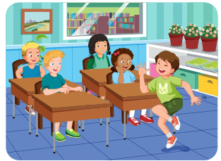
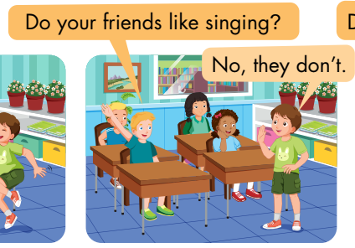
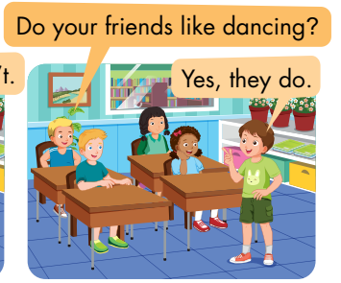
Activity 1
F
Play the Pretend game.
A student does the action for a word.
Other students guess by asking questions.
The student answer “Yes” when others guess it right.
Notes:
Click the stars to show pictures quickly. Get students to pay attention and fill in the blank to ask question about the picture.

Slide 21
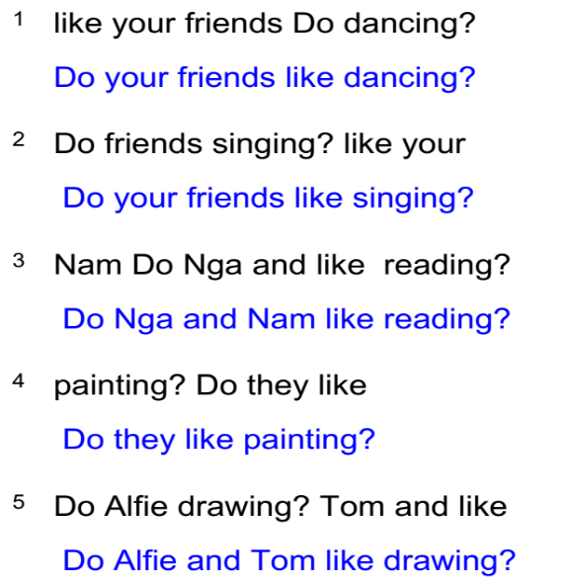
Activity 2
Unscramble the sentences.
Notes:
Click the stars to show pictures quickly. Get students to pay attention and fill in the blank to ask question about the picture.

Slide 22
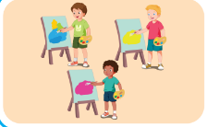
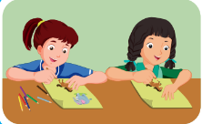

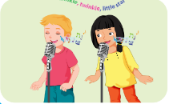
Activity 3
Look, read and fill in the blanks.
1
These are my friends Nick, Tom and Alex.
They like …………...
2
They are Kim and Lucy. They are in the classroom.
They like ………………
painting
drawing
3
Quan and Tom are my friends. They are …………….. books.
They like………………
4
Can you see two people in this picture? They are………………
Nick and Lucy like………………
reading
singing
reading
singing
Notes:
Click to show one by one part.

Slide 23
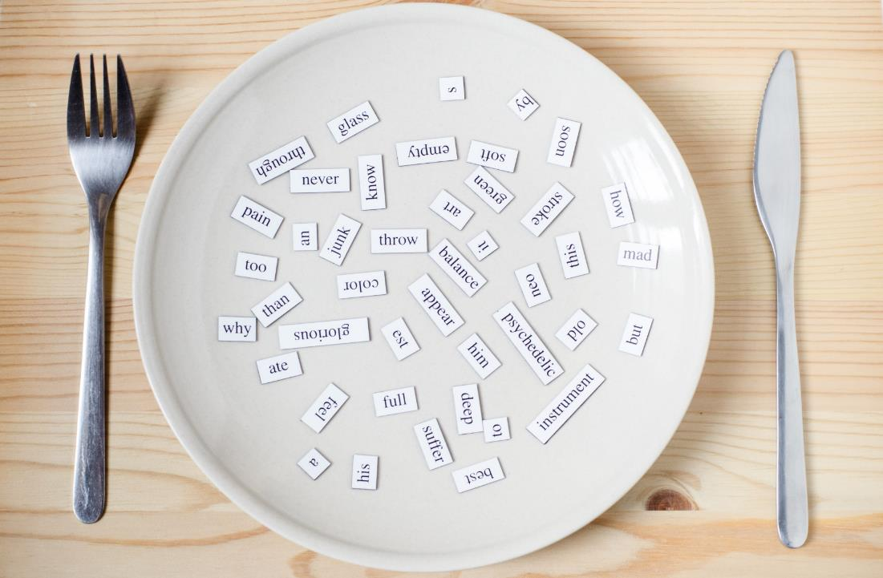
Consolidation

Slide 24
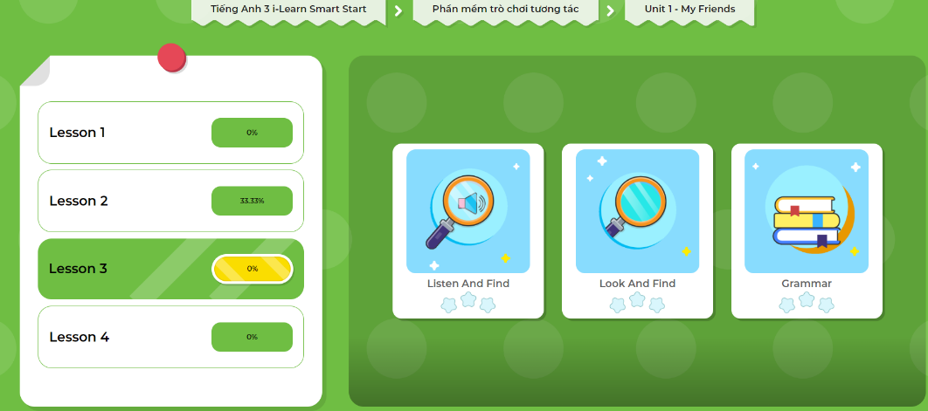
Extra- DHA app.
Click here to play the games

Slide 25
Write about your friends.
Hi, everyone. It’s me, Anna. I like drawing.
Today, I’m talking about my friends.
They are Nick, Tim and Tom. They like painting.
They are Lucy and Kim. They like drawing.
Notes:
Interview some friends and talk about them.

Slide 26

WRAP-UP

Slide 27
Today’s lesson
Vocabulary
Dancing
Singing
Drawing
Reading
Painting
Structures/ Sentence patterns
Do your friends like dancing?
Yes, they do.
No, they don’t.

Slide 28
Lesson 3
Homework
Practice vocabularies and structure. Make sentences using them.
Do the exercises in Tiếng Anh 3 i-Learn Smart Start Workbook (page 13)
Practice the vocabulary and structure in Tiếng Anh 3 i-Learn Smart Start Notebook (page 13)
Play the consolidation games in Tiếng Anh 3 i-Learn Smart Start DHA App on www.eduhome.com.vn
Prepare the next lesson (page 19)

Slide 29
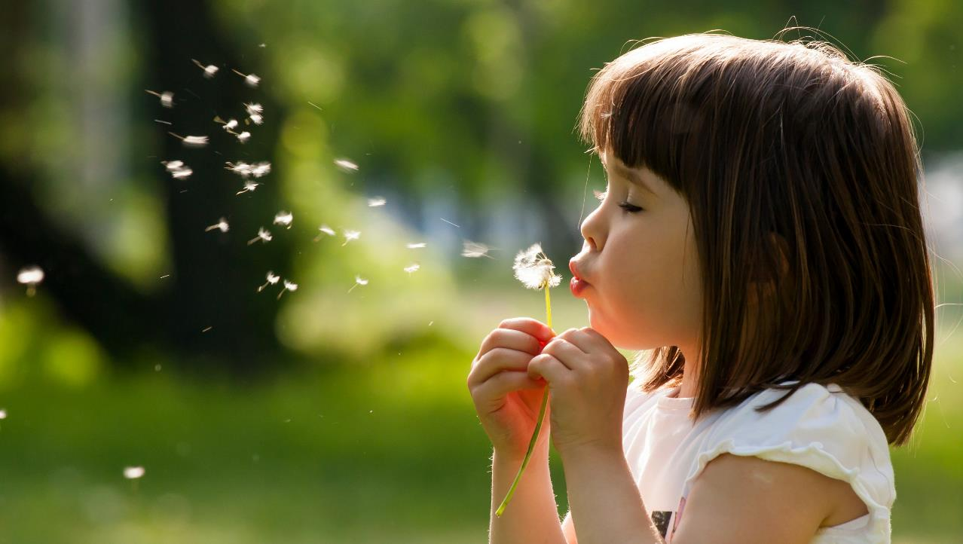
Enjoy your day!

