Slide 1

Unit 4: HOME
Lesson 4.3
Page 63

Slide 2
Lesson Outline
Warm-up
Reading
Writing
Consolidation
Wrap-up

Slide 3
Objectives
By the end of this lesson, students will be able to read a text about one’s home and write a short paragraph about their home.
Vocabulary:
Revision (words about colors and things in a house).
Structure: - I have a desk in my bedroom.
- I love my bedroom. It is pink.
It has a picture in it.

Slide 4

WARM UP

Slide 5

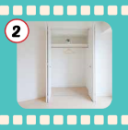
Guessing game.
Where is a bed ?
Notes:
Choose which safe to get the right answer. E.g.: (Where is a bed? It’s in the brown safe.) That’s right. What color is it? It’s blue.

Slide 6
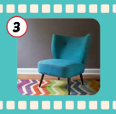

Guessing game.
Where is a chair ?

Slide 7
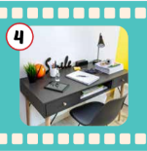

Guessing game.
Where is a TV ?

Slide 8

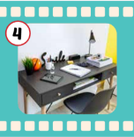
Guessing game.
Where is a desk?

Slide 9

It’s time to learn …

Slide 10

Reading

Slide 11

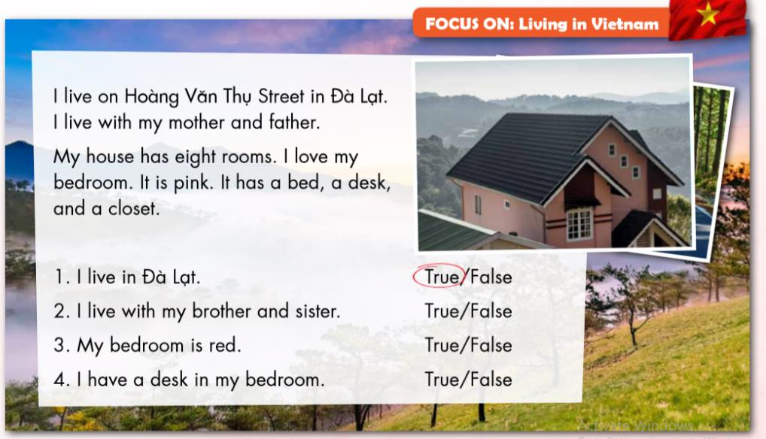

Slide 12


Slide 16

Writing

Slide 17

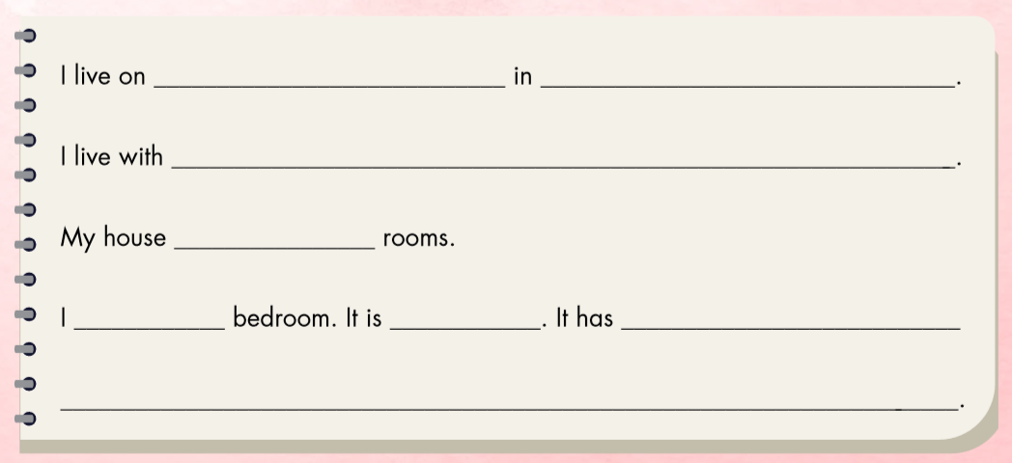

Slide 18

Dương Tự Minh Street
Thái Nguyên
my mother and father.
has six
love my
blue
a bed, a desk, and a closet.

Slide 19

Workbook
p. 43

Slide 20
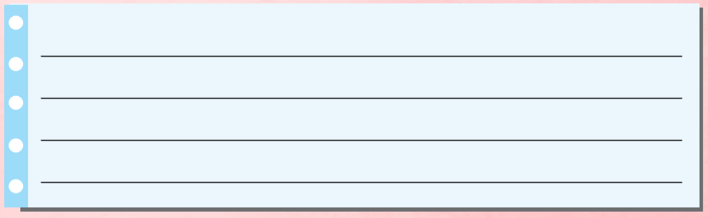
E. Write about your home. Write 10–20 words.

Slide 21
Use the suggested words to complete the task.
I/Hàng Bài Street/Hanoi.
I/live/my mother/my father/my sister.
My house/ five/ rooms.
I/love/my living room. It/blue. It/TV/picture/sofa.

Slide 22
Use the suggested words to complete the task.
I live on Hàng Bài Street in Hanoi.
I live with my mother, my father, and my sister.
My house has five rooms.
I love my living room. It is blue. It has a TV, a picture, and a sofa.

Slide 23

CONSOLIDATION

Slide 24





1
3
3
1
4
SPIN
5
2
2
4
3
5

Slide 25
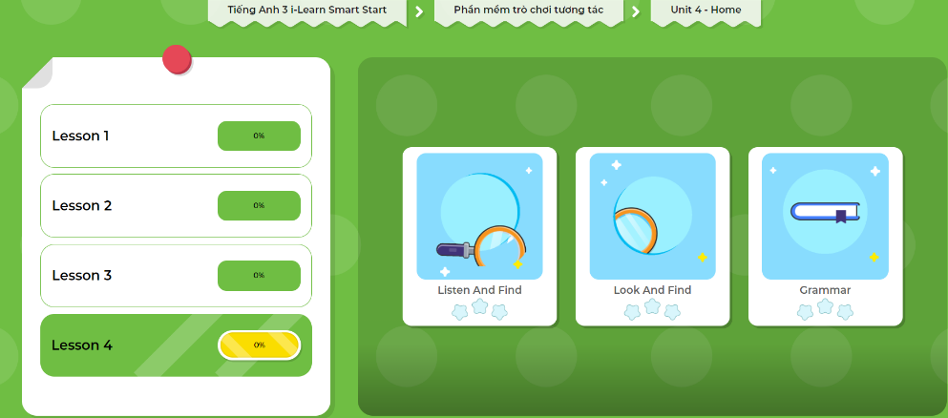
LET’S PLAY!
Click here to play the games!

Slide 26
Go around and ask 3 friends about their living room.
Name | color | a TV | a sofa
An
blue


Hoa
Nam
Notes:
GV giới thiệu hoạt động HS sẽ đi vòng quanh lớp và hỏi ý kiến của 3 bạn về các loại động vật bạn yêu mến, thích, và không thích. GV chuẩn bị handout cho HS.

Slide 27

WRAP-UP

Slide 28
Homework
Review the vocabularies and sentence patterns. Make sentences using them.
Do the exercises on page 45 (WB)
Prepare the next lesson (page 64 SB)
Play the consolidation games in Tiếng Anh 3 i-Learn Smart Start DHA App on www.eduhome.com.vn
Do the exercises in Tiếng Anh 3 i-Learn Smart Start Notebook on page 31.

Slide 29

Enjoy your day!

Slide 30

Have a nice day!

