Slide 1
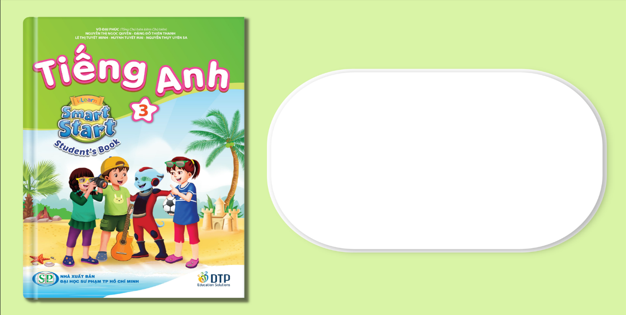
Unit 7: Toys
Lesson 2.2
Page 100

Slide 2
Lesson Outline
Warm-up
Vocabulary
Structure
Consolidation
Wrap-up

Slide 3
Objectives
By the end of this lesson, students will be able to…
Phonics: Pronounce /r/ correctly.
Structure: Review:
How many marbles do you have?
I have five marbles.
Listen: Listen to friends talking about the quantities of toys.
Practice: Practice the conversations with friends.

Slide 4

WARM UP

Slide 5
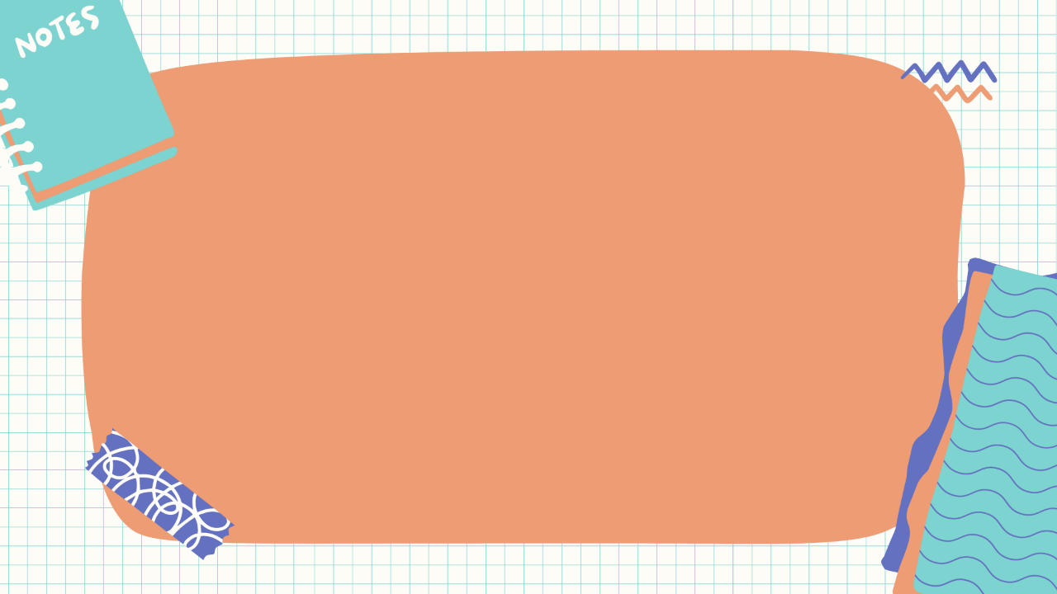
Check your memory
Listen to the word and choose A or B.

Slide 6







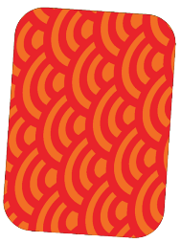




Listen and choose
A
B

Slide 7

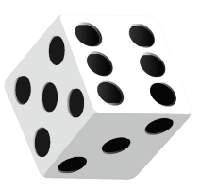
Listen and choose
A
B

Slide 8

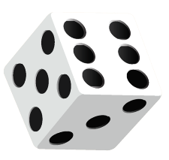
Listen and choose
A
B

Slide 9
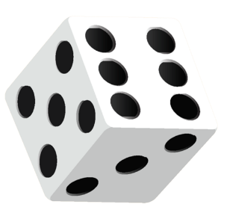

Listen and choose
A
B

Slide 10

It’s time to learn …

Slide 11
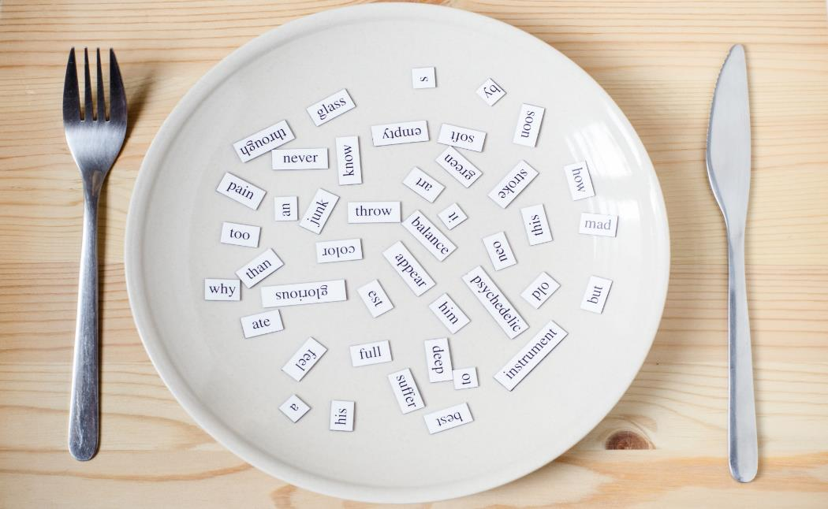
Phonics
/r/

Slide 12
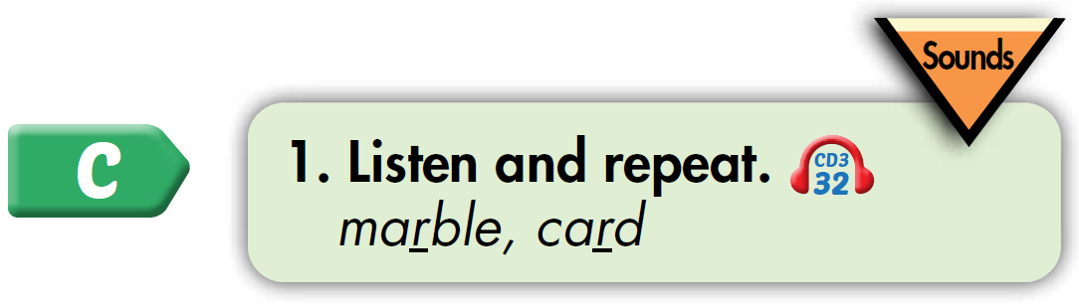
Click CD3 track 32 to hear the sound.
marble
card
Notes:
Click vô hình để nghe

Slide 13
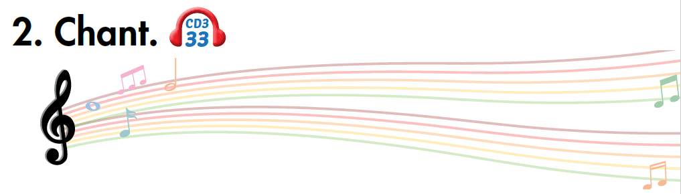






Click on the music note to hear the sound.
Notes:
Bấm vào ngôi sao là ra script, bấm vào hình CD3-49 sẽ ra audio

Slide 14

large
dark
List the words with the same sound /r/. Practice saying them with a partner.
alarm
hard
garden
bar
farm
art
Notes:
Tìm từ tận cùng bằng ts đã học và tạo chant giống từ donuts

Slide 15

Listening

Slide 16
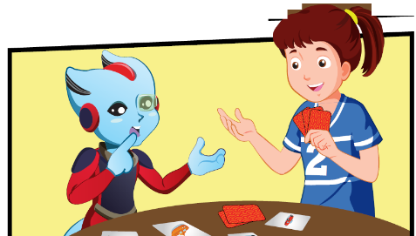
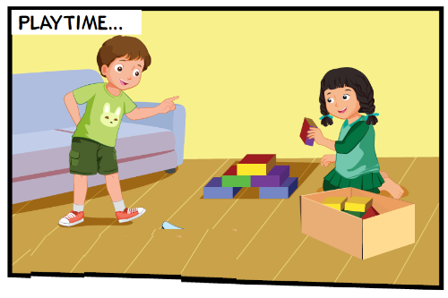
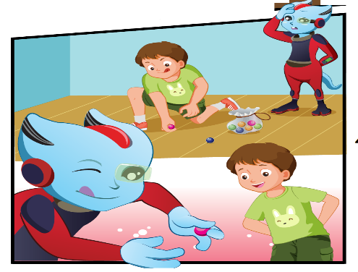
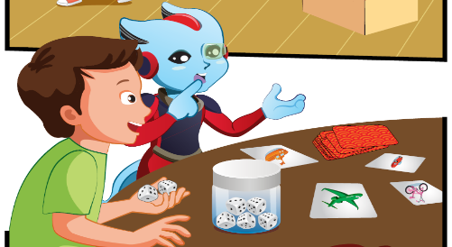
Pre Listening
LOOK

Slide 17
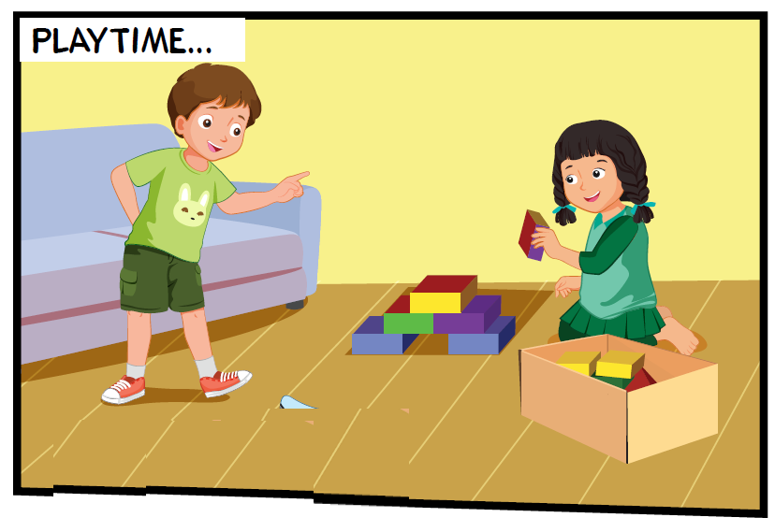
Pre Listening
Where are they?
They're at home.

Slide 18
Pre Listening
What are they doing?
They are playing with the blocks.

Slide 19

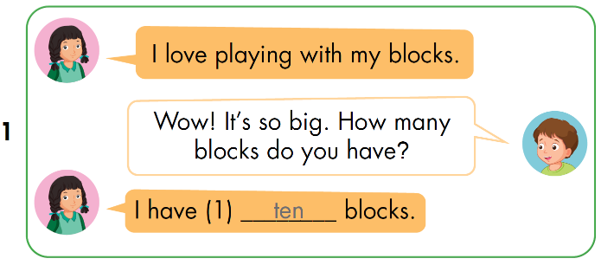
While Listening
Notes:
Click vô chữ listen để nghe

Slide 20

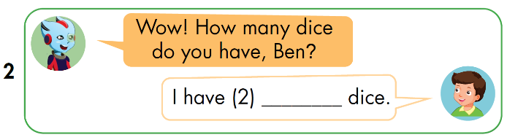
While Listening
Notes:
Click vô chữ listen để nghe

Slide 21
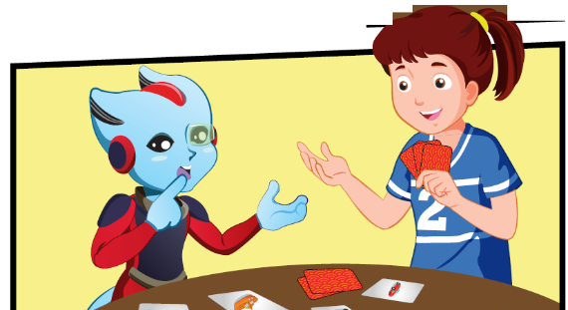
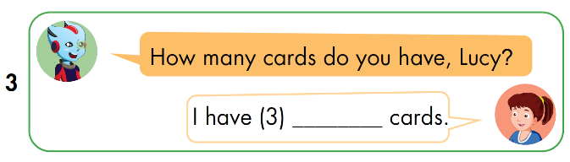
While Listening
Notes:
Click vô chữ listen để nghe

Slide 22

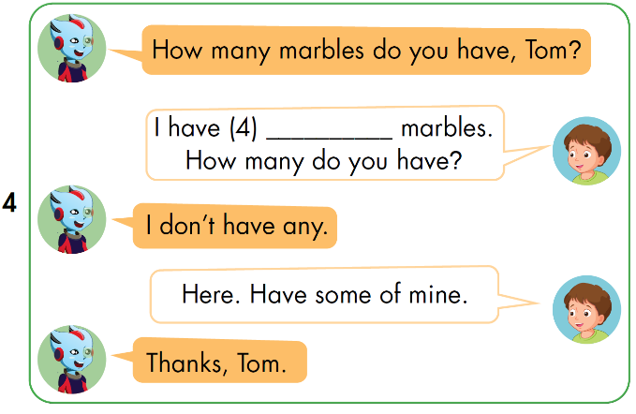
While Listening
Notes:
Click vô chữ listen để nghe

Slide 23
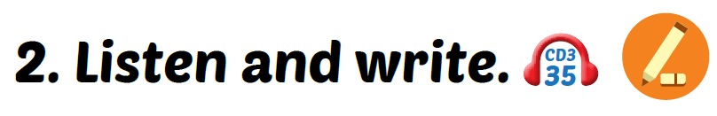
While Listening
Notes:
Click vô chữ listen để nghe

Slide 24
While Listening
eight
Notes:
Click vô chữ listen để nghe

Slide 25
While Listening
five
Notes:
Click vô chữ listen để nghe

Slide 26
While Listening
nine
Notes:
Click vô chữ listen để nghe

Slide 27
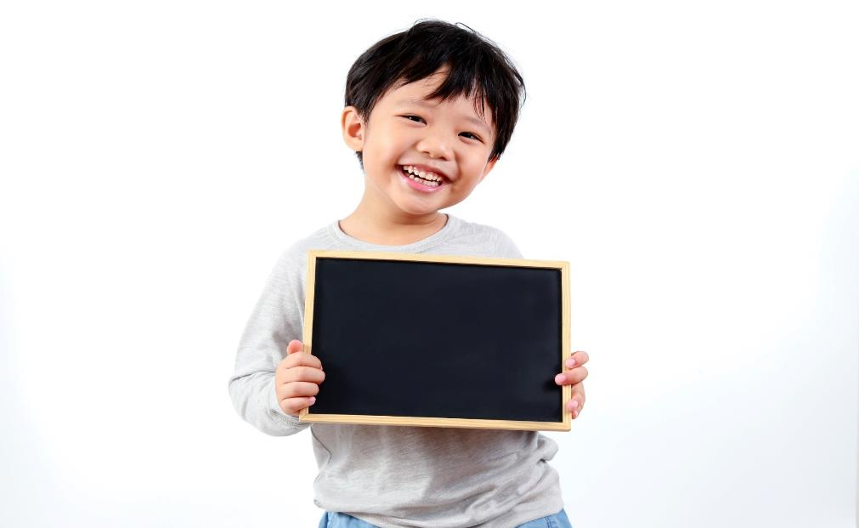
More practice

Slide 28

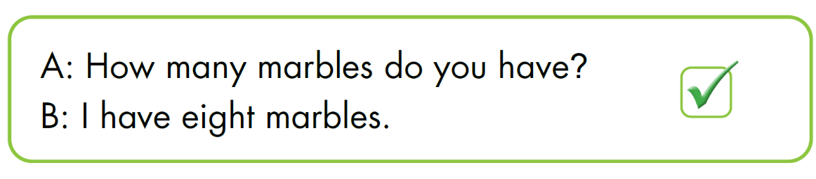



Wordbook, p.71

Slide 29
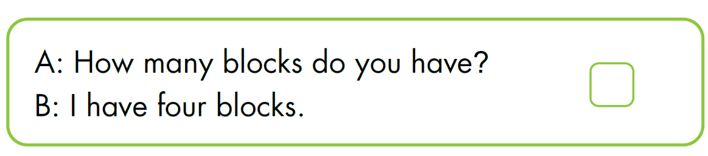


Wordbook, p.71

Slide 30
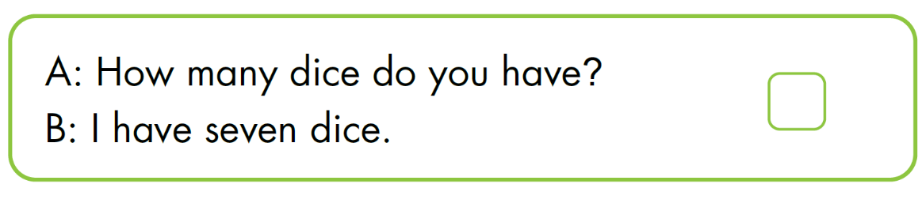

Wordbook, p.71

Slide 31
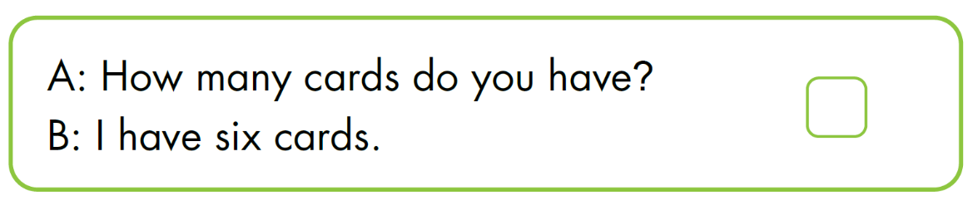

Wordbook, p.71

Slide 32
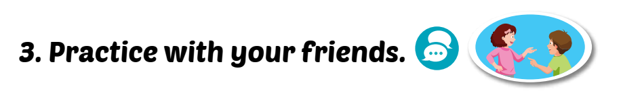

Post Listening
Notes:
Chia lớp làm 2, từng nhóm thay phiên nhau đọc từng câu, sau đó mời vài cặp học sinh đứng lên đọc to trước lớp

Slide 33
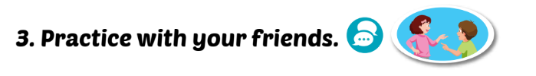
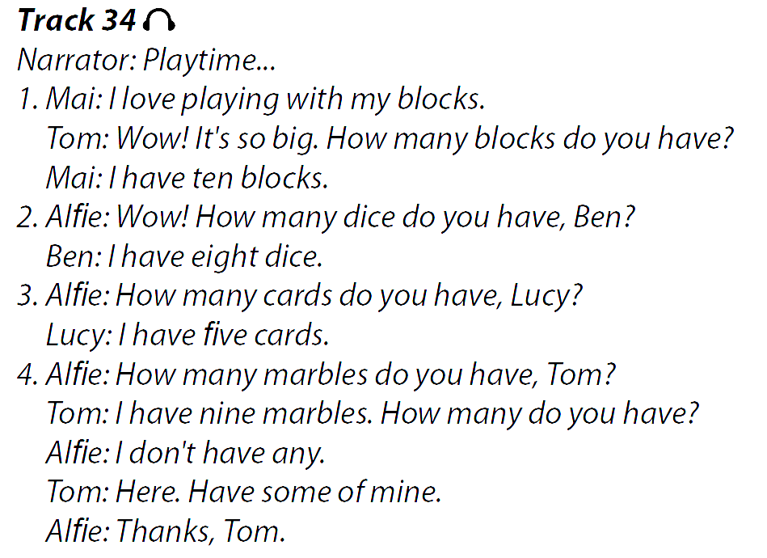
Post Listening
Notes:
Chia lớp làm 2, từng nhóm thay phiên nhau đọc từng câu, sau đó mời vài cặp học sinh đứng lên đọc to trước lớp

Slide 34

CONSOLIDATION

Slide 35
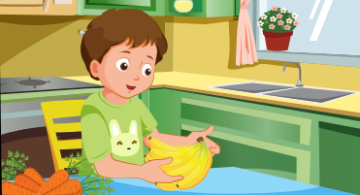
Draw the food in the kitchen in your house and talk with your classmate.

Slide 36
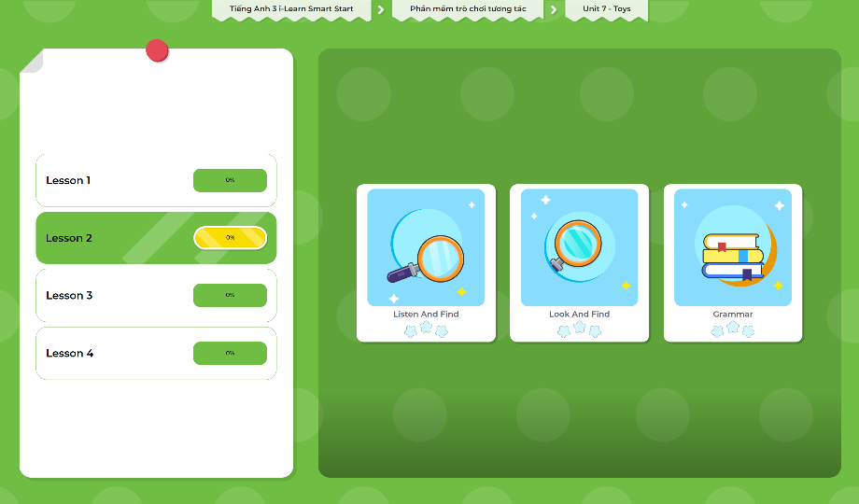
Extra Practice
DHA App
LET’S PLAY!
Click here to play the games

Slide 37
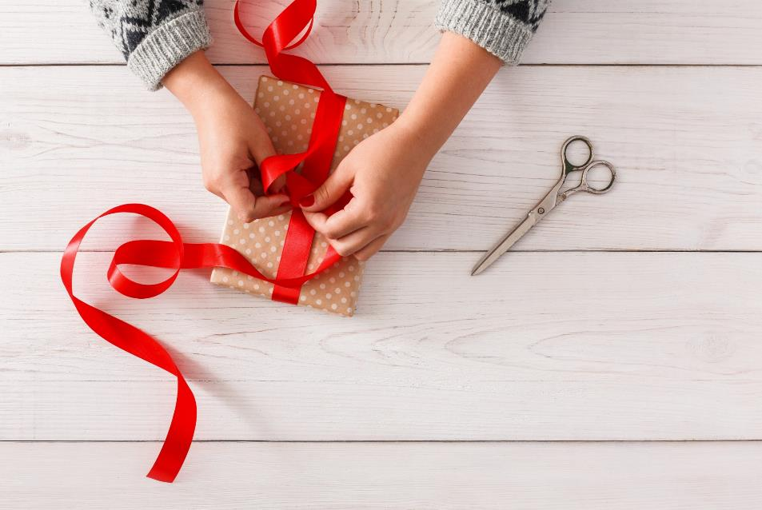
WRAP-UP

Slide 38
Today’s lesson
Vocabularies
card, block, dice, marble
Listen: Listen to friends talking about the quantities of toys.
Phonics: /r/
Structures/ Sentence patterns
Ho many marbles do you have?
I have five marbles.

Slide 39
Homework
Practice the vocabularies and structure; and make sentences using them.
Do the exercises in Tiếng Anh 3 i-Learn Smart Start WB (page 71)
Prepare the next lesson (page 101 SB)
Play the consolidation games in Tiếng Anh 3 i-Learn Smart Start DHA App on www.eduhome.com.vn

Slide 40
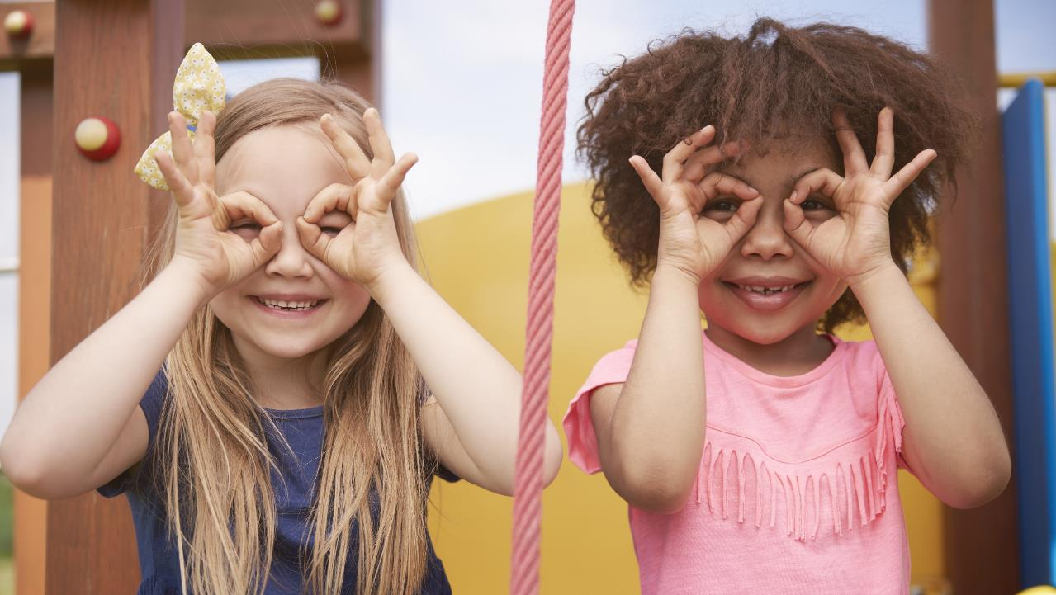
Enjoy your day!

