Slide 1
Unit 4 : Animals
Review 4
Page: 33

Slide 2
Lesson Outline
Warm-up
Practice
Production
Consolidation
Wrap-up

Slide 3
Objectives
By the end of this lesson, students will be able to review talking about number of objects and identifying animals.
Vocabulary: eleven, twelve, thirteen, fourteen, fifteen, sixteen, seventeen, eighteen, nineteen, twenty, cow, duck, goat, pig
Structure: What’s that?
It’s a (goat).

Slide 4
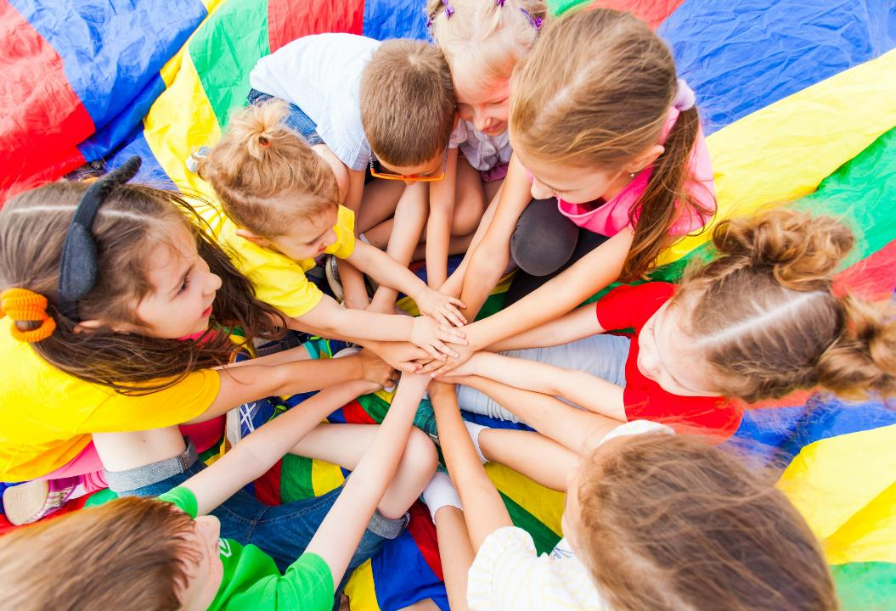
WARM UP

Slide 5
Let’s sing!

Slide 7
It’s time to learn …

Slide 8
Let’s play!
WHAT ANIMAL IS IT?
Students guess the animals by saying a letter.
Press BUILD when student says a correct letter.
Press the letter on the board when it is incorrect.
Press BUILD to fly the spaceship when they guess the animal correctly.

Slide 9
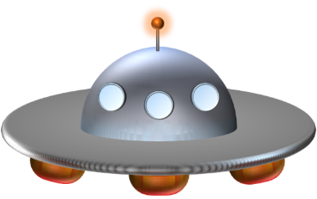
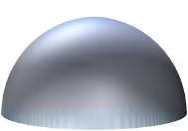
A
B
C
D
EXAMPLE
E
F
G
H
I
J
K
L
M
N
O
P
Q
R
S
T
U
V
W
X
R
A
B
B
I
T
Y
Z
BUILD
Notes:
RABBIT

Slide 10
A
B
C
D
E
F
G
H
I
J
K
L
M
N
O
P
Q
R
S
T
U
V
W
X
S
N
A
K
E
Y
Z
BUILD
Notes:
snake

Slide 11
A
B
C
D
E
F
G
H
I
J
K
L
M
N
O
P
Q
R
S
T
U
V
W
X
C
O
W
Y
Z
BUILD
Notes:
cow

Slide 12
A
B
C
D
E
F
G
H
I
J
K
L
M
N
O
P
Q
R
S
T
U
V
W
X
M
O
N
K
E
Y
Y
Z
BUILD
Notes:
Monkey

Slide 13
A
B
C
D
E
F
G
H
I
J
K
L
M
N
O
P
Q
R
S
T
U
V
W
X
B
E
A
R
Y
Z
BUILD
Notes:
Bear

Slide 14
A
B
C
D
E
F
G
H
I
J
K
L
M
N
O
P
Q
R
S
T
U
V
W
X
D
U
C
K
Y
Z
BUILD
Notes:
DUCK

Slide 15
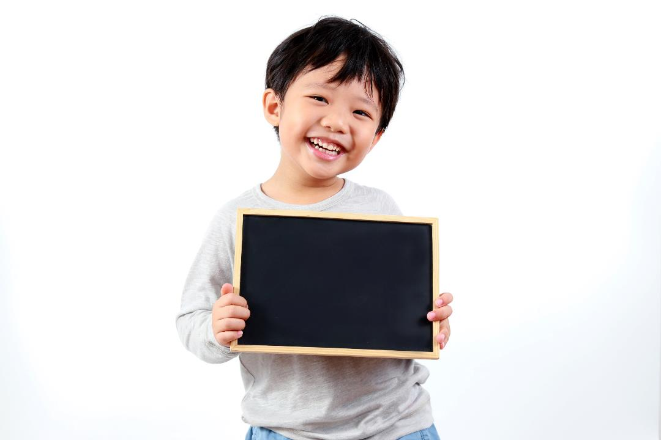
Practice

Slide 16
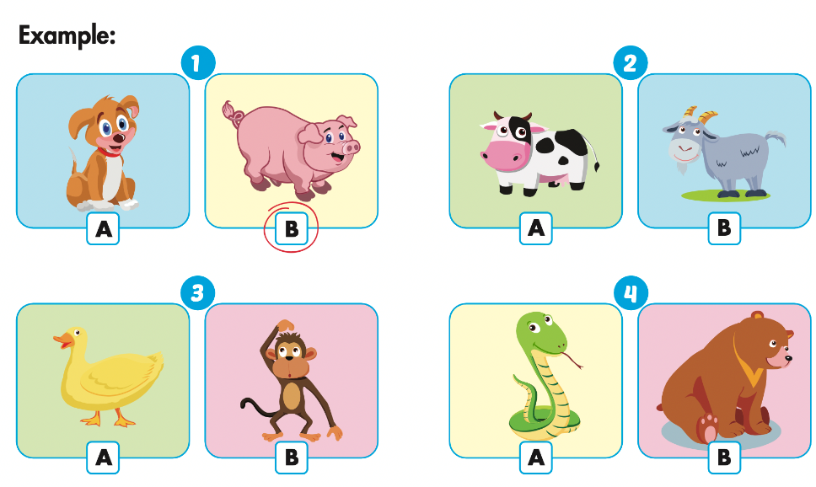
Click on the icon to hear the sound.

Slide 17
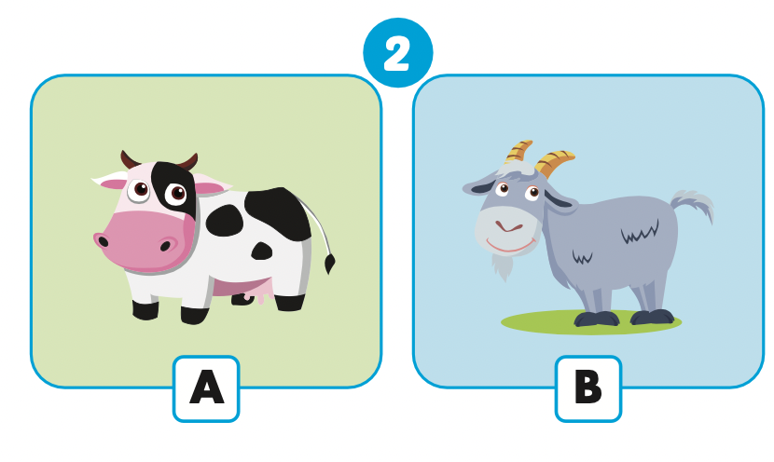
Let’s check!

Slide 18
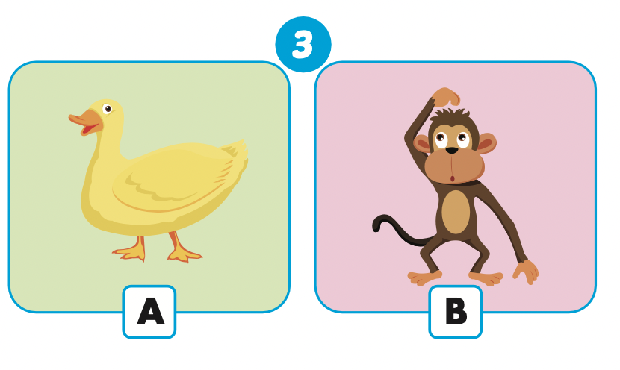
Let’s check!

Slide 19
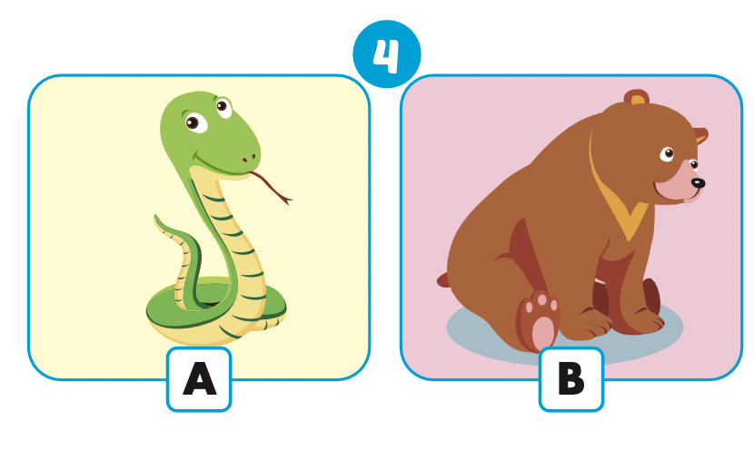
Let’s check!

Slide 20
Production

Slide 21
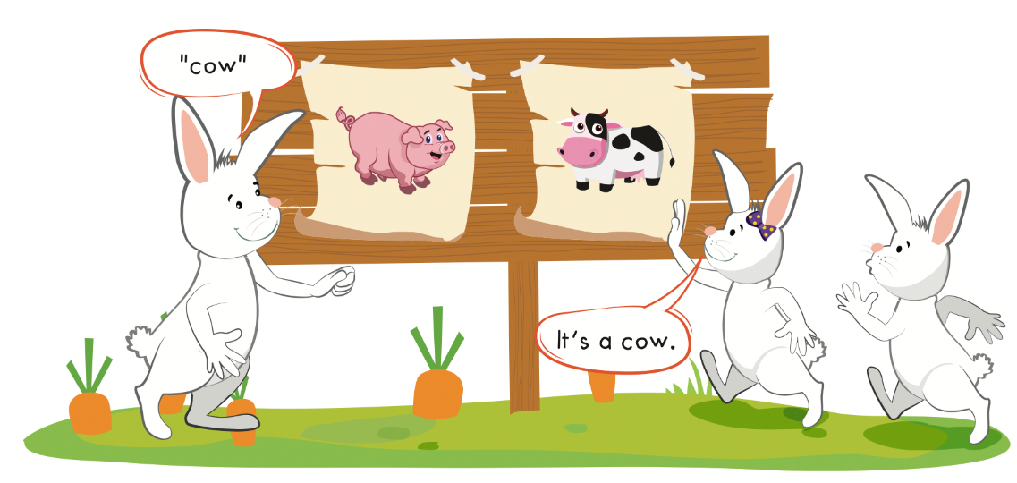

Slide 22
How to play

Slide 23
CONSOLIDATION

Slide 24
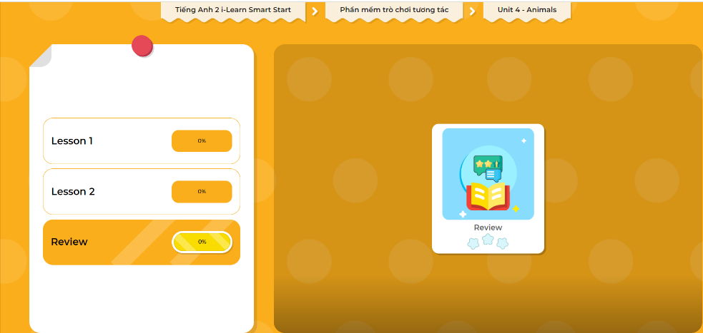
Extra Practice
DHA on Eduhome
LET’S PLAY!
Click on the picture below to play the games.

Slide 25
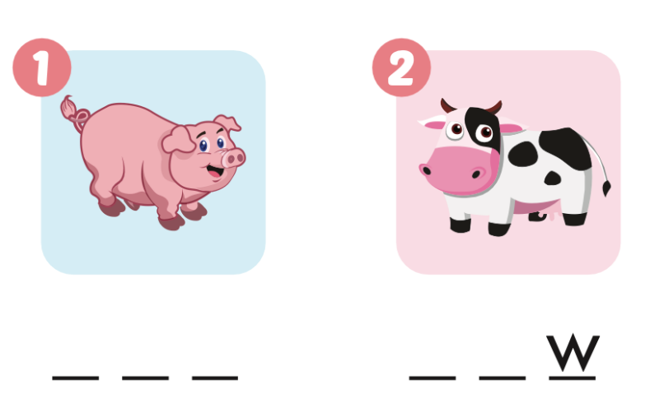
Extra Practice
WB, page 31
p i g
c o

Slide 26
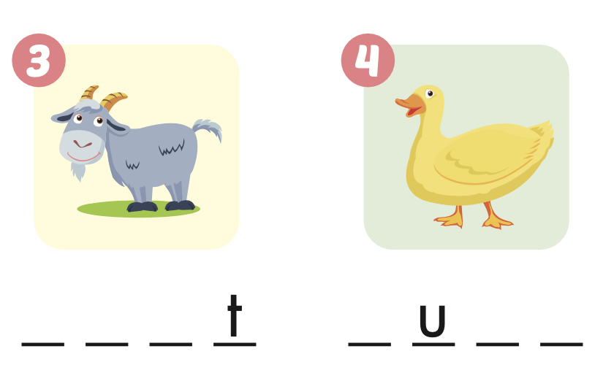
g o a
D C K

Slide 27
WRAP-UP

Slide 28
Lesson 3
Today’s lesson
Vocabularies
Pig, cow, duck, goat
Structures/ Sentence patterns
What’s that?
It’ s a (goat).

Slide 29
Homework
Practice the vocabularies and structure; and make sentences using them.
Do the exercises in Tiếng Anh 2 i-Learn Smart Start WB (page 31)
Prepare the next lesson (page 34 SB)
Play the consolidation games in Tiếng Anh 2 i-Learn Smart Start DHA App on www.eduhome.com.vn

Slide 30
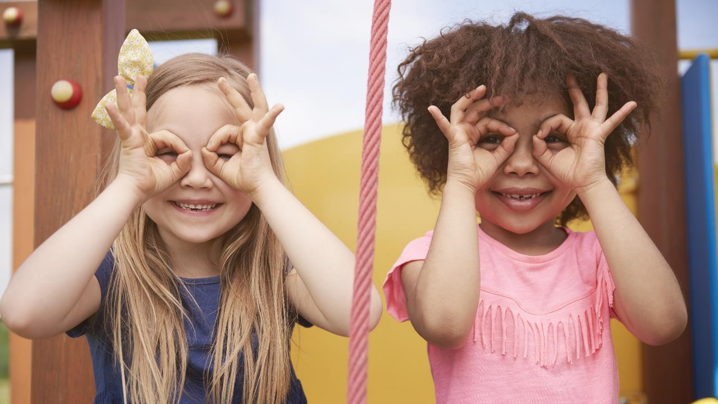
Enjoy your day!

Slide 31
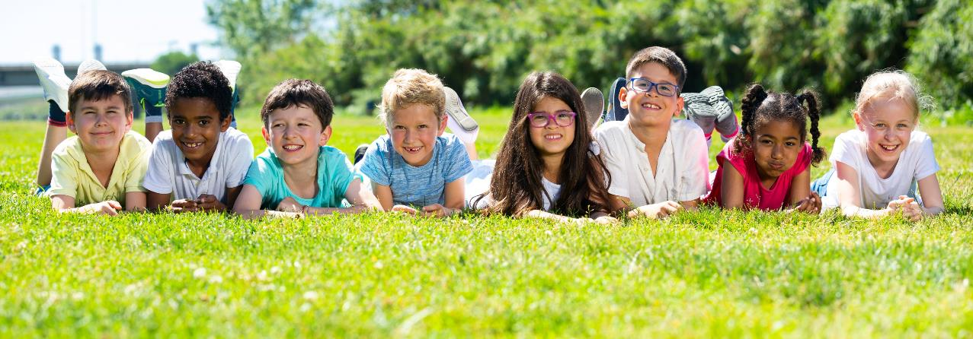
Have a nice day!

