Slide 1
Unit 7
What do you
like doing?
Lesson 3

Slide 2
Reveiw

Slide 3
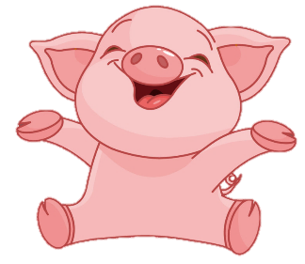
BOMSTAR
PLAY
Notes:
Ms Huyền Phạm - 0936.082.789 – YOUTUBE: MsPham. Facebook: Powerpoint thật dễ

Slide 4
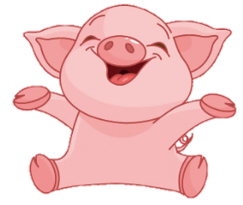
10
10
10
20
20
10
20
20

Slide 5
Thêm
1 lượt
Back

Slide 6
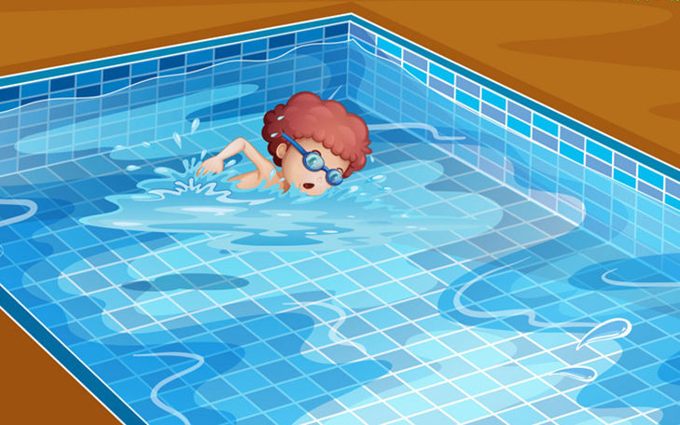
What's your hobby?
Back
I like swimming.
I like swim.
I like go swimming.

Slide 7
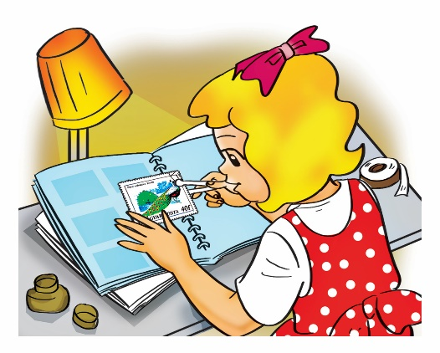
What's your hobby?
Back
I like collect stamps.
I like collecting stamps.
I like to
collecting stamps.

Slide 8
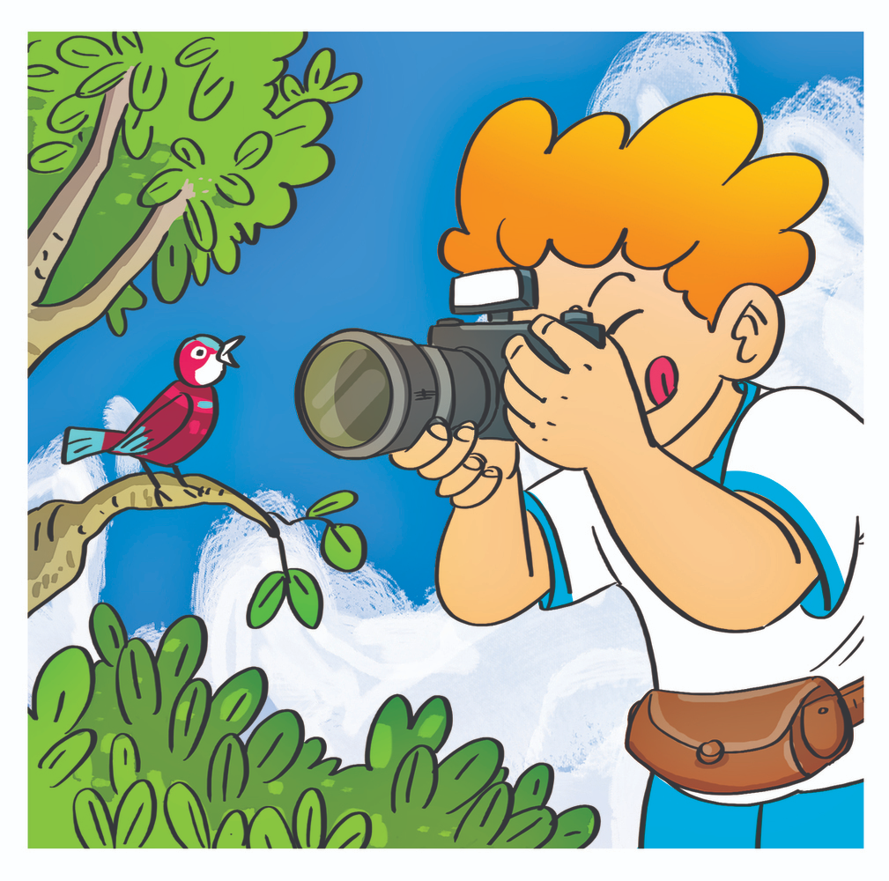
What do you
like doing?
Back
I like photos.
I taking photos.
I like taking photos.

Slide 9
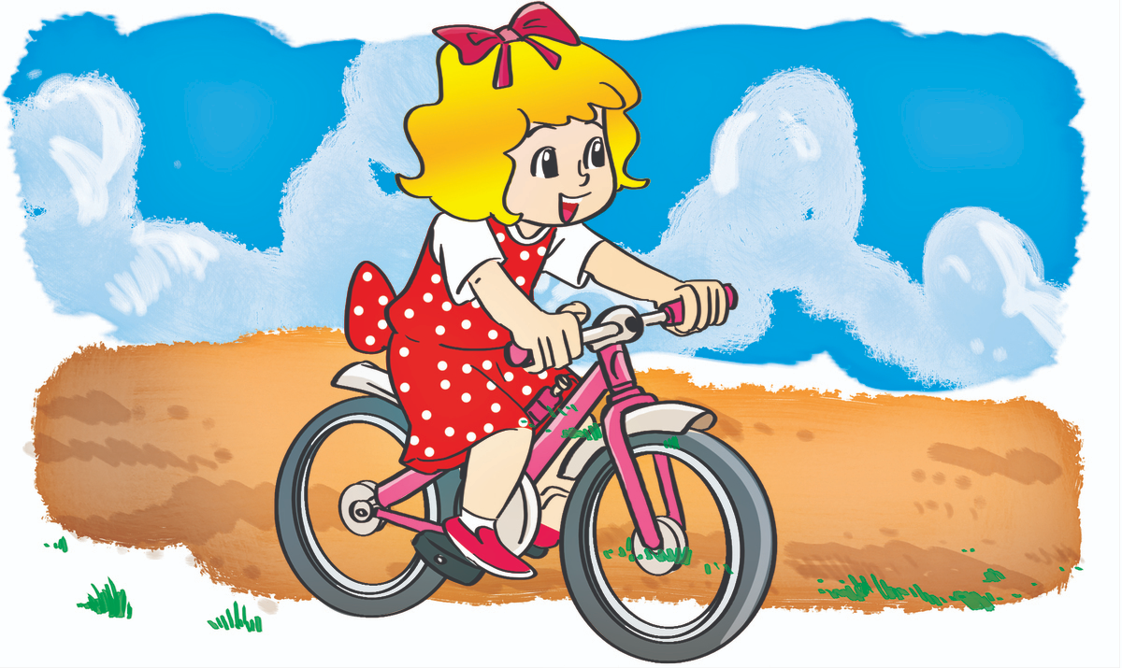
What do you
like doing?
Back
I riding
a bike.
I like riding
a bike.
I like ride
a bike.

Slide 10
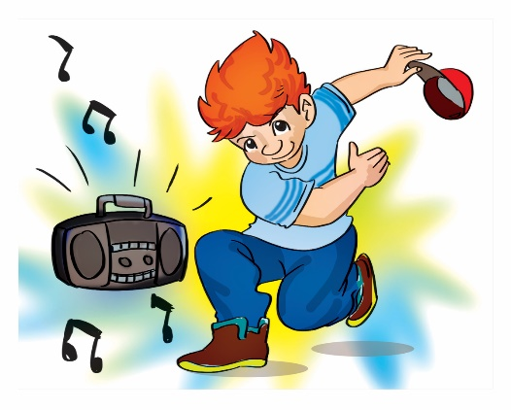
I like dancing.
Back
What do you
like doing?
What do you
like hobby?
What are you
hobby?

Slide 11
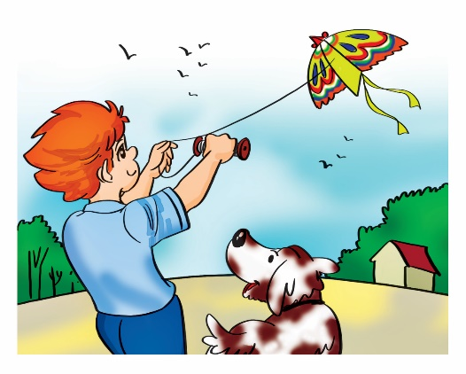
I like flying a kite.
Back
What is your
like doing?
What is your hobby?
What do your hobby?

Slide 12
PHONICS

Slide 13
1. Listen and repeat.

Slide 14
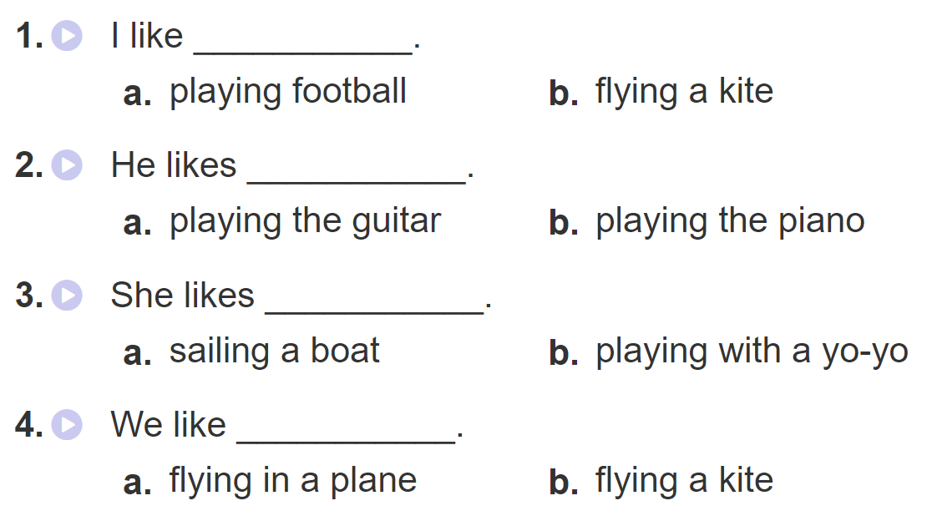
2. Listen and circle. Then say aloud

Slide 15
PRACTISE

Slide 16
3. Let’s chant

Slide 17
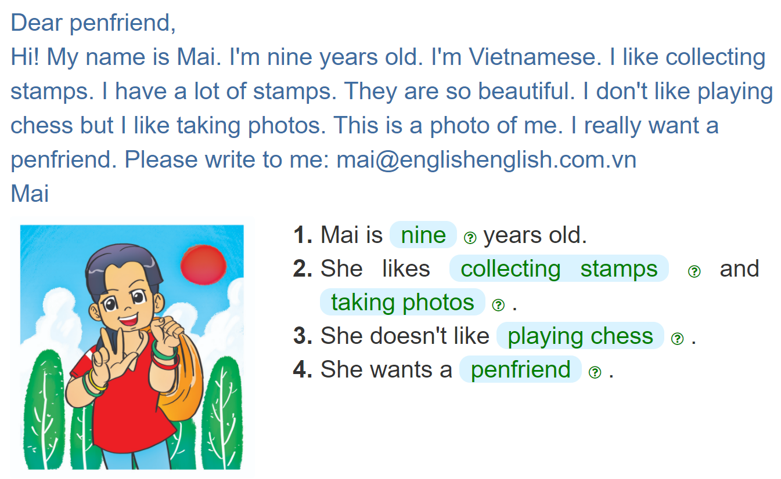
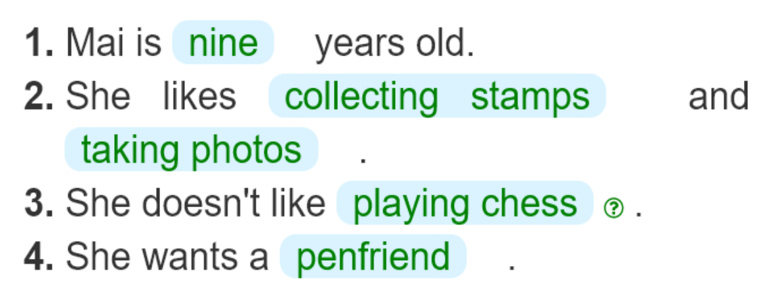
4. Read and complete

Slide 18
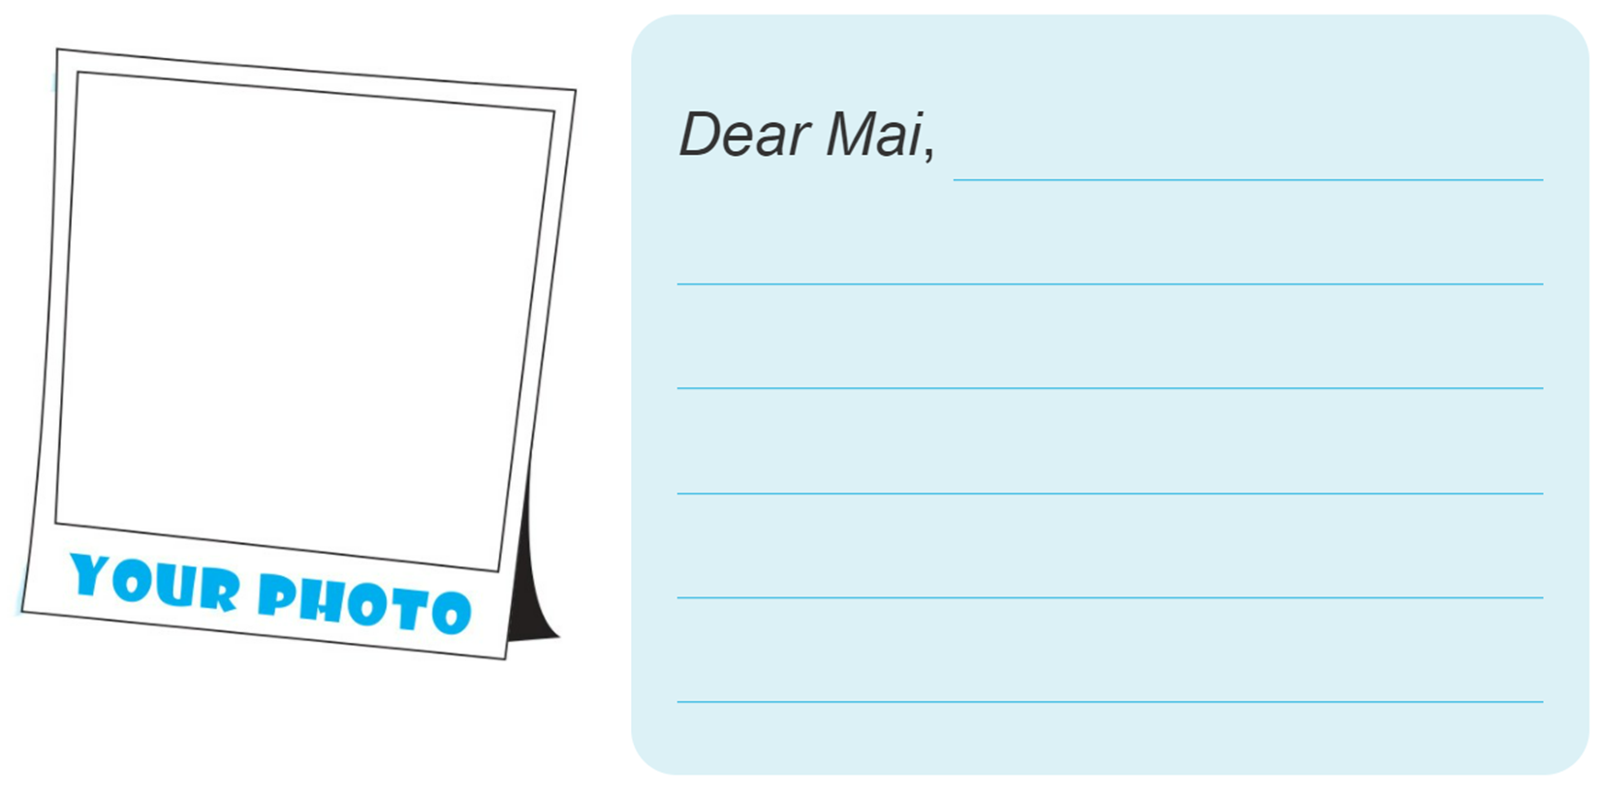
5. Add your photo and write a reply email to Mai.

Slide 19
6. Project
Collect things that you like (e.g. stickers, stamps, candy wrappers) and show them to your classmates.

