Slide 1
Unit 5: Sports and hobbies
Lesson 1.2
Page 69

Slide 2
Objectives
By the end of this lesson, students will be able to…
Vocabulary: badminton, tennis, volleyball, basketball, soccer
Structure: Can you play soccer?
- Yes, I can./No, I can't.

Slide 3
/ɑː/
volleyball
soccer
Click on each word to hear the sound.

Slide 4
/ɑː/, /ɑː/, /ɑː/, /ɑː/, /ɑː/, /ɑː/, volleyball, soccer, /ɑː/, /ɑː/, /ɑː/.
/ɑː/, /ɑː/, /ɑː/,
/ɑː/, /ɑː/, /ɑː/,
volleyball, soccer,
/ɑː/, /ɑː/, /ɑː/.
Click to follow the lyrics.

Slide 5
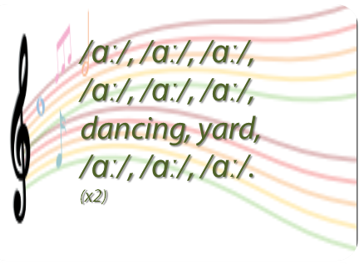
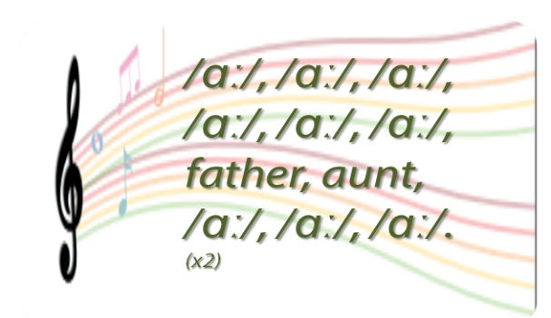
Do a similar chant. 🎤
Click on the circle to open the chant
/ɑː/
🎤
🎤

Slide 6
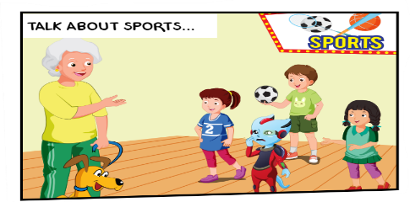
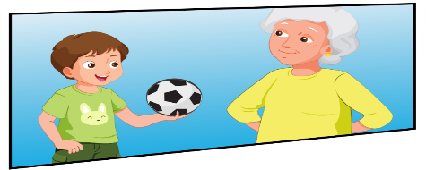
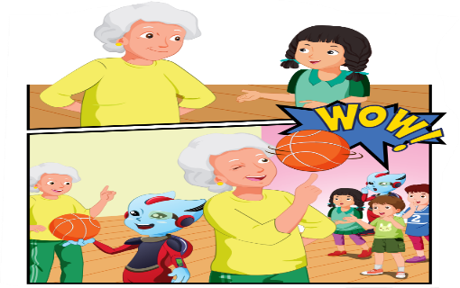
1
Who is she?
2
Are they talking about soccer?
3
What are they talking about?
4
What is Grandma doing ?

Slide 7
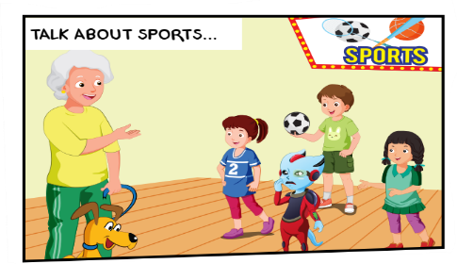
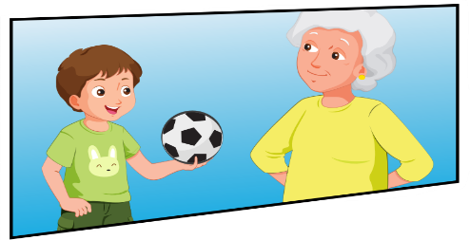
2
1
3
1. Grandma: Lucy, can you play badminton? Lucy: Yes, I can, Grandma.
2. Grandma: Hey, Tom, can you play tennis? Tom: No, I can't
3. Grandma: Mai, can you play volleyball? Mai: Yes, I can. I love volleyball. Grandma: Me too. It's a lot of fun.
4. Grandma: Alfie, can you play basketball? Alfie: No, I can't. Lucy: What about you, Grandma? Grandma: Watch this! Children: Wow!
4

Slide 8
Can you play soccer?
Yes, I can.
/No, I can't.

Slide 9
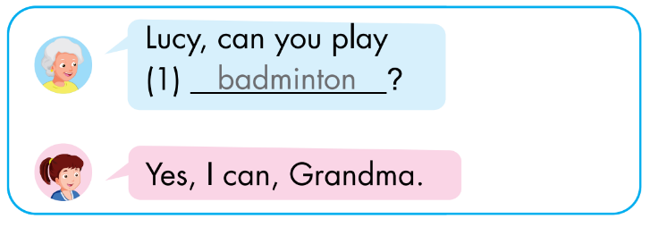
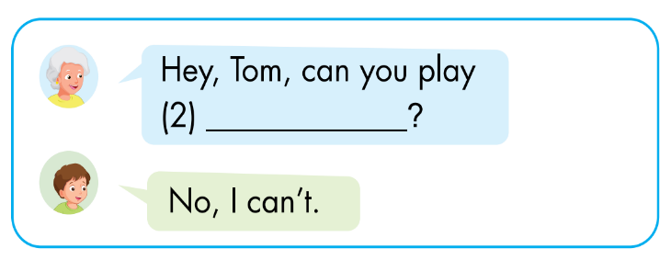
Click on each box to hear the sound.
tennis

Slide 10
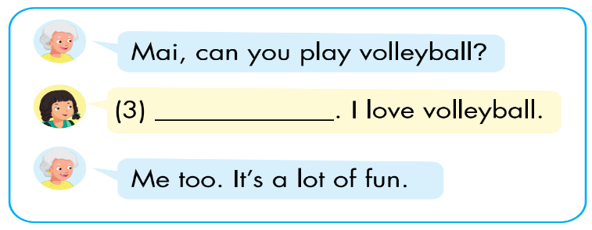
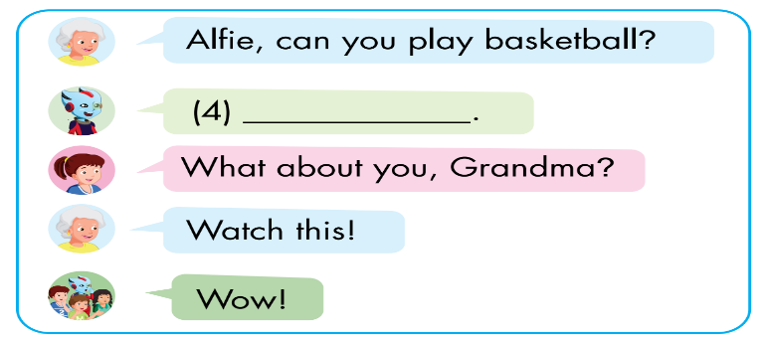
Click on each box to hear the sound.
Yes, I can
No, I can’t.

Slide 11
CONSOLIDATION

Slide 12
WRAP-UP

Slide 13
Today’s lesson
Vocabulary
badminton
tennis
volleyball
basketball
soccer
Structures/ Sentence patterns
Can you play soccer?
- Yes, I can./No, I can't.

Slide 14
Lesson 3
Homework
Do the exercises in Tiếng Anh 3 i-Learn Smart Start Workbook (page 49)
Do the exercises in Tiếng Anh 3 i-Learn Smart Start Notebook (page 34)
Prepare the next lesson (page 70)

Slide 15
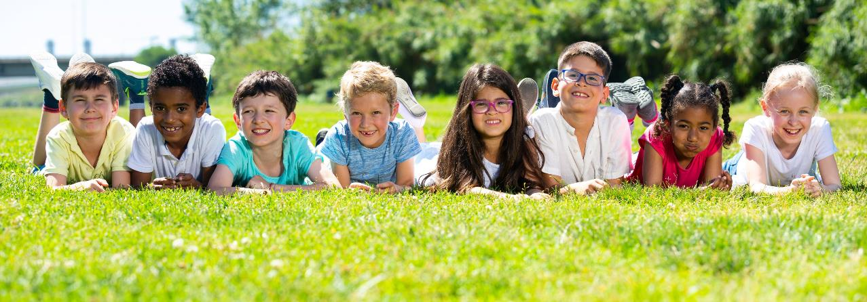
Have a nice day!

