Slide 1

Unit 8: Food
Lesson 1.2
Page 111

Slide 2
Lesson Outline
Warm-up
Listening
Consolidation
Wrap-up

Slide 3
Objectives
By the end of this lesson, students will be able to ….
Phonics: Pronounce /ts/ correctly.
Vocabulary: practice and use apple, donut, banana, cupcake, carrot
Structure: Review: There is…/There are…
Listen: Listen to friends talking about food.
Practice: Practice the conversations with friends.

Slide 4

WARM UP

Slide 5

1. There are __________
D
A. 6 donuts
B. 6 carrots
C. 6 cupcakes
D. 6 apples

Slide 6

1. There are __________
B
A. 2 donuts
B. 2 carrots
C. 2 apples
D. 2 bananas

Slide 7

1. There is __________
C
A. a cupcake
B. a banana
C. a donut
D. an apple

Slide 8

1. There are __________
C
A. three cupcakes
B. three donuts
C. three bananas
D. three carrots

Slide 9

1. There are __________
D
A. two donuts
B. two carrots
C. two apples
D. two cupcakes

Slide 10
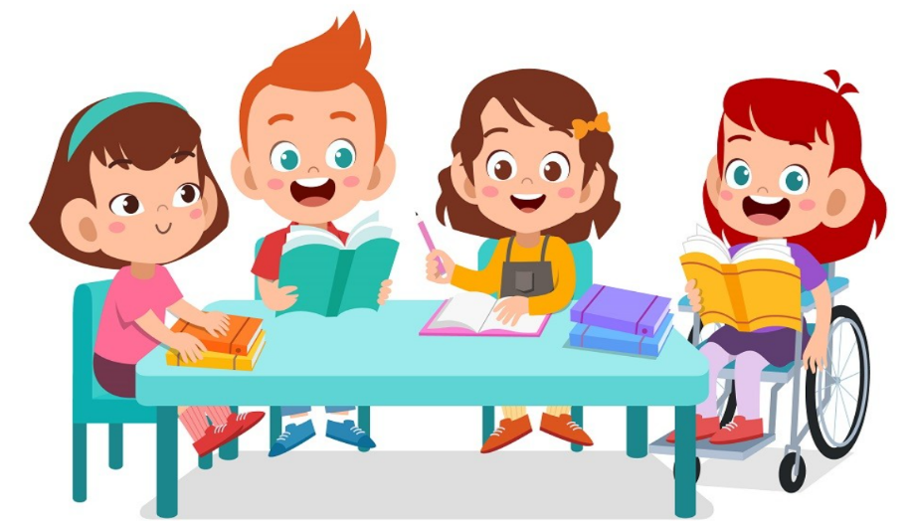
It’s time to learn …

Slide 11
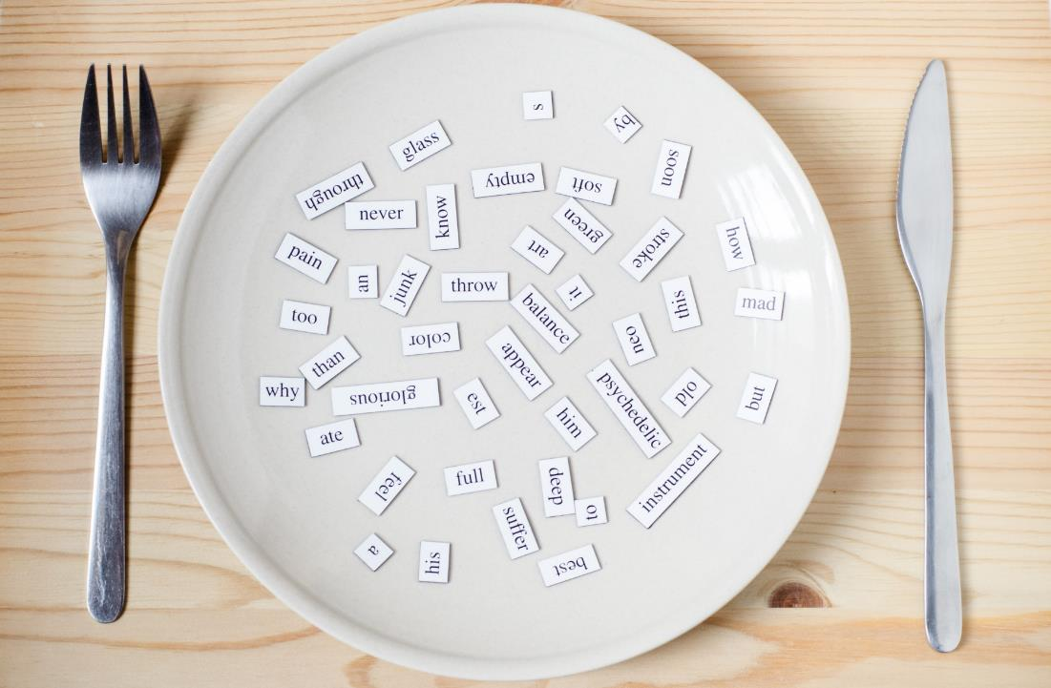
Phonics
/ts/

Slide 12
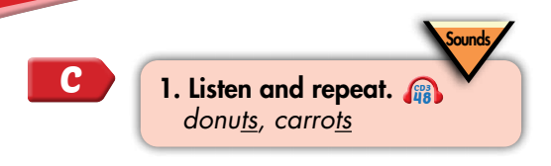

Click CD3 track 48 to hear the sound.
Notes:
Bấm vô CD-48 sẽ ra âm thanh

Slide 13
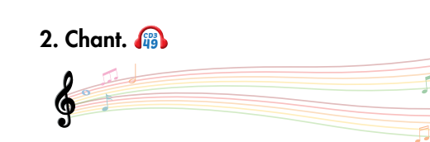
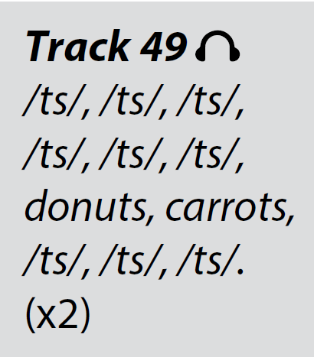
Click on the music note to hear the sound.
Notes:
Bấm vào ngôi sao là ra script, bấm vào hình CD3-49 sẽ ra audio

Slide 14
List the words with the same sound /ts/. Practice saying them with a partner.
robots
students
aunts
skirts
shirts
cats
pants
jackets
Notes:
Tìm từ tận cùng bằng ts đã học và tạo chant giống từ donuts

Slide 15
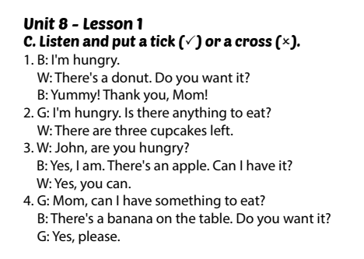
SCRIPTS

Slide 16

CONSOLIDATION

Slide 17

WRAP-UP

Slide 18
Lesson 3
Today’s lesson
Vocabularies
apple, banana, donut, carrot, cupcake
Listen: Listen to friends talking about food.
Phonics: /ts/
Structures/ Sentence patterns
There is…/There are…

Slide 19
Lesson 3
Homework
Review the vocabularies & structures and make sentences using them.
Do the exercises on page 79 WB
Prepare the next lesson (page 112 SB)
Play the consolidation games in Tiếng Anh 3 i-Learn Smart Start DHA App on www.eduhome.com.vn

Slide 20
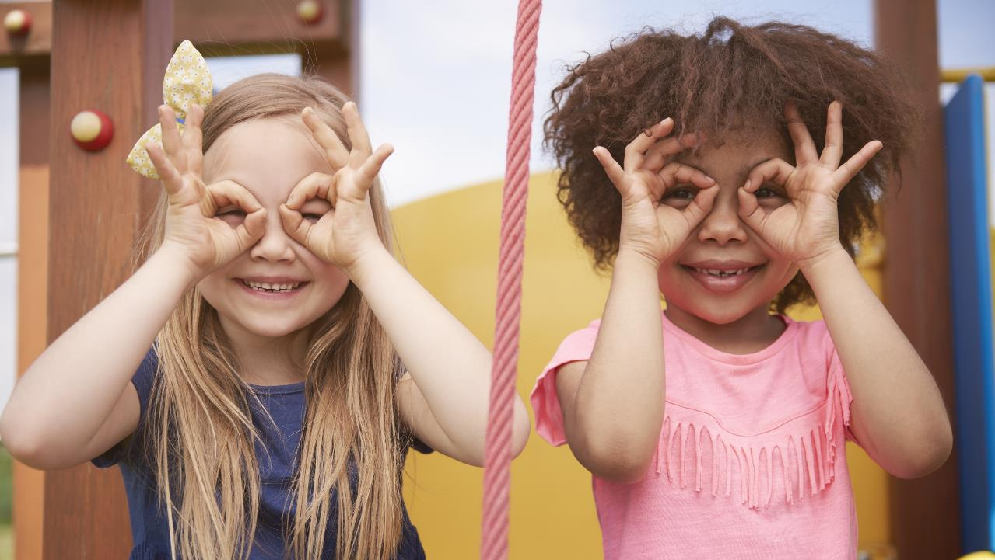
Enjoy your day!

