Slide 1
Unit 10
When will
Sports Day be?
Lesson 1

Slide 2
VOCABULARY

Slide 3
1
1
ant
2
mouse
3
elephant
4
dog
5
fish
6
iguana
7
hen
8
pet
9
Notes:
Ms Huyền Phạm - 0936.082.789 – YOUTUBE: MsPham. Facebook: Dạy và học cùng công nghệ.

Slide 4
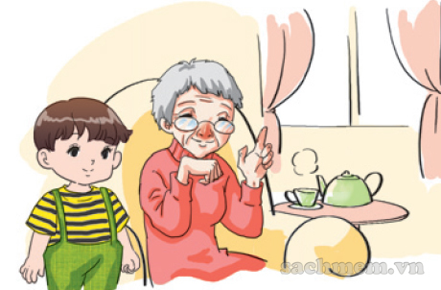
Question
1
2
3
4
5
6
7
8
9
10
The boy is ________ and the grandmother is old.
Time’s up
young
Answer
Back
Notes:
Ms Huyền Phạm - 0936.082.789 – YOUTUBE: MsPham. Facebook: Dạy và học cùng công nghệ.

Slide 5
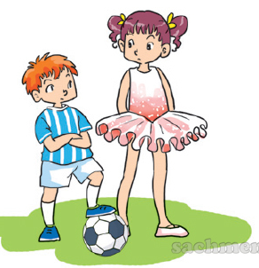
Question
The sister is tall
and the brother is _______.
1
2
3
4
5
6
7
8
9
10
Time’s up
short
Answer
Back
Notes:
Ms Huyền Phạm - 0936.082.789 – YOUTUBE: MsPham. Facebook: Dạy và học cùng công nghệ.

Slide 6
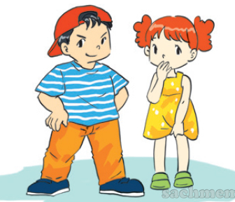
Question
He is big and she is ______.
1
2
3
4
5
6
7
8
9
10
Time’s up
Small
Answer
Back
Notes:
Ms Huyền Phạm - 0936.082.789 – YOUTUBE: MsPham. Facebook: Dạy và học cùng công nghệ.

Slide 7
Question
My grandparents are ______.
1
2
3
4
5
6
7
8
9
10
Time’s up
old
Answer
Back
Notes:
Ms Huyền Phạm - 0936.082.789 – YOUTUBE: MsPham. Facebook: Dạy và học cùng công nghệ.

Slide 8
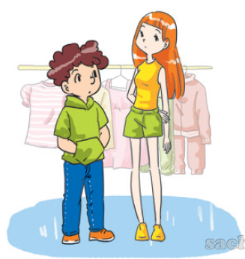
Question
The girl is ______.
1
2
3
4
5
6
7
8
9
10
Time’s up
slim
Answer
Back
Notes:
Ms Huyền Phạm - 0936.082.789 – YOUTUBE: MsPham. Facebook: Dạy và học cùng công nghệ.

Slide 9
Question
What does her mother look like? a. She's old.
b. She's young.
1
2
3
4
5
6
7
8
9
10
Time’s up
b. She's young.
Answer
Back
Notes:
Ms Huyền Phạm - 0936.082.789 – YOUTUBE: MsPham. Facebook: Dạy và học cùng công nghệ.

Slide 10
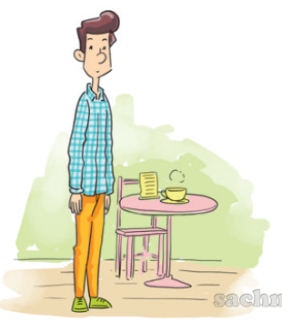
Question
What does her father look like?
a. He's short.
b. He's slim.
1
2
3
4
5
6
7
8
9
10
Time’s up
b. He's slim.
Answer
Back
Notes:
Ms Huyền Phạm - 0936.082.789 – YOUTUBE: MsPham. Facebook: Dạy và học cùng công nghệ.

Slide 11
Question
1
2
3
4
5
6
7
8
9
10
Time’s up
does
What do / does her father look like?
He's tall.
Answer
Back
Notes:
Ms Huyền Phạm - 0936.082.789 – YOUTUBE: MsPham. Facebook: Dạy và học cùng công nghệ.

Slide 12
Question
1
2
3
4
5
6
7
8
9
10
Time’s up
What does he look like?
________________________.
He's tall.
Answer
Back
Notes:
Ms Huyền Phạm - 0936.082.789 – YOUTUBE: MsPham. Facebook: Dạy và học cùng công nghệ.

Slide 13
PRONUNCIATION

Slide 14
1. Listen and repeat.

Slide 15
2. Listen and underline the stressed words. Then say the sentences aloud.

Slide 16
PRACTISE

Slide 17
3. Let’s chant

Slide 18
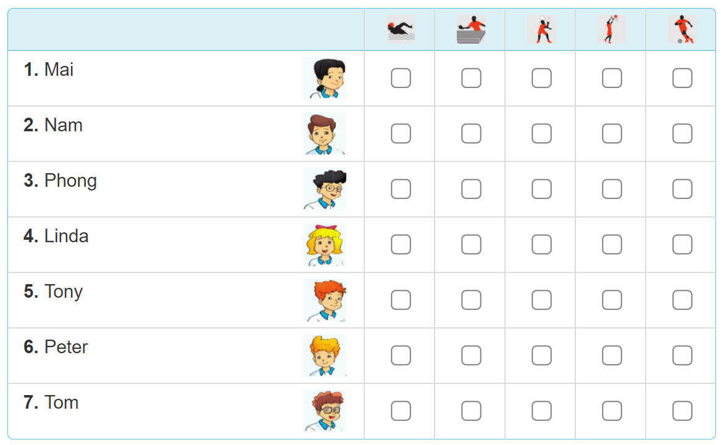
4. Read and tick

Slide 19
4. Read and tick
Our school Sports Day will be next Saturday. Everyone in my class is going to take part in it. Mai and Linda are going to play table tennis. Tony's going to play basketball and Peter's going to play badminton. Phong and Nam are going to play in a football match. Tom's going to swim. My classmates are practising hard for the events. We hope that we will win the competitions.

Slide 20
4. Read and tick

Slide 21
5. Write about Sport Day
Sports Day is going to be _______________.
Some of the boys are going to____________.
Some of the girls are going to_____________.
I am going to__________________________.
I hope that we will______________________.

Slide 22
6. Project
Draw three sports and talk about them.

