Slide 1






















Slide 2

Unit 6:
My Hobby
Lesson 2 – Task 1, 2, 3

Slide 3
1 WARM UP
Find the path game.
Notes:
(Set context: Class 3… is going to the zoo. Students choose the correct number (1 or 2, 3 or 4, 5 or 6, 7 or 8?) in turn and answer the question to help them find the right way. )
- Set the game rules
- Play as a model
- Play game

Slide 4





8
7
6
5
1
4
3
2
Exit
Notes:
Bấm vào số để chọn câu hỏi
- Students choose the number 1 or 2, 3 or 4, 5 or 6, 7 or 8? in turns and answer the questions to help them find the right way.

Slide 5


write
I can ………….
Back

Slide 6


They
…….. can cook.
Back

Slide 7


can
We …….. speak English.
Back

Slide 8


swim
She can ……..
Back

Slide 9



2 PRESENTATION
Task 1 Listen and point. Repeat.

Slide 10



New words
buy
Mia
Aiden

Slide 11
New words
colour
Mia
Aiden

Slide 12
New words
dance
Mia
Aiden

Slide 13
New words
paint
Mia
Aiden

Slide 14
New words
sing
Mia
Aiden

Slide 15
Listen and point. Repeat.
buy
colour
dance
paint
sing
Notes:
- Play the audio, ask students to listen and repeat in chorus, groups.
- Read the words at different speeds and ask students to repeat and point.

Slide 16




Let’s check
WHISPER GAME
Notes:
- Students stand in a circle.
- Put the pictures in different positions in the circle.
- The teacher whispers a word to the student on the right. Each student whispers the word to the next person until the last person in the circle hears it. The last student find the picture that matches what he/she heard, point and say aloud.

Slide 17
3 PRACTICE
Task 2 Listen and write.

Slide 18
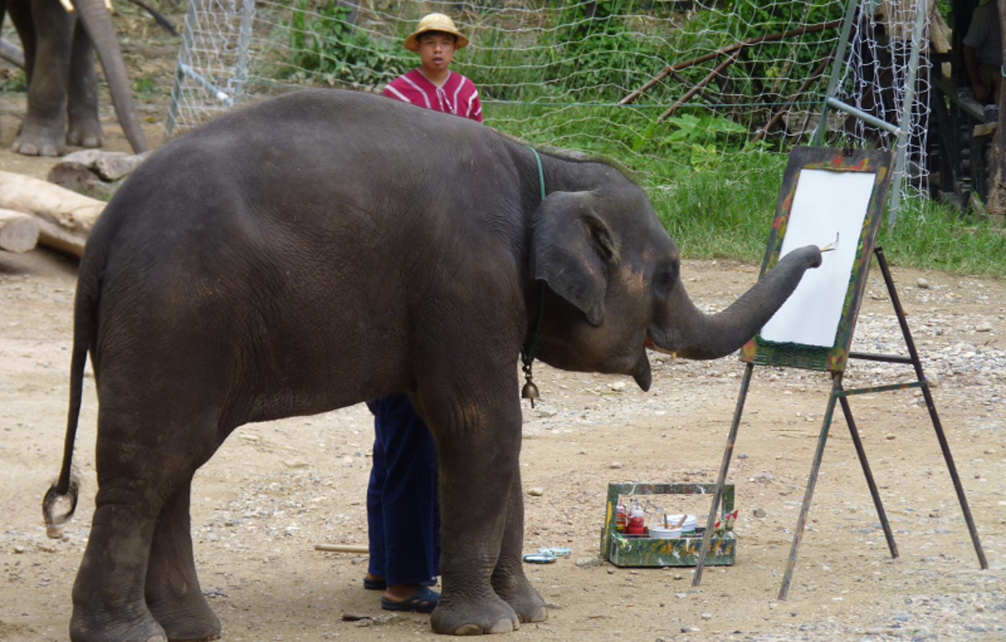


Aiden: Look! This is Susu the elephant.
Mia: Wow, look! She can paint.
Aiden: Yes. She can paint.
Mia: How old is she?
Mia: That’s cool!
Aiden: She’s 2 years old. She’s from Thailand.
Aiden: She can colour, too.
1 Susu is __________ years old.
2 She can paint and she can ________, too.
2
Mia
colour
Aiden
Notes:
HOẠT ĐỘNG TƯƠNG TÁC : HỌC SINH NGHE VÀ ĐIỀN TỪ VÀO CHỖ TRỐNG (để 1 câu tương tác): Susu is _ years old. She can paint and she can _ _ _ _ _ _ , too. (mỗi chỗ trống chỉ để đủ số lượng ký tự cần điền).
- Show 2 characters Mia, Aiden and set context that they are at the zoo.
- Show the picture
- Ask students to look at the picture and answer:
What is this?
What is she doing?
- Ask students to read 2 sentences and guess the answer before listening
- Play track 6.5 and ask students to listen.
- Play track 6.5 twice for students to give the answer
- Show the conversation and ask students to repeat
- Play role
- Some pairs perform in front of the class

Slide 19

3 PRACTICE
Task 3 Look and say.

Slide 20
Look and say.
1
2
She can colour.
He can dance.
3
4
She can paint.
He can sing.
Notes:
- Show 4 pictures and ask students to identify the actions in each picture.
- Ask students to look at the pictures and say “ He/she can….”

Slide 21


4 PRODUCTION
Charades game.
She can sing.
She can dance.
Notes:
(Divide class into 6 groups. A student in each group chooses an action and acts out it for the rest of the group to guess. The rest of group have to say a full sentence He/she can…. )
- Introduce and set game rules
- Do a demo
- Play several rounds.

Slide 22



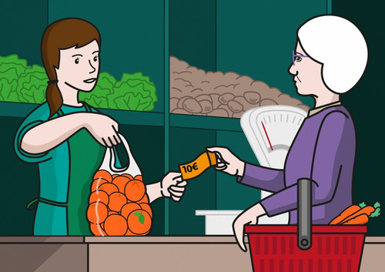

5 ASSESSMENT
Reorder the letters to make correct words
rocuol
nisg
tainp
colour
sing
paint
__________
__________
__________
uyb
cande
buy
dance
__________
__________
Notes:
HOẠT ĐỘNG TƯƠNG TÁC CHO 5 CÂU NÀY

Slide 23




Thank you & goodbye!

