Slide 1
Unit 3
Where did you go
on holiday?
Lesson 2

Slide 2
Vocabulary

Slide 3
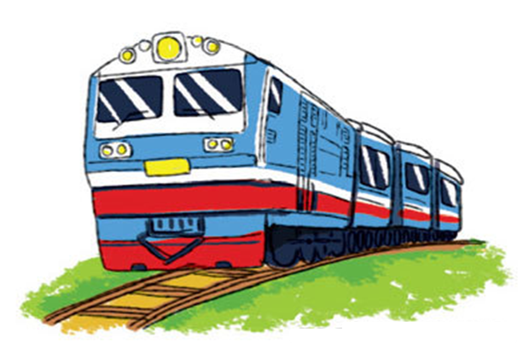
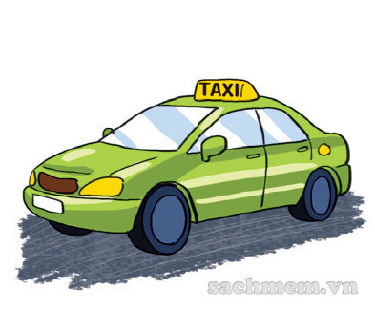
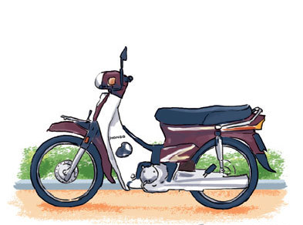
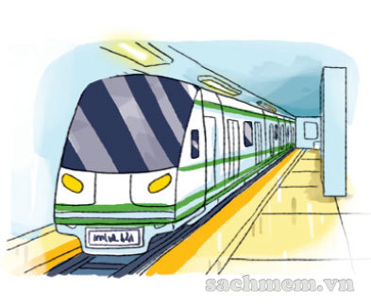
Vocabulary
train
/treɪn/
taxi
/ˈtæk.si/
motorbike
/ˈməʊ.tə.baɪk/
tàu hỏa
xe ta-xi
xe máy
underground
/ˌʌn.dəˈɡraʊnd/
bus
/bʌs/
coach
/kəʊtʃ/
tàu điện ngầm
xe buýt
xe khách

Slide 4
Look read and circle.
train
taxi
bicycle
bus
coach
motorbike
underground
taxi
train
plane
bus
coach

Slide 5
Grammar

Slide 6
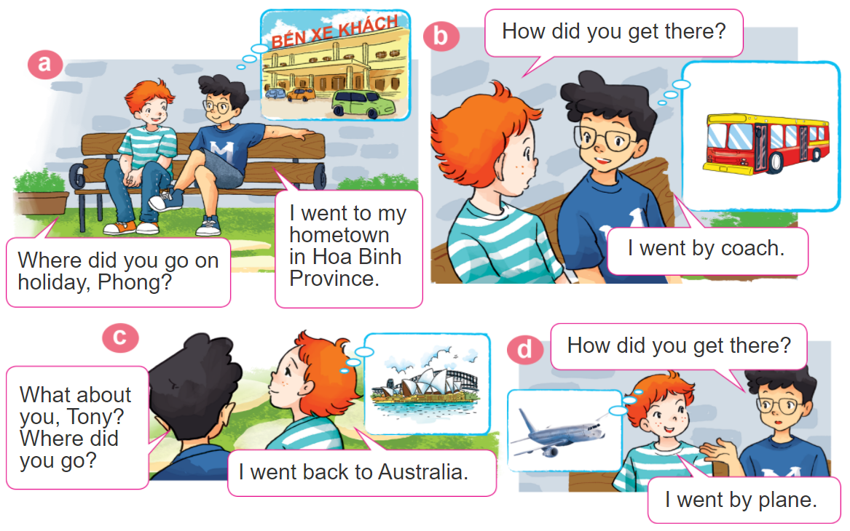
1. Look, listen and repeat.

Slide 7
2. Point and say.
How did you get there?
I went by____________.
train
underground
motorbike
taxi

Slide 8
Grammar
Hỏi và đáp bạn đã đi bằng phương tiện gì?
How did you get _______?
+ place
(Bạn đã đến ____ bằng gì?)
I went by ___________.
+ phương tiện
(Tớ đã đi bằng _____)

Slide 9
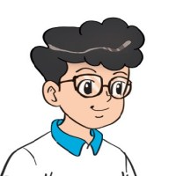
3. Let’s talk.
Where were you
on holiday?
I was ________.
I went to ________.
Where did you go?
I went by ________.
How did you get there?

Slide 10
4.
Listen and write one word in each blank
1. Mai went to see her grandparents by ___________.
2. Linda went to her hometown by ___________.
3. Nam went to the seaside by ___________.
4. Trung went to Da Nang by ___________.
motorbike
train
taxi
plane

Slide 11
5.
Write about your last holiday.
1. Where did you go last holiday?
2. How did you get there?
3. What did you do there?
4. Did you enjoy the trip?

Slide 12
6. Let’s sing.

Slide 13
THANK YOU!
Welcome to join with me!
MsPham Powerpoint
Mspham

