Slide 1








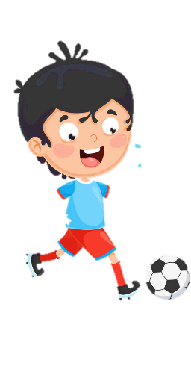
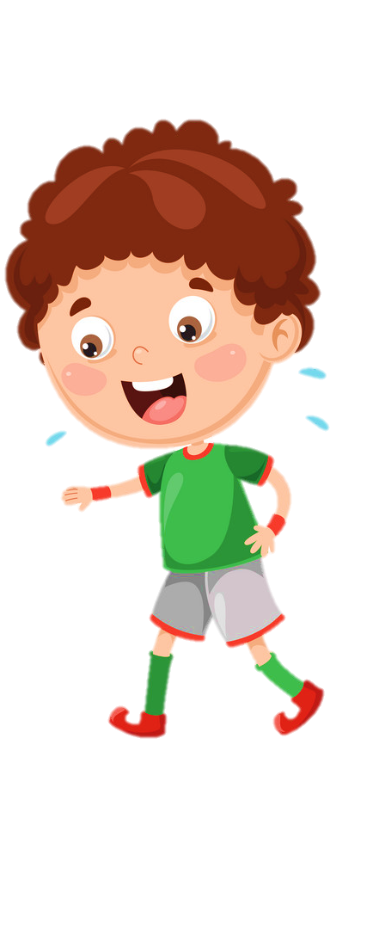











Notes:
Để nguyên trang bìa như này, chỉ thay đổi tên bài trong quá trình làm. Logo của sách Wonderful World

Slide 2

Unit 6:
My Hobby
Lesson 2 – Task 4, 5, 6

Slide 3
1 WARM UP
MEMORY GAME
I can dance.
Find the correct pairs
Notes:
(There are 5 pairs of cards, each pair is a picture and a sentence. Students choose the number to find the correct pairs.)
- Set the game rules
- Play as a model
- Have students play in turns.
- Award the best groups

Slide 4
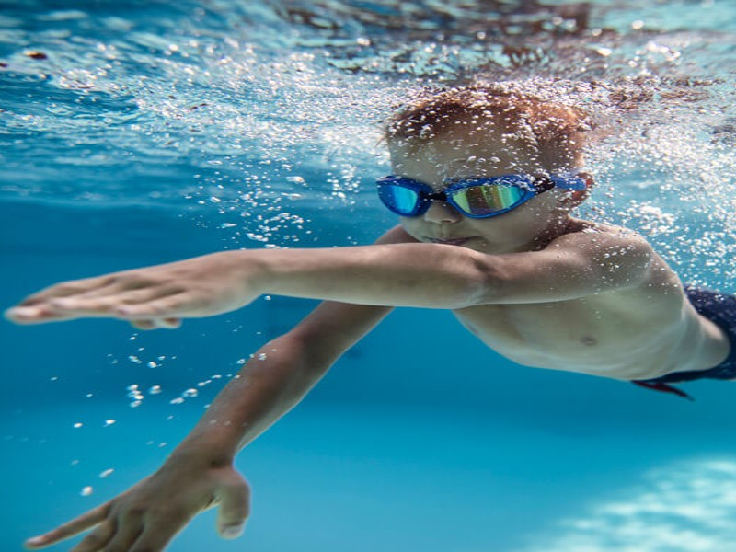

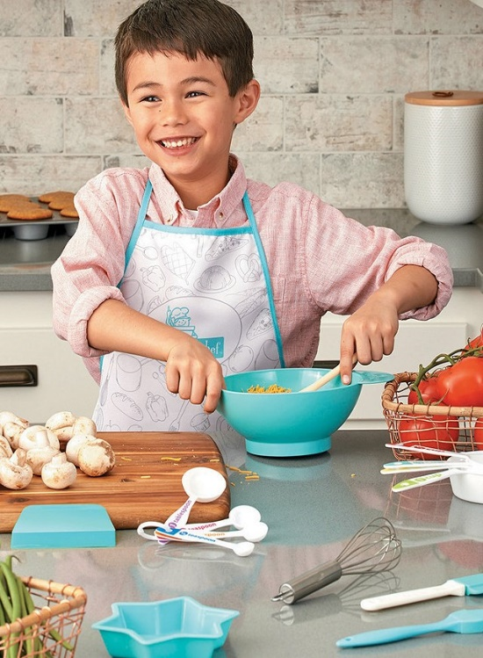
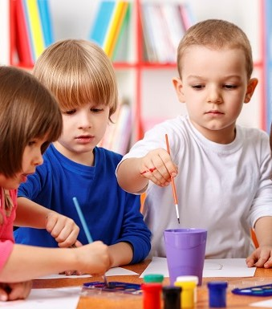

1
2
3
4
5
She can sing.
They can colour.
I
can paint.
6
7
8
10
He
can cook.
He
can swim.
9
Notes:
Bấm vào số để mở thẻ bài
Bấm vào trái tim để đóng thẻ bài
Bấm vào ngôi sao để biến mất cặp thẻ bài đã ghép đúng

Slide 5


2 PRESENTATION
Task 4 Listen and repeat.

Slide 6

✓
✗
I can paint.
I can’t paint.
Notes:
- Present the structure: I can’t….

Slide 7

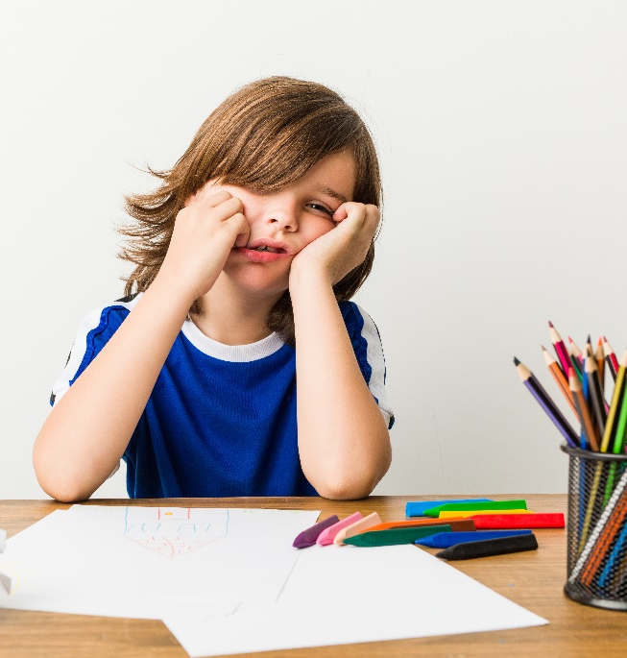

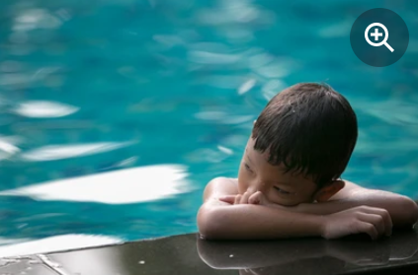
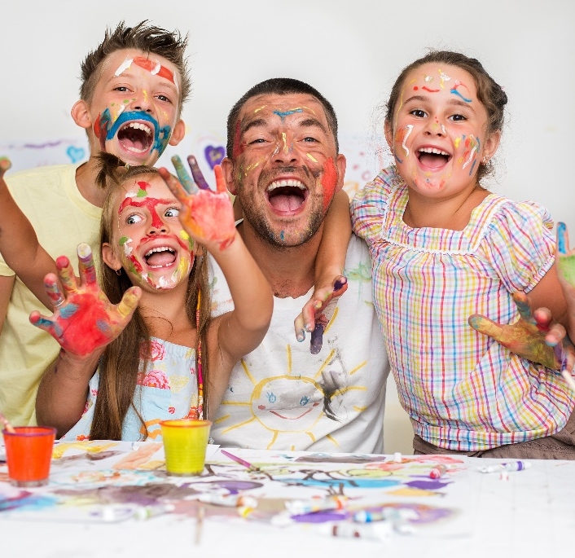
Listen and repeat.
✗
✗
✗
✗
1 I can’t paint.
2 He can’t cook.
3 He can’t swim.
4 They can’t colour.
Notes:
Bấm vào câu để nghe từng câu
Bấm vào loa để nghe cả bài
- Ask students to point and say the actions in each picture.
- Play the track 6.6 and ask students to listen.
- Play the track 6.6 again, ask students to listen and repeat in chorus, groups.

Slide 8






NEXT
20
10
10
30
SPIN
15
10
STOP
30
20
Notes:
Bấm vào phần nắp hộp để mở
Bấm vào spin để quay
Bấm vào stop để dừng lại
+ Prepare 4 sets of sentences:
I can’t paint.
He can’t cook.
He can’t swim.
They can’t colour.
+ Divide the class into 4 groups
+ Set the game rules
+ Hand each group a set of sentences.
+ Put a chair in front of class. Teacher spin the wheel. When the arrow point to the picture, students have to pick up the sentence that corresponds to the picture. Then run to the chair and sit. The group that has a sentence correctly and fast will be the winner.
+Ask students to read the sentence again.
+Open the gift box to get stars.

Slide 9

3 PRACTICE
Task 5 Look and say.

Slide 10
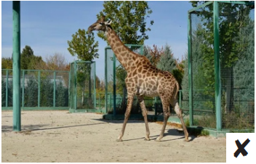

A giraffe can’t sing.
1 A giraffe/ sing
Notes:
- Ask students to look at the picture and identify can or can’t in each picture.
- Ask students to read the words under each picture.
- Have students look at the pictures, point and say in chorus, group, pairs, using … can/can’t ….

Slide 11


We can paint.
✓
2 We/ paint
Notes:
- Ask students to look at the picture and identify can or can’t in each picture.
- Ask students to read the words under each picture.
- Have students look at the pictures, point and say in chorus, group, pairs, using … can/can’t ….

Slide 12
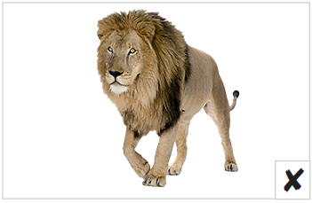
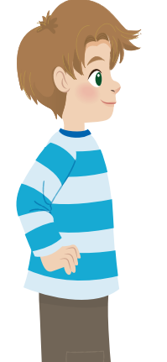
A lion can’t colour.
3 A lion/ colour
Notes:
- Ask students to look at the picture and identify can or can’t in each picture.
- Ask students to read the words under each picture.
- Have students look at the pictures, point and say in chorus, group, pairs, using … can/can’t ….

Slide 13
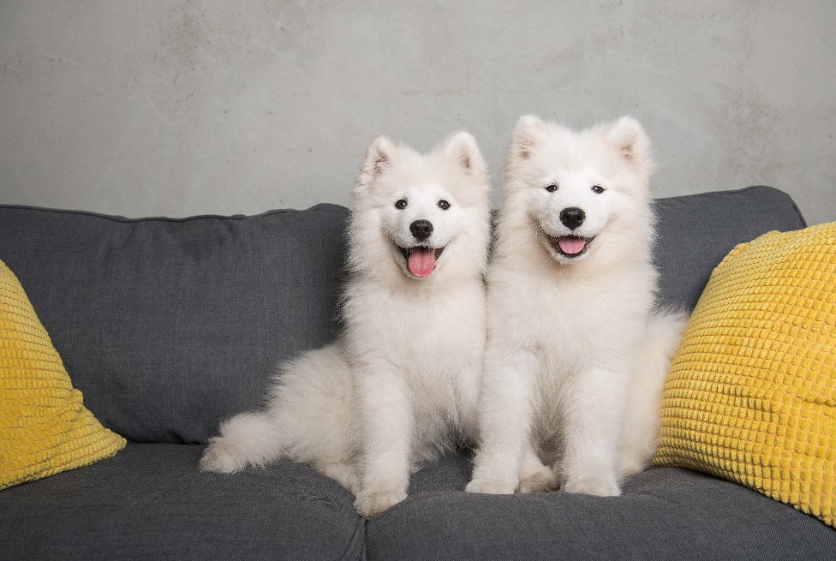
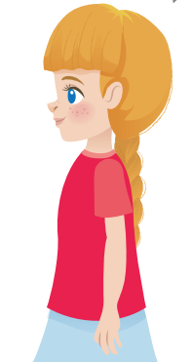
Dogs can’t read.
✗
4 Dogs/ read
Notes:
- Ask students to look at the picture and identify can or can’t in each picture.
- Ask students to read the words under each picture.
- Have students look at the pictures, point and say in chorus, group, pairs, using … can/can’t ….

Slide 14
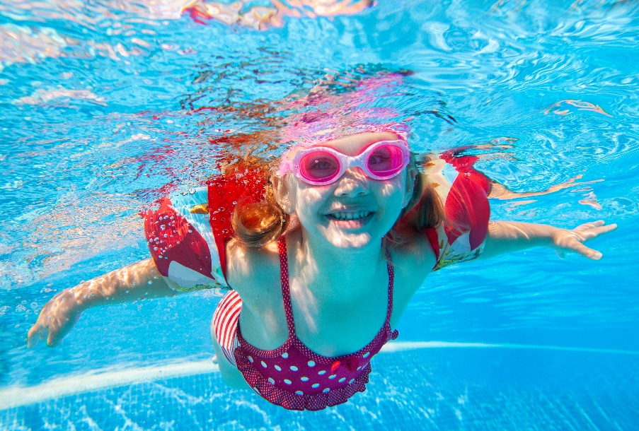
I can swim.
✓
5 I/ swim
Notes:
- Ask students to look at the picture and identify can or can’t in each picture.
- Ask students to read the words under each picture.
- Have students look at the pictures, point and say in chorus, group, pairs, using … can/can’t ….

Slide 15

We can dance.
6 We / dance
Notes:
- Ask students to look at the picture and identify can or can’t in each picture.
- Ask students to read the words under each picture.
- Have students look at the pictures, point and say in chorus, group, pairs, using … can/can’t ….

Slide 16

✓
1 A giraffe can’t sing.
2 We can paint.
3 A lion can’t colour.
✗
✓
4 Dogs can’t read.
5 I can swim.
6 We can dance.
Notes:
- Have students look at the pictures, point and say in chorus, group, pairs, using … can/can’t ….

Slide 17
4 PRODUCTION
Task 6 Draw and write. Say
Notes:
- Tell students to draw a picture of themselves doing something, like the boy in the picture.
- Ask them to show their drawings to their classmates and talk about what it is that they can do.
- Ask them to write two or three more things they can do and two or three things they can’t do.
- Ask students to hold up their books and to show each other their pictures. Ask volunteers to read out their work.

Slide 18
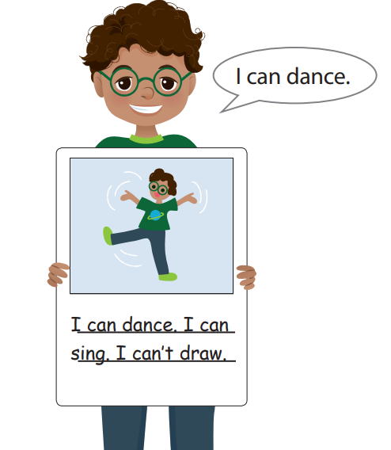
Draw and write. Say
Notes:
- Tell students to draw a picture of themselves doing something, like the boy in the picture.
- Ask them to show their drawings to their classmates and talk about what it is that they can do.
- Ask them to write two or three more things they can do and two or three things they can’t do.
- Ask students to hold up their books and to show each other their pictures. Ask volunteers to read out their work.

Slide 19


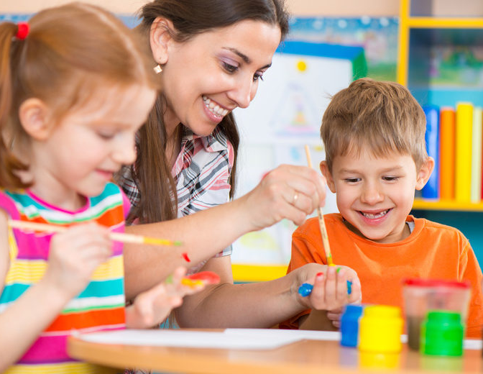
5 ASSESSMENT
Look at the pictures and circle the correct answers.
1 He …. sing.
A can B can’t
2 She … colour.
A can B can’t
3 They can ……
A paint B cook
✗
✓
Notes:
HOẠT ĐỘNG TƯƠNG TÁC

Slide 20




Thank you & goodbye!

