Slide 1
Unit 15
Dou you have
any toys?
Lesson 1

Slide 2
VOCABULARY

Slide 3
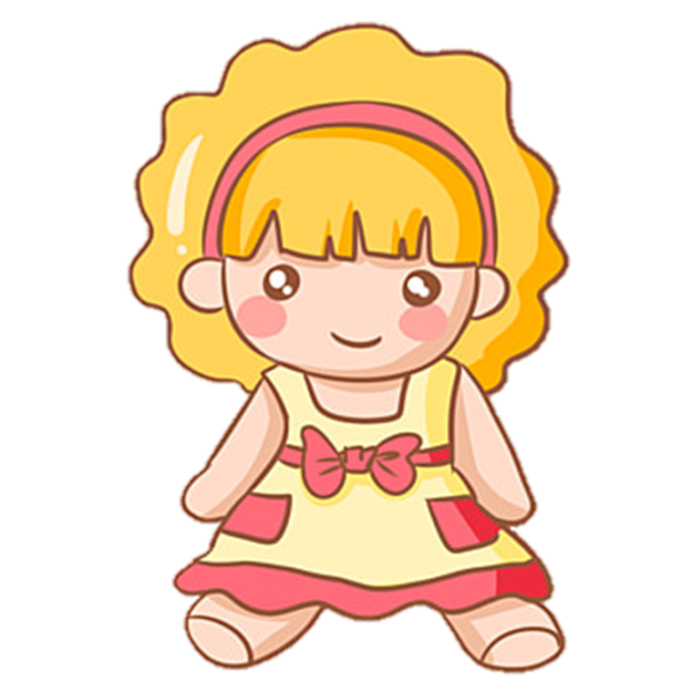
Vocabulary
doll
/dɒl/

Slide 4
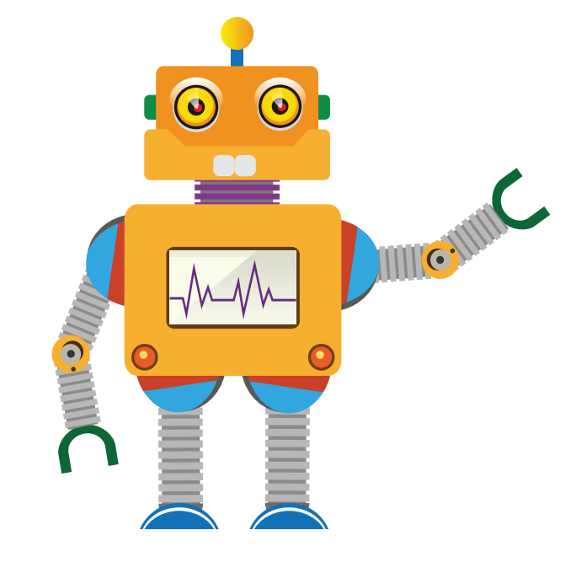
Vocabulary
robot
/ˈrəʊbɒt/

Slide 5
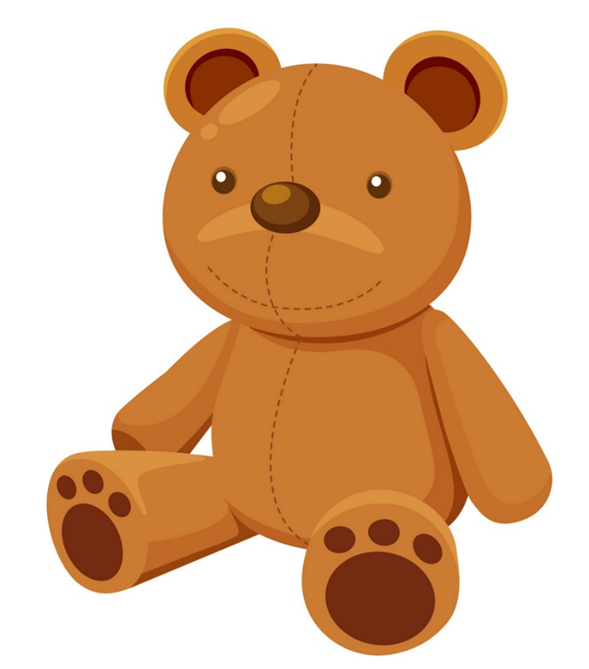
Vocabulary
teddy bear
/ˈtedi beər/

Slide 6
Vocabulary
puzzle
/ˈpʌzl/

Slide 7
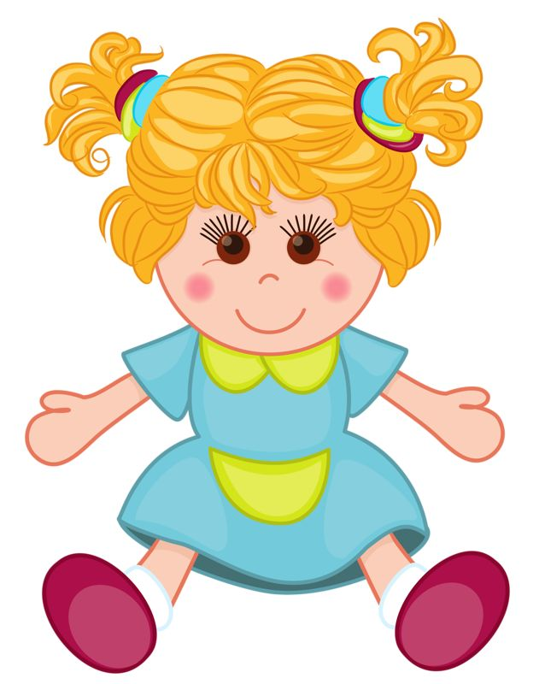
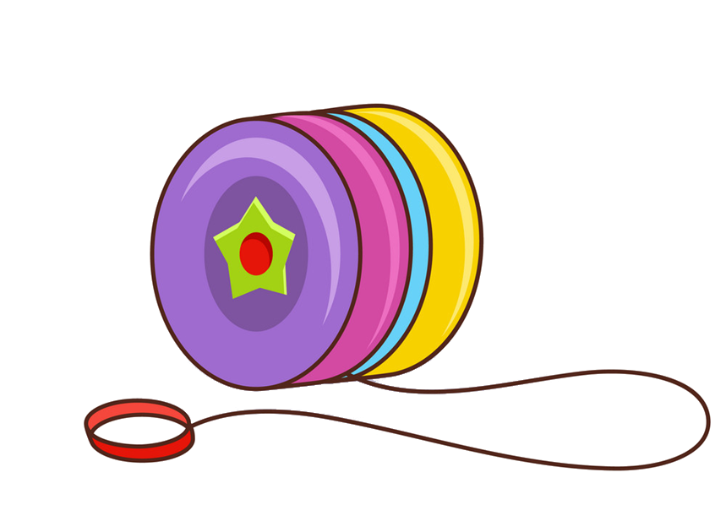
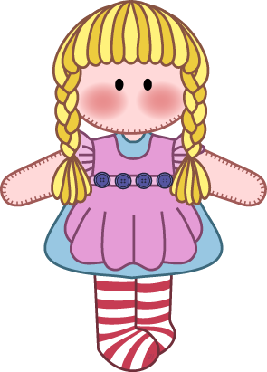
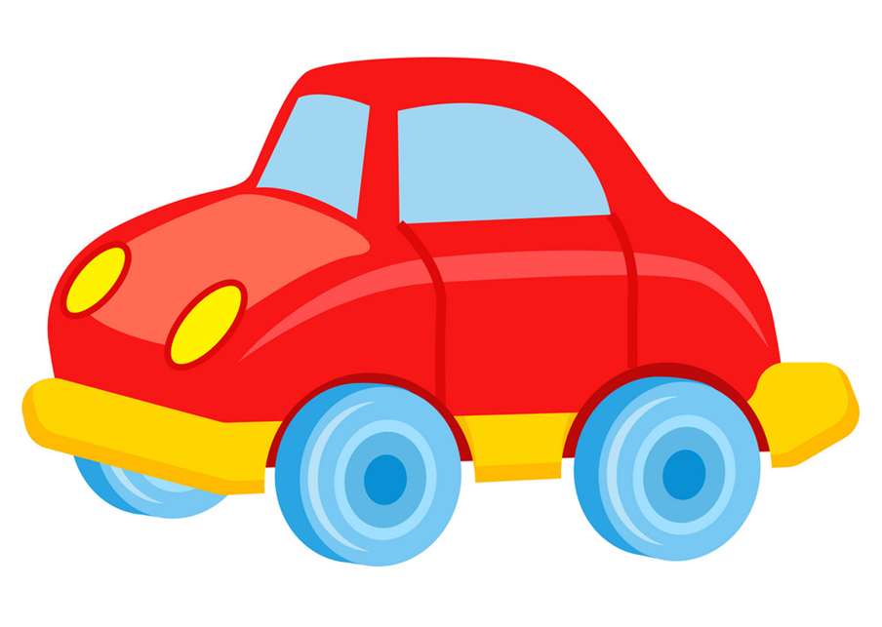
Vocabulary
car
/kɑːr/

Slide 8
Vocabulary
yo-yo
/ˈjəʊ jəʊ/

Slide 9
Vocabulary
Doll
Car
Yo-yo
Puzzle
Robot
Teddy bear

Slide 10
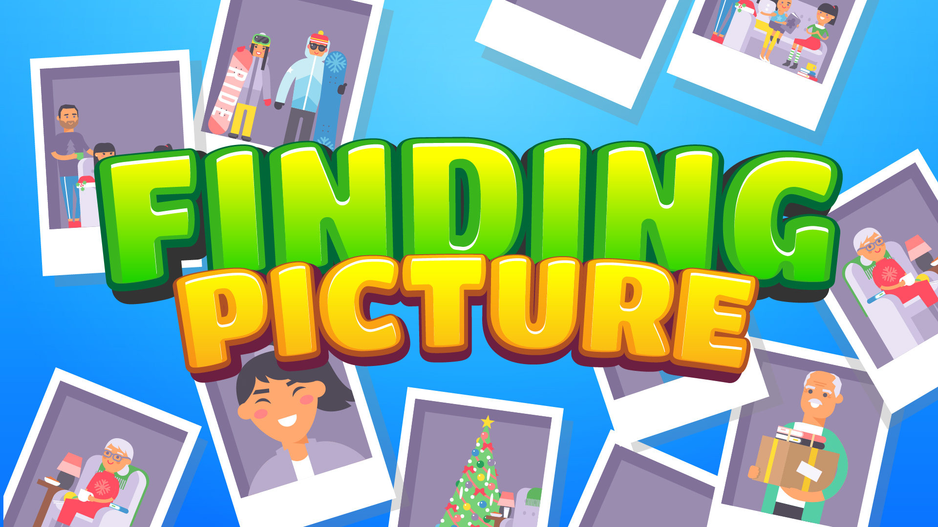

Slide 11
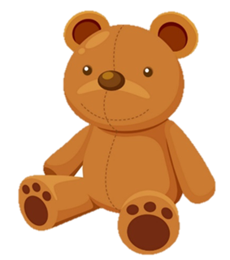
A doll

Slide 12
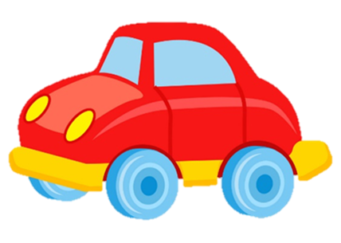
A robot

Slide 13
A yo- yo

Slide 14
A car

Slide 15
A puzzle

Slide 16
A teddy bear

Slide 17
doll
Yo-yo
Teddy bear

Slide 18
Yo-yo
puzzle
kite

Slide 19
car
doll
robot

Slide 20
car
robot
Yo-yo

Slide 21
puzzle
robot
doll

Slide 22
Yo-yo
Teddy bear
doll

Slide 23
WELLDONE!

Slide 24
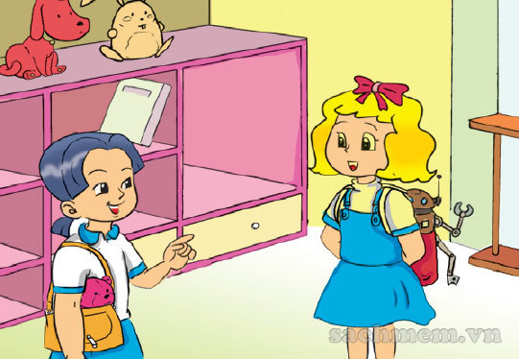
1. Look, listen and repeat
What's that?
No, I don't.
It's my robot.
Do you have a robot?

Slide 25
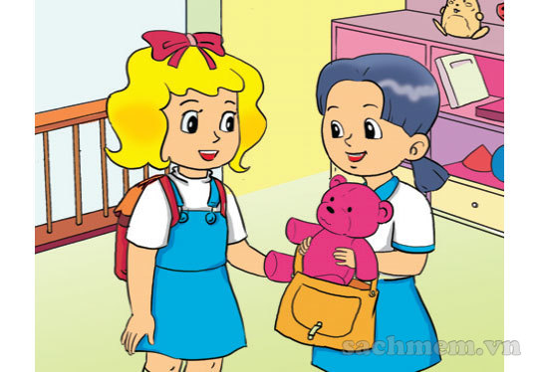
1. Look, listen and repeat
Do you have a teddy bear?
Yes, I do.

Slide 26
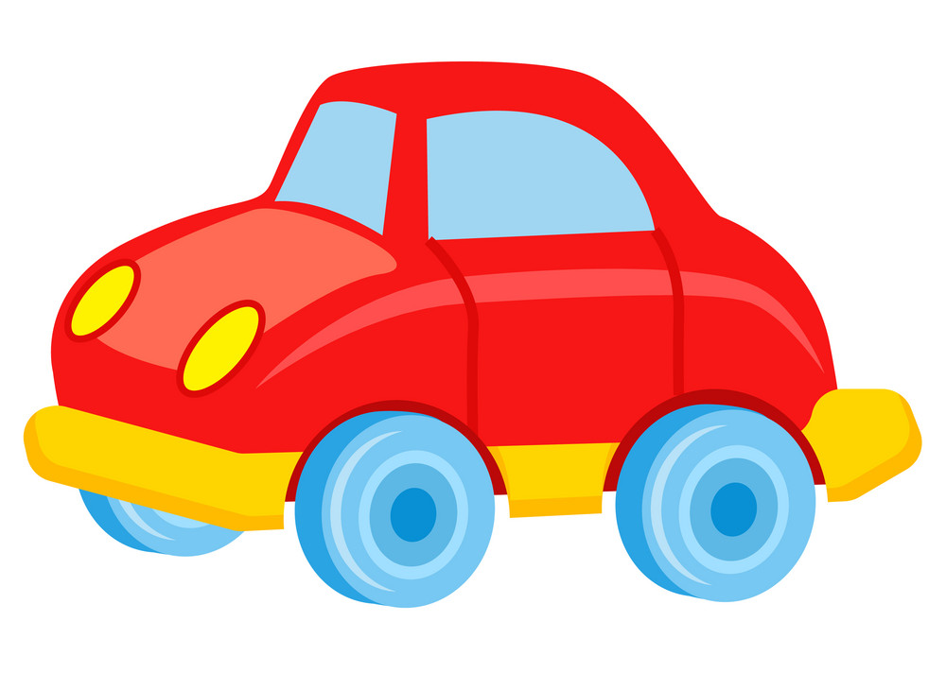
2. Point and say
a car
Do you have __________?
Yes, I do.

Slide 27
2. Point and say
a puzzle
Do you have __________?
Yes, I do.

Slide 28
2. Point and say
a robot
Do you have __________?
Yes, I do.

Slide 29
2. Point and say
a yo-yo
Do you have __________?
No, I don't.

Slide 30
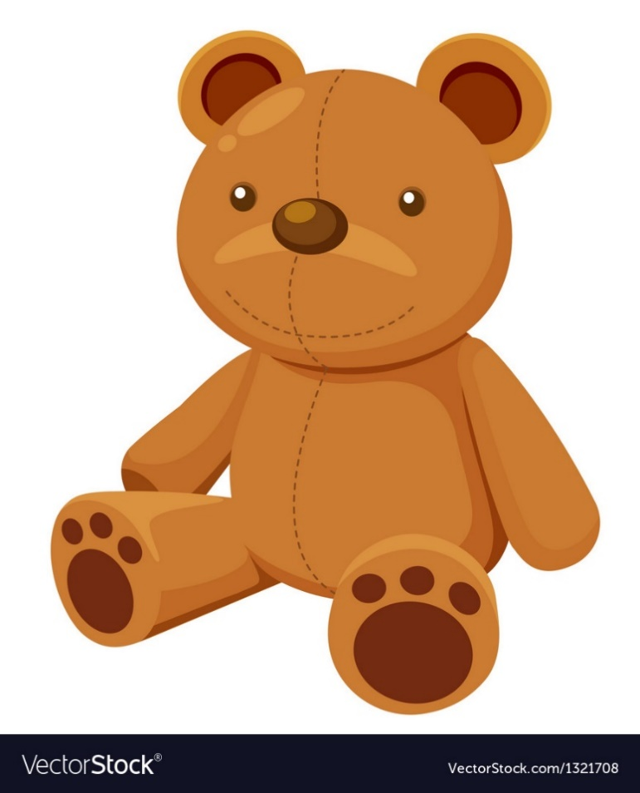
2. Point and say
a teddy bear
Do you have __________?
No, I don't.

Slide 31
2. Point and say
a doll
Do you have __________?
No, I don't.

Slide 32
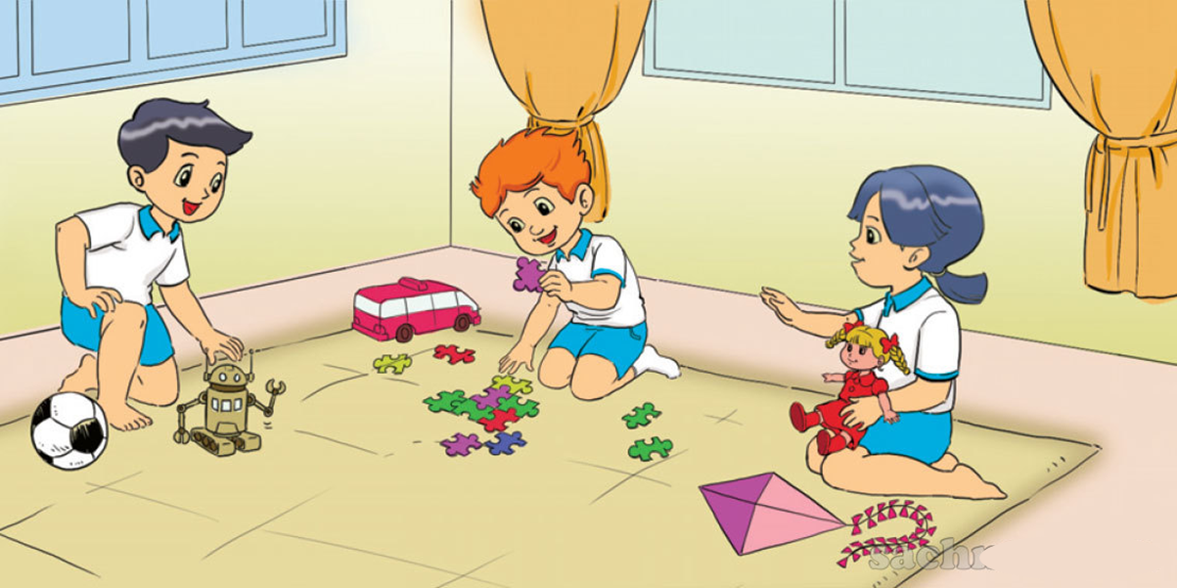
3. Let's talk

Slide 33
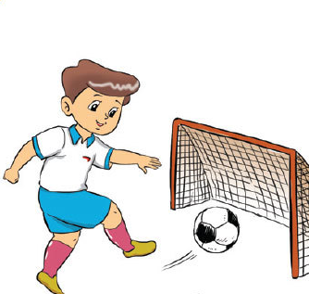
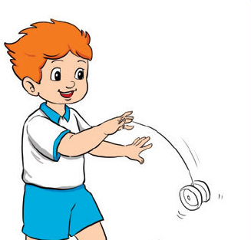
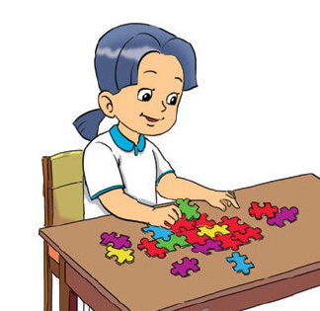
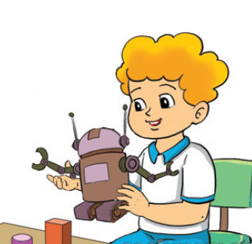
1
2
4. Listen and number
3
4
a
b
c
d
3
4
1
2

Slide 34
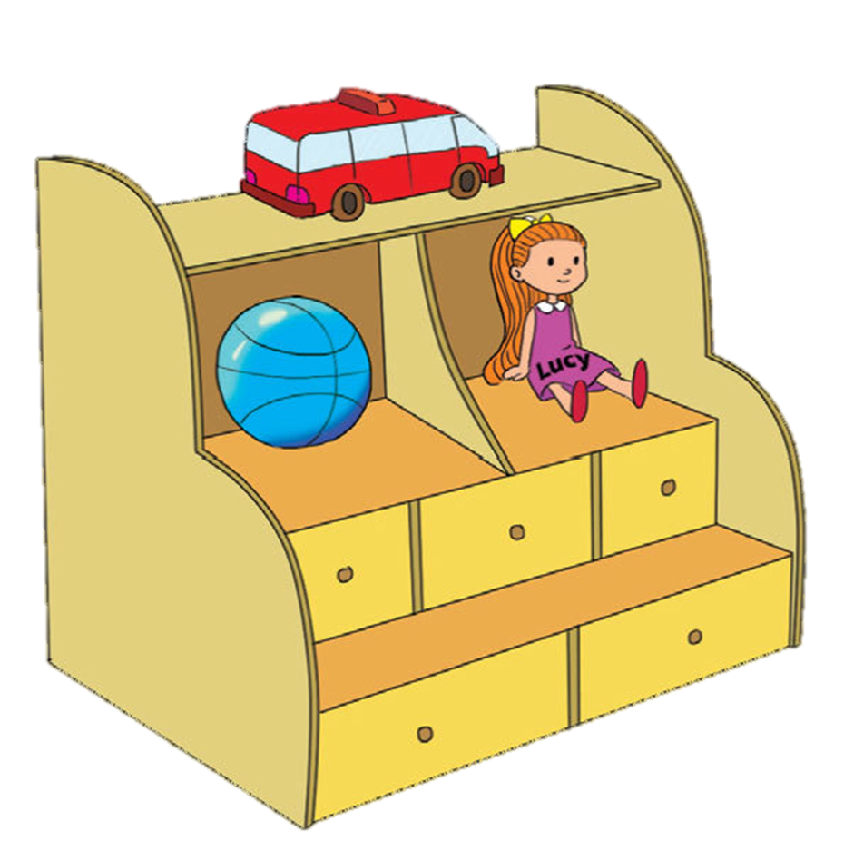
5. Read and write
These are my toys on the shelf. I have a (1) car . It is red. I have a (2) ball . It is blue. And I have a pretty (3) doll . It is Lucy. I like my toys very much. (4) Do you have any toys? What are (5) they ?
_____
_____
____
____
____

Slide 35
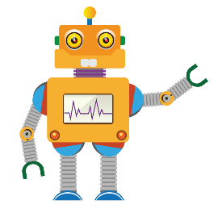
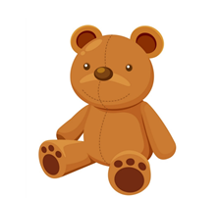
Yes, I do
Do you have __________?
No, I don’t
a yo-yo
a robot
a puzzle
a car
a teddy bear
a doll

Slide 36
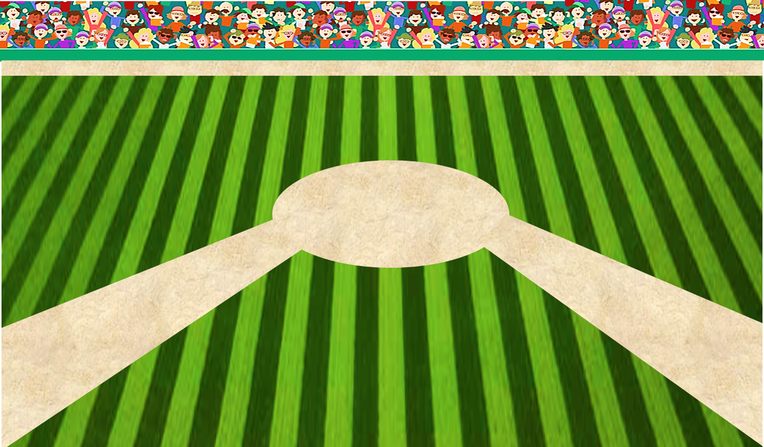
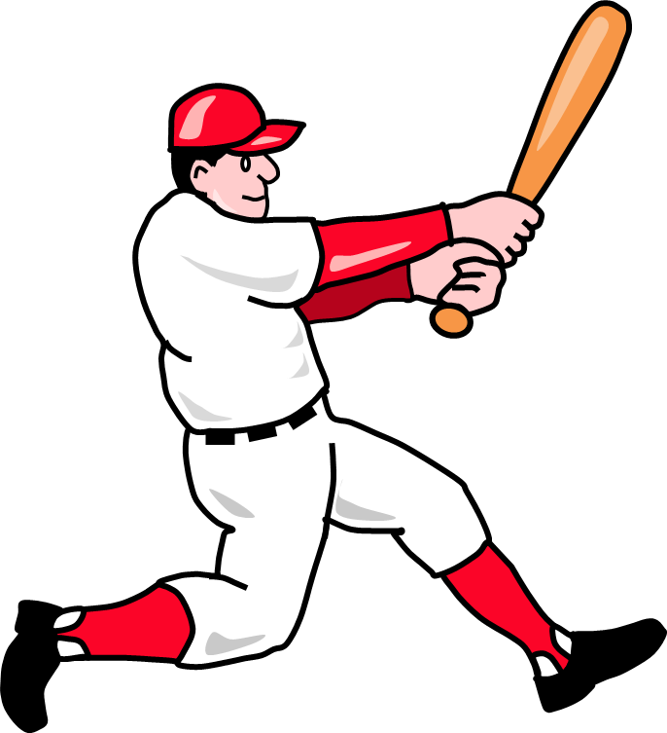
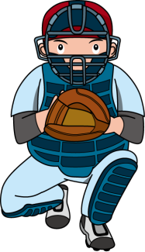
PLAY
BASEBALL CUP

Slide 37
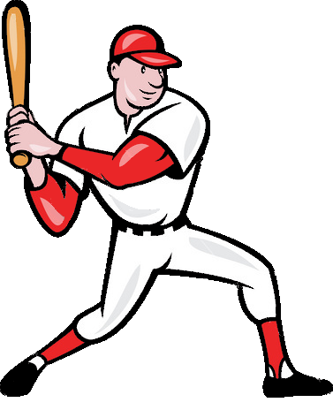
Yes, I do.
you
Yes, I am.
they
Do you have a car?
Close your book

Slide 38
No, I’m not
you
No, I don’t.
they
Do you have a robot?
Sing a song

Slide 39
Do you
you
Are you
they
______ have a yo-yo?
Yes, I do.
Close your book

Slide 40
has
you
have
they
Do you _____ a doll?
No, I don’t.
Sing a song

Slide 41
puzzle
you
yo-yo
they
Do you have a _____?
Yes, I do.
Close your book

Slide 42
Do you have a teddy bear?
you
Do you have a doll?
they
_____________?
Yes, I do.
Close your book

Slide 43
Yes, I do.
you
No, I don’t.
they
Do you have a doll?
Sing a song

Slide 44
Yes, I do.
you
No, I don’t.
they
Do you have a yo-yo?
Sing a song

Slide 45
PLAY
TIME’S UP!

Slide 46
6. Let's write
Do you have a doll / car / teddy bear?
What colours are your toys?
Where is your doll / car / teddy bear?

