Slide 1
Unit 15
Dou you have
any toys?
Lesson 2

Slide 2
VOCABULARY

Slide 3
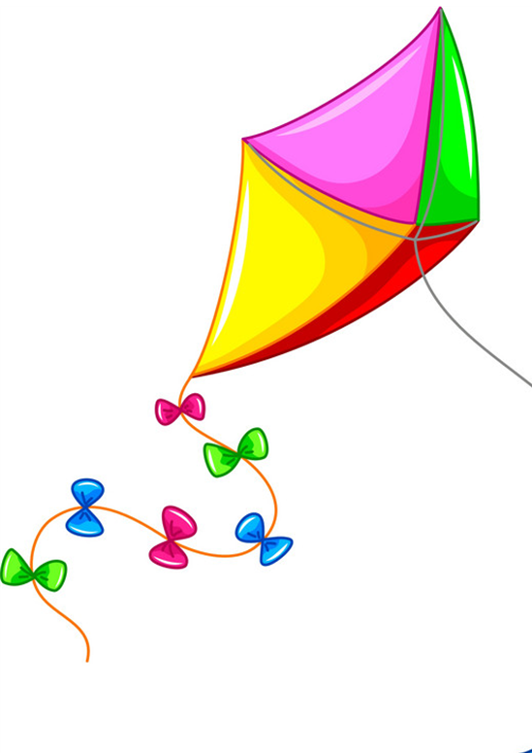
Vocabulary
kite
/kaɪt/

Slide 4
Vocabulary
plane
/pleɪn/

Slide 5
Vocabulary
ship
/ʃɪp/

Slide 6
Vocabulary
train
/treɪn/

Slide 7
Vocabulary
ball
/bɔːl/

Slide 8
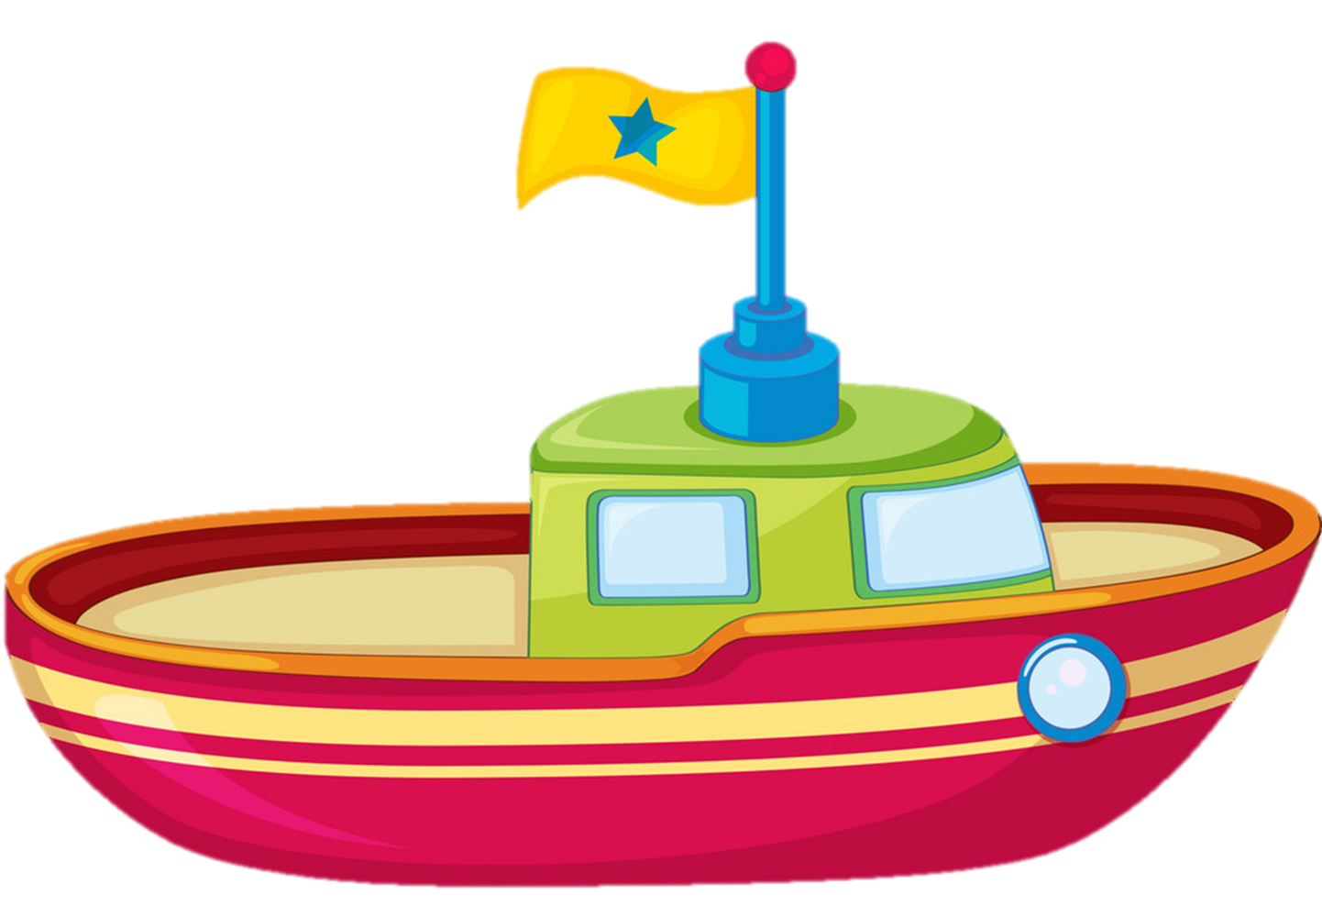
Vocabulary
boat
/bəʊt/

Slide 9
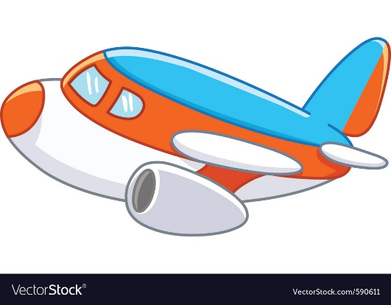
Vocabulary
Train
Kite
Plane
Ship
Ball
Boat

Slide 10
Choose the correact word
Plane
Train
Ship

Slide 11
Choose the correact word
Boat
Ship
Train

Slide 12
Choose the correact word
Ship
Plane
Boat

Slide 13
Choose the correact word
Plane
Kite
Train

Slide 14
Choose the correact word
Kite
Plane
Ball

Slide 15
Choose the correact word
Kite
Train
Ship

Slide 16
Tick or cross
✔
✔
Boat
Kite
Plane
✔
Train
Ball
Ship

Slide 17
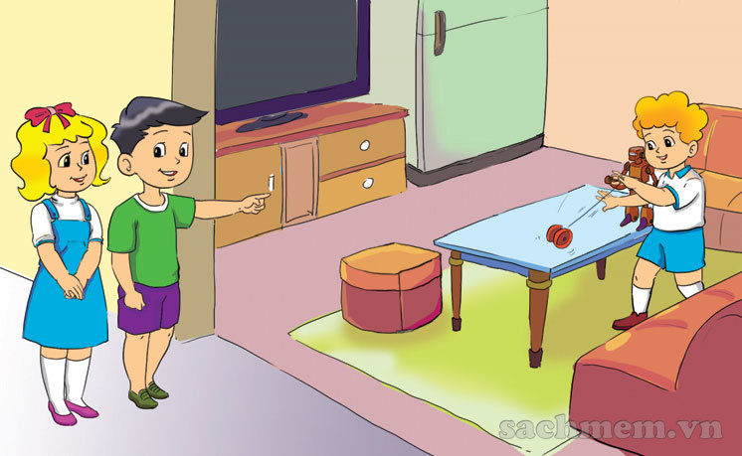
1. Look, listen and repeat
Does your brother have a robot?
Yes, he does.

Slide 18
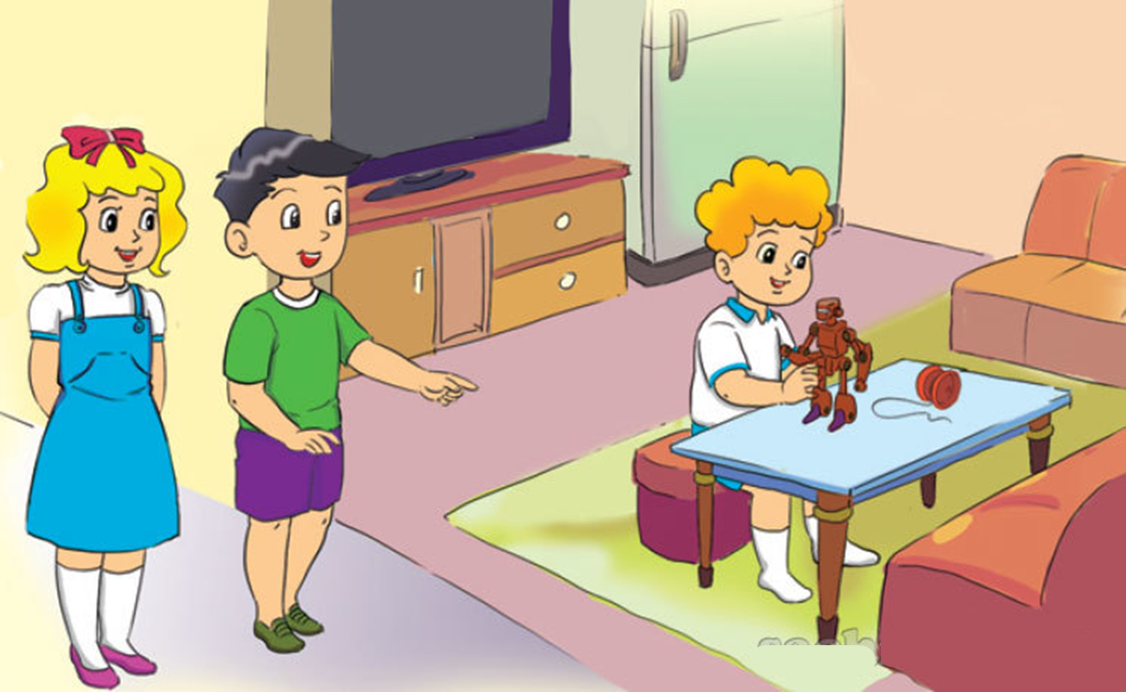
1. Look, listen and repeat
Does he have a puzzle?
No, he doesn’t.

Slide 19
2. Point and say
a kite
Does she have _______?
Yes, she does.

Slide 20
2. Point and say
Does he have _________?
a ship
Yes, he does.

Slide 21
2. Point and say
a plane
Does she have __________?
No, she doesn't.

Slide 22
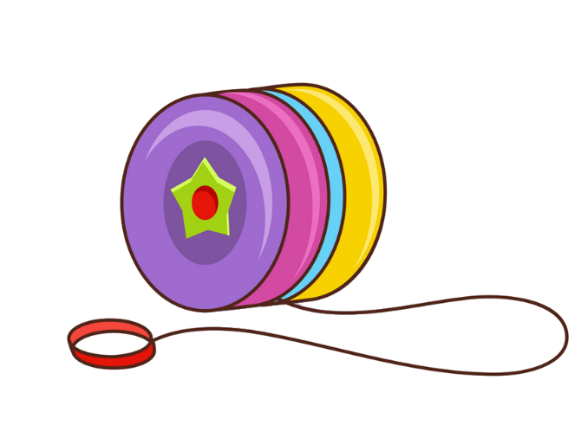
2. Point and say
Does he have _________?
a yo-yo
No, he doesn't.

Slide 23
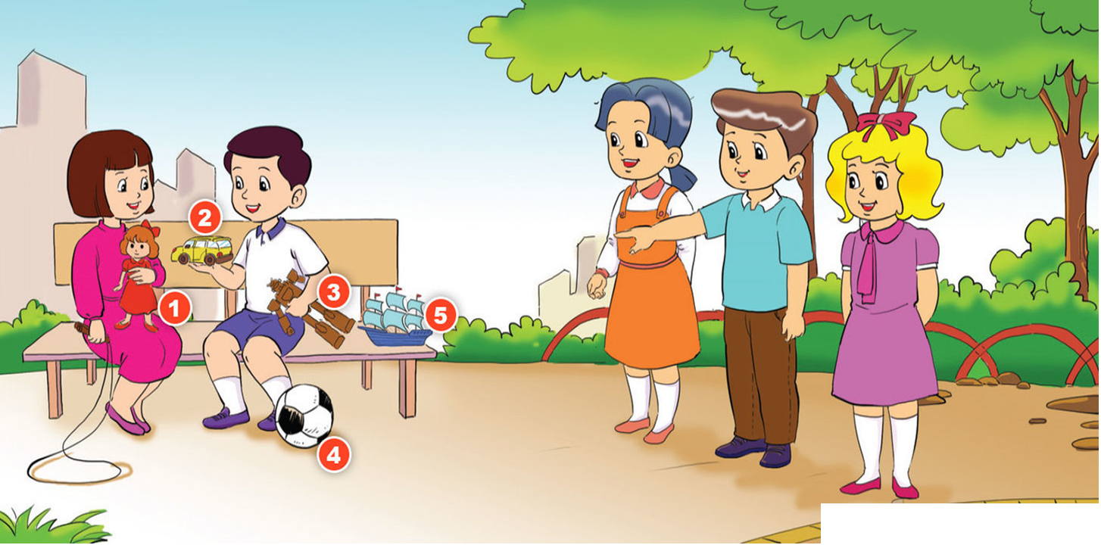
3. Let's talk

Slide 24
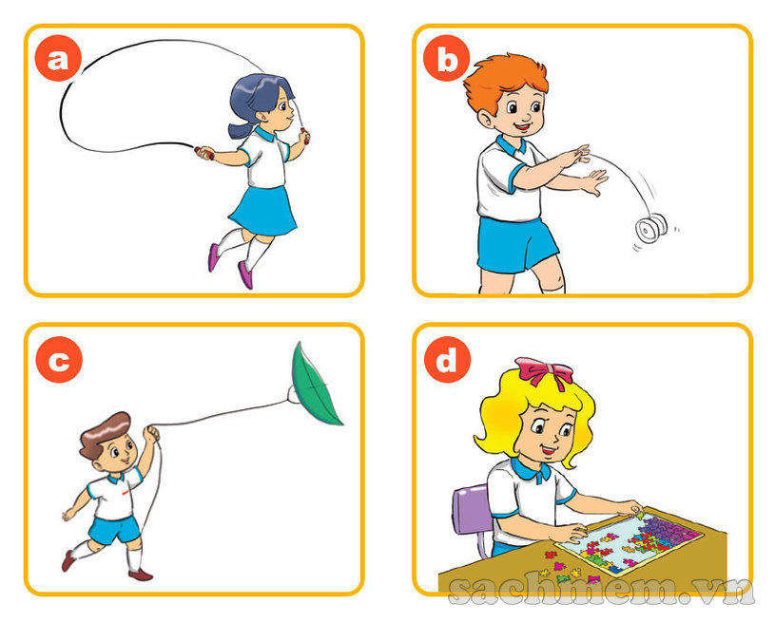
4. Listen and tick
 | True | False
a
b
c
d

Slide 25
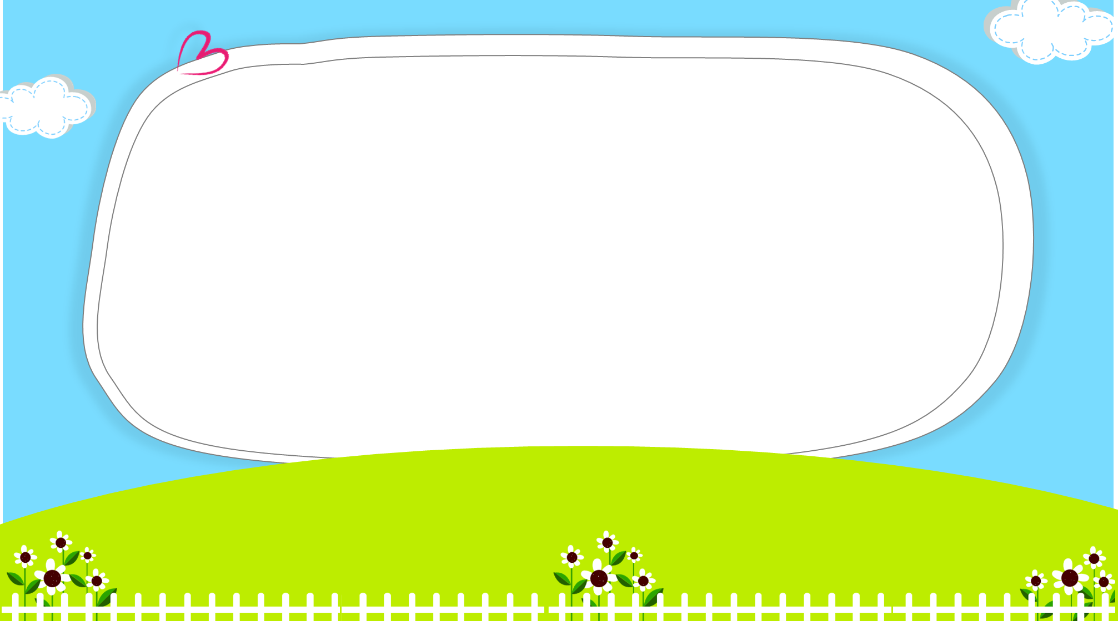
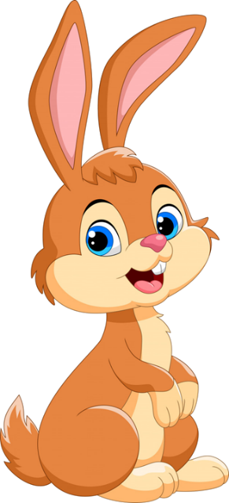
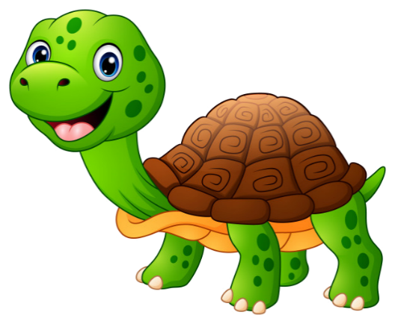
Click hình chú Thỏ hoặc chú Rùa khi chọn đáp án.
Notes:
Ms Huyền Phạm - 0936.082.789 – YOUTUBE: MsPham. Facebook: Dạy và học cùng công nghệ.

Slide 26
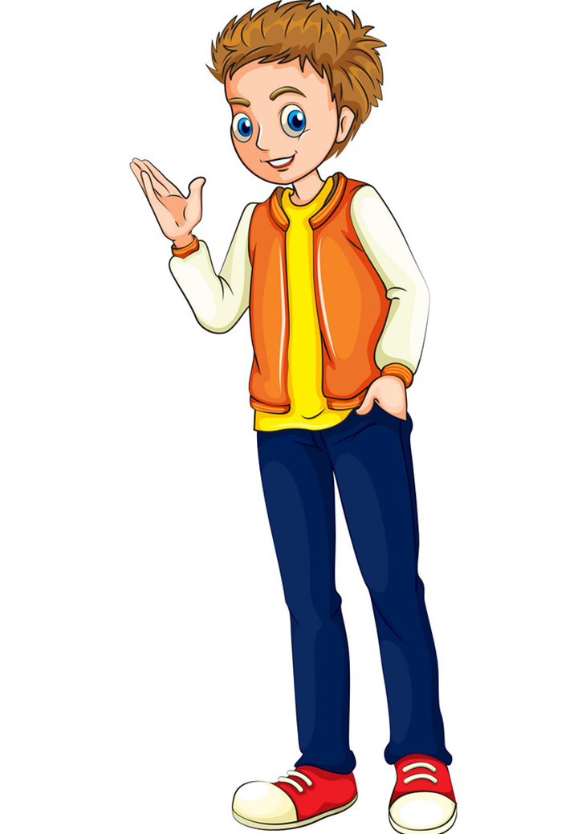
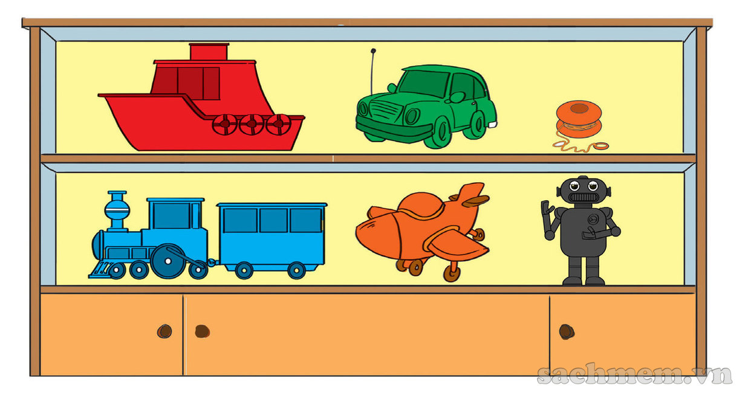
Does he have a green plane?
Yes, he does.
No, he doesn’t.
Notes:
Ms Huyền Phạm - 0936.082.789 – YOUTUBE: MsPham. Facebook: Dạy và học cùng công nghệ.

Slide 27
Does he have a train?
No, he doesn’t.
Yes, he does.
Notes:
Ms Huyền Phạm - 0936.082.789 – YOUTUBE: MsPham. Facebook: Dạy và học cùng công nghệ.

Slide 28
Does he have a black robot?
Yes, he does.
No, he doesn’t.
Notes:
Ms Huyền Phạm - 0936.082.789 – YOUTUBE: MsPham. Facebook: Dạy và học cùng công nghệ.

Slide 29
Does she have a ship?
No, she doesn’t.
Yes, she does.
Notes:
Ms Huyền Phạm - 0936.082.789 – YOUTUBE: MsPham. Facebook: Dạy và học cùng công nghệ.

Slide 30
Does your sister have a kite?
Yes, she does.
No, she doesn’t.
Notes:
Ms Huyền Phạm - 0936.082.789 – YOUTUBE: MsPham. Facebook: Dạy và học cùng công nghệ.

Slide 31
Does he have _______?
Yes, he does
a robot
robot
Notes:
Ms Huyền Phạm - 0936.082.789 – YOUTUBE: MsPham. Facebook: Dạy và học cùng công nghệ.

Slide 32
Does he have an orange yo-yo?
Yes, he does.
No, he doesn’t.
Notes:
Ms Huyền Phạm - 0936.082.789 – YOUTUBE: MsPham. Facebook: Dạy và học cùng công nghệ.

Slide 33
Does the boy have a doll?
Yes, he does.
No, he doesn’t.
Notes:
Ms Huyền Phạm - 0936.082.789 – YOUTUBE: MsPham. Facebook: Dạy và học cùng công nghệ.

Slide 34
Does the girl have a doll?
Yes, she does
No, she doesn’t.
Notes:
Ms Huyền Phạm - 0936.082.789 – YOUTUBE: MsPham. Facebook: Dạy và học cùng công nghệ.

Slide 35
Does your father have a kite?
Yes, _____ does.
he
she
Notes:
Ms Huyền Phạm - 0936.082.789 – YOUTUBE: MsPham. Facebook: Dạy và học cùng công nghệ.

Slide 36
Does ____ have a yo-yo?
Yes, _____ does.
she
he
Notes:
Ms Huyền Phạm - 0936.082.789 – YOUTUBE: MsPham. Facebook: Dạy và học cùng công nghệ.

Slide 37
____ your brother have a puzzle?
Yes, he ______.
Do
Does
Notes:
Ms Huyền Phạm - 0936.082.789 – YOUTUBE: MsPham. Facebook: Dạy và học cùng công nghệ.

Slide 38
Notes:
Ms Huyền Phạm - 0936.082.789 – YOUTUBE: MsPham. Facebook: Dạy và học cùng công nghệ.

Slide 39
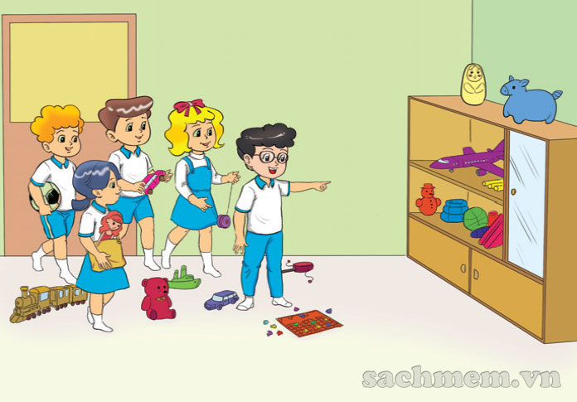
5. Read and write
I am Phong. Peter, Mai, Nam, and Linda are my friends. We have a lot of toys. Peter has a robot and a ball. Mai has a teddy bear and a doll. Nam has a car and a plane. Linda has a yo-yo and a puzzle. I have a plane and a ship.
1. What does Peter have?
He has a robot and a ball.
__________________________

Slide 40
5. Read and write
I am Phong. Peter, Mai, Nam, and Linda are my friends. We have a lot of toys. Peter has a robot and a ball. Mai has a teddy bear and a doll. Nam has a car and a plane. Linda has a yo-yo and a puzzle. I have a plane and a ship.
2. What does Mai have?
She has a teddy bear and a doll.
__________________________

Slide 41
5. Read and write
I am Phong. Peter, Mai, Nam, and Linda are my friends. We have a lot of toys. Peter has a robot and a ball. Mai has a teddy bear and a doll. Nam has a car and a plane. Linda has a yo-yo and a puzzle. I have a plane and a ship.
3. Does Nam have a car
and a plane?
Yes, he does.
__________________________

Slide 42
5. Read and write
I am Phong. Peter, Mai, Nam, and Linda are my friends. We have a lot of toys. Peter has a robot and a ball. Mai has a teddy bear and a doll. Nam has a car and a plane. Linda has a yo-yo and a puzzle. I have a plane and a ship.
4. What does Linda have?
She has a yo-yo and a puzzle.
__________________________

Slide 43
5. Read and write
I am Phong. Peter, Mai, Nam, and Linda are my friends. We have a lot of toys. Peter has a robot and a ball. Mai has a teddy bear and a doll. Nam has a car and a plane. Linda has a yo-yo and a puzzle. I have a plane and a ship.
5. Does Phong have a kite?
No, he doesn't.
__________________________

Slide 44
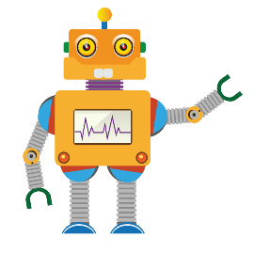
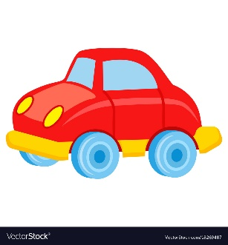
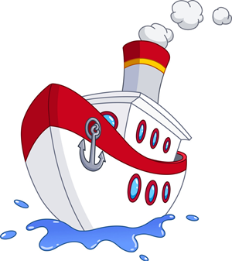
Yes, he/she does.
Does he/she have __________?
No, he/she doesn’t.
a robot
a yo-yo
a car
a puzzle
a plane
a ship
a kite

