Slide 1

Getting Started
Lesson 2
Page 6

Slide 2

WARM UP

Slide 3


Look, guess, and spell.
h
a
n
d
s
u
p

Slide 4
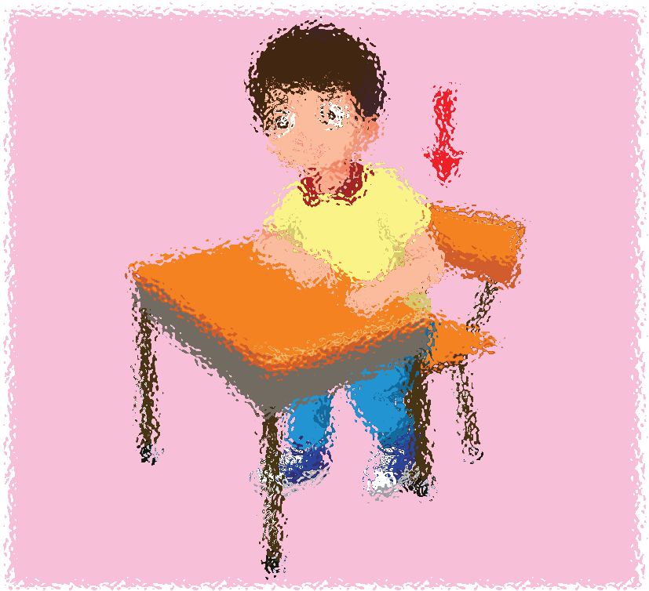
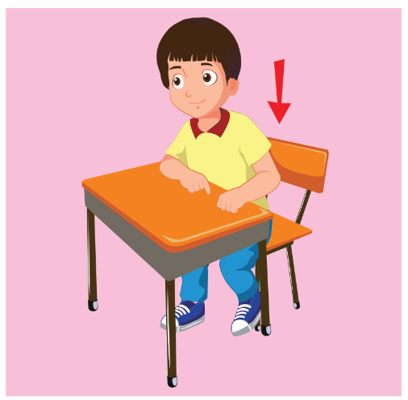
Look, guess, and spell.
s
i
t
d
o
w
n

Slide 5
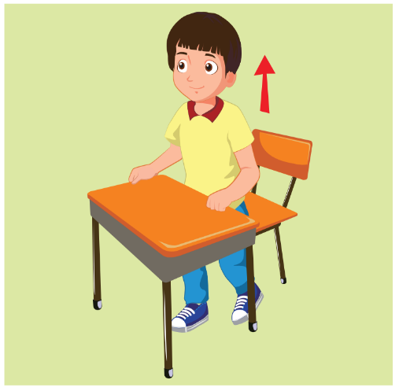
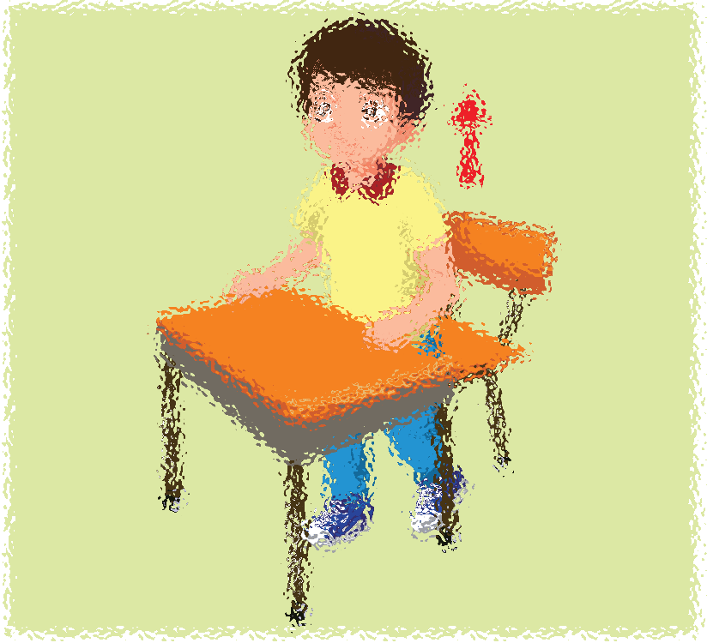
Look, guess, and spell.
s
t
a
n
d
u
p

Slide 6


Look, guess, and spell.
b
o
o
k

Slide 7

It’s time to learn …

Slide 8
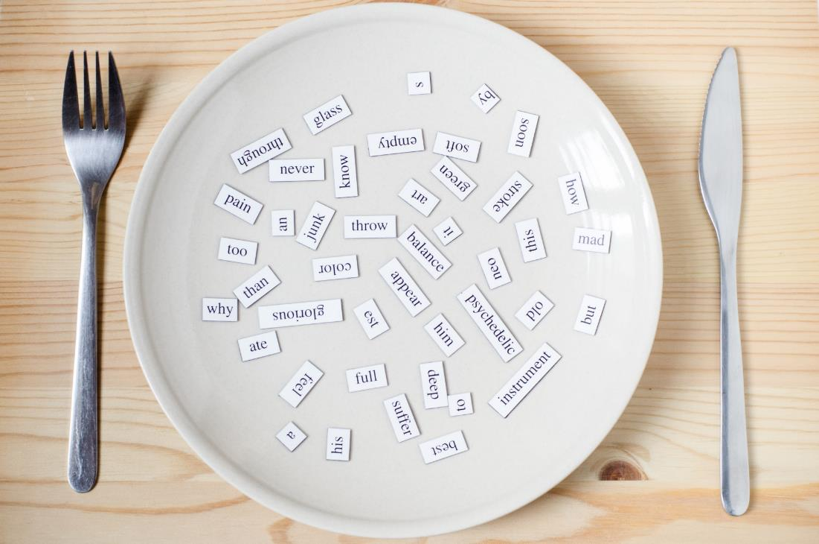
New words
open your book close your book hands down

Slide 9

Presentation

Slide 10


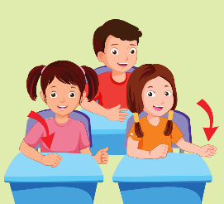

A
Listen and point. Repeat. (CD1 Track 04)
1
2
3
open your book
close your book
hands down
/ˈəʊpən jʊr bʊk/
mở sách ra
/kləʊz jʊr bʊk/
đóng sách lại
/hændz daʊn/
hạ tay xuống
Click on each English word to hear the sound.

Slide 11


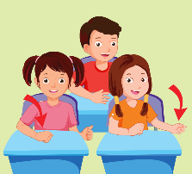
Look at the vocabulary and do the action.
Perfect!
open your book
close your book
hands down
close your book
close your book
hands down
close your book
hands down
open your book
hands down
hands down
open your book
hands down
hands down
hands down
close your book
open your book
hands down
close your book
hands down
open your book
open your book
hands down
close your book
close your book
hands down
hands down
close your book
hands down
open your book
open your book
close your book

Slide 12
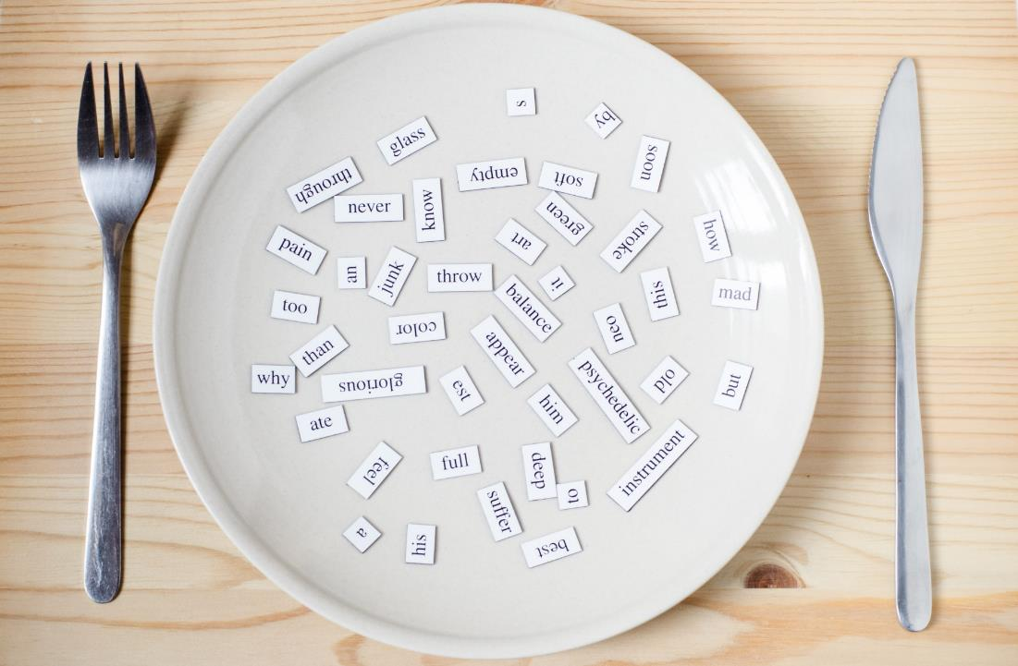
Structures
Close your book, please.
Open your book, please.
Hands down, please.

Slide 13
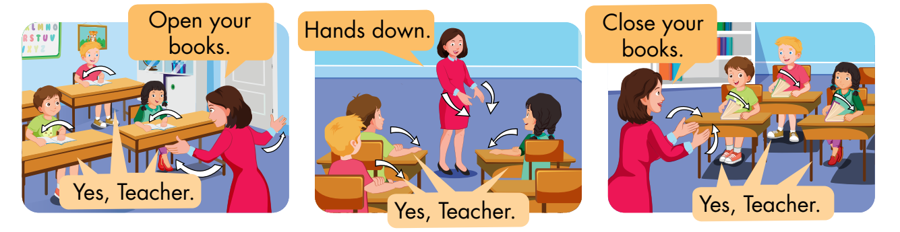
B
Listen and point. Repeat. Role-play. (CD1 Track 05)
Notes:
B. Listen and point. Repeat. Role-play. (CD1 Track 05)
Have students call out the things they can see in each picture.
Play the audio and have them point to the characters.
Play the audio again and have them repeat the new words.
Divide the class into pairs to role-play the dialogue.
Swap roles and repeat.
Invite some pairs to demonstrate the activity in front of the whole class.
Go around the class and support them if necessary.

Slide 14

Practice

Slide 15
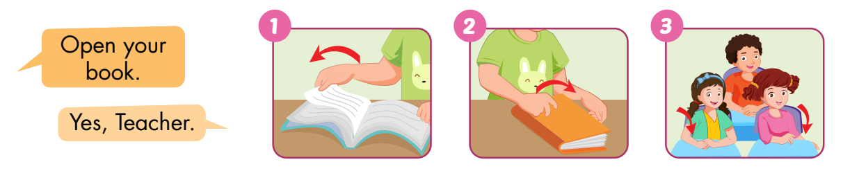
C
Point, say, and do.
Notes:
C. Point, say, and do.
Divide the class into two teams.
Show a flashcard to the class.
Have Team A call out the command and Team B do the action.
Swap roles and repeat.
Monitor the class and support if needed.

Slide 16
Speaking

Slide 17
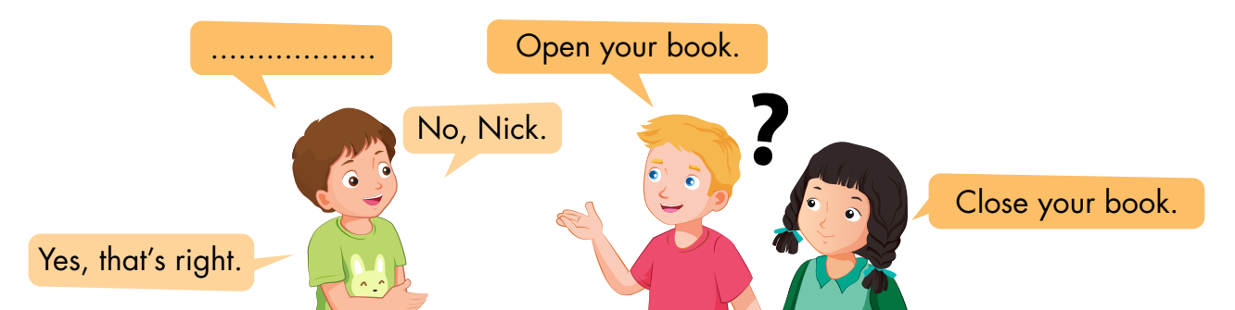
D
Play Read my lips.

Slide 18
Further Practice

Slide 19
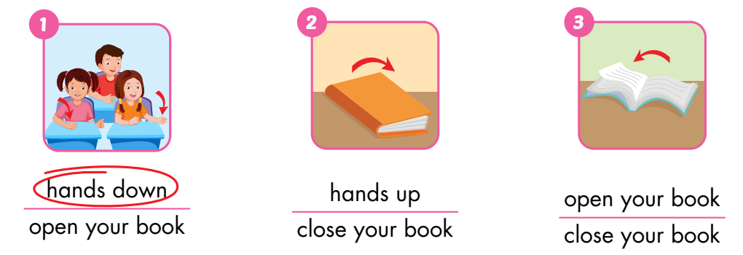
A
Look and circle.

Slide 20
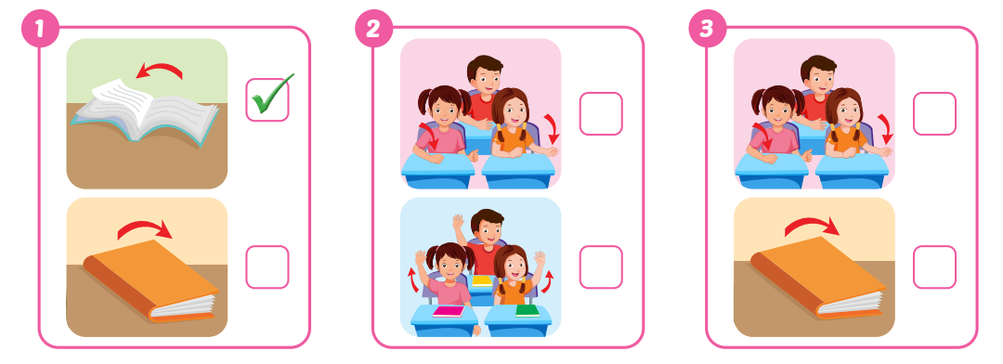
B
Listen and tick (✓) the box. (WB Track 03)
✓
✓

Slide 21
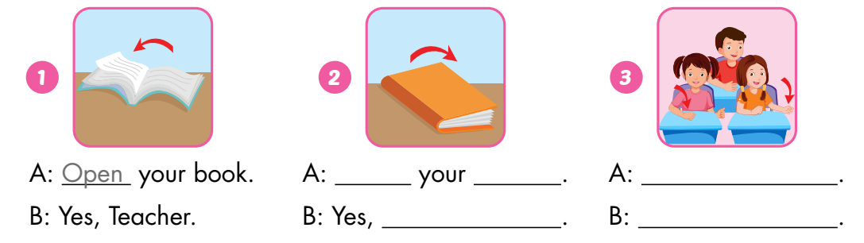
C
Look and write.
Close
book
Hands down
Teacher
Yes, Teacher

Slide 22

Consolidation

Slide 23

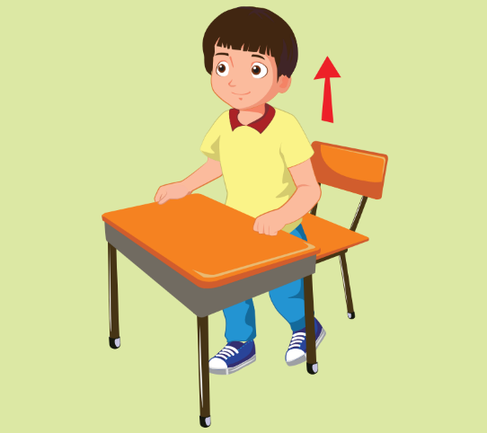
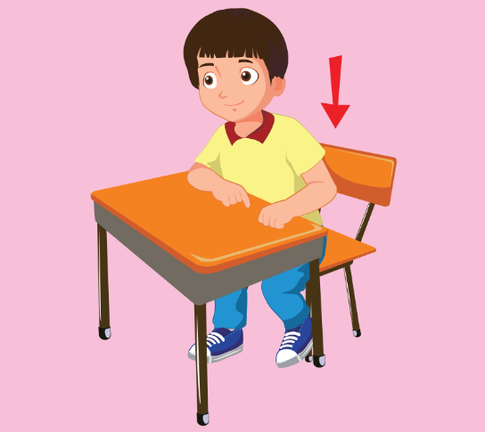




Hot Seat
Notes:
Hot Seat
Divide the class into two groups.
Ask a student from each team to come to the front of the class, sit on chairs, and face to the class.
Show the picture and have other students use their body language to describe the picture.
The student who says the vocabulary first will a point for their team.

Slide 24

WRAP-UP

Slide 25
Today’s lesson
Vocabulary:
open your book, close your book, hands down
Structures:
Open your book./ Close your book./
Hands down./ Yes, Teacher.

Slide 26

Have a nice day!

