Slide 1
Getting Started
Lesson 4
Page 8

Slide 2
Objectives
By the end of this lesson, students will be able to ask the colors of things.
Vocabulary:
red, yellow, blue, black, white
Structures:
What color is it?/ It’s yellow.

Slide 3
WARM UP

Slide 4
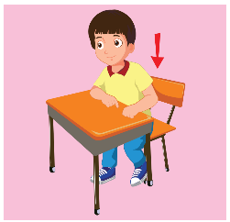
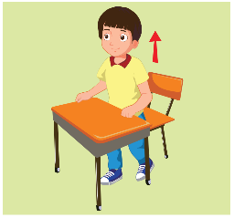
What’s missing?
1
2
3
4
5
6
7
8

Slide 5
It’s time to learn …

Slide 6
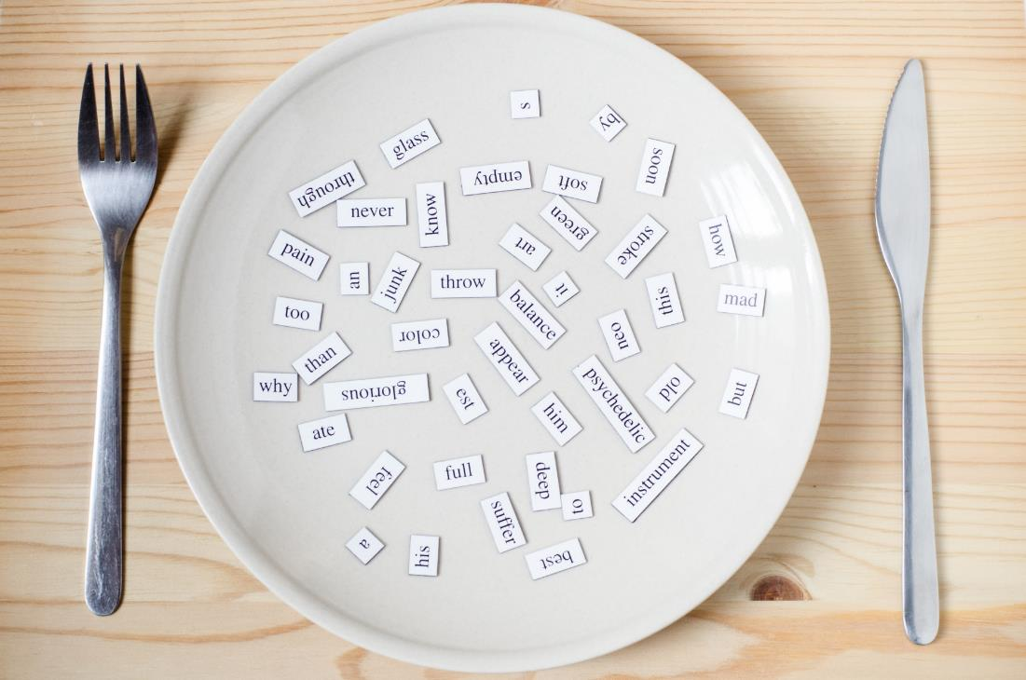
New words
red
yellow
blue
black
white

Slide 7
A
Listen and point. Repeat. (CD1 Track 08)
1
2
3
4
5
red
yellow
blue
black
white
/red/
màu đỏ
/ˈjeləʊ/
màu vàng
/bluː/
màu xanh dương
/blæk/
màu đen
/waɪt/
màu trắng
Click on each English word to hear the sound.

Slide 8
Listen and match.
1
2
3
4
5
a
b
c
d
e
Keys

Slide 9
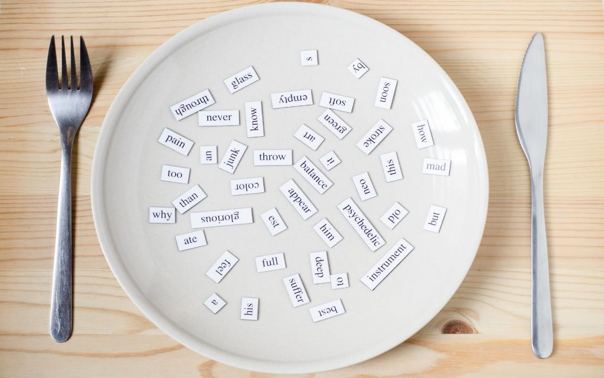
Structures
What color is it?
It’s yellow.

Slide 10
B
Listen and fill the blank. Repeat. Role-play. (CD1 Track 09)
blue
red
Notes:
B. Listen and point. Repeat. Role-play. (CD1 Track 09)
Have students call out the things they can see in each picture.
Play the audio and have them point to the characters.
Play the audio again and have them repeat the new words.
Divide the class into pairs to role-play the dialogue.
Swap roles and repeat.
Invite some pairs to demonstrate the activity in front of the whole class.
Go around the class and support them if necessary.

Slide 11
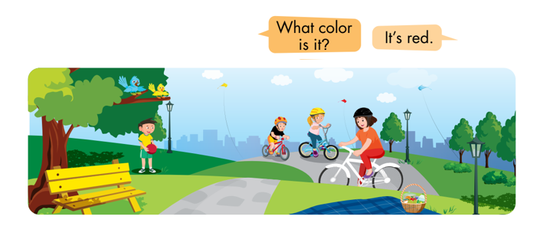
C
Point, ask, and answer.
Notes:
C. Point, ask, and answer.
Divide the class into two teams.
Have the student A point and ask and the student B answer.
Swap roles and repeat.
Afterwards, have some pairs demonstrate the activity in front of the class.
Monitor the class and support if needed.

Slide 12
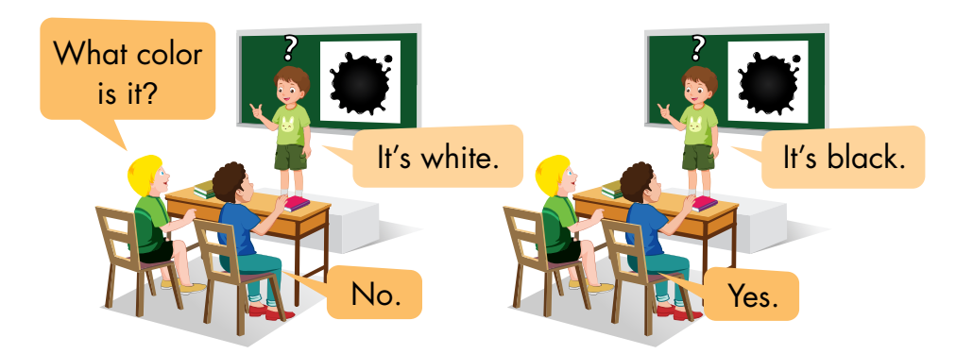
D
Play Guess the picture.
Notes:
D. Play Guess the picture.
Have the students time to look and read at the examples.
Divide the class into two teams.
Have a student stand facing away from the board and stick a flashcard on the board behind them.
Have someone from the same team ask the student a question about the flashcard.
Have a student try to guess the answer without looking at the flashcard.
Give that team one point if it’s a correct guess.
Have teams take turns asking and guessing.

Slide 13
WORKBOOK page 6

Slide 14
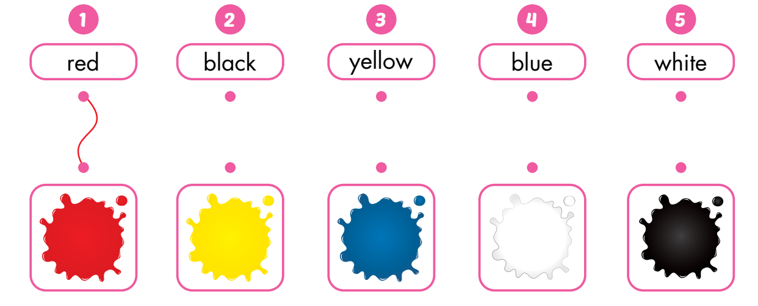
A
Draw lines.

Slide 15
B
Listen and circle. (WB Track 05)

Slide 16
C
Look and write.
white
blue

Slide 17
Consolidation

Slide 18
Find something in… .
Notes:
Finding game
Have students stand up to play this game.
Show them the colors and ask them to find a thing in the classroom in (red/yellow/black/white/blue).
Demonstrate the activity in front of the class.
Help the class if necessary.

Slide 19
WRAP-UP

Slide 20
Today’s lesson
Vocabulary:
red, yellow, blue, black, white
Structures:
What color is it?
It’s yellow.

Slide 21
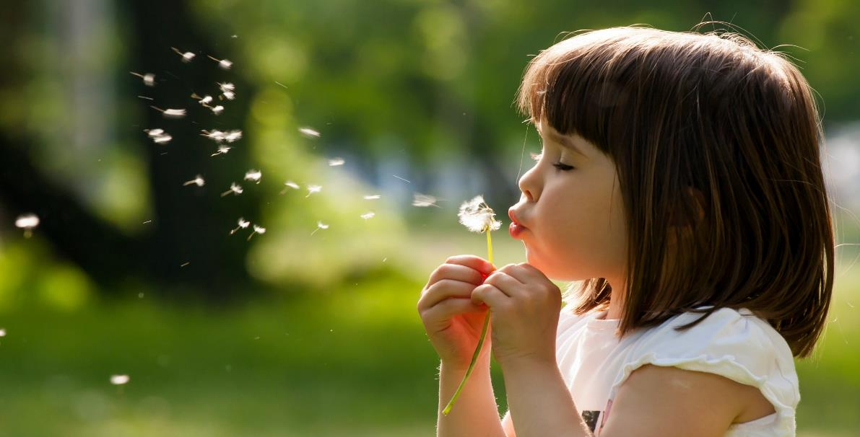
Enjoy your day!

