Slide 1

Unit 1: My Friends
Lesson 3.2
Page 17

Slide 2

WARM UP

Slide 3
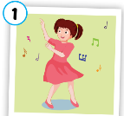
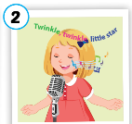
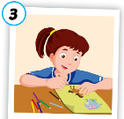
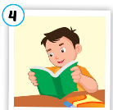
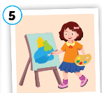
Lucky numbers!
A
1
2
3
4
5
$20
$30
$50
$30
$20
B
1
2
3
4
5
$30
$20
$30
$0
$50
C
1
2
3
4
5
$50
-$30
$20
-$10
$20
Notes:
Students say : 1A, 1B or 1C to open a picture.
After the picture is shown, ask students to say it and make sentences with “ Do your friends like…?” and answer.
Click the pictures to show the money behind.

Slide 4
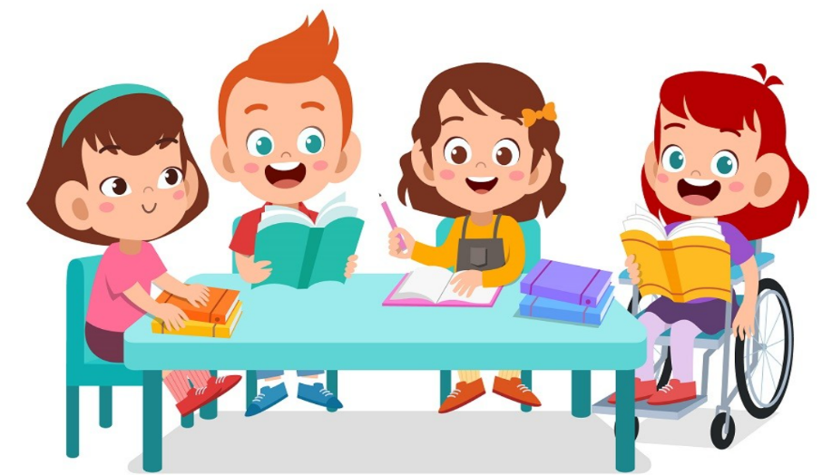
It’s time to learn …

Slide 5
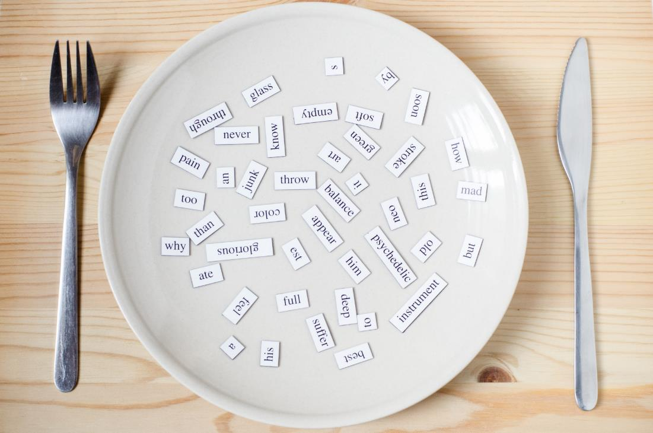
Phonics
/ŋ/ sound
singing
drawing
painting
reading
dancing

Slide 6
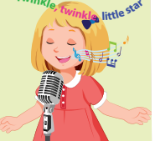
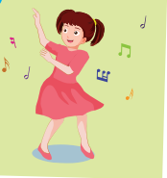





C
1. Listen and repeat.
singing
dancing
Click the speakers to listen. Click the light bulb to show the words.
Notes:
Click the speakers to listen.
Click the light bulb to show the words.
Get student to pay attention to highlighted “ing” which is /ŋ/ sound . Pronounce it correctly.

Slide 7











C
2. Listen and chant.
/ŋ/, /ŋ, /ŋ/,
/ŋ/, /ŋ, /ŋ/
singing, dancing,
/ŋ/, /ŋ, /ŋ/.
(x2)
Click the mic to listen.
Notes:
Click the mic to listen.
Get student to listen and repeat carefully.
Click to show the lyrics.

Slide 8

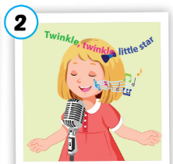



Activity 1
Look, complete and say.
danc___
sing___
draw___
read___
paint___
ing
ing
ing
ing
ing

Slide 9
Activity 2
Listen and repeat. Then draw lines.
1
singing
2
dancing
3
drawing
reading
4
painting
5
Click the hearts to listen. Click the hearts again to show answers
Notes:
Click the hearts to listen. Ask students to read along.
Click the hearts again to show answers.

Slide 10
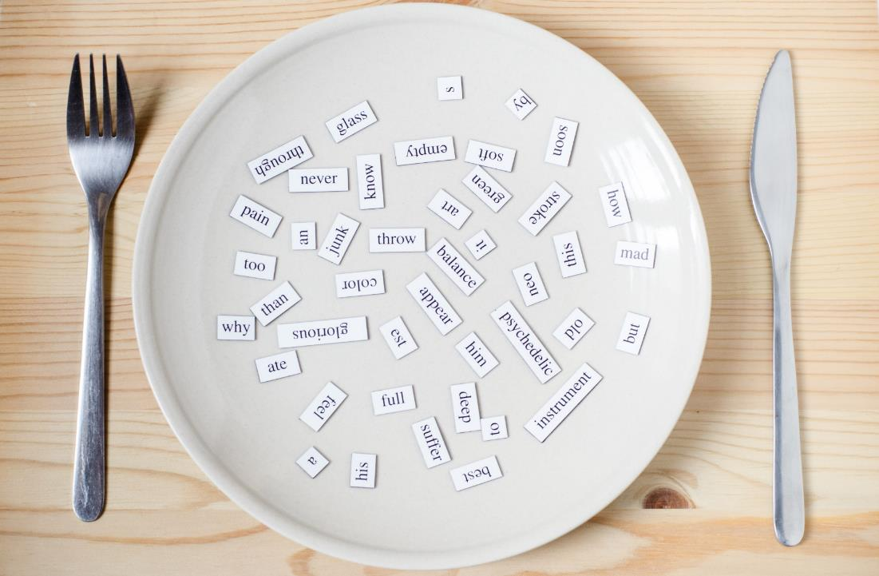
Listening
Do your friends like dancing?
Yes, they do.
Do your friends like singing?
No, they don’t.

Slide 11
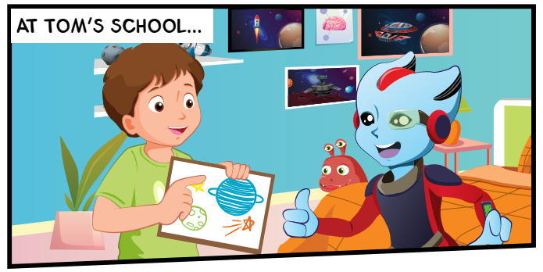
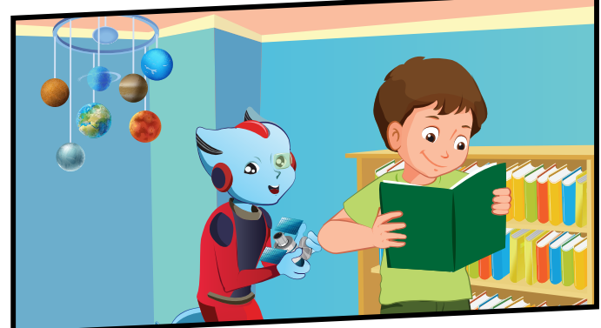
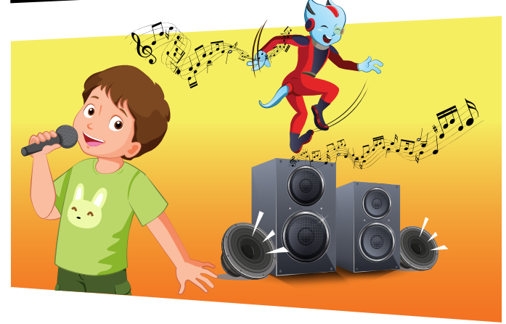
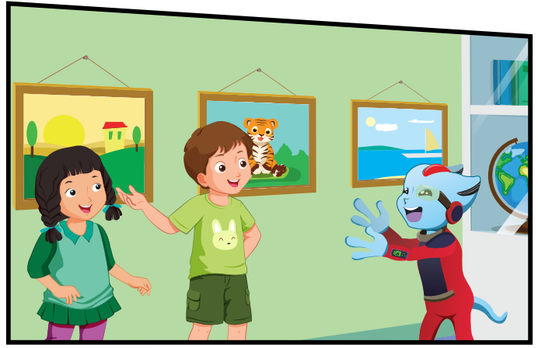
D
1. Look and listen.
drawing
reading
dancing
singing
Mai
Notes:
Ask:
Look at the picture and ask: What is in Tom’s hand? A picture.
What can you do with the picture? I can draw a picture.
Guess the word: Is it reading? Is it singing? Is it drawing?
The get students to listen and check. Do the same for the rest.
Click on the picture to listen.

Slide 12

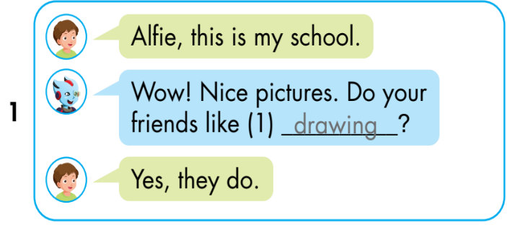
D
2. Listen and write.
Click on the picture to listen.
Notes:
Ask:
Look at the picture and ask: What is in Tom’s hand? A picture.
What can you do with the picture? I can draw a picture.
Guess the word: Is it reading? Is it singing? Is it drawing?
The get students to listen and check. Do the same for the rest.
Click on the picture to listen.

Slide 13

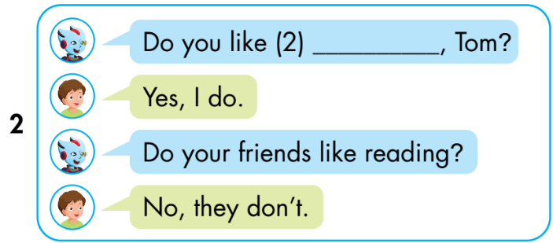
D
2. Listen and write.
reading
Notes:
Ask:
Look at the picture and ask: What is in Tom’s hand? A book.
What can you do with the picture? I can read.
Guess the word: Is it reading? Is it singing? Is it drawing?
The get students to listen and check. Do the same for the rest.
Click on the picture to listen.

Slide 14

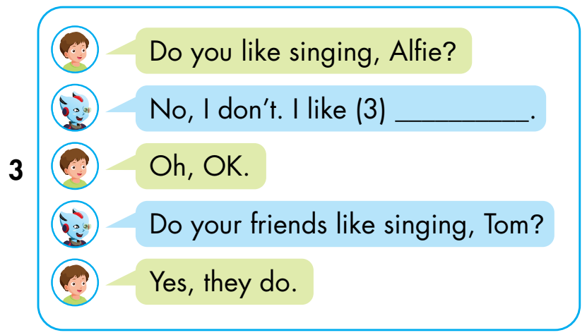
D
2. Listen and write.
dancing
Notes:
What’s Tom doing?

Slide 15

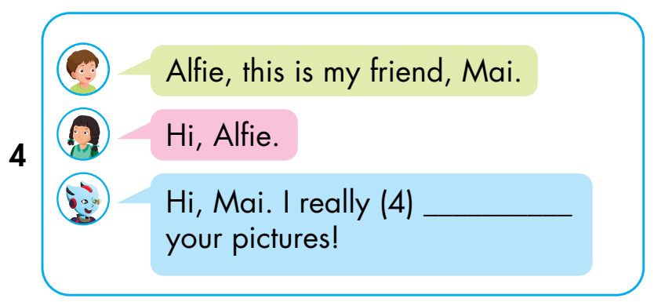
D
2. Listen and write.
like
Notes:
Who is the girl? Mai.
What can you see on the wall? Pictures.
What’s Alfie saying? Student’s own answers,

Slide 16

Practice

Slide 17
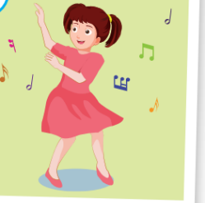
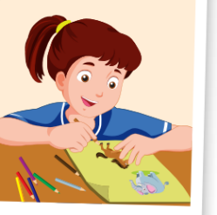
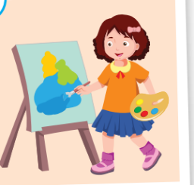
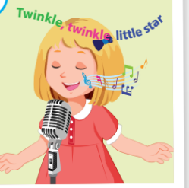
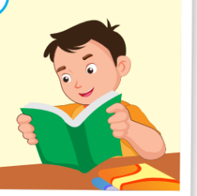
Activity 1
Can you catch it?
1
2
3
Do your friends like……………?
4
5
Yes, they do.
No, they don’t.
Notes:
Click the stars to show pictures quickly. Get students to pay attention and fill in the blank to ask question about the picture.

Slide 18
Activity 2
Look, read and choose the best answer.
Red: Do your friends like_ _ _ _ _ _ _?
Blue: Yes, they do.
a. singing b. dancing

Slide 19
Activity 2
Look, read and choose the best answer.
Red: Do your friends like _ _ _ _ _?
Blue: No, they don’t
a. painting b. drawing

Slide 20
Activity 2
Look, read and choose the best answer.
Red: Do your friends like _ _ _ _ _?
Blue: No, they don’t.
a. painting b. drawing

Slide 21
Activity 2
Look, read and choose the best answer.
Red: Do your friends like _ _ _ _ _?
Blue: Yes, they do.
a. singing b. reading

Slide 22
Activity 2
Look, read and choose the best answer.
Red: Do your friends like dacing?
Blue: _ _ _, they do.
a. Yes b. No

Slide 23
Activity 2
Look, read and choose the best answer.
Red: Do your friends like drawing?
Blue: _ _ , they don’t
a. Yes b. No

Slide 24
Activity 2
Look, read and choose the best answer.
Red: Do you friends like painting?
Blue: No,_ _ _ _ _.
a. they don’t b. they do

Slide 25
Activity 2
Look, read and choose the best answer.
Red: Do your friends like singing?
Blue: _ _ _ _ _ _ _ .
a. Yes, they do b. Yes, they don’t

Slide 26
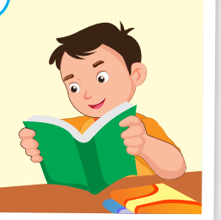
Activity 2
Look, read and choose the best answer.
Red: Do your friends like reading ?
Blue: _ _ _ _ _ _ .
a. No, they do b. No, they don’t

Slide 27

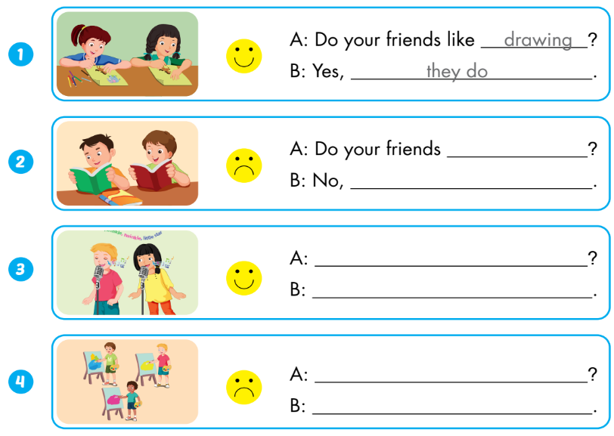
Extra Activity
WB p.13
like reading
they don’t
Do your friends like singing
Yes, they do.
Do your friends like painting
No, they don’t

Slide 28
Consolidation

Slide 29
What your friends like doing?
Hi, class. My name’s……. I’m here to tell you about my friends.
They are Alfie and Tom. They don’t like singing, but they like painting.
They are Sam and Nick. They like reading, but they don’t like drawing.
Notes:
Interview some friends and talk about them.

