Slide 1
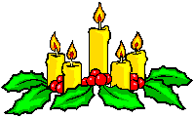
WELCOME TO OUR CLASS
Good morning Everybody

Slide 2
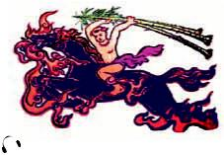
* WARM UP: CHATTING
* Look at the picture and answer the questions.
1. Who is Saint Giong?
2. What did he do for the country?
He is considered a mythical hero because he grew from3 year – old child into a giant overnight.
He defended the country from foreign invaders – the An.

Slide 3
Thursday, november 15th 2018
UNIT FIVE
FESTIVALS IN VIET NAM
Period 38
SKILLS 2

Slide 4
I. VOCABULARY
- Mythical (adj)
: (thuộc) thần thoại
- Commemorate (v)
: kỷ niệm
- Invader (n)
: kẻ xâm lược
- Defend (v)
: bảo vệ

Slide 5
Matching
1.mythical
a.kẻ xâm lược
2.commemorate
b.thần thoại
3.invander
c.kỷ niệm
4.defend
d.bảo vệ

Slide 6
II. LISTENING
1. Listen and circle the correct answer A,B, or C. (Ex. 2/p. 55)
1. The Giong Festival is held in ________ District, Ha Noi.
A. Dong Anh B. Soc Son C. Dong Da
2. This festival is held to commemorate Saint Giong who defeated ________.
A. the An B. the Ming C. the Mongols
3. The festival is held ________.
A. on the 6th day of the 4th lunar month
B. on the 12th day of the 4th lunar month
C. from the 6th to the 12th of the 4th lunar month

Slide 7
2. Listen to the talk again and write answers to the questions below.
(Ex. 3/p. 55)
1. How different is Saint Giong from other heroes in Viet Nam?
2. When do the preparations for the festival begin?
3. What kind of ceremony takes place after the procession?
4. What happens when night fall?
5. How important is this festival?
He is a mythical hero because he grew from3 year – old child into a giant overnight.
One month before the festival.
A religious ceremony.
There is a cheo performance.
This festival shows the love for our motherland and the preservation of our cultural heritage.

Slide 8
III. WRITING
1. Ask Ss to work in pairs. Discuss with your partner the festival in Viet Nam that you like best. Use the web below to take notes.
(Ex. 4/p. 55)
It’s held on _______
It’s held in _______
It worships _______
I LIKE
…………
FESTIVAL
It commemorates _______
The main activities are
___________
___________
___________
It’s impressive because _______
I like this festival because _______
I also like it because _______

Slide 9
Example
I like the Tet festival
It’s held in February (or the first lunar month)
In this festival, Vietnamese people worships their ancestors .The main activities are farewell ceremony for the Kitchen Gods (Ong Tao), New Year's Eve, the aura of the earth, giving away red envelopes (filled with lucky money) and making offers for the ancestors. I like it because it’s valuable time for every family to gather and enjoy a happy festival.

Slide 10
III. WRITING
1. Ask Ss to work in pairs. Discuss with your partner the festival in Viet Nam that you like best. Use the web below to take notes.
(Ex. 4/p. 55)
It’s held on _______
It’s held in _______
It worships _______
I LIKE
…………
FESTIVAL
It commemorates _______
The main activities are
___________
___________
___________
It’s impressive because _______
I like this festival because _______
I also like it because _______

Slide 11
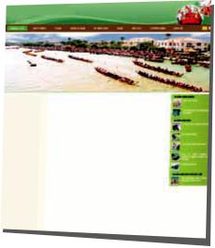
2. Now use the notes to write an article about this festival for the school website. Remember to add any necessary connectors below to make compound and complex sentences.
(Ex. 5/p. 55)
when while because
and but so
first then moreover

Slide 12
You can refer back to the reading passages in Skills 1 for useful language and ideas, and note some necessary expressions and language as well as connectors they may need on the board.

Slide 13
2. Now use the notes to write an article about this festival for the school website. Remember to add any necessary connectors below to make compound and complex sentences.
(Ex. 5/p. 55)
when while because
and but so
first then moreover

Slide 14
IV. HOMEwork
- Learn by heart new words.
- Complete the notes to write an article about this festival for the school website.
- Prepare LOOKING BACK AND PROJECT.

