Slide 1

WELCOME TO CLASS 8A2
Teacher – Vu Thu Thuy

Slide 2



PERIOD 94
UNIT 12: LIFE ON OTHER PLANETS
LESSON 1: GETTING STARTED

Slide 3

OBJECTIVES
-Students learn vocabulary related to life on other planets.
-Can read conversation.

Slide 4

LIFE ON OTHER PLANETS
- Can you tell me name of this planet where we are living?
How many planets in the solar system?
What planet in the solar system similar our Earth?

Slide 5
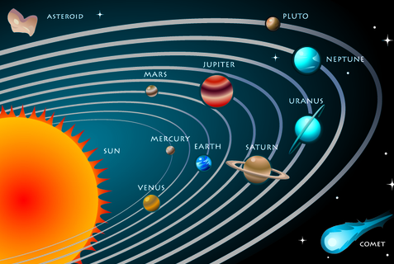
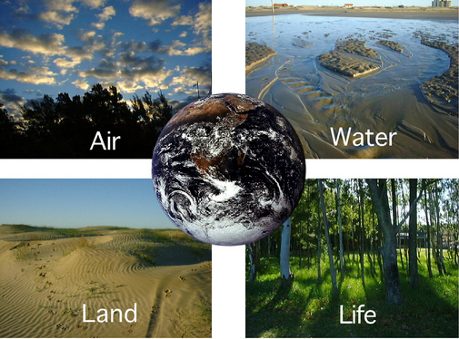
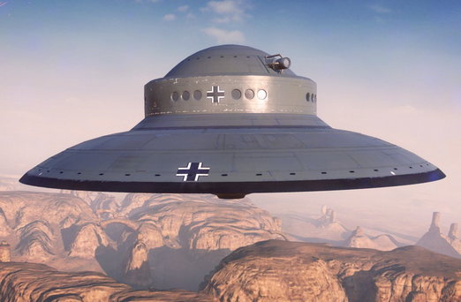
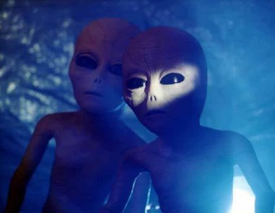
Solar system
Solar system
Earth
Unidentified Flying Object (UFO)
Aliens

Slide 6
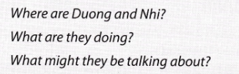
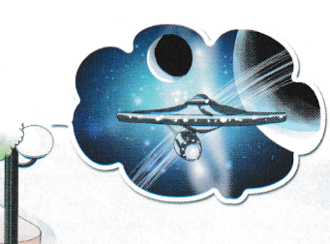
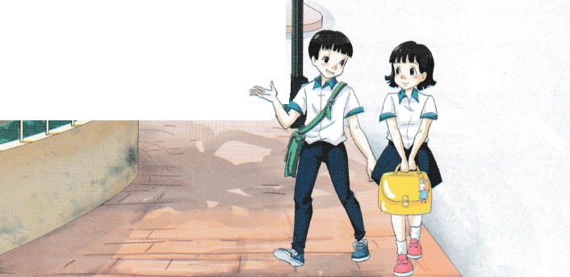
All Call
Student Demo

Slide 7

PERIOD 1st
UNIT 12: LIFE ON OTHER PLANETS
LESSON 1: GETTING STARTED

Slide 8


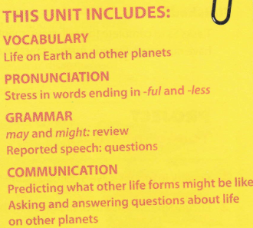

All Call
ABProgram + StartA + AV1
Student Demo

Slide 9


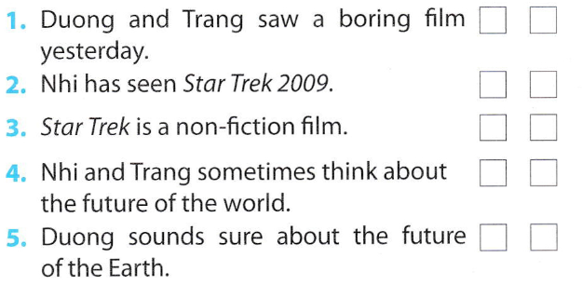
✓
✓
✓
✓
✓
All Call
Student Demo

Slide 10


James Kirk is the captain of the spaceship.
They went to Nibiru planet.
It happens in 2259.
It’s the name of the spaceship that the crew travels on.
He wants to destroy Earth.
All Call
Student Demo

Slide 11

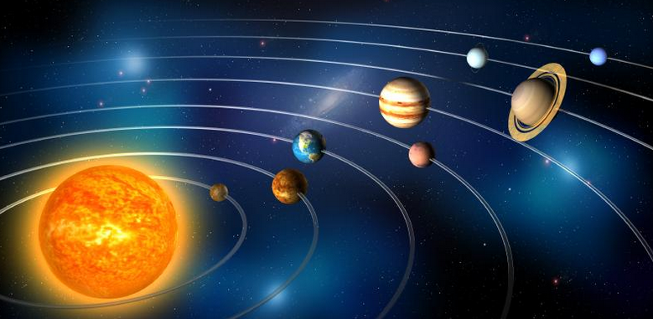
That’s funny, Trang also asked me what I thought would happen to Earth in the future.
I said I didn’t know but that Earth might be run by aliens!
All Call
Student Demo

Slide 12

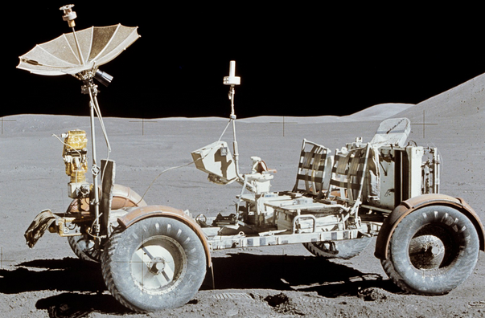
aliens space buggy galaxy planet
weight less solar system spaceship UFO
1.
Aliens
2.
Space buggy
All Call
ABProgram + StartA + AV1
Student Demo

Slide 13
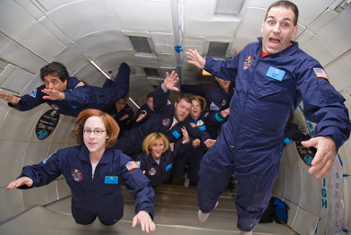
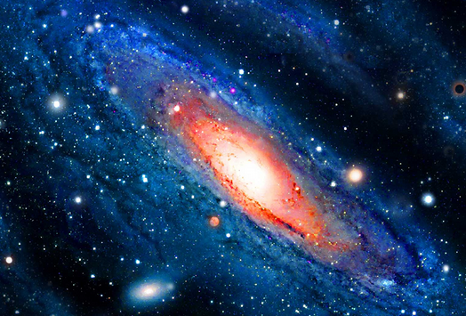
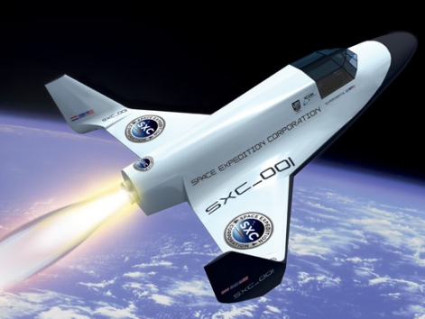
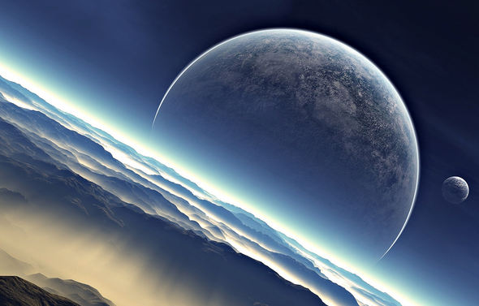
3.
UFO
4.
Weightless
5.
Galaxy
6.
Spaceship
7.
Planet
Solar system
8.
All Call
ABProgram + StartA + AV1
Student Demo

Slide 14
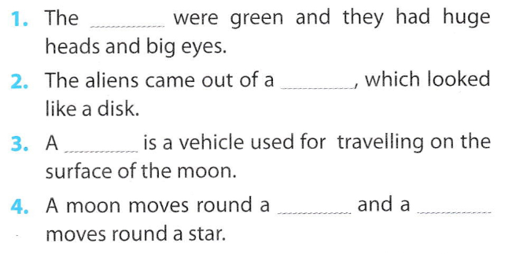
aliens space buggy galaxy planet
weight less solar system spaceship UFO
aliens
UFO
space buggy
planet planet
All Call
Student Demo

Slide 15
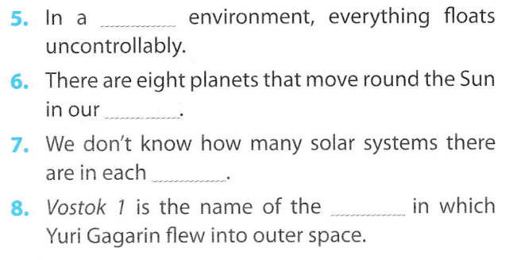
weightless
solar system
galaxy
spaceship
All Call
Student Demo

Slide 16


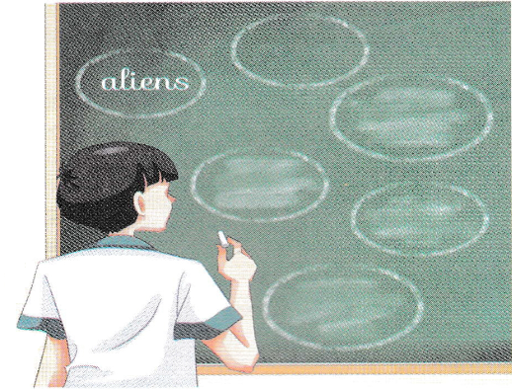
All Call
Student Demo

Slide 17
WRAP UP
-Students learn vocabulary related to life on other planets correctly.
-Can read conversation well.

Slide 18
Homework
Learn by heart the new words.
Speak with your friends
Prepare for the next..

Slide 19


