Slide 1
WELCOME TO OUR CLASS TODAY
Subject: English 8

Slide 2
* WARM UP*
chatting
+ How many people in your family?
+ What does your father usually do in his free time?
+ What about your mother?
………….

Slide 3
UNIT ONE
LEISURE ACTIVITIES
Period 5
Lesson 4 – communication (P11)

Slide 4
Unit 1: Leisure activities Period 5 – Lesson 4: Communication (P. 11)
I. New words:
1. be addicted to /əˈdɪktɪd/ (adj) : nghiện (thích) cái gì
2. be hooked on /hʊkt/ (adj) : yêu thích cái gì
3. netlingo/netˈlɪŋɡəʊ/(n):ngôn ngữ dùng để g/tiếp trên mạng
4. window shopping /ˈwɪndəʊ ˈʃɒpɪŋ/ (n): đi chơi ngắm đồ bày ở cửa hàng

Slide 5
Unit 1: Leisure activities Period 5 – Lesson 4: Communication (P. 11)
I. New words:
II. Reading:
This week 4Teen has opened a forum for friends around the world to share how they spend their free time.

Slide 6
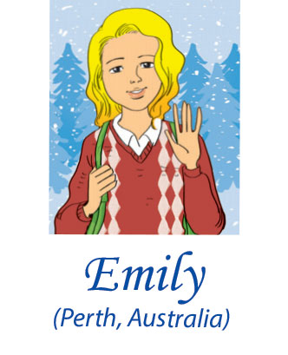
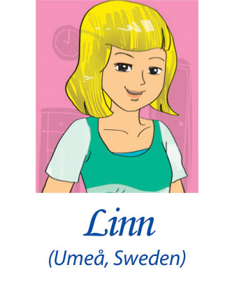
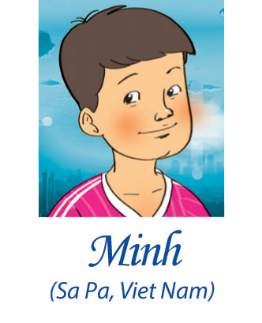
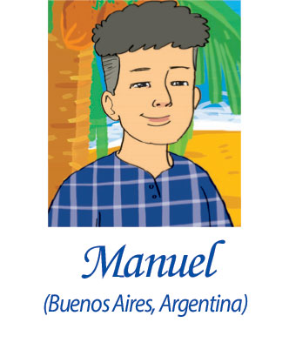
I love hanging out w/ my best friend Helen in my spare time, like going ‘window shopping’. J4F! We also work as volunteers for an animal protection organisation. 2moro we r going to a farm. posted Tue 3.20 pm
This may sound weird, but I adore cloud watching. Find an open space, lie on ur back, n’ look at the clouds. Use ur imagination. EZ! DYLI too? posted Wed 8.04 pm
This year my city is the European Capital of Culture, so lots goin’ on. At weekends my bro n’ I go 2 our city community centre where we dance, paint, and do drama. I’m hooked on drama! <3 it! posted Thu 6.26 pm
I like doing sports – I’m in my school’s football team. But what I mostly do in my free time is help my aunt. She has cooking classes 4 small groups of tourists. It’s WF 4 me! posted Fri 7.19 pm
I’ve been kind of addicted to the net. I just love sitting in front of my computer for hours! But now my mum has said it’s NUFF! I’ll start my judo class this weekend. It’s OK. WBU? posted Fri 8.45 pm

Slide 7
* Note: These abbreviations are informal language that is used on line and in texting message (Part 2. P11). .
2moro | tomorrow
4 | for
<3 | love
bro | brother
DYLI | Do you love it?
EZ | easy
J4F | just for fun
goin’ | going
n’ | and
NUFF | enough

Slide 8
* Table - fill (Part 3. P11).
Who? | What activity is mentioned? | What does he/ she think of it?
Emily

Slide 9
* Table - fill (Part 3. P11).
Who? | What activity is mentioned? | What does he/ she think of it?
Emily | hanging out with friends (window shopping) and working as a volunteer | She loves it.
Hang | cloud watching | She adores it. It’s easy.
Linn | going to community centre, painting, dancing, doing drama | She loves it.
Minh | playing football and helping his aunt in running cooking classes | He likes it. It’s fun.
Manuel | playing computer games doing judo | He’s addicted to it. It’s OK.

Slide 10
* Pair work (Part 4 p11).
Ss work with their partner and put the activities in 3 in order from the most interesting to the most boring. Then compare their ideas with other pairs.

Slide 11
Friday, September 6th, 2019 Unit 1: Leisure activities Period 4 – Lesson 3: A closer look 2 (P. 9, 10)
I. New words:
1. be addicted to /əˈdɪktɪd/ (adj) : nghiện (thích) cái gì
2. be hooked on /hʊkt/ (adj) : yêu thích cái gì
3. netlingo /netˈlɪŋɡəʊ/ (n) : ngôn ngữ dùng để g/ tiếp trên mạng
4. window shopping /ˈwɪndəʊ ˈʃɒpɪŋ/ (n): đi chơi ngắm đồ bày ở cửa hàng
II. Reading:
IIi. Homework:
- Do the exercises in the workbook: Ex C 1, 2 p. 6
- Prepare the new lesson: Unit 1: Lesson 5: Skills 1.

Slide 12
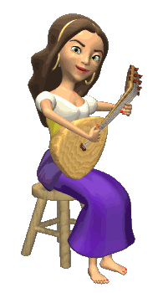
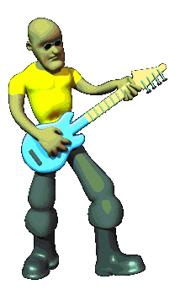
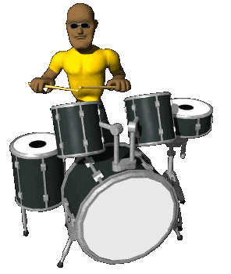
THANK YOU FOR ATTENTION!
GOOD BYE!
the end

