Slide 1
WELCOME TO OUR CLASS
Unit 1
Lesson 3: A closer look 2

Slide 2
I. Vocabulary
to pass down: truyền lại
to live on: sống nhờ vào
- to close down: dừng công việc
- to face up to:chấp nhận
to get on with: hòa thuận với
to turn down: từ chối, phản đối
to bring out : xuất bản
- to look through : đọc
- to keep up with : theo kịp ai/ cái gì

Slide 3
II. Grammar: 1. Complex sentence: câu phức(Review)
When people talk about traditional paintings, they think of Dong Ho village.
Dependent clause of time: mệnh đề phụ chỉ thời gian
Types of dependent clauses: Các loại mệnh đề phụ
a. Dependent clause of time: mệnh đề phụ chỉ thời gian
when, while, before, after, as soon as, etc
Ex: When I have free time, I often go to my friends’ houses.
DT
b. Dependent clause of purpose: ( chỉ mục đích) so that, in order that…
Ex: The artisan moulded the clay so that he could make a mask.
DP
c. Dependent clause of reason: ( chỉ lí do) because, since
Ex: Because it was raining, they cancelled the trip to Trang An.
DR
d. Dependent clause of concession: Chỉ nhượng bộ / tương phản
although, though, even though
Ex: Although she was tired, she finished knitting the scarf for her dad.
DC

Slide 4
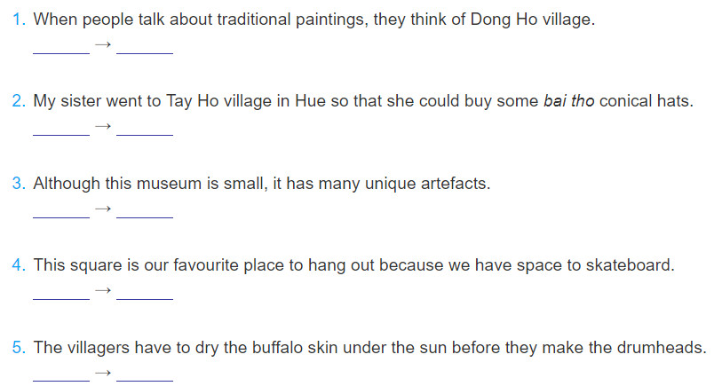
Ex 1.Underline the dependent clause in each sentence below. Say whether it is a dependent clause of concession (DC), of purpose (DP), of reason (DR), or of time (DT).
DT
DP
DC
DR
DT

Slide 5
Ex2. Make a complex sentence from each pair of sentences. Use the subordinator provided and make any necessary changes.
1. The villagers are trying to learn English.They can communicate with foreign customer.( in order that)
The villagers are trying to learn English in order that they can communicate with foreign customers.
2. We ate lunch. Then we went to Non Nuoc marble village to buy some souvenirs . (after)
After we had eaten lunch, we went to Non Nuoc marble village to buy some souvenirs.
3. This hand-embroidered picture was expensive. We bought it . (even though)
Even though this hand-embroidered picture was expensive, we bought it.

Slide 6
4. This department store is an attraction in my city. The products are of good quality. (because)
This department store is an attraction in my city because the products are of good quality.
5. This is called a Chuong conical hat. It was made in Chuong village. (since)
This is called a Chuong conical hat since it was made in Chuong village.

Slide 7
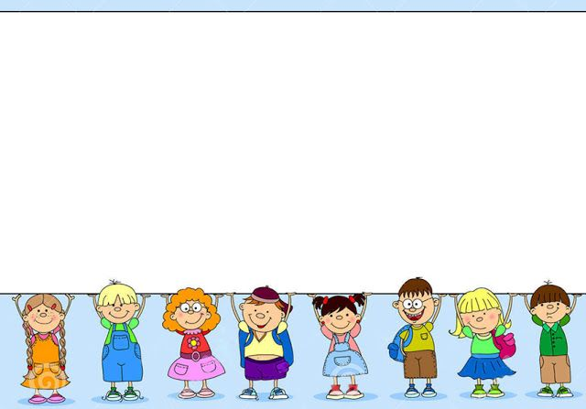
2.PHRASAL VERBS

Slide 8
Mi:
Wow! When did your grandparents set up this workshop?
Phong:
My great-grandparents started it, not my grandparents. Then my grandparents took over the business.
set up : start something (a business, an organization, etc.)
take over : take control of something (a business, an organization, etc.)

Slide 9
*. Phrasal verb là sự kết hợp giữa một động từ và một hoặc hai tiểu từ (particles) như: back, in, on, off, through, up, etc. Khi một phụ ngữ được thêm vào động từ, cụm động từ thường có một ý nghĩa đặc biệt.
Example: get up (get out of bed): thức dậy
find out (get information): tìm thấy bring out (publish/launch): xuất bản look through (read): đọc
Note: A verb can go with two particles. Example:
keep up with (stay equal with): theo kịp
look forward to (be thinking with pleasure about something to come): mong đợi run out of (have no more of): sử dụng hết

Slide 10
*. Form:
:
Verb + Particle (s) = Phrasal verb
Adverb: over, up, down, into, away...
Go:
Go away, go on, go over, go off, go down with, go in for ...
Preposition:
on, in, at, after, off, with, about...

Slide 11
Ex 4. Match the phrasal verbs in A with
1. pass down | a. stop doing business
2. live on | b. have a friendly relationship with somebody
3. deal with | c. transfer from one generation to the next
4. close down | d. reject or refuse something
5. face up to | e. return
6. get on with | f. take action to solve a problem
7. come back | g. have enough money to live
8. turn down | h. accept, deal with

Slide 12
Ex 6. Complete the second sentence so that it has a similar meaning to the ﬁrst sentence, using the word given.
1. Where did you get the information about Disneyland Resort?
find
Where ________________________________________?
2. What time did you get out of bed this morning?
up
When _________________________________________?
3. I’ll read this leaflet to see what activities are organised at this attraction.
look
I’ll _____________________________________________.
4. They’re going to publish a guidebook to different beauty spots in Viet Nam.
out
They’re ________________________________________.
5. I’m thinking with pleasure about the weekend!
forward
I’m _____________________________________________
did you find out about Disneyland Resort?
did you get up this morning?
look through this leaflet to see what activities are……..
going to bring out a guidebook to different beauty spots in Viet Nam
looking forward to the weekend!

Slide 13
Homework
- Complete the exercises
- Do B (Workbook)
- Prepare unit 1- Communication.

