Slide 1
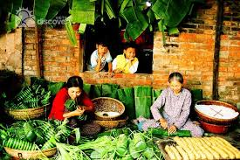
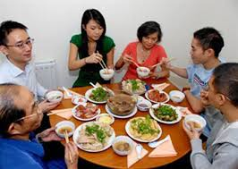
+ WARM UP:
TRADITIONS
CUSTOMS
CUSTOMS and TRADITIONS

Slide 2
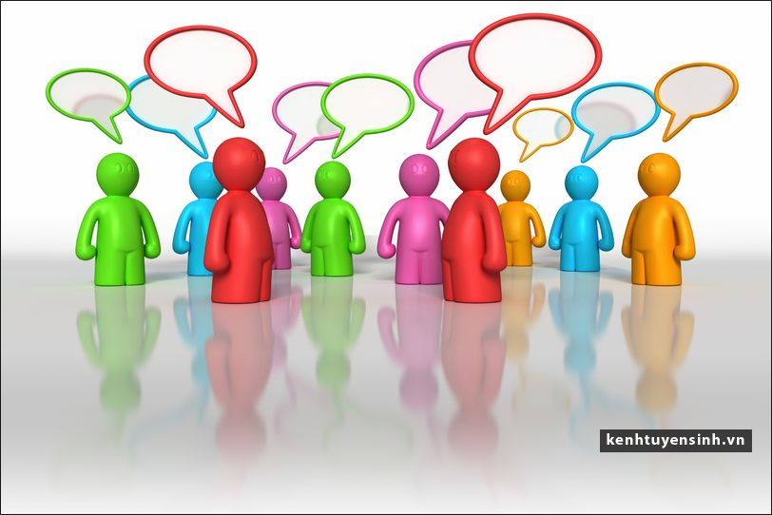
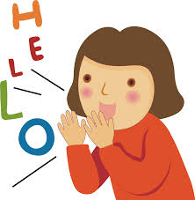
Welcome to English Class7
Unit 4: OUR CUSTOMS AND TRADITIONS
Period 26: Getting started
Let’s learn English !

Slide 3
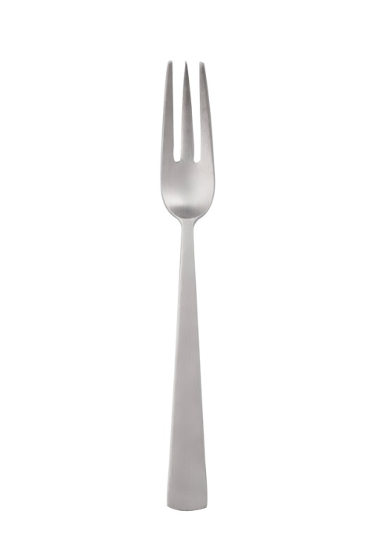
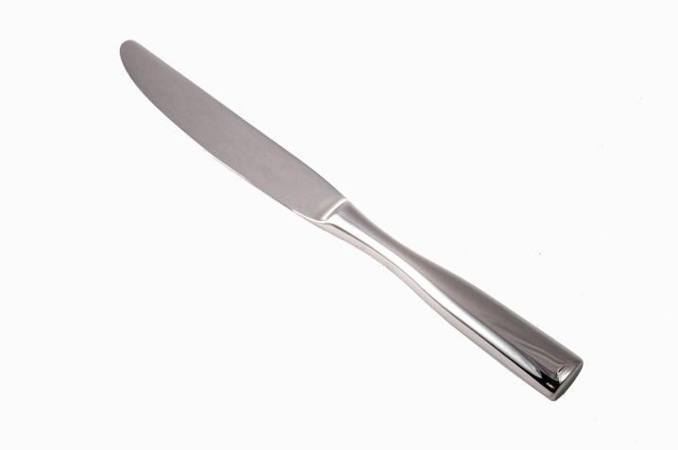
Unit 4: OUR CUSTOMS AND TRADITIONS – Getting started
+ Vocabulary:
- Custom (n):/ˈkʌs.təm/ văn hóa
- Tradition (n) /trəˈdiʃən/ truyền thống
- accept (v) /əkˈsept/
= agree (v) đồng ý, chấp nhận
- pass down (v)
truyền qua
- generations (n) /ˌdʒen·əˈreɪ·ʃən/
thế hệ
- spot on
= totally correct: hoàn toàn chính xác
- manner (n) /ˈmæn.ər/
cách thức, phép tắc
Table manner (n) phép tắc ăn uống
Knife (n) /naɪf/ dao
- Fork (n) /fɔːk/ dĩa

Slide 4
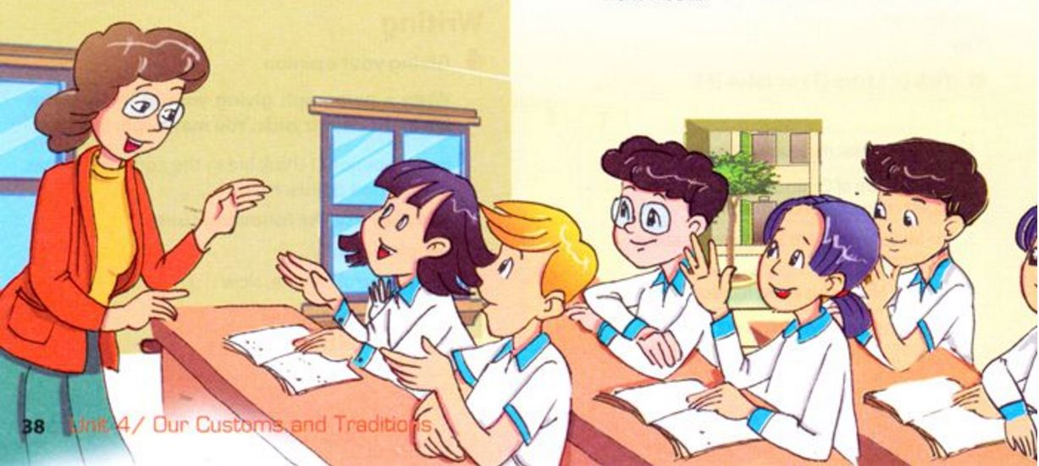

Slide 5
A lesson on customs and traditions
Teacher: Today we’re going to learn about customs and traditions. Do you think they’re the same?
Mi: I think they’re different, but it’s hard to explain how.
Nick: In my opinion, a custom is something that has become an accepted way of doing things. And a tradition is something we do that is special and is passed down through the generations.
Teacher: Yes, spot on! Give me an example of a custom.
Mai: My family has this custom of eating dinner at 7 p.m. sharp.
Teacher: Really?
Mai: Yes, we have to be at the dinner table on time.
Teacher: That’s interesting! How about a tradition, Phong?
Phong: We have a family tradition of visiting the pagoda on the first day of every lunar month.
Nick: You’re kidding!
Phong: No, no. We’ve followed this tradition for generations.
Teacher: You’ve mentioned family, but what about social customs and traditions, Nick?
Nick: Well, in the UK there are lots of customs for table manners. For example, we have to use a knife and fork at dinner. Then, there’s a British tradition of having afternoon tea at 4 p.m.
Teacher: Sounds lovely! Now, for homework, you should find information about a custom or tradition. You’re doing mini presentations next week...

Slide 6
Unit 4: OUR CUSTOMS AND TRADITIONS – Getting started
1. Listen and read:
a . Find a word/ phrase that means:
1. Agreed
2. grandparents, parents, and children
3. totally correct
4. exactly on time
5. relating to human society
6. a polite way of eating at the dinner table
1.accepted
2.social
3.table manners
4.generations
5.spot on
6.sharp

Slide 7
b. Tick (✔) true (T) or false (F).
 | T | F
1. Nick’s explanation of customs and traditions is correct.
2. Only families have customs and traditions.
3. In the UK there’s a tradition of having afternoon tea.
4. In the UK there is no accepted way of behaving at the dinner table.
✔
✔
✔
✔

Slide 8
c. Choose the best answer .
1. Mai’s family custom is________at 7 p.m. sharp.
A. eating dinner B. eating lunch C. eating breakfast
2. When Phong talks about one of his family traditions Nick feels ____. A. angry B. surprised C. boring
The similarity between a custom and a tradition both refer to doing something that_____________ .
A. develops on time B. undevelops C. develops over time
4. The difference between a custom and a tradition is: A custom is something______ . A tradition is something _______ and is passed down
through the generations
A. accepted- special B. special- accepted C. specially- accept
The students should find______ about a custom or tradition for homework.
A. looks B. lesson C. information

Slide 9
Unit 4: OUR CUSTOMS AND TRADITIONS – Getting started
d. Find these sentences in the conversation and fill in the missing words.
have to
1. We .................. be at the dinner table on time.
2. You .............. find information about a custom or tradition.
should
What do you think these sentences mean?
have to
Express obligation/ necessity
should
Giving advice

Slide 10
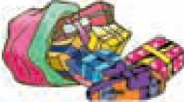
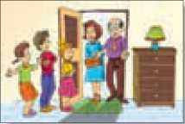
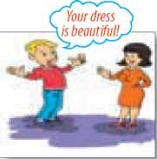
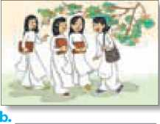
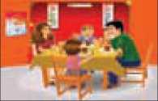
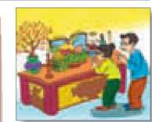
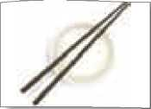
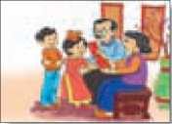
Unit 4: OUR CUSTOMS AND TRADITIONS – Getting started
.
2 a. Match the pictures with the customs and traditions in the box.
1. smiling to accept a compliment
2.worshipping ancestors
3. wrapping gifts in colourful paper
4. having lunch together on the second day of Tet
5. placing the chopsticks on top of the rice bowl when finishing a meal
6. children in the family standing in a row to greet guests
7.wearing aodai on special occassions
8. giving children lucky money at Tet
c
c
c
t
t
c/t
c
c/t

Slide 11
Unit 4: OUR CUSTOMS AND TRADITIONS – Getting started
* Homework:
- Learn vocabulary by heart and rewrite them in sentences.
- Redo the exercise in your notebook.
- Prepare for a closer look 1

