Slide 2

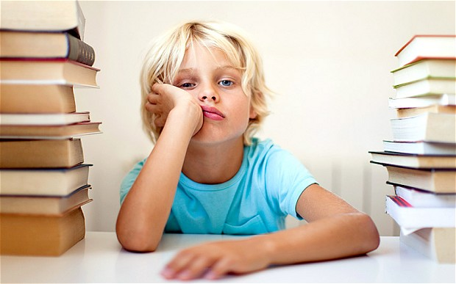
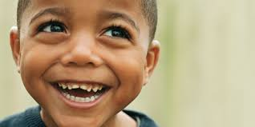
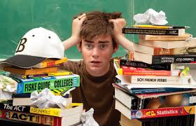
Look at these pictures and write down

Slide 4
Period 16
UNIT 3: TEEN STRESS AND PRESSURE
Lesson 1: Getting started

Slide 5
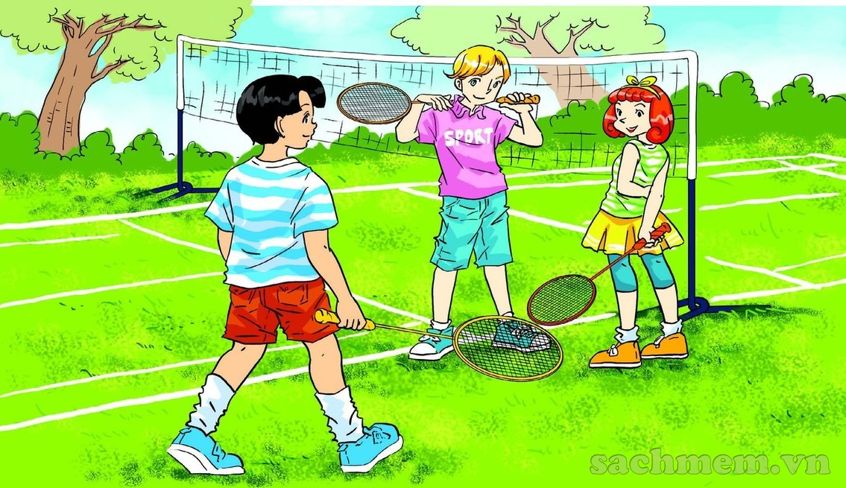


Slide 6
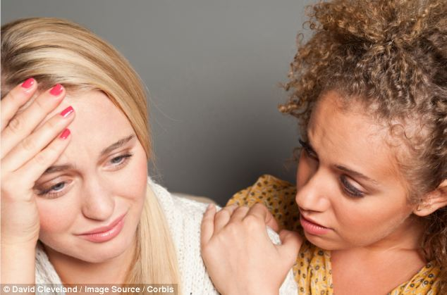

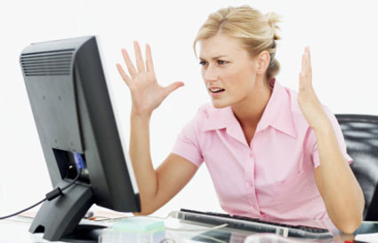

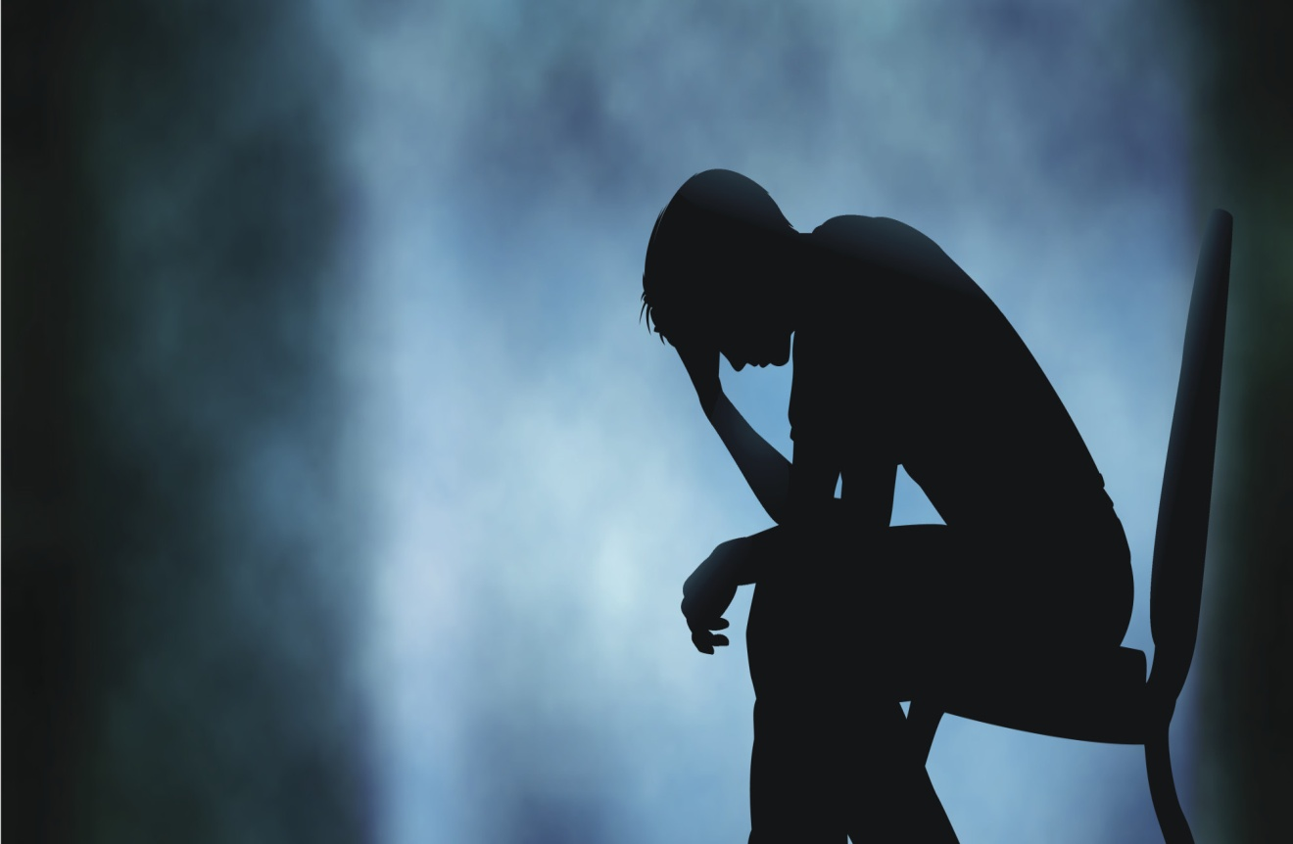

New words
stress(n)
The same meaning with tense
Pressure (n)
graduate(v)
Depressed (a)
frustrated(a)
empathise(v)
Confident ( a)

Slide 7
1. to go to bed early
2. to be relaxed
3. bad exam results
4. to make someone happy
5. to work continuously
6. to have no plans
to stay up late
to be stressed /
to be stressed out
good grades
to disappoint someone
to take a break
to be fully booked

Slide 8
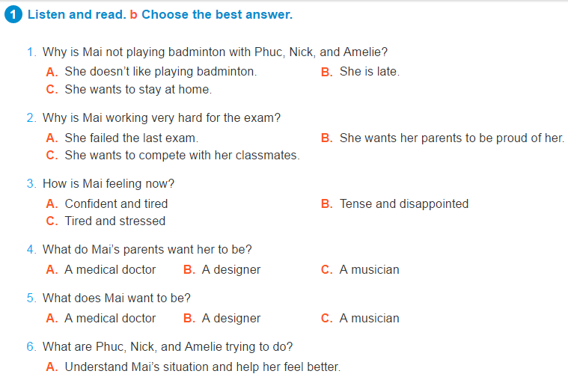

Slide 9
10
9
8
7
6
5
4
3
2
1
0
CHOOSE THE BEST ANSWER
1. Why is Mai not playing badminton with Phuc, Nick and Amelie?
⬧
a
She doesn’t like playing badminton.
b
She is late
K
c
She wants to stay at home
Notes:
9

Slide 10
10
9
8
7
6
5
4
3
2
1
0
CHOOSE THE BEST ANSWER
2. Why is Mai working very hard for the exam?
⬧
a
She failed the last exam
b
She wants her parents to be proud of her
K
c
She wants to compete with her classmates
Notes:
10

Slide 11
10
9
8
7
6
5
4
3
2
1
0
CHOOSE THE BEST ANSWER
3. How is Mai feeling now?
⬧
a
Confident and tired
b
Tense and disappointed
K
c
Tired and stressed
Notes:
11

Slide 12
10
9
8
7
6
5
4
3
2
1
0
CHOOSE THE BEST ANSWER
4. What do Mai’s parents want her to be ?
⬧
a
A medical doctor
K
b
A designer
c
A musician
Notes:
12

Slide 13
10
9
8
7
6
5
4
3
2
1
0
CHOOSE THE BEST ANSWER
5. What does Mai want to be?
⬧
a
A medical doctor
b
A designer
K
c
A musician
Notes:
13

Slide 14
CHOOSE THE BEST ANSWER
10
9
8
7
6
5
4
3
2
1
0
6. What are Phuc, Nick, and Amelie trying
to do?
⬧
Understand Mai’s situation and help
her feel better
a
K
b
Make Mai feel left out.
c
Find somebody else to replace Mai for
badminton.
Notes:
14

Slide 15
Amelie wishes her parents could put themselves in her situation to better understand her

Slide 16


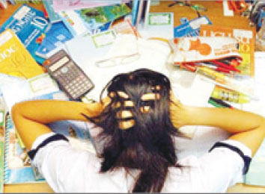
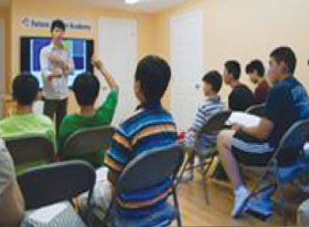
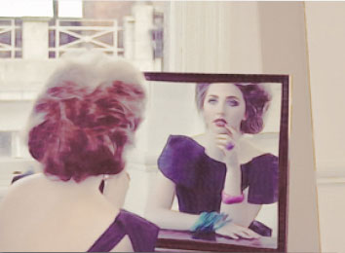
2.Fill the gaps with the words in the box . In some cases more than one word may be suitable
tense frustrated delighted confident relaxed worried depressed calm stressed
1. Thu had been studying very hard for the exam, but she still felt………… ……………… . . Now that she has done well in the exam she is feeling much more……………….…
worried/tense/stressed
relaxed/ confident
2. My mother is a strong person. She stays………….. even in the worst situations.
calm
3. Linh is feeling a bit………….. …………………about her
study. She’s failed the exam once again!
depressed/ frustrated
4. I think taking a speech class is a good idea if you want to be more……………………
relaxed/ confident/ calm
delighted/ confident
5. Emma is feeling so……………………. with her fashionable new hairstyle.
worried/ frustrated
6. Phuc, Nick, and Amelie feel……… ………………. They want to help Mai but don’t know what they can do for her.

Slide 17
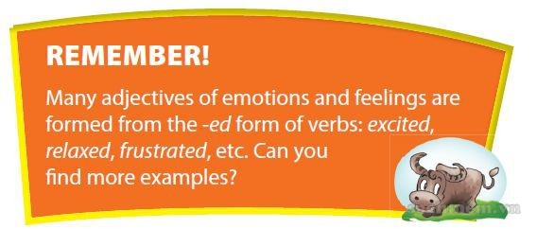

Slide 18

give advice to someone
encourage someone
encourage someone
empathise with someone
empathise with someone
assure someone
1. ‘Go on! I know you can do it!’
2. ‘If I were you, I would (get some sleep).’
3. ‘You must have been really disappointed.’
4. ‘Stay calm. Everything will be alright.’
5. ‘I understand how you feel.’
6. ‘Well done! You did a really great job!’

Slide 20
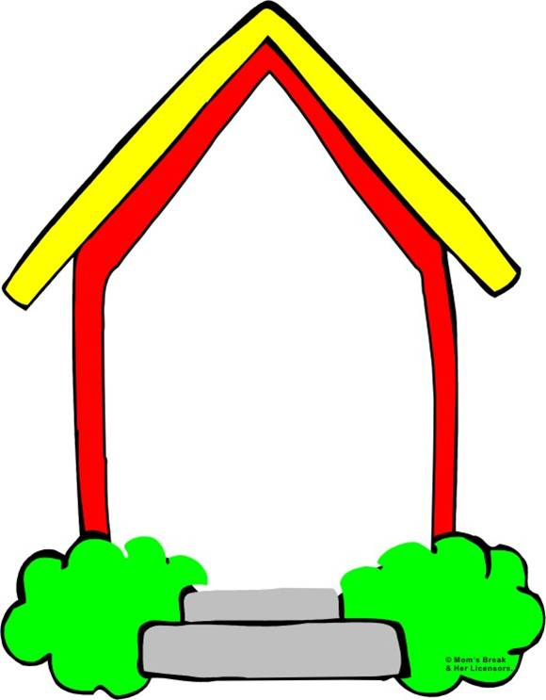
III. Homework.
- Learn new words by heart.
- Practice the conversation.
Do A1,2- workbook.
- Prepare Unit 3 : A closer look 1

Slide 21

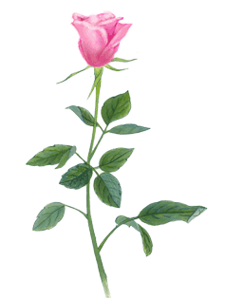
THANK YOU FOR ATTENTION!
the end
GOOD BYE!

