Slide 1
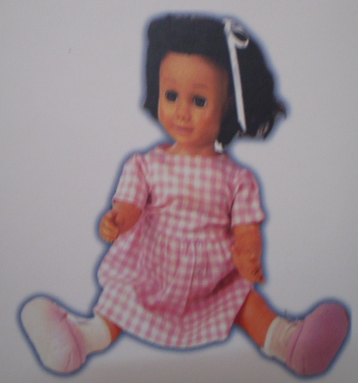
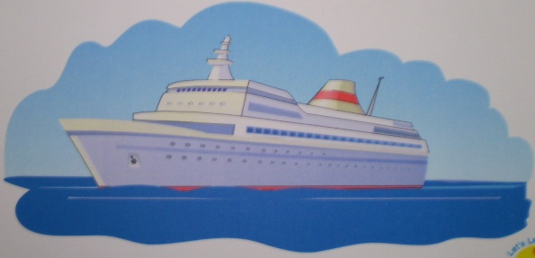
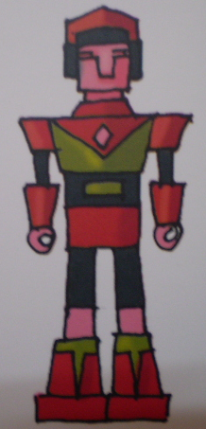
English
Our toys (Setion A)
Unit 12:

Slide 2
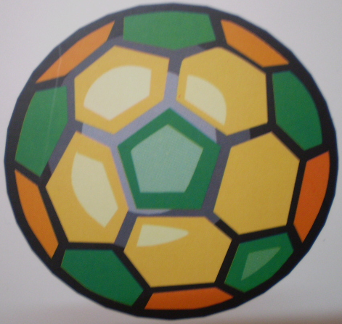
English
Unit 12: Our toys (Setion A)
1. Look, listen and repeat:
Vocabulary:
toy:
new:
robot:
nice:
doll:
ball:
ship:
đồ chơi
mới
người máy
đẹp
búp bê
quả bóng
chiếc tà

Slide 3
English
Unit 12: Our toys (Setion A)
1. Look, listen and repeat:
Nam: That is my new robot.
Alan: It’s very nice.
Nam: And my sister has two new dolls.
Alan: Oh, they’re nice too.

Slide 4
English
Unit 12: Our toys (Setion A)
1. Look, listen and repeat:
Training:
toy
new
robot
nice
doll
ball
ship

Slide 5
English
Unit 12: Our toys (Setion A)
2. Look and say:
Alan has five balls.
Li Li has three dolls.

Slide 6
English
Unit 12: Our toys (Setion A)
3. Let’s talk:
ball
He has a ……………
She has a ………….
dog

Slide 7
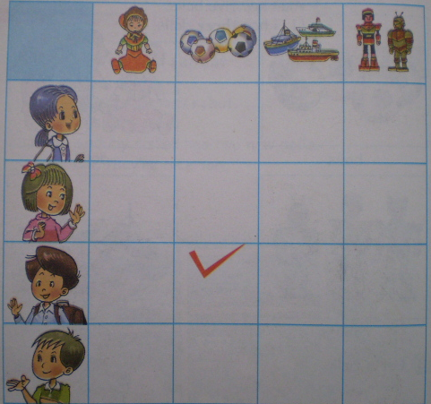
English
Unit 12: Our toys (Setion A)
4. Listen and check:
✓
✓
✓

Slide 8
English
Unit 12: Our toys (Setion A)
5. Say it right:
balls
dolls
pets
robots
she
ship

Slide 9
English
Unit 12: Our toys (Setion A)
6. Let’s write:
1. I have …………………………
2. She has …………………………
3. He has …………………………
Ex: I have a doll.

Slide 10
English
Unit 12: Our toys (Setion A)
7. Let’s play:
Kim’s Game

