Slide 1


Welcome to class 3B
Đức Giang Primary School
Teacher: Do Thi Hoa

Slide 2
Unit 6: stand up?
Lesson 3
Friday, November 6th 2021.

Slide 3

I. Warm-up:
Game: Who is faster?

Slide 4

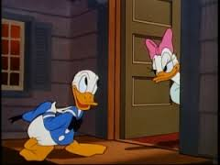
come in
May I ...................?

Slide 5

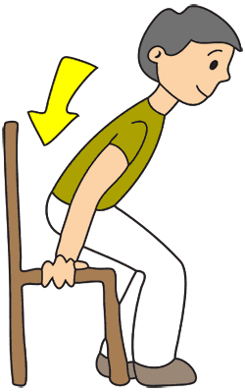
Sit down
.................,please!

Slide 6

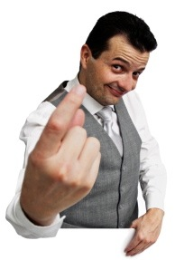
Come here
........................,please!

Slide 7

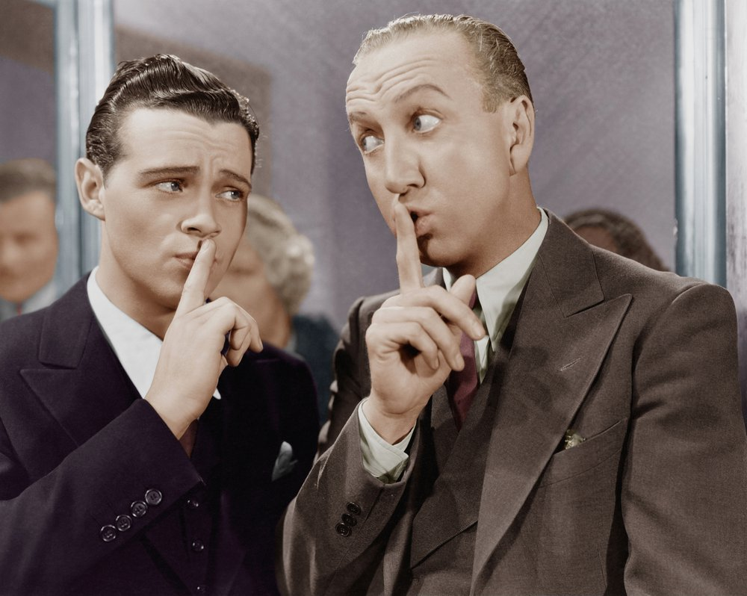
Don’t talk
....................,please!

Slide 8


come in
sit down
come here
don’t talk

Slide 9

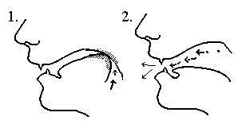
II.Listen and repeat:
c
come
May I come in?
/k/

Slide 10
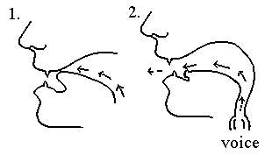
II.Listen and repeat:
d
down
May I sit down?
/d/

Slide 11
II.Listen and repeat:
c come May I come in?
/k/
d down May I sit down?
/d/

Slide 12

III. Listen and write:
come
May I _________ in?
2. Sit _________,please.
down

Slide 13

Game: Guess What?
M / I / C / I / A/ S/ D?
May I come in and sit down?

Slide 14
Game: Guess What?
Y / Y / C
Yes, you can.

Slide 15
Game: Guess What?
C / I, / S / D / A / S.
Come in, sit down and study.

Slide 16
Game: Guess What?
O / Y / B / A / R / A.
Open your book and read aloud.

Slide 17
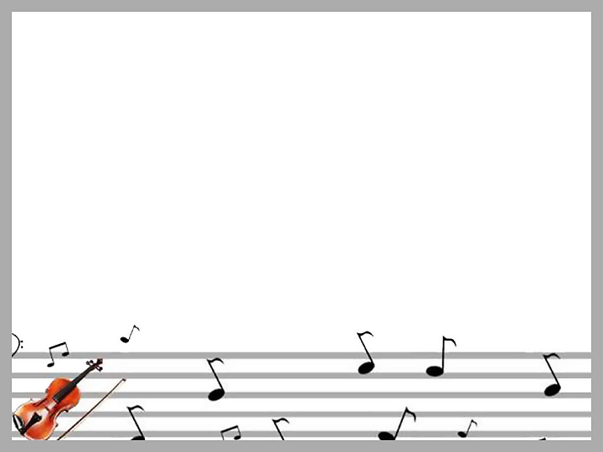
IV. Let’s sing:
Hello, hello, Miss Minh Hien.
May I come in and sit down?
Hello, hello. Yes, you can.
Come in, sit down and study.
Open your book and read aloud:
A B C D E F G!
Come in and sit down

Slide 18


*Homework:
* Luyện phát âm các âm của letter c và d
* Học thuộc lòng bài hát.
* Làm bài tập đầy đủ trong sách bài tập.

