Slide 1
Listening

Slide 2
Pre-Listening
Look at the pictures and answer these questions.

Slide 3
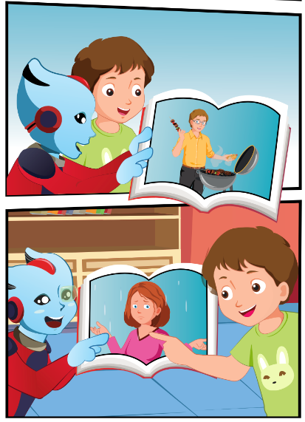
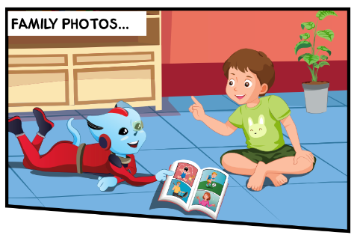
Who are the people in the photos?
What photos do they look at?
Who can you see?
3.
1.
4.
2.

Slide 4
While-Listening
3.
1.
4.
2.

Slide 5
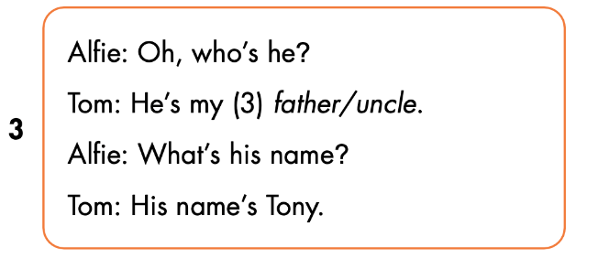
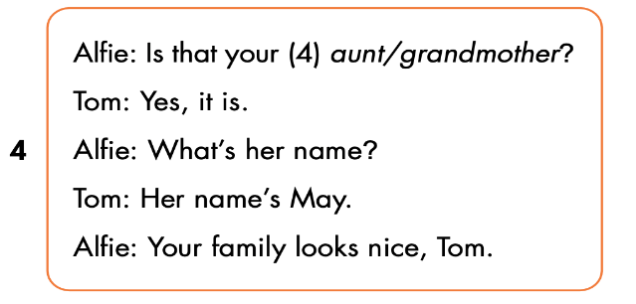

Slide 6
Let’s check!

Slide 9
Lesson 3
Stay positive and have a nice day!

