Slide 1

Unit 1: MY FRIENDS
Lesson 4.1
Page 19

Slide 2
Lesson Outline
Warm-up
Vocabulary
Structure
Consolidation
Wrap-up

Slide 3
Objectives
By the end of this lesson, ﻿students will be able to use polite greetings.
Vocabulary: hi, good, great
Sentence patterns:
1. How are you?
=> I’m good.
2. It’s nice to meet you.
=> It’s nice to meet you, too.
﻿3. Thank you.
=> You're welcome.

Slide 4

WARM UP

Slide 5
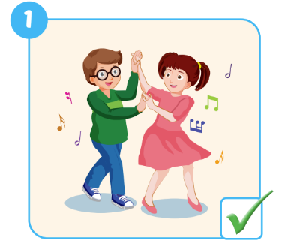
Look and read. Then write the correct words.
dancing
1. Do your friends like ……………….?
Yes, they do.
Notes:
Divide class into 2 groups. Make 2 lines
Show the picture and the structure with the missing words.
Ask ss write the words letter by letter in turn. 1st st writes ”D”, next st writes ”A” till they finish the word. When finishing the word, st needs to slap the board
Ask ss look at the tick/cross on the picture. Ask they say out loud the answer
Next round, the answer also has the missing words.

Slide 6
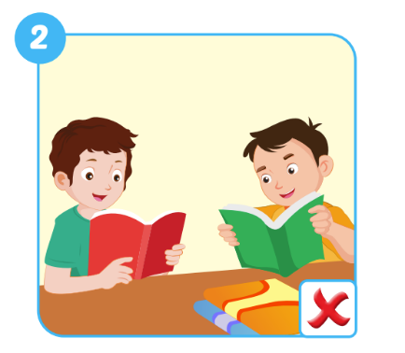
Look and read. Then write the correct words.
like reading
2. Do your friends …………… ……………….?
No
…….. , they don’t.
Notes:
Divide class into 2 groups. Make 2 lines
Show the picture and the structure with the missing words.
Ask ss write the words letter by letter in turn. 1st st writes ”D”, next st writes ”A” till they finish the word. When finishing the worss, st needs to slap the board
Ask ss look at the tick/cross on the picture. Ask they say out loud the answer
Next round, the answer also has the missing words.

Slide 7
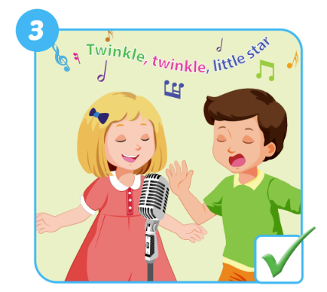
Look and read. Then write the correct words.
friends like singing
3. Do your …………… …………… ……………….?
they do
Yes , ………… ……… .
Notes:
Divide class into 2 groups. Make 2 lines
Show the picture and the structure with the missing words.
Ask ss write the words letter by letter in turn. 1st st writes ”D”, next st writes ”A” till they finish the word. When finishing the worss, st needs to slap the board
Ask ss look at the tick/cross on the picture. Ask they say out loud the answer
Next round, the answer also has the missing words.

Slide 8
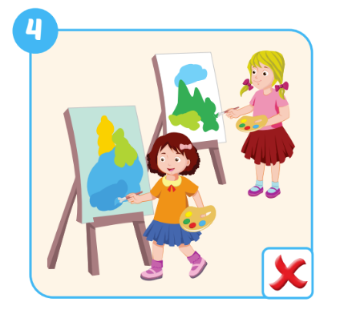
Look and read. Then write the correct words.
your friends like paiting
4. Do ………….. ………….. …………… ……………….?
No they don’t
….. , ………. .……. .
Notes:
Divide class into 2 groups. Make 2 lines
Show the picture and the structure with the missing words.
Ask ss write the words letter by letter in turn. 1st st writes ”D”, next st writes ”A” till they finish the word. When finishing the worss, st needs to slap the board
Ask ss look at the tick/cross on the picture. Ask they say out loud the answer
Next round, the answer also has the missing words.

Slide 9
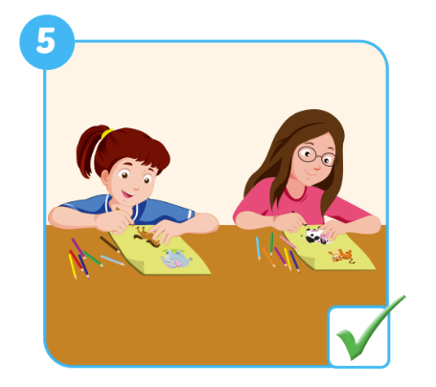
Look and read. Then write the correct words.
Do your friends like drawing
5. ………. ………….. ………….. …………… ……………….?
Yes they do
….. , ………. .……. .
Notes:
Divide class into 2 groups. Make 2 lines
Show the picture and the structure with the missing words.
Ask ss write the words letter by letter in turn. 1st st writes ”D”, next st writes ”A” till they finish the word. When finishing the worss, st needs to slap the board
Ask ss look at the tick/cross on the picture. Ask they say out loud the answer
Next round, the answer also has the missing words.

Slide 10

It’s time to learn …

Slide 11
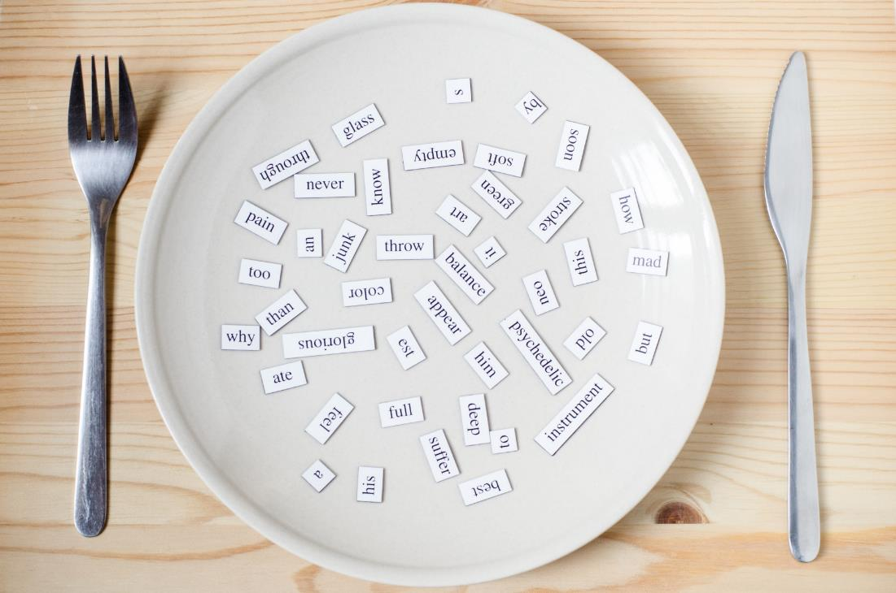
New words
hi
good
great

Slide 12

Presentation

Slide 13


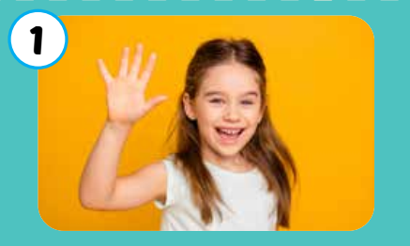

Click each English word to hear the sound.
hi
﻿/haɪ/
﻿xin chào

Slide 14
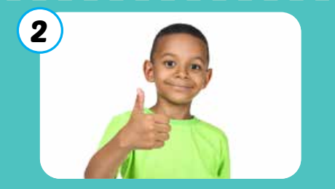
Click each English word to hear the sound.
good
﻿/ɡʊd/
﻿﻿khỏe, tốt

Slide 15
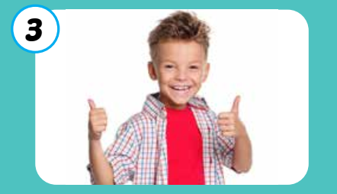
Click each English word to hear the sound.
great
﻿﻿/ɡreɪt/
﻿﻿﻿tuyệt vời, rất tốt

Slide 16
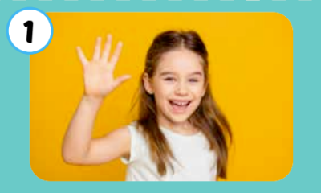

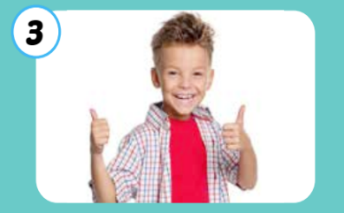
Click each English word to hear the sound.
hi
good
great
﻿/haɪ/
﻿xin chào
﻿/ɡʊd/
﻿﻿khỏe, tốt
﻿﻿/ɡreɪt/
﻿﻿﻿tuyệt vời, rất tốt

Slide 17
Practice

Slide 18

Friday September 30th 2022
Unit 1. My friends – Lesson 4.1
1. New words.
- hi - good
- great - meet
2. Model sentences.
a) A: How are you? b) A: It’s nice to meet you.
B: I’m good. B: It’s nice to meet you, too.
c) A: Thank you.
B: You are welcome.

Slide 19
Activity 1
Look and read. Then listen and do the correct action.
a
b
c
d
e
f
g
h
i
j
k
hi
good
great
Click on the letters to play audios.
Notes:
Divides class into 3 groups. Make lines.
Play the audio
- Ask ss to stand up and do the actions when listening to the words
Which groups has the ss do it fast and correctly will get the point
The group has the highest point win this game

Slide 20

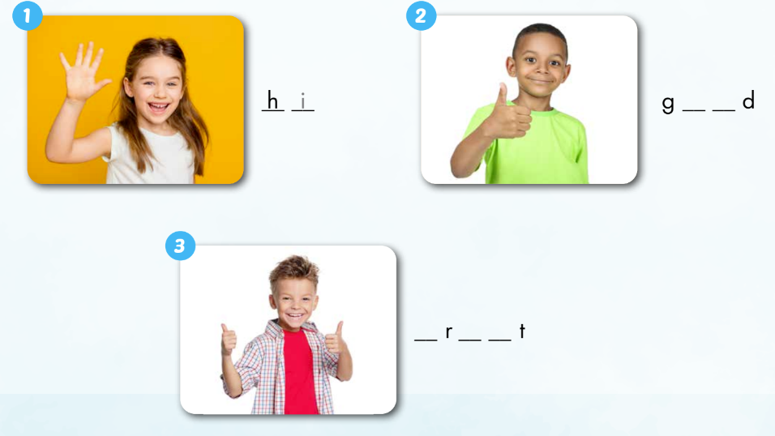
Extra Activity 1 WB p. 184
_
i
o o
g e a

Slide 21
Activity 2
Look at the pictures. Then write and say the right words
Notes:
- Divides class into 4 groups. Ask ss to sit on the floor and take out a4 paper and pen
Ask ss to count the number in their team
Show each pic, T calls out a number, ss look and write and say the words
Later, ss must write 2 and 3 words at the same time as pictures are shown

Slide 22
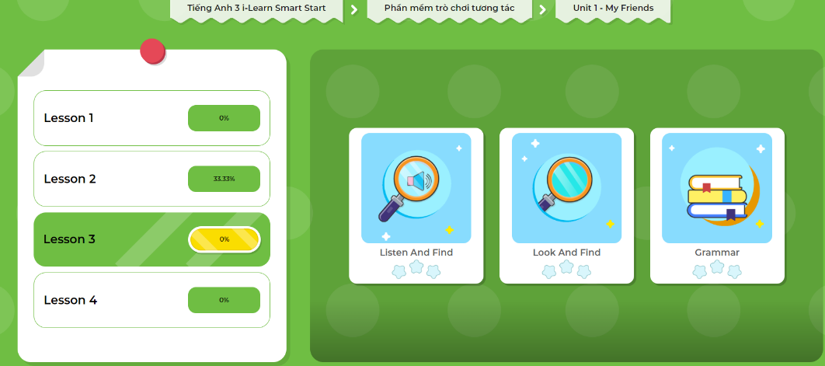
Extra- DHA app.
Click here to play the games

Slide 23
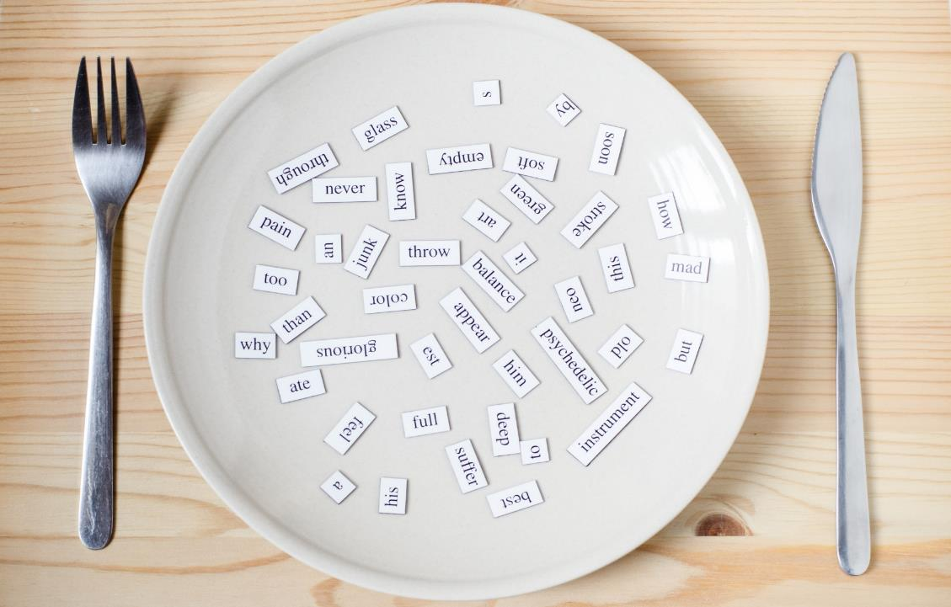
Structures
How are you?
I’m good, and you?
It’s nice to meet you.
It’s nice to meet you, too.
Thank you.
You’re welcome.

Slide 24

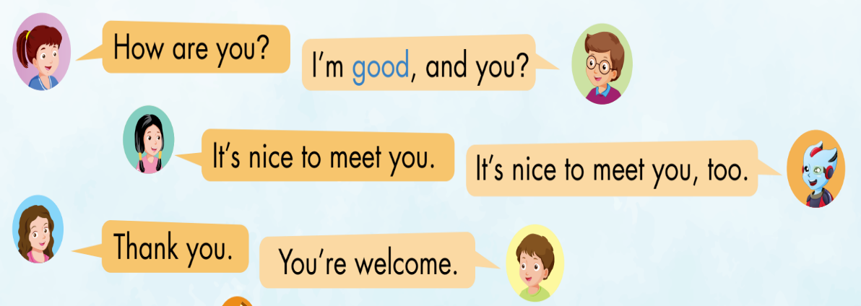
1
Nick
Lucy
2
Jill
3
Alfie
Anna
Tom
Notes:
Set context, analyze picture
Listen to each conversation
Repeat from whole class => big group => small group => pair => individual

Slide 25

Practice

Slide 26

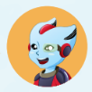
Activity 1
Look and choose the correct answer
How are you?
Lucy
a. It’s nice to meet you, too.
b. I’m good, and you?
c. You’re welcome.
Alfie
Notes:
Work in groups
Ask ss write the correct answer on the paper
Repeat the sentences

Slide 27
Activity 1
Look and choose the correct answer
How are you?
Lucy
a. I’m great, and you?
b. Nice to meet you, too.
c. You’re welcome.
Alfie

Slide 28
Activity 1
Look and choose the correct answer
It’s nice to meet you.
Lucy
a. You’re welcome.
b. It’s nice to meet you, too.
c. I’m good, and you?
Alfie

Slide 29
Activity 1
Look and choose the correct answer
How are you?
Lucy
a. I’m fine, and you?
b. It’s nice to meet you, too.
c. You’re welcome.
Alfie

Slide 30
Activity 1
Look and choose the correct answer
Thank you.
Lucy
a. It’s nice to meet you, too.
b. You’re welcome.
c. I’m great, and you?
Alfie

Slide 31
Activity 1
Look and choose the correct answer
How are you?
Lucy
a. I’m happy, and you?
b. It’s nice to meet you, too.
c. You’re welcome.
Alfie

Slide 32
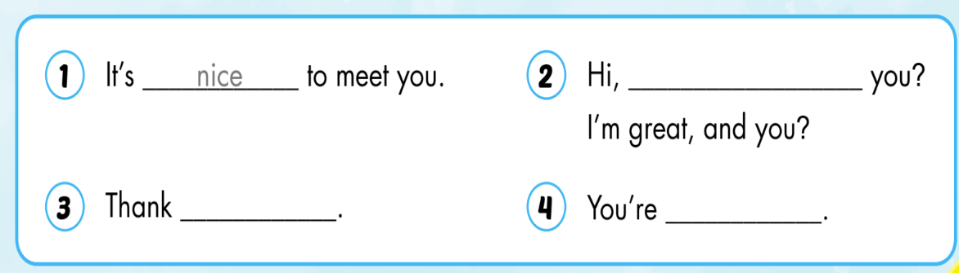
Activity 2
SB p.19
how are
you
welcome

Slide 33
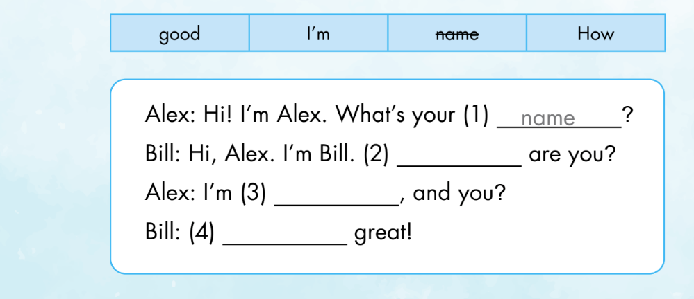
Extra Activity WB p.14
Read and write. Then do the role-play
How
good
I’m
Now it’s your turn. Let’s do the role-play.

Slide 34
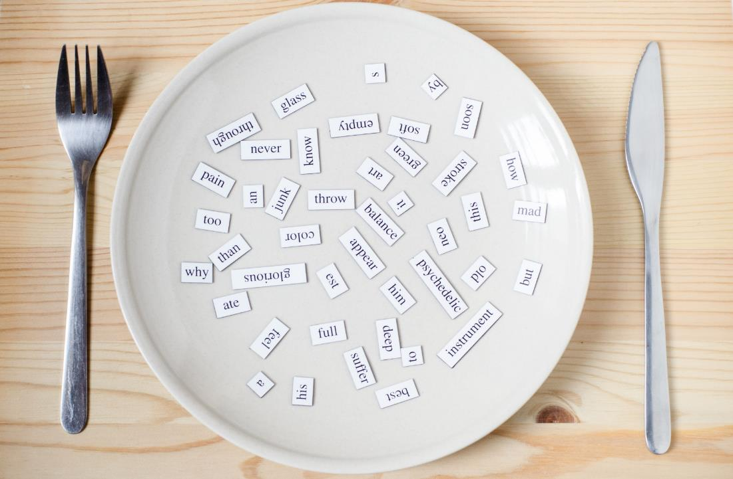
Consolidation

Slide 35
Copy the table down on your A4 paper. Then go around the class and speak with your friends.
What’s your name? | How are you? | It’s nice to meet you.
Notes:
Set up time (5 mins or more)
Ask ss to go around the class => tic tac toe with friends => winner ask and write the answer down
Time’s up. The st with the most answers win the game

Slide 36

WRAP-UP

Slide 37
Vocabulary
hi
good
great

Slide 38
Sentence patterns
How are you?
I’m good, and you?
It’s nice to meet you.
It’s nice to meet you, too.
Thank you.
You’re welcome.

Slide 39
Lesson 3
Homework
Practice vocabularies and structure. Make sentences using them.
Do the exercises in Tiếng Anh 3 i-Learn Smart Start Workbook (page 14)
Practice the vocabulary and structure in Tiếng Anh 3 i-Learn Smart Start Notebook (page 13)
Play the consolidation games in Tiếng Anh 3 i-Learn Smart Start DHA App on www.eduhome.com.vn
Prepare the next lesson (page 20)

Slide 40
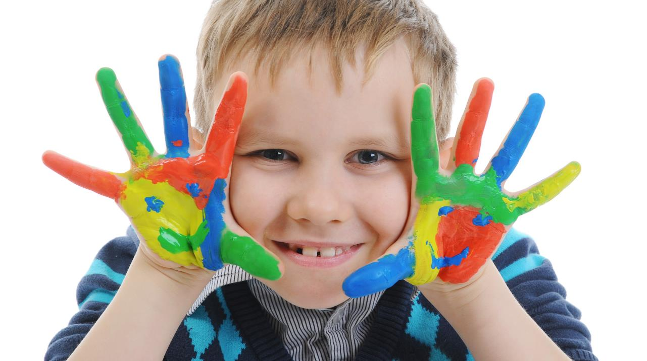
Enjoy your day!

