Slide 1
Unit 17
What toys do
you like?
Lesson 2

Slide 2
GRAMMAR

Slide 3

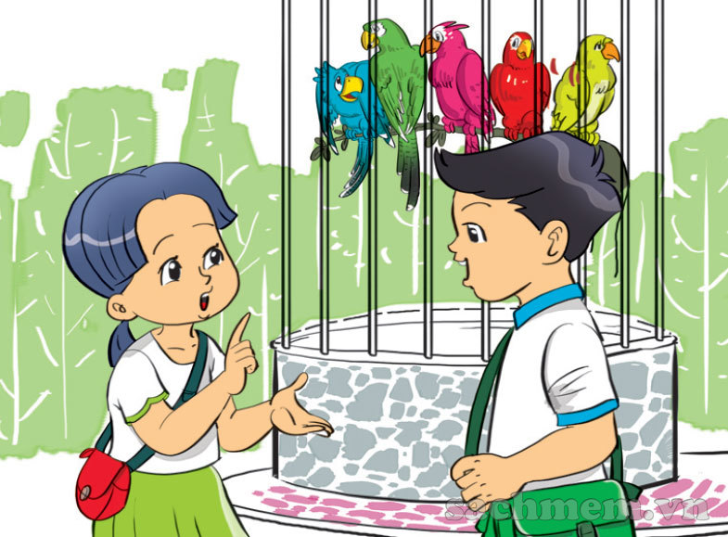
1. Look, listen and repeat
Do you have any parrots?
Yes, I do.

Slide 4
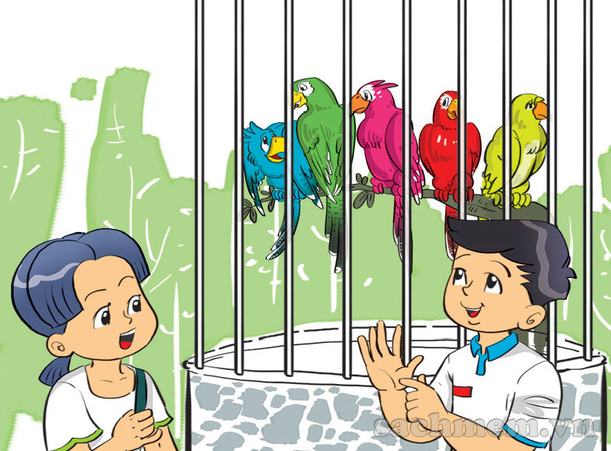
1. Look, listen and repeat
How many parrots do you have?
I have five.

Slide 5
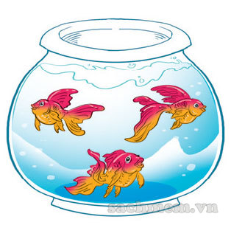
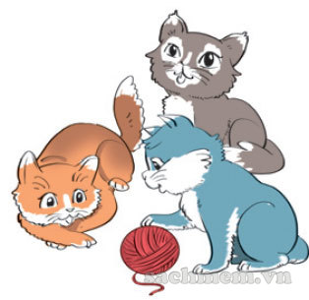
2. Point and say
cats
How many _________ do you have?
a
I have ________.
three
b
goldfish
How many _________ do you have?
I have ________.
three

Slide 6
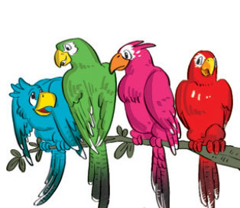
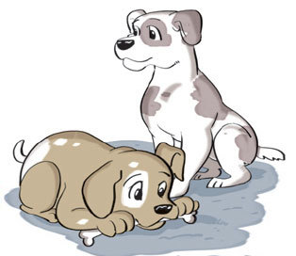
2. Point and say
dogs
How many _________ do you have?
c
I have ________.
two
d
parrots
How many _________ do you have?
I have ________.
four

Slide 7
How many ______ do you have?
I have _________.
parrots
cats
goldfish
dogs

Slide 8
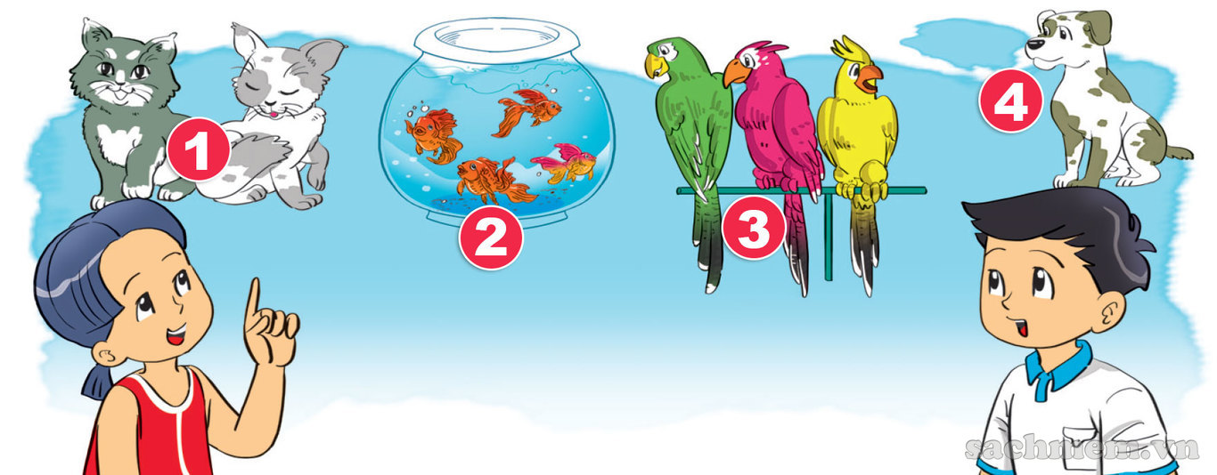
3. Let's talk.
How many _________ do you have?
I have ________.

Slide 9

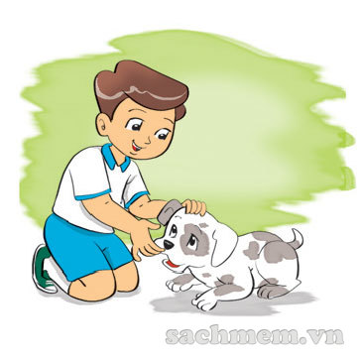
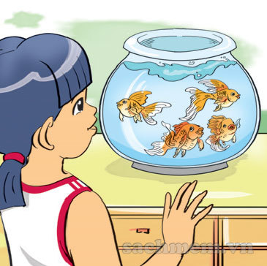
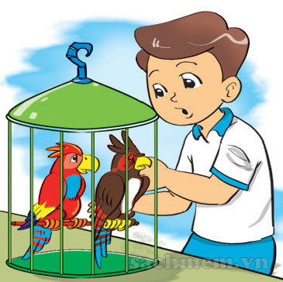
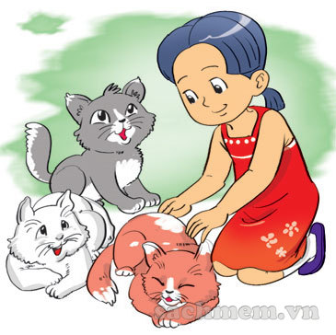
4. Listen and number.
1
2
3
4
a
2
b
1
c
4
d
3

Slide 10
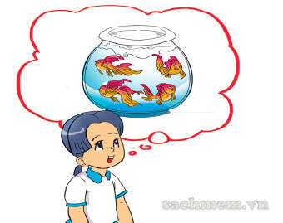
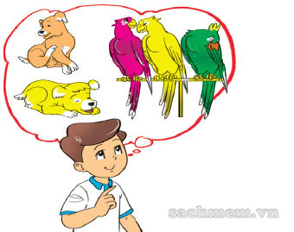
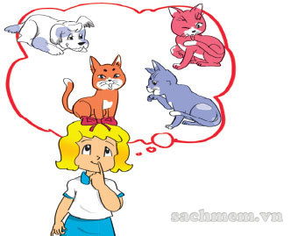
5. Read and complete
Nam, Linda and Mai like pets. They have different pets. Nam has two dogs and three parrots. Linda has three cats and one dog. Mai has four goldfish.
1. Nam has two _____ and three ________.
2. Linda has three _____ and one _____.
3. Mai has four _________
dogs
parrots
cats
dog
goldfish

Slide 11
How many ______ does she/he have?
She/ he has_________.
parrots
cats
goldfish
dogs

Slide 12
6. Let’s write
1. Do you like pets?
2. What pets do you have?
3. How many do you have?

Slide 13

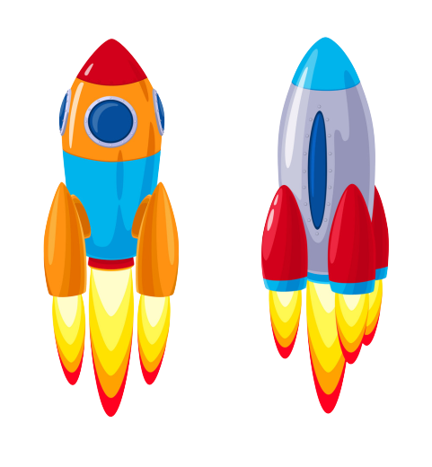
Next
ĐUA TÊN LỬA
Start
Notes:
Ms Huyền Phạm - 0936.082.789 – YOUTUBE: MsPham. Facebook: Dạy và học cùng công nghệ.

Slide 14

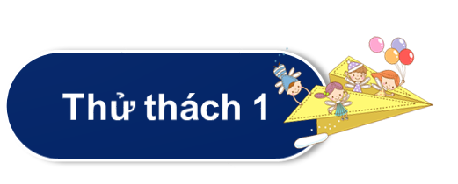






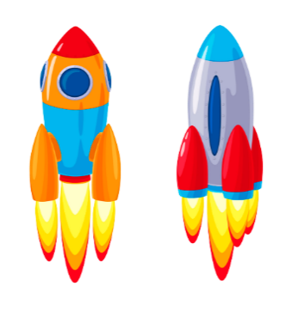
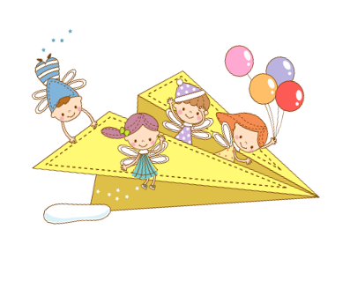
Next
Thử thách
QUYẾT ĐỊNH
Notes:
Ms Huyền Phạm - 0936.082.789 – YOUTUBE: MsPham. Facebook: Dạy và học cùng công nghệ.

Slide 15
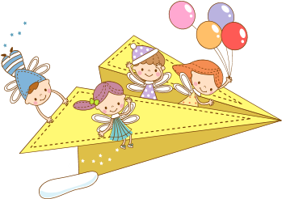
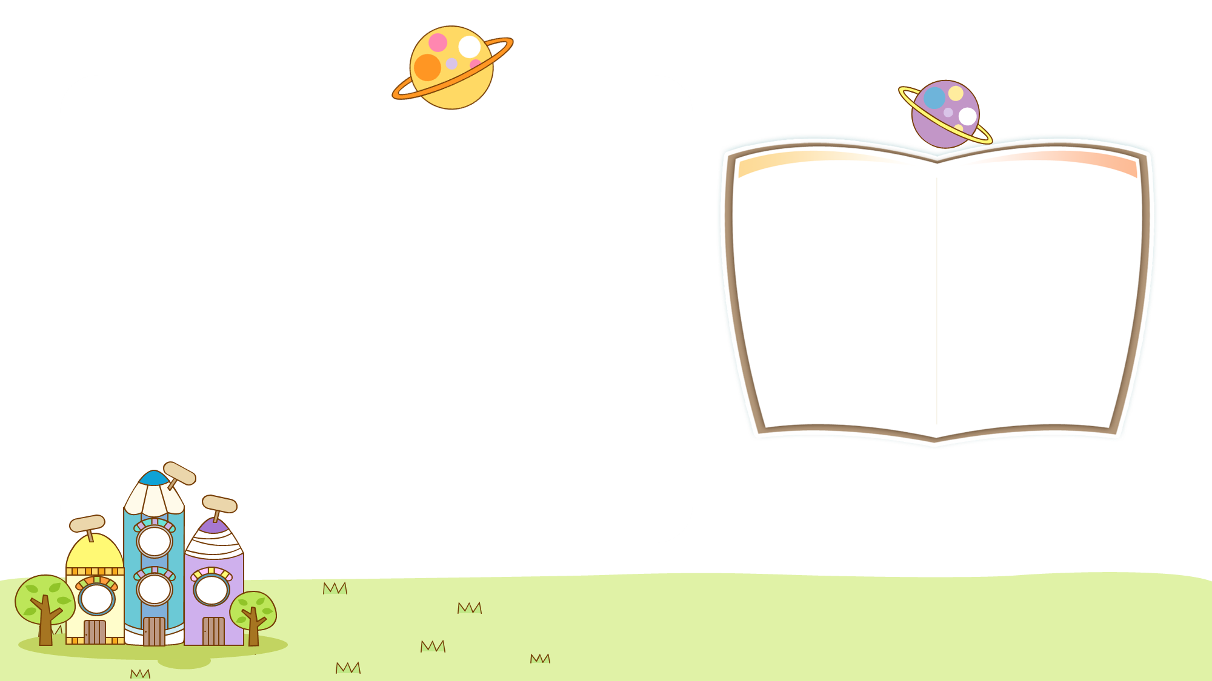
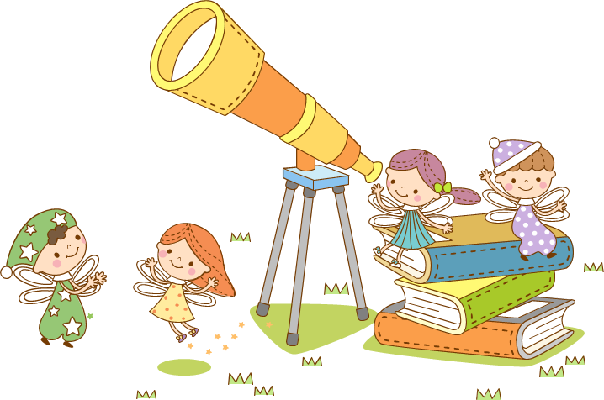
Back
How many parrots do you have?
I have five.
Xem đáp án
Notes:
Ms Huyền Phạm - 0936.082.789 – YOUTUBE: MsPham. Facebook: Dạy và học cùng công nghệ.

Slide 16
Back
How many dogs do you have?
I have five.
Xem đáp án
Notes:
Ms Huyền Phạm - 0936.082.789 – YOUTUBE: MsPham. Facebook: Dạy và học cùng công nghệ.

Slide 17
Back
How many goldfish do you have?
I have nine.
Xem đáp án
Notes:
Ms Huyền Phạm - 0936.082.789 – YOUTUBE: MsPham. Facebook: Dạy và học cùng công nghệ.

Slide 18
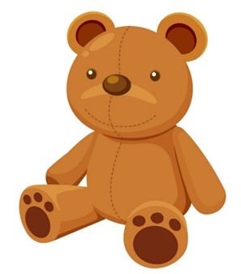
Back
How many ______ do you have?
I have three.
Teddy bears
Xem đáp án
Notes:
Ms Huyền Phạm - 0936.082.789 – YOUTUBE: MsPham. Facebook: Dạy và học cùng công nghệ.

Slide 19
Back
How many parrots does he have?
He ___ two.
has
Xem đáp án
Notes:
Ms Huyền Phạm - 0936.082.789 – YOUTUBE: MsPham. Facebook: Dạy và học cùng công nghệ.

Slide 20
Back
How many cats does she have?
She ___ three.
has
Xem đáp án
Notes:
Ms Huyền Phạm - 0936.082.789 – YOUTUBE: MsPham. Facebook: Dạy và học cùng công nghệ.

Slide 21
Back
______ do you have?
I have one.
How many dogs
Xem đáp án
Notes:
Ms Huyền Phạm - 0936.082.789 – YOUTUBE: MsPham. Facebook: Dạy và học cùng công nghệ.

