Slide 1
5. Read and complete
1. What are you doing?
2. What's Mai doing?
3. What's Peter doing?
What are Tony and
Linda doing?
a. He's watching TV.
b. I'm playing the piano.
c. They're skating.
d. She's cooking.

Slide 2
Unit 18 – Lesson 2
What are you doing?

Slide 3
Vocabulary

Slide 4
singing
/ˈsɪŋɪŋ/

Slide 5
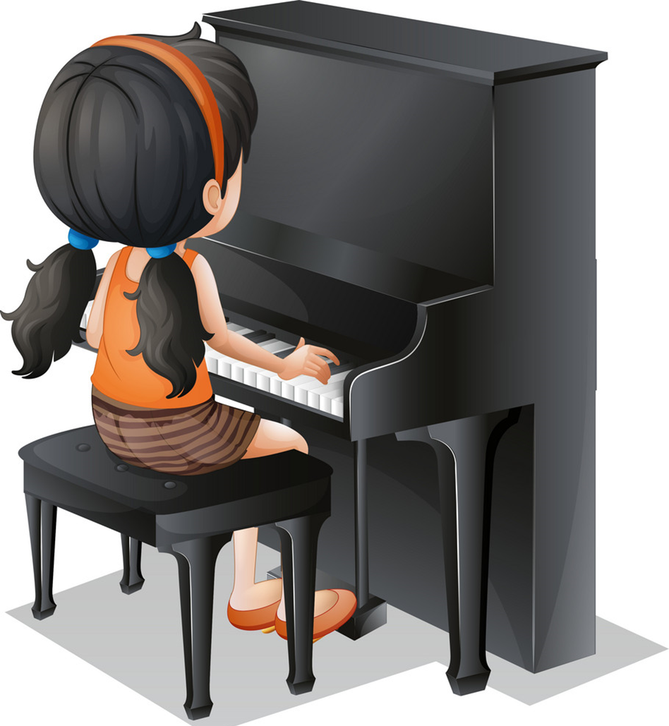
playing the piano
/ˈpleɪɪŋ ðə piˈænəʊ/

Slide 6
drawing
/ˈdrɔːɪŋ/

Slide 7
watching TV
/wɑːtʃ ˌtiː ˈviː/

Slide 8
Vocabulary
drawing
watching TV
singing
playing the piano

Slide 9
Tick or cross
Next
playing the piano
singing
watching TV
drawing

Slide 10
Match
singing
playing the piano
drawing
watching TV
Next

Slide 11
Grammar

Slide 12
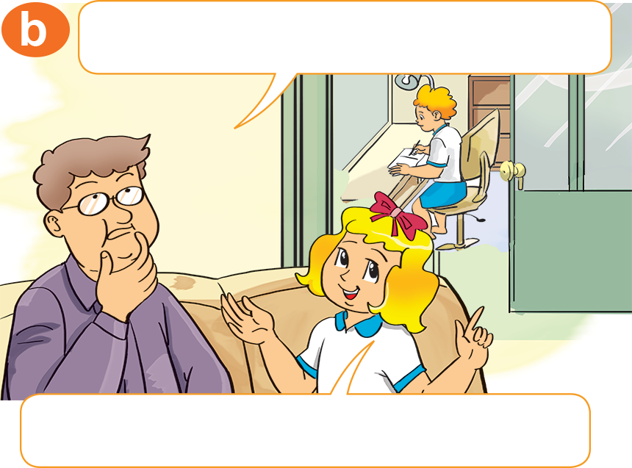
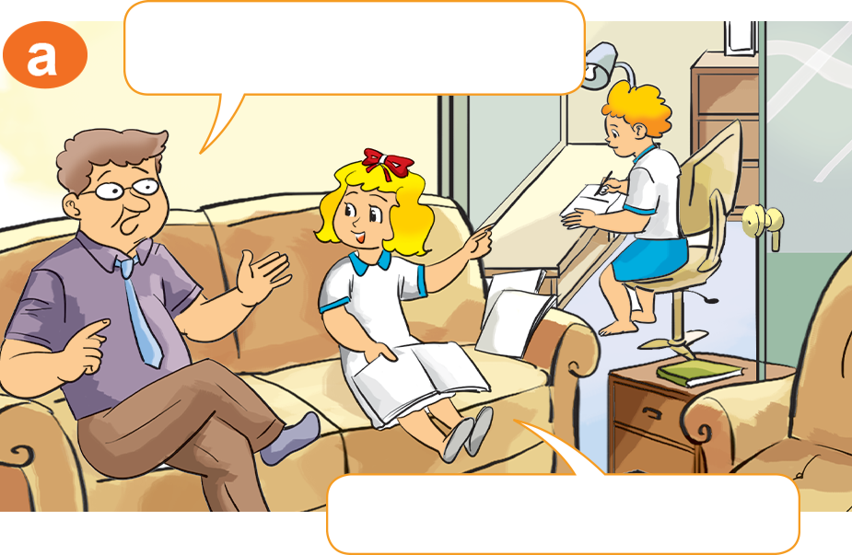
He’s in his room.
He’s doing his homework
1. Look, listen and repeat.
What's he doing there?
Where's Peter?
He's in his room.
He's doing his homework.

Slide 13
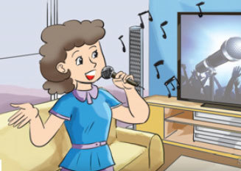
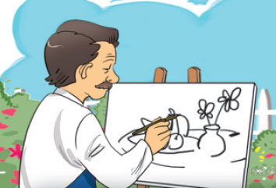
2. Point and say.
What's she doing?
What's he doing?
singing
drawing
She's _________.
He's _________.

Slide 14
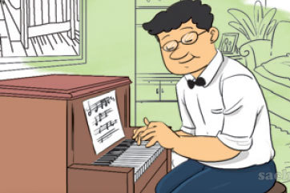
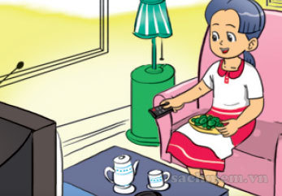
2. Point and say.
What's he doing?
What's she doing?
playing the piano
watching TV
He's _________________.
She's ____________.

Slide 15
Model sentence
What's she/ he doing?
She/He's _______.
drawing
watching TV
singing
playing the piano

