Slide 1
Unit 11
What’s the matter with you?
Lesson 1

Slide 2
Vocabulary

Slide 3
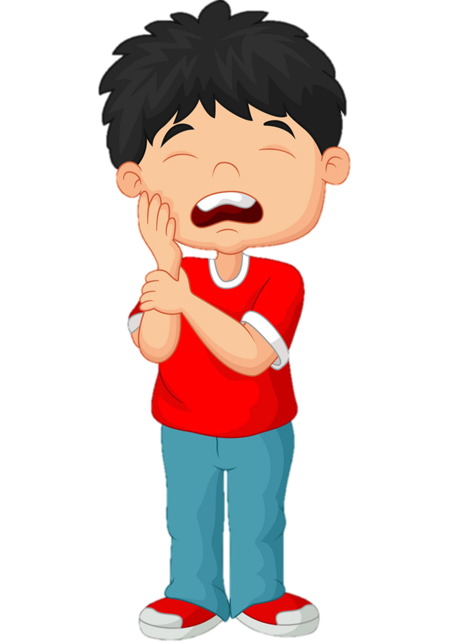
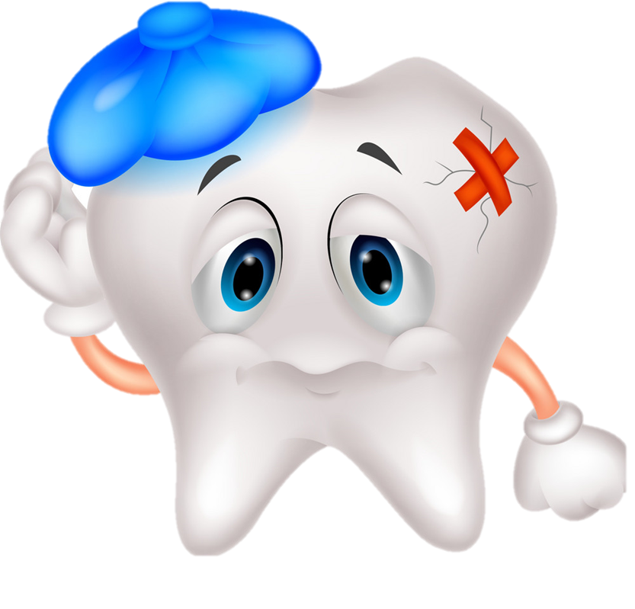
Toothache
/ˈtuːθeɪk/

Slide 4
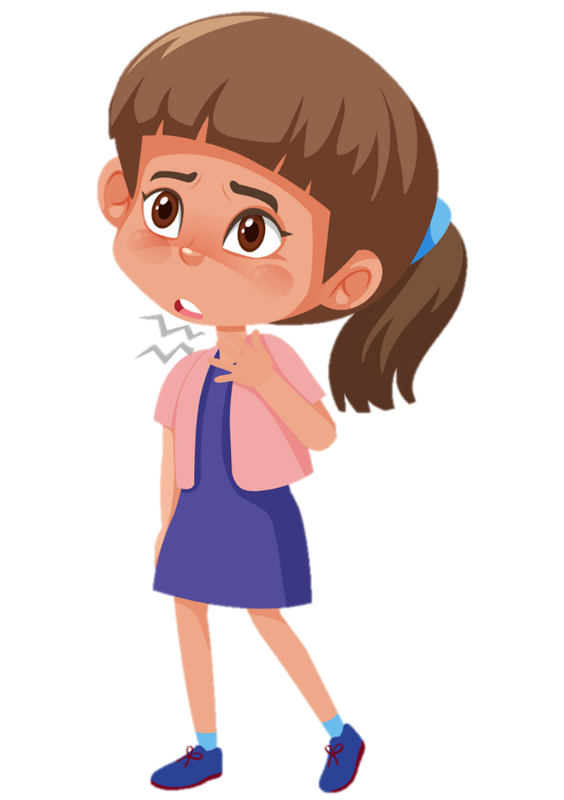
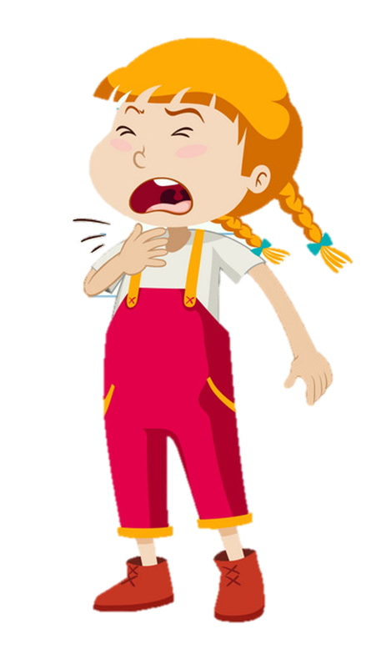
Sore throat
/sɔː θrəʊt/

Slide 5
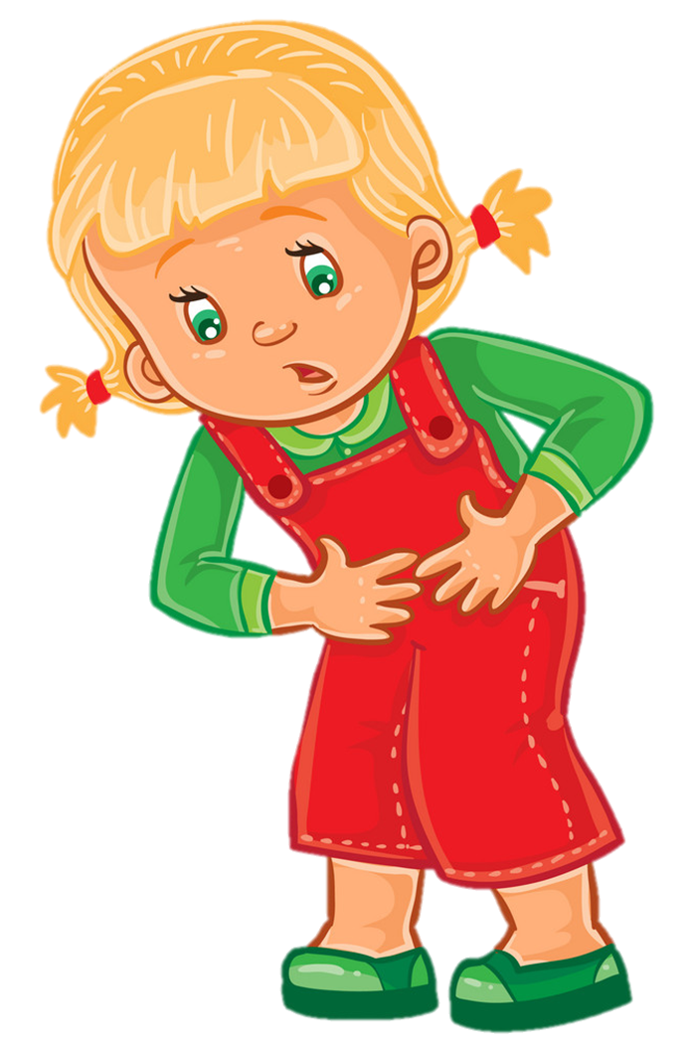
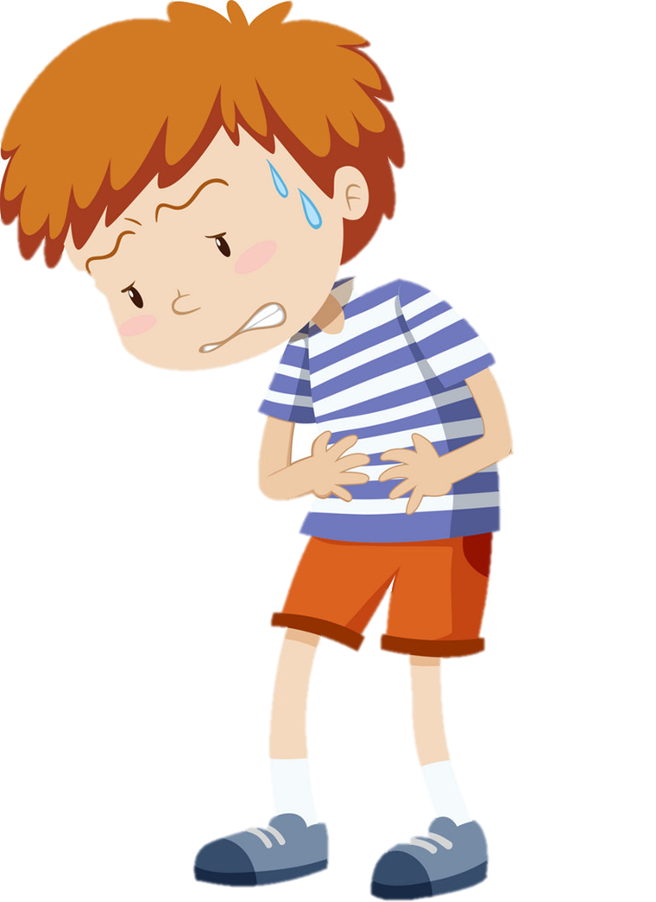
Stomach ache
/ˈstʌmək eɪk/

Slide 6
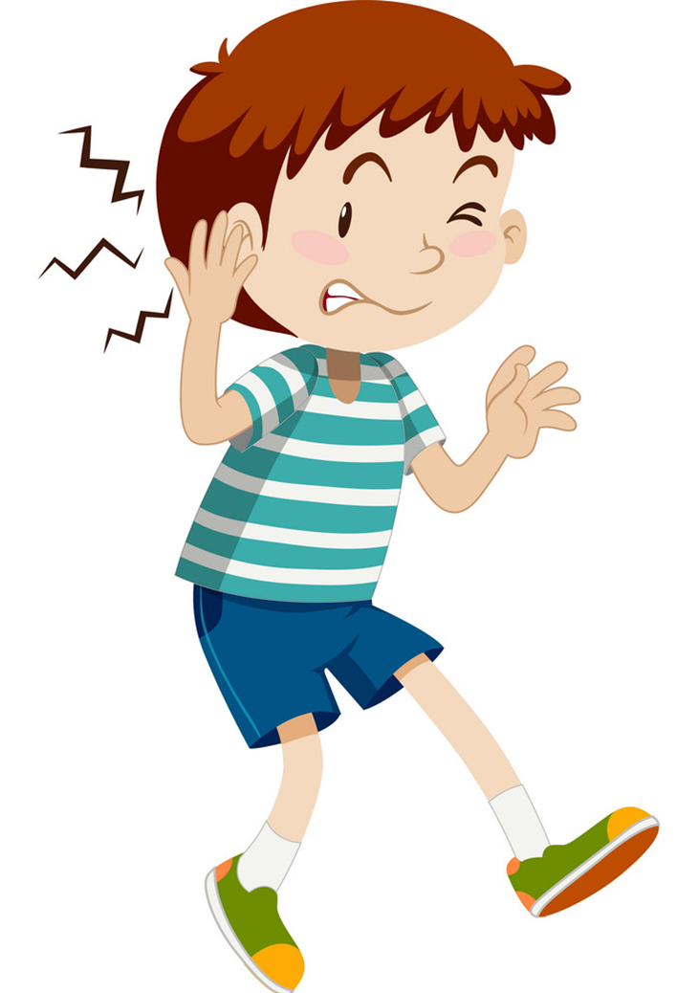
Earache
/ˈɪəreɪk/

Slide 7
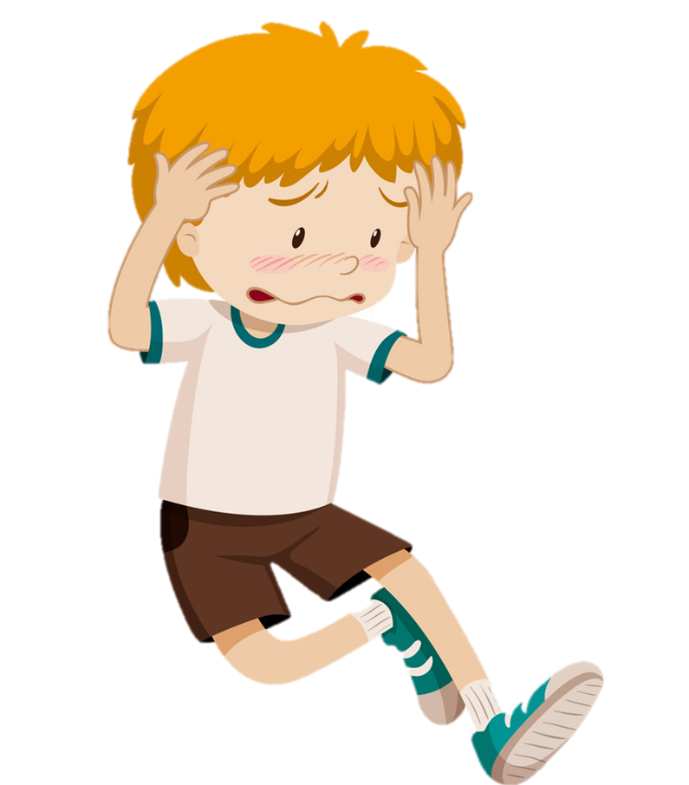
Headache
/ˈhedeɪk/

Slide 8
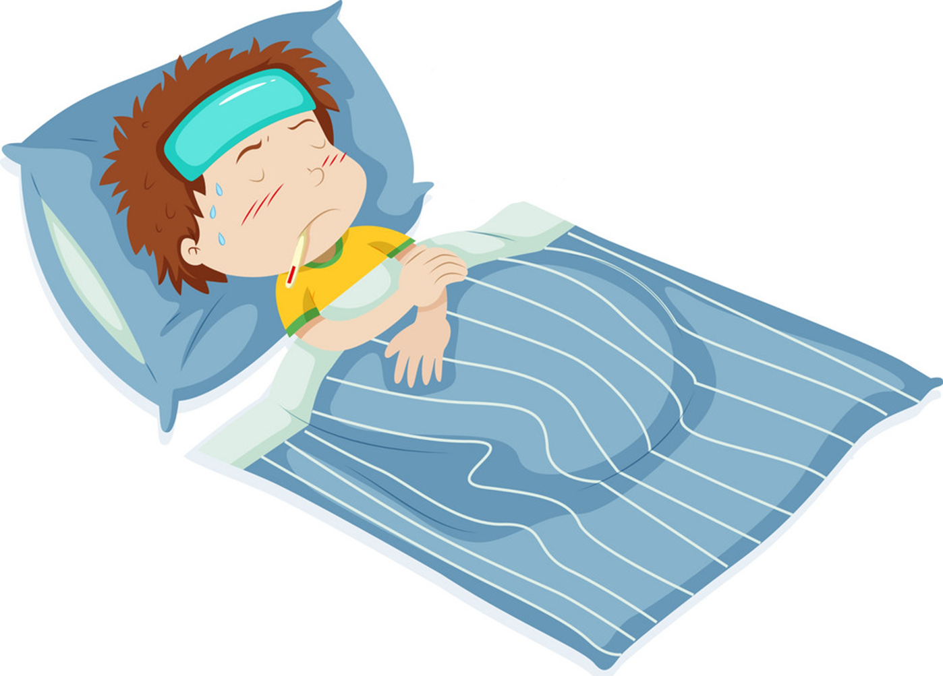
Fever
/ˈfiːvər/

Slide 9
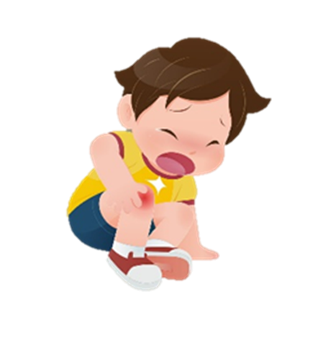
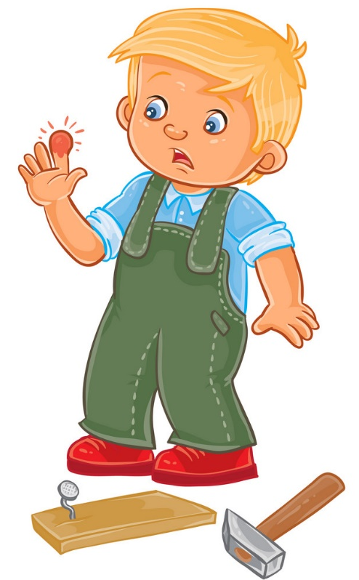
Pain
/peɪn/

Slide 10
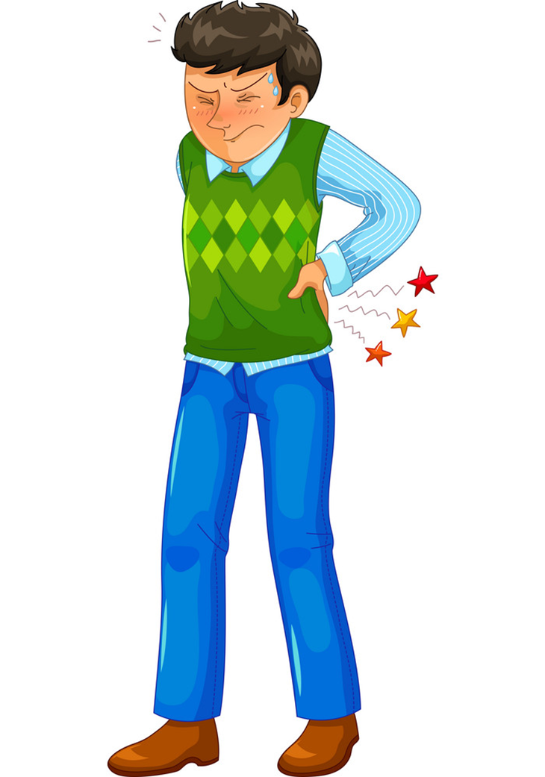
Backache
/ˈbækeɪk/

Slide 11
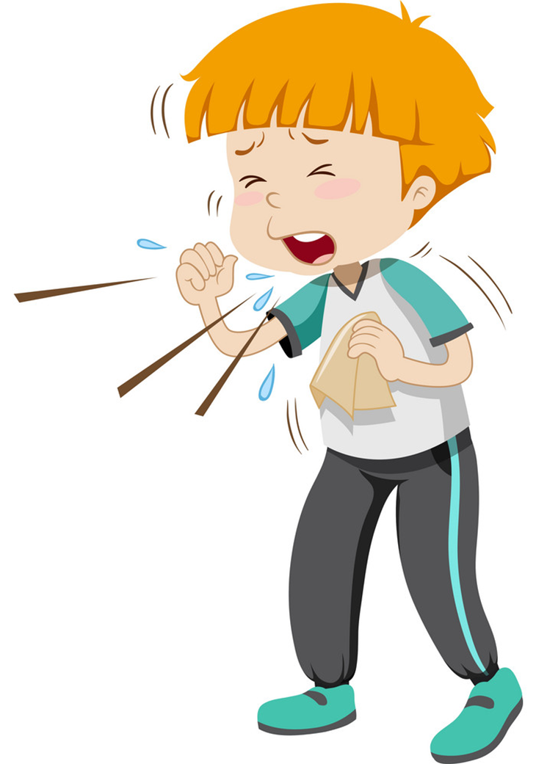
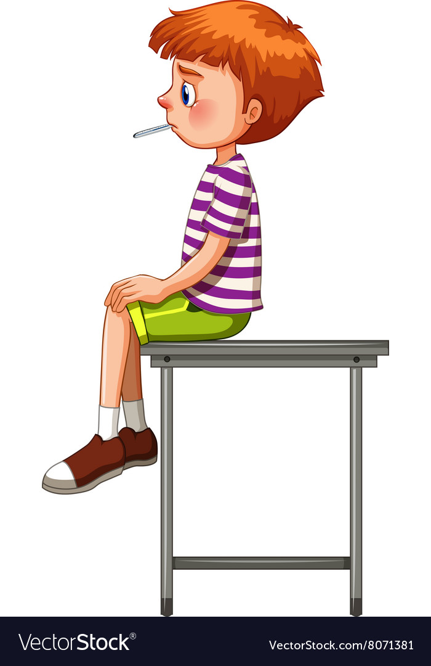
Cough
/kɒf/

Slide 12
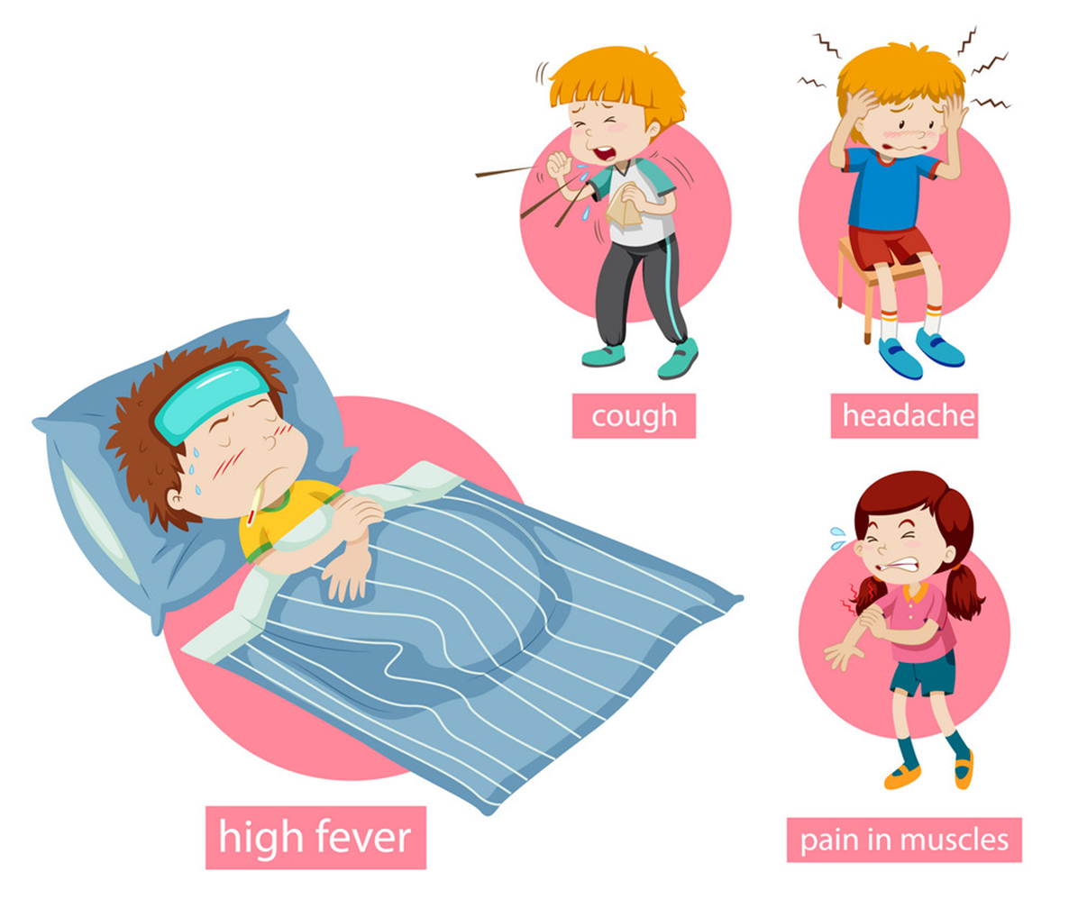
Flu
/fluː/

Slide 13
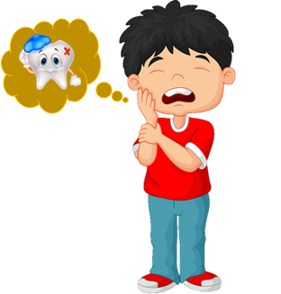
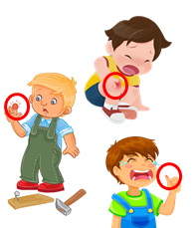
Review
1
2
3
4
5
Flu
/fluː/
Sore throat
/sɔː θrəʊt/
Cough
/kɒf/
Toothache
/ˈtuːθeɪk/
headache
/ˈhedeɪk/
10
6
7
8
9
Earache
/ˈɪəreɪk/
Pain
/peɪn/
Fever
/ˈfiːvər/
Stomach ache
/ˈstʌmək eɪk/
Backache
/ˈbækeɪk/

Slide 14
Toothache
/ˈtuːθeɪk/
Pain
/peɪn/
Backache
/ˈbækeɪk/

Slide 15
Flu
/fluː/
Pain
/peɪn/
headache
/ˈhedeɪk/

Slide 16
Cough
/kɒf/
Backache
/ˈbækeɪk/
Stomach ache
/ˈstʌmək eɪk/

Slide 17
Earache
/ˈɪəreɪk/
Backache
/ˈbækeɪk/
Stomach ache
/ˈstʌmək eɪk/

Slide 18
Stomach ache
/ˈstʌmək eɪk/
Fever
/ˈfiːvər/
Cough
/kɒf/

Slide 19
Flu
/fluː/
Sore throat
/sɔː θrəʊt/
Cough
/kɒf/

Slide 20
Toothache
/ˈtuːθeɪk/
headache
/ˈhedeɪk/
Earache
/ˈɪəreɪk/

Slide 21
Sore throat
/sɔː θrəʊt/
Toothache
/ˈtuːθeɪk/
Stomach ache
/ˈstʌmək eɪk/

Slide 22
Toothache
/ˈtuːθeɪk/
Earache
/ˈɪəreɪk/
Sore throat
/sɔː θrəʊt/

Slide 23
Cough
/kɒf/
Toothache
/ˈtuːθeɪk/
headache
/ˈhedeɪk/

Slide 24
A
B
C
Stomach ache

Slide 25
A
B
C
Fever

Slide 26
A
B
C
Earache

Slide 27
A
B
C
Flu

Slide 28
A
B
C
Headache

Slide 29
A
B
C
Toothache

Slide 30
A
B
C
Sore throat

Slide 31
A
B
C
Cough

Slide 32
A
B
C
Backache

Slide 33
A
B
C
Pain

Slide 34
Grammar

Slide 35
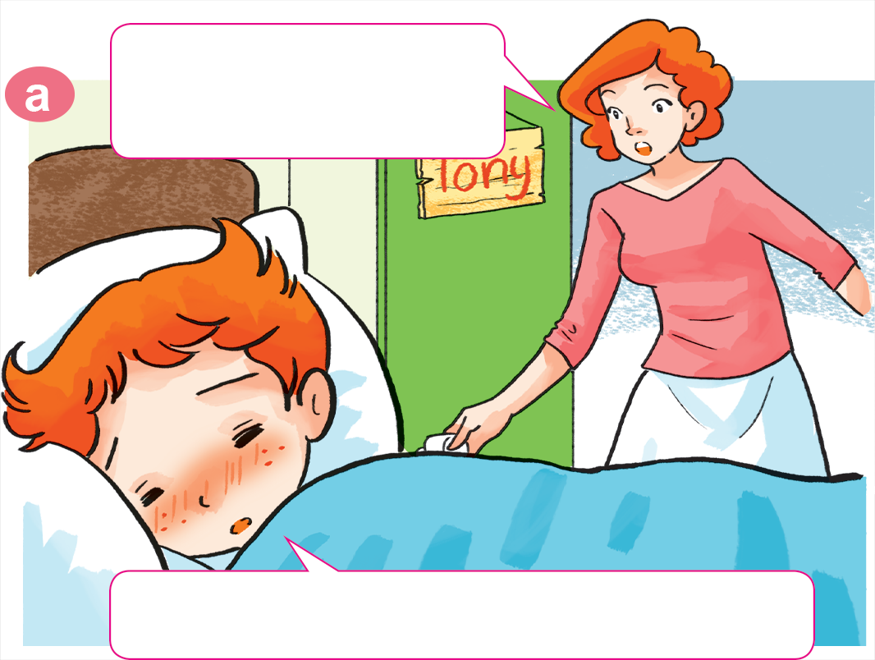
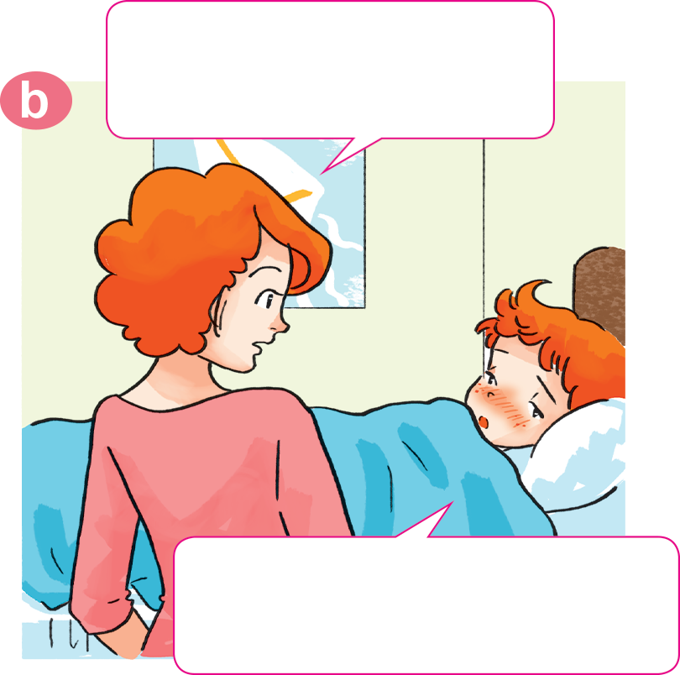
1. Look, listen and repeat.
Why not? What's the
matter with you?
Tony, get up!
Breakfast's ready.
I don't feel well.
I have a headache.
Sorry, I can't have breakfast, Mum.

Slide 36
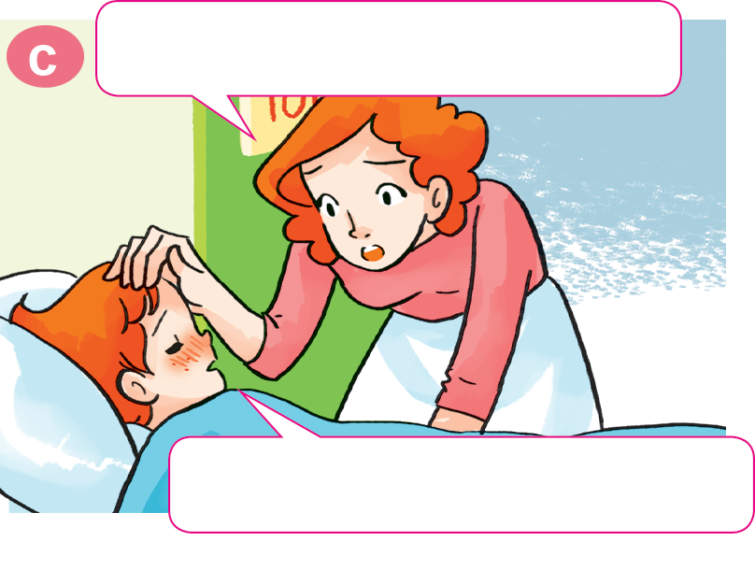
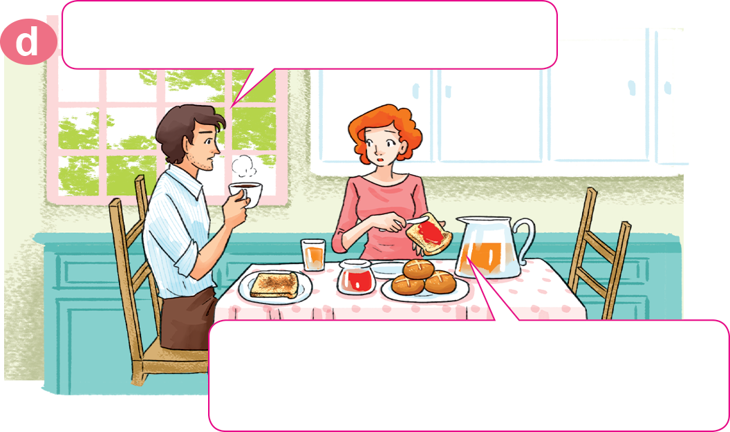
1. Look, listen and repeat.
Oh, you have a fever, too.
What's the matter with Tony?
He has a fever. I'll take him to
the doctor after breakfast.
Yes, Mum. I feel very hot.

Slide 37
2. Point and say.
What's the matter with you?
I have a toothache.
___________________

Slide 38
2. Point and say.
What's the matter with you?
I have an earache.
___________________.

Slide 39
2. Point and say.
What's the matter with you?
I have a sore throat.
___________________.

Slide 40
2. Point and say.
What's the matter with you?
I have a stomach ache.
___________________.

Slide 41
Model sentence
What's the matter with you?
What's the matter with you?
I have a _______________.
I have an _______________.
sore throat
earache

Slide 42
Temperature
/ˈtemprətʃər/
Model sentence
cough
toothache
sore throat
flu
headache
What's the matter with you?
I have a/an ______________.
earache
backache
pain
stomach ache
fever
Earache
/ˈɪəreɪk/

Slide 43
Extra sentence
What's the matter with her?
What's the matter with him?
She has
a stomach ache.
He has
a stomach ache.

Slide 44
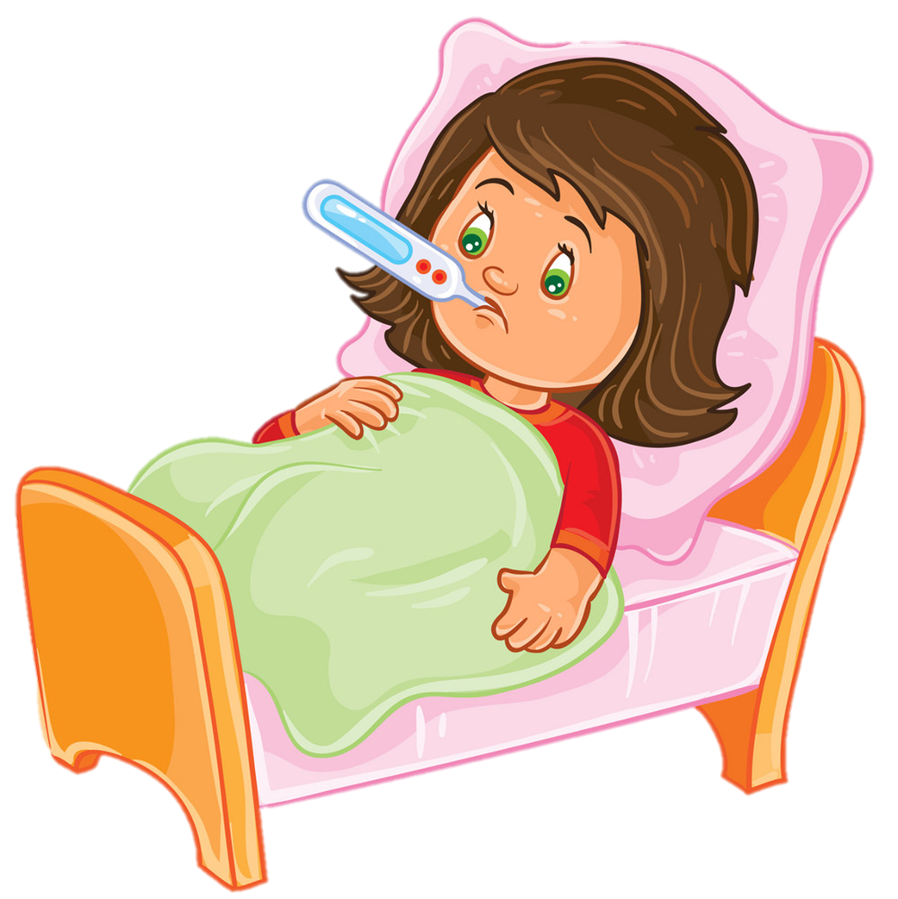
Temperature
/ˈtemprətʃər/
Extra sentence
cough
toothache
headache
sore throat
What's the matter with her/him?
She/He has a/an ______________.
backache
earache
stomach ache
fever
Earache
/ˈɪəreɪk/

Slide 45
4. Listen and tick.
 | headache | sore throat | toothache | stomach ache
1. Nam
2. Peter
3. Linda
4. Tony

Slide 46
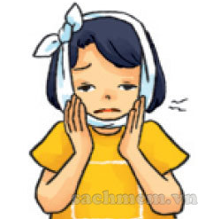
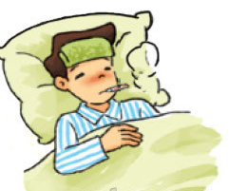
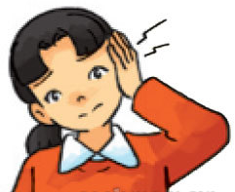
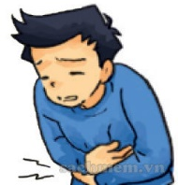
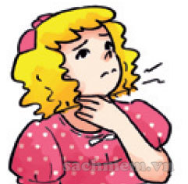
5. Read and complete.
1. She has a pain in her tooth.
She has a toothache.
2. Nam has a high temperature.
He has a fever.
3. Mai has a pain in her ear.
She has an earache.
4. Quan has a pain in his stomach.
He has a stomach ache.
5. Linda has a pain in her throat.
She has a sore throat.
________________
a stomach ache
a toothache
a sore throat
a fever
an earache
_______
_______________
_______________
_______________

Slide 47
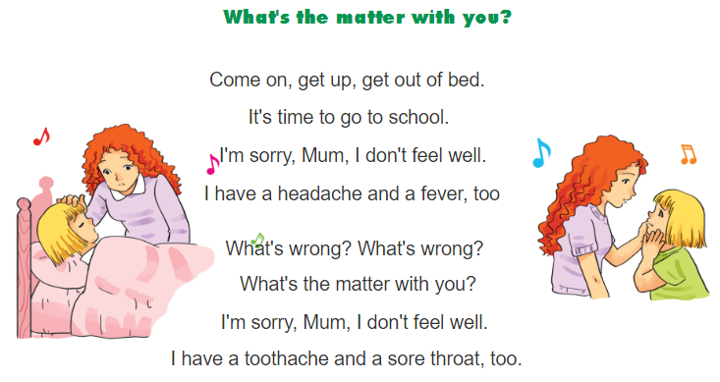
6. Let’s sing.

