Slide 1

Welcome to my class
Teacher:
Nguyen Nha Phuong

Slide 2

Guessing game

Slide 3
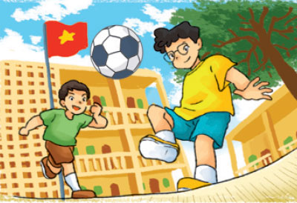
At school

Slide 4
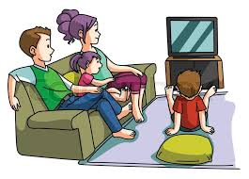
At home

Slide 5
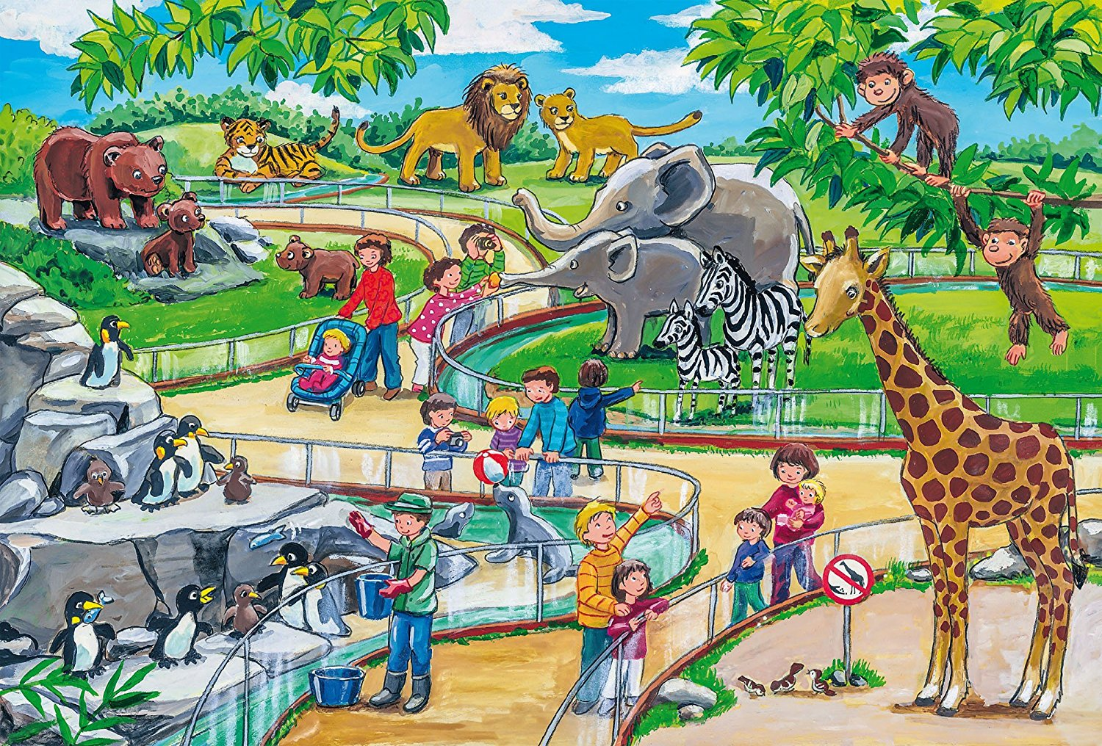
At the zoo

Slide 6

In Japan

Slide 7

In the supermarket

Slide 8

In the mountains

Slide 9


At school
At home
At the zoo
In Japan
In the supermarket
In the mountains

Slide 10

Unit 5:
Where will you be this weekend?
Lesson 1

Slide 11
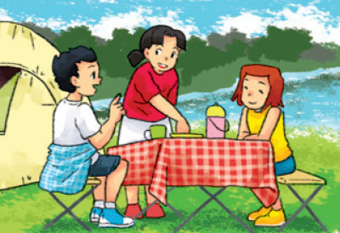

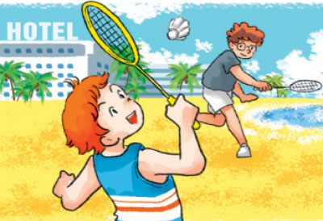
I. New words:
in the countryside
on the beach
by the sea

Slide 12
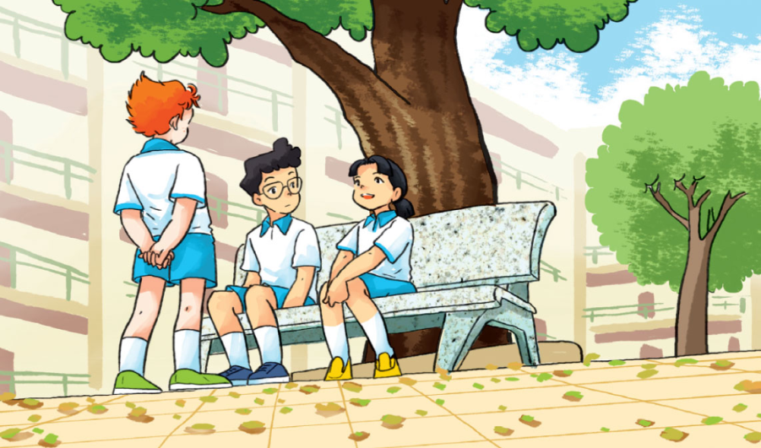
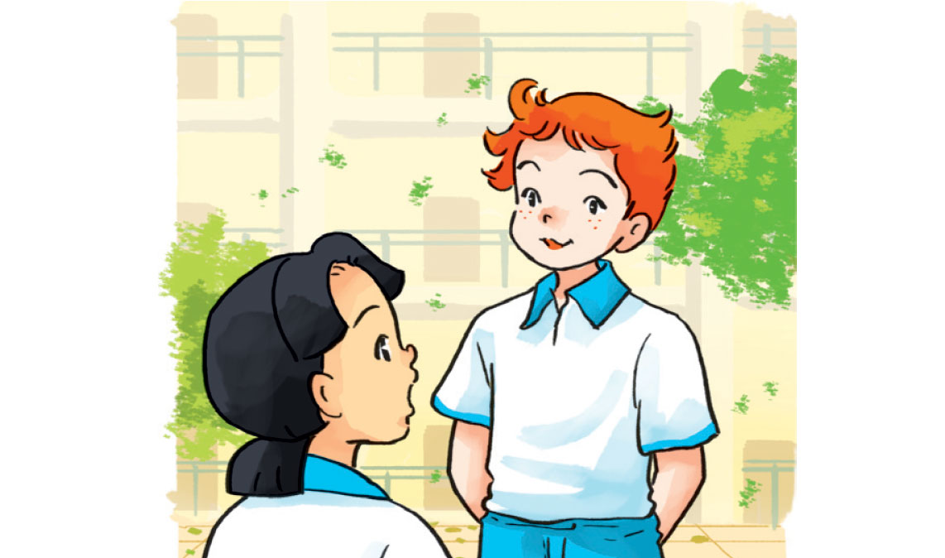
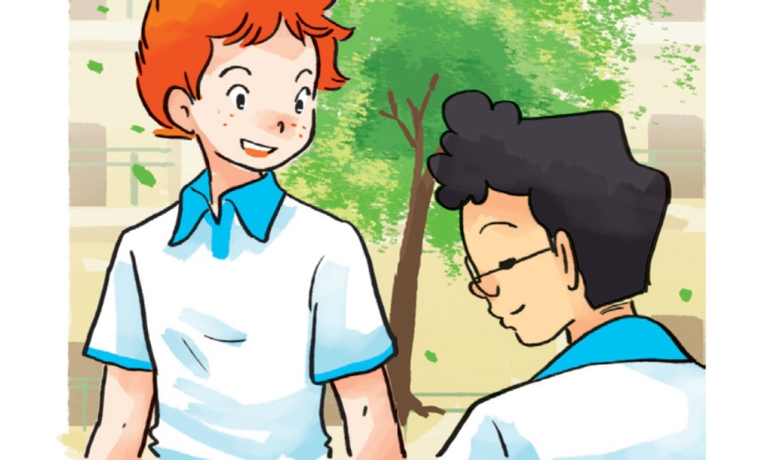
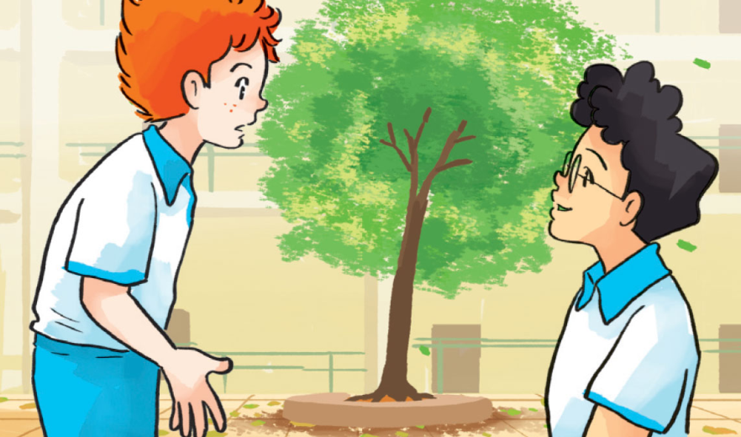
1. Look, listen and repeat
What about you, Tony? Where will you be on Saturday ?
I think my family and I will go for a picnic
Great! That will be
a lot of fun
What will you do this weekend ?
I think I’ll be in the mountains
I’ll be at home
What about you, Phong? Where will you be?
At home? Why?
Because I have to study

Slide 13




What will Mai do this weekend?
a. go for a walk b. go to the zoo c. go for a picnic
2. Where will Tony be on Saturday?
a. in the countryside b. in the mountains
c. in the supermarket
3. Where will Phong be ?
a. at home b. at the zoo c. at school

Slide 14
II. Models:
Where will you be this weekend?
I think I’ll be in the mountains
* I’ll = I will

Slide 15
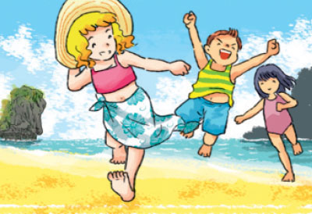
2. Point and say
( tomorrow
next week / month /… )
Where will you be this weekend?
I think I’ll be …
a
b
In the countryside
On the beach
c
d
At school
By the sea

Slide 16


Lucky Number
1
2
3
4
5
6
7
8

Slide 17


Slide 18

500$

Slide 19


Slide 20


Slide 21
800$

Slide 22
700$

Slide 24
600$

Slide 25



Slide 26

5. Read and match
1. Where will you be this weekend?
2. Where will Mai be tomorrow?
3. Where will Phong be next week?
4. Where will Peter and Linda be next month?
a. He’ll be in the mountains.
b. They’ll be by the sea.
c. I think I’ll be at home.
d. She’ll be on the beach.

Slide 27
Unit 5: Where will you be this weekend?
Lesson 1
Words:
In the countryside
By the sea
On the beach
II. Models:
Where will you be this weekend?
I think I’ll be in the mountains
* I’ll = I will

Slide 28

Thank you for your attention !

