Slide 1
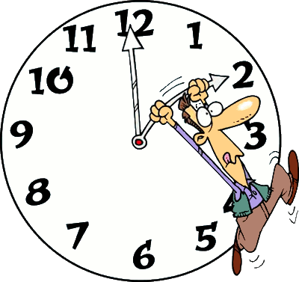

Slide 2
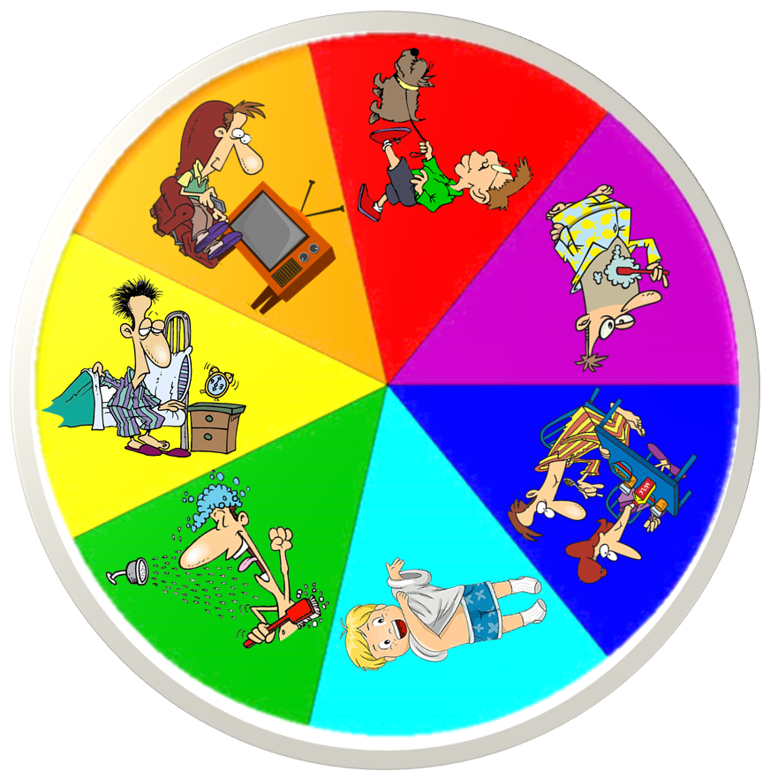
Spin the wheel and make a sentence
He gets up
at seven o’clock
SPIN
CHECK

Slide 3
Spin the wheel and make a sentence
He watches TV
at nine o’clock
SPIN
CHECK

Slide 4
Spin the wheel and make a sentence
He takes a shower
at a quarter past seven
SPIN
CHECK

Slide 5
Spin the wheel and make a sentence
He gets dressed
at a quarter to eight
SPIN
CHECK

Slide 6
Spin the wheel and make a sentence
They have breakfast
at eight o’clock
SPIN
CHECK

Slide 7
Spin the wheel and make a sentence
He brushes his teeth
at five past eight
SPIN
CHECK

Slide 8
Spin the wheel and make a sentence
He walks his dog
at half-past eight
SPIN
CHECK

Slide 9
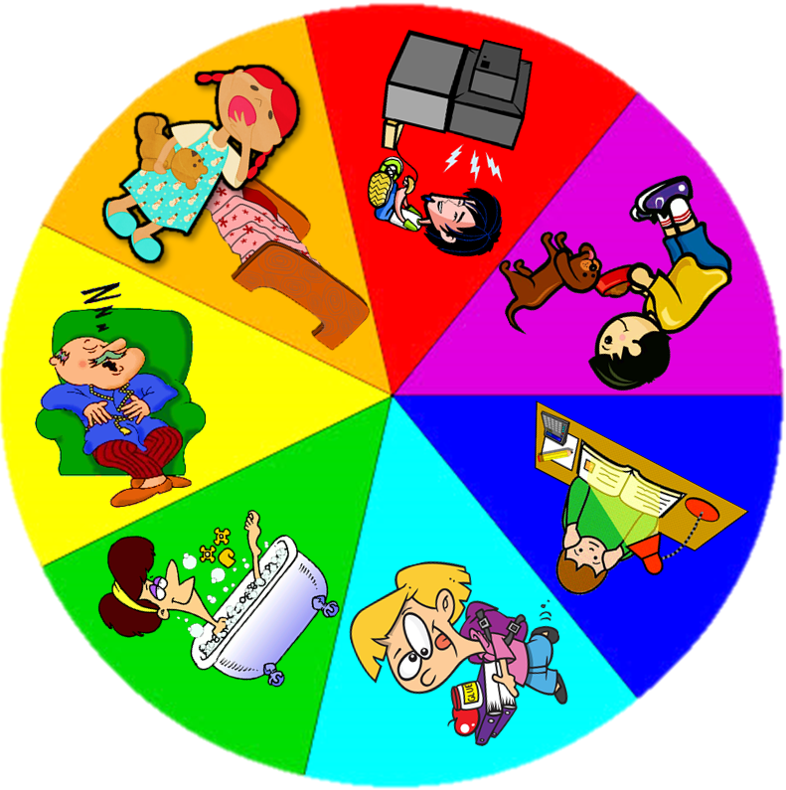
Spin the wheel and make a sentence
He plays video games
at ten past six
SPIN
CHECK

Slide 10
Spin the wheel and make a sentence
He takes a nap
at a quarter to four
SPIN
CHECK

Slide 11
Spin the wheel and make a sentence
He takes a bath
at ten to nine
SPIN
CHECK

Slide 12
Spin the wheel and make a sentence
She goes to school
at five to nine
SPIN
CHECK

Slide 13
Spin the wheel and make a sentence
He does his homework
at five o’clock
SPIN
CHECK

Slide 14
Spin the wheel and make a sentence
He feeds his dog
at half-past seven
SPIN
CHECK

Slide 15
Spin the wheel and make a sentence
She goes to bed
at half-past nine
SPIN
CHECK

