Slide 1
TEACHERS TO CLASS 4A4

Slide 3
What is the next LETTER
after K in the alphabet?
A. letter J B. letter L

Slide 4
What is the next LETTER
after K in the alphabet?
- It’s letter L

Slide 5
What does letter “L” say?

Slide 6
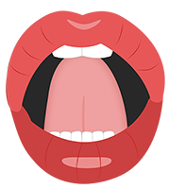
What does letter “L” say?
It says /l/

Slide 7
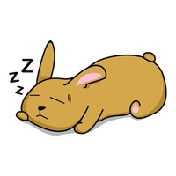
I ________ my eyes when I’m sleeping. A. close B. open

Slide 8
I CLOSE my eyes.

Slide 9
They’re beautiful. You buy them to decorate the house at Tet.
What are they?

Slide 10
They’re beautiful. You buy them to decorate the house at Tet.
They’re FLOWERS.

Slide 11
PHONICS L – blend sounds

Slide 12
- cl
clothes
She wears new clothes at Tet.
close
Close the door, please.

Slide 13
- fl
flowers
My mother buys lots of flowers for Tet.
floor
I clean the floor in the afternoon.

Slide 14
Activity 2: Listen and write.
flowers
1. We give our teachers lots of _________ on Teacher’s Day.
2. _______ the door, please.
3. The ________ are beautiful.
4. She’s cleaning the _______ now.
Close
clothes
floor

Slide 15
Word build find more words with –fl and –cl sounds

Slide 16
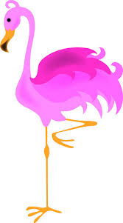
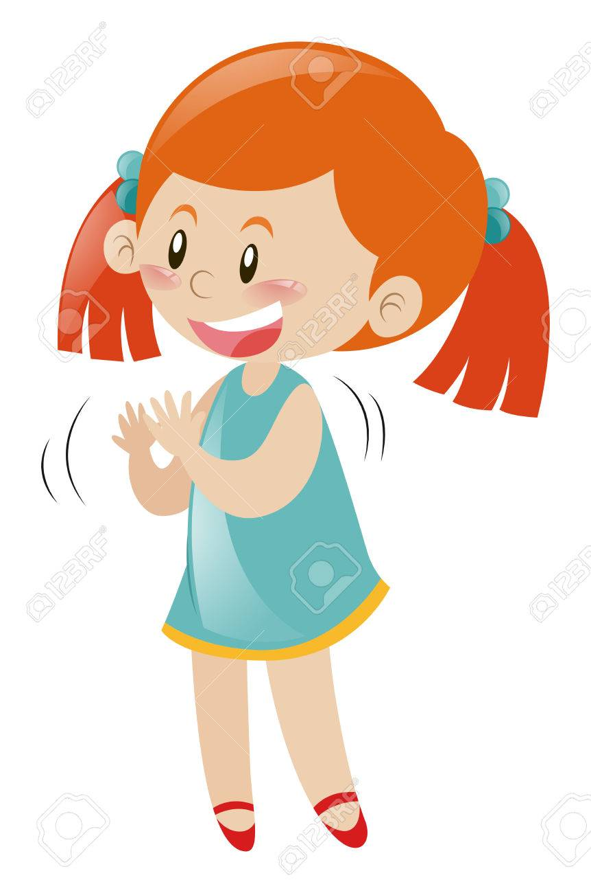
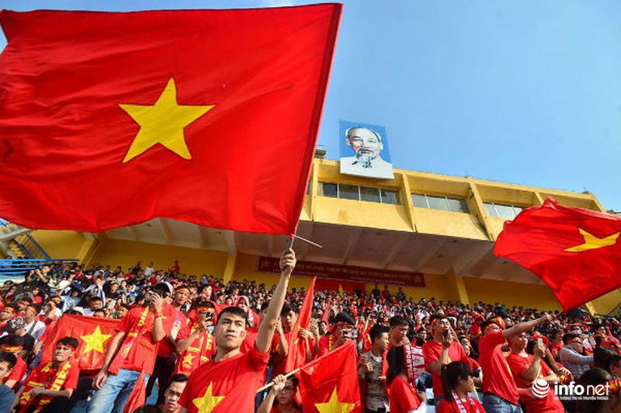
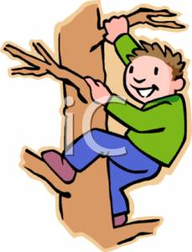
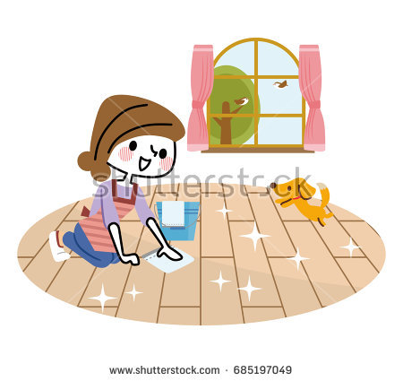
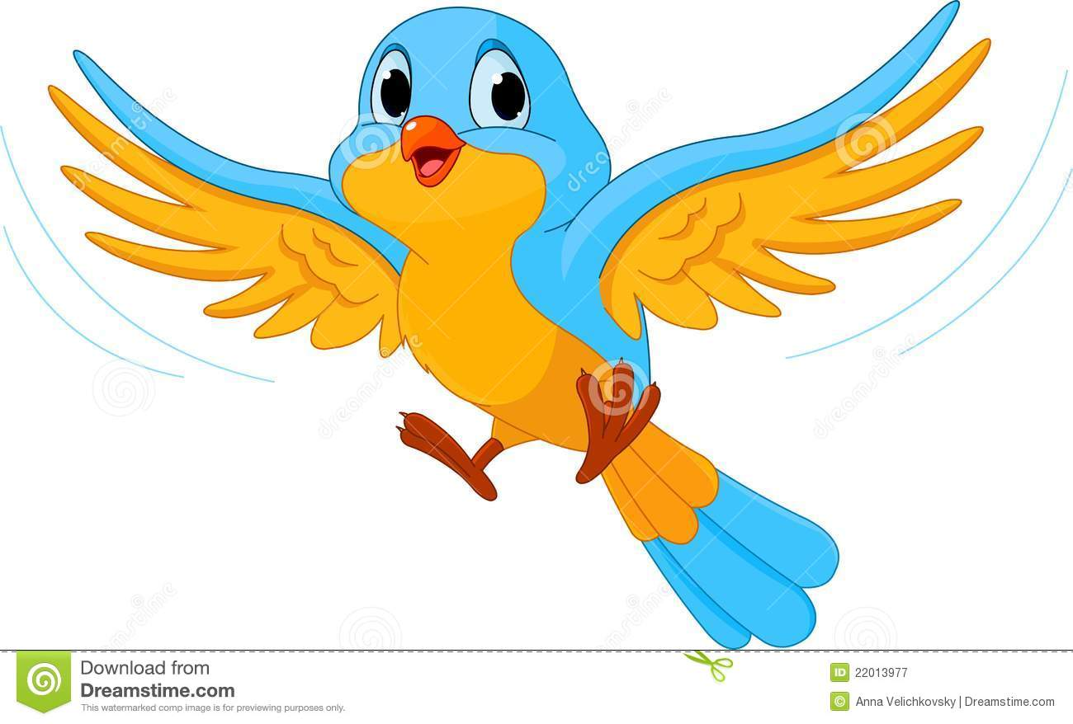
FAST AND FURIOUS

Slide 17
L – BLEND SOUNDS
CL
Clean
FL
Flag
GROUP THE WORDS
clean flag
climb flat
flap clothes
floor cloud
clap flamingo
clock fly

Slide 18
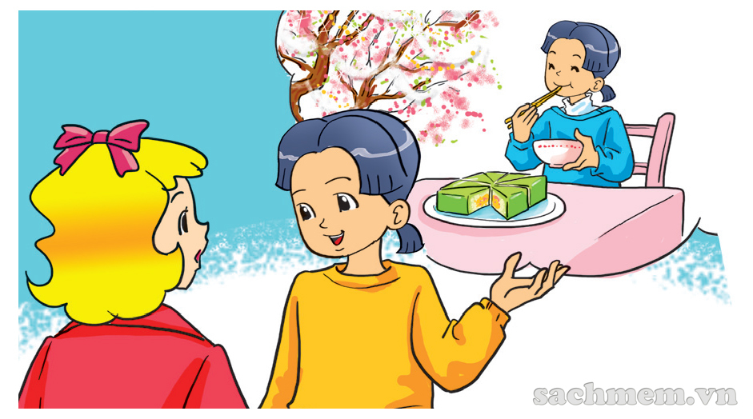

Slide 19
Activity 4: Read and complete
the house flowers banh chung teachers
friends firework displays grandparents Tet
1. It’s ______ soon.
2. Mai’s family go to the market and buy many_________.
3. They decorate ____________ and make ______________.
4. They watch __________________.
5. They visit ________________, ___________, and __________.
Tet
flowers
the house
banh chung
firework displays
grandparents
teachers
friends

Slide 20
Activity 5: Write about your Tet
Before Tet
Decorate the house
Make banh chung
During Tet
Visit grandparents
Watch firework displays
…………….
…………….

Slide 21
Project: Make a Phonics Book

