Slide 1
BÀI HỌC TUẦN 23
MÔN TIẾNG ANH
LỚP 3

Slide 2


Going
Fishing

Slide 3
Q1. How many ___ are there?
A. door
B. doors

Slide 4
Scoring

Slide 5
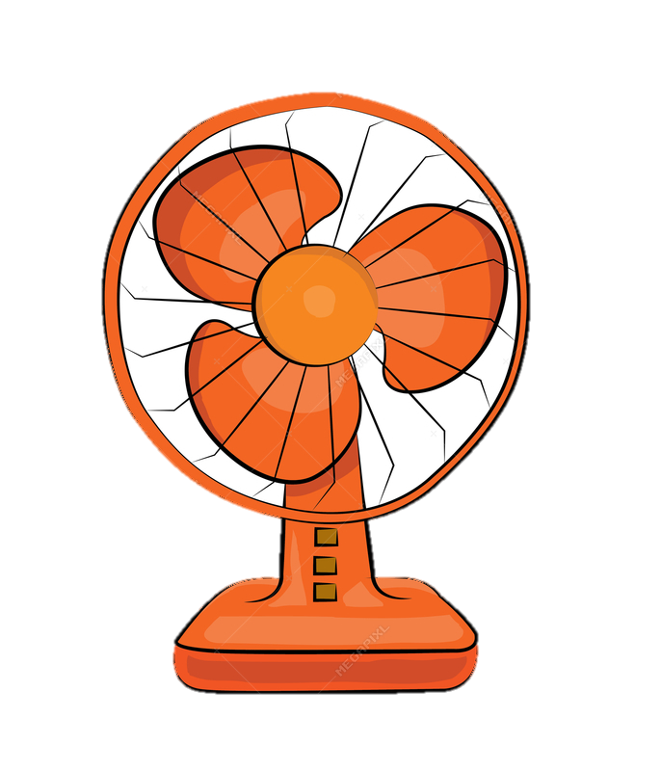
Q2. What’s this?
- It’s a ___
A. window
B. fan

Slide 6
Scoring

Slide 7
Q3. ___ there any chairs?
A. Are
B. Is

Slide 8
Scoring

Slide 9

Q4. What are they?
- They are ______.
A. map
B. maps

Slide 10
Scoring

Slide 11
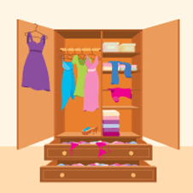
Q5. Are there any cupboards?
No, there aren’t.
Yes, there is.

Slide 12
Scoring

Slide 13
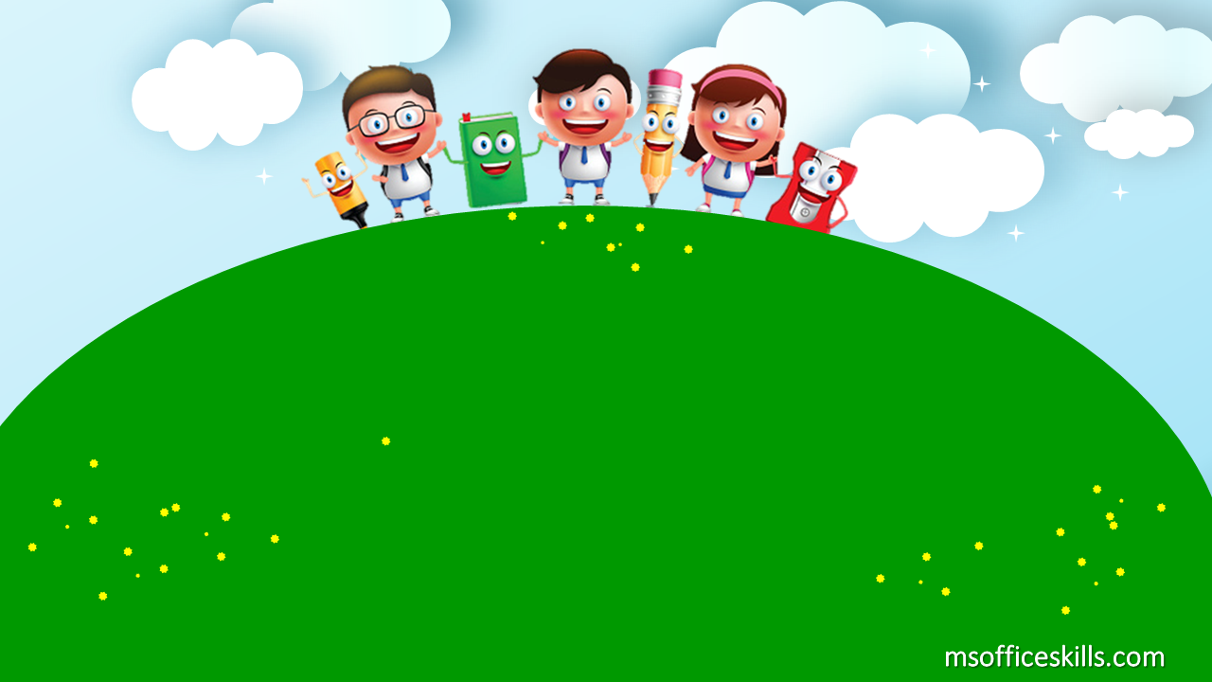
UNIT 15:
DO YOU HAVE ANY TOYS?
LESSON 1

Slide 14
01
SOME VOCABULARY
02
GRAMMAR
03
DO LISTENING & SPEAKING
04
PLAY GAMES & SING A SONG
TABLE OF CONTENTS
(doll, yo-yo, teddy bear, puzzle, car, robot)
(Do you have….?)

Slide 15
01
VOCABULARY

Slide 16
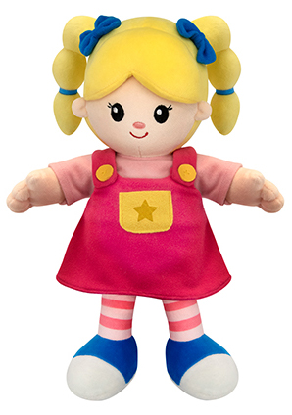
tOYS
D
O
L
L

Slide 17
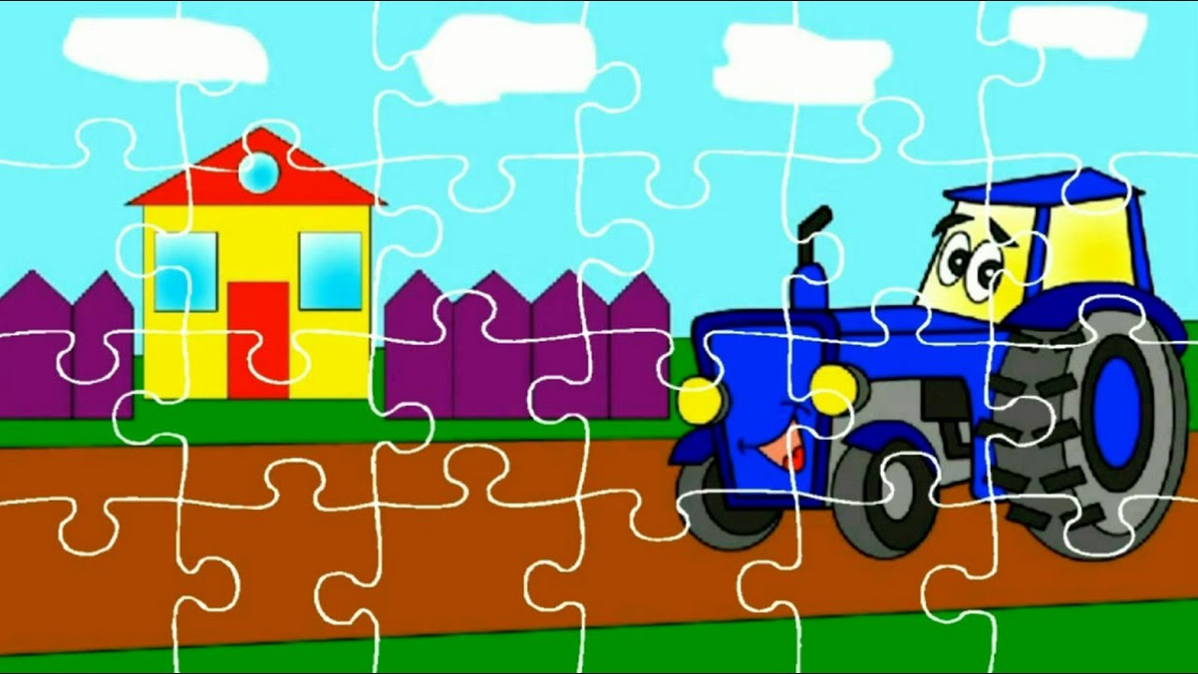
tOYS
P
U
Z
Z
L
E
TRÒ CHƠI GHÉP HÌNH

Slide 18

tOYS
R
O
B
O
T

Slide 19
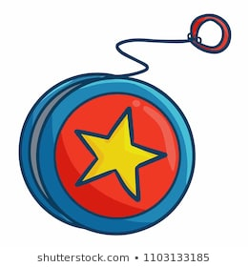
tOYS
Y
Y
O
O
-

Slide 20
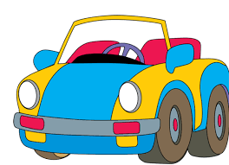
tOYS
C
A
R

Slide 21
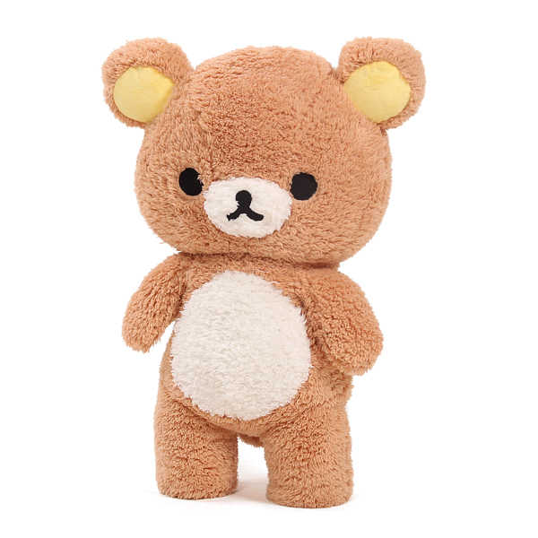
tOYS
T
E
D
D
Y
B
E
A
R

Slide 22


- car
- teddy bear
- yo-yo
New words:
- doll
- puzzle
- robot
TOYS

Slide 23


Slide 24

ROUND 1

Slide 25
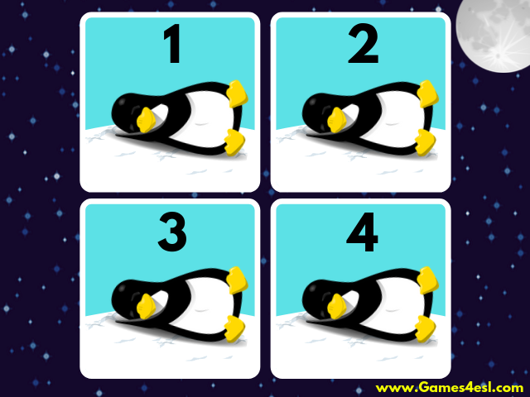

Slide 26
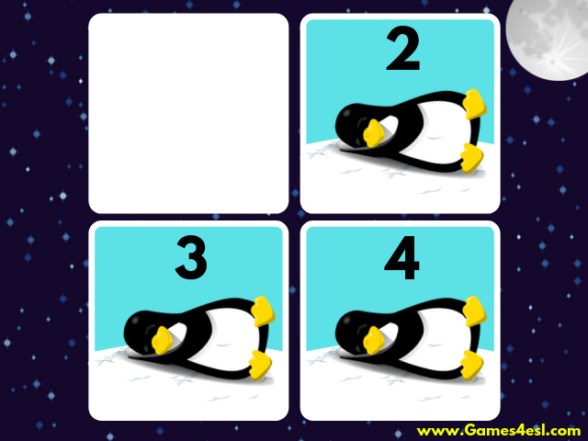

Slide 28
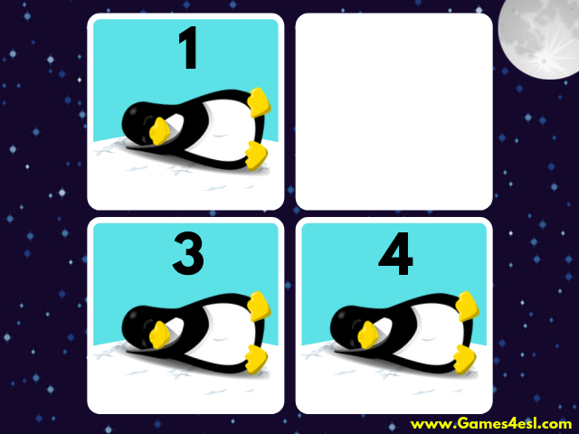

Slide 30
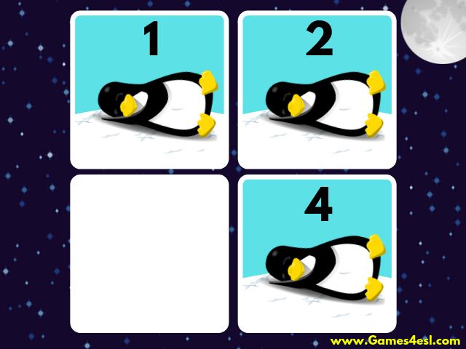

Slide 32
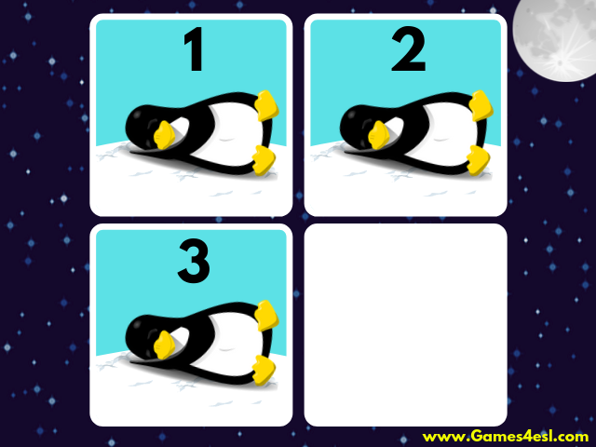

Slide 34


Slide 35
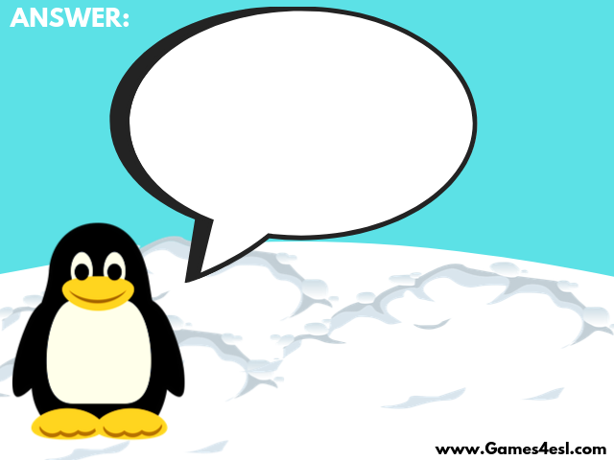
TEAM 1:
teddy bear

Slide 36
TEAM 2:
car

Slide 37
TEAM 3:
puzzle

Slide 38
TEAM 4:
doll

Slide 39
ROUND 2

Slide 50
TEAM 1:
robot

Slide 51
TEAM 2:
puzzle

Slide 52
TEAM 3:
teddy bear

Slide 53
TEAM 4:
yo-yo

Slide 54


Slide 55
02
GRAMMAR

Slide 56
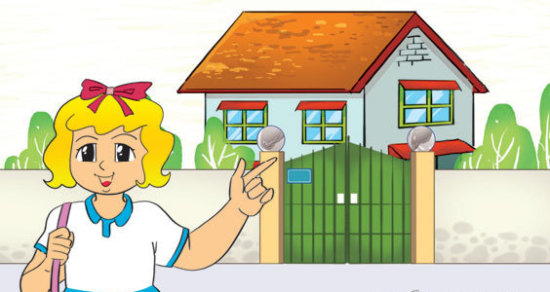
Linda's house

Slide 57
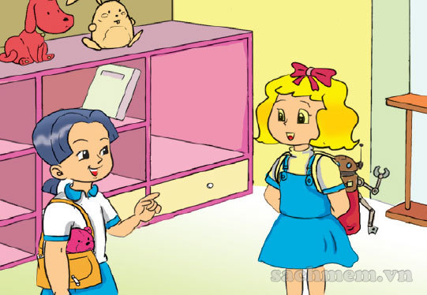

Slide 58
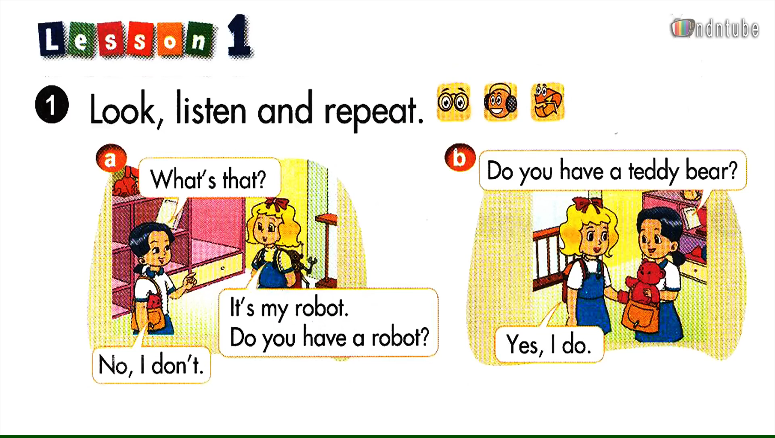

Slide 60
Do you have a robot?
No, I don’t.

Slide 61
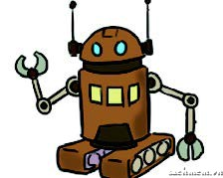
2. New sentences:
Do
Do you have a robot?
do
- No, I don’t.
Do
Do you have a teddy bear?
do
- Yes, I do.
(don’t = do not)

Slide 62
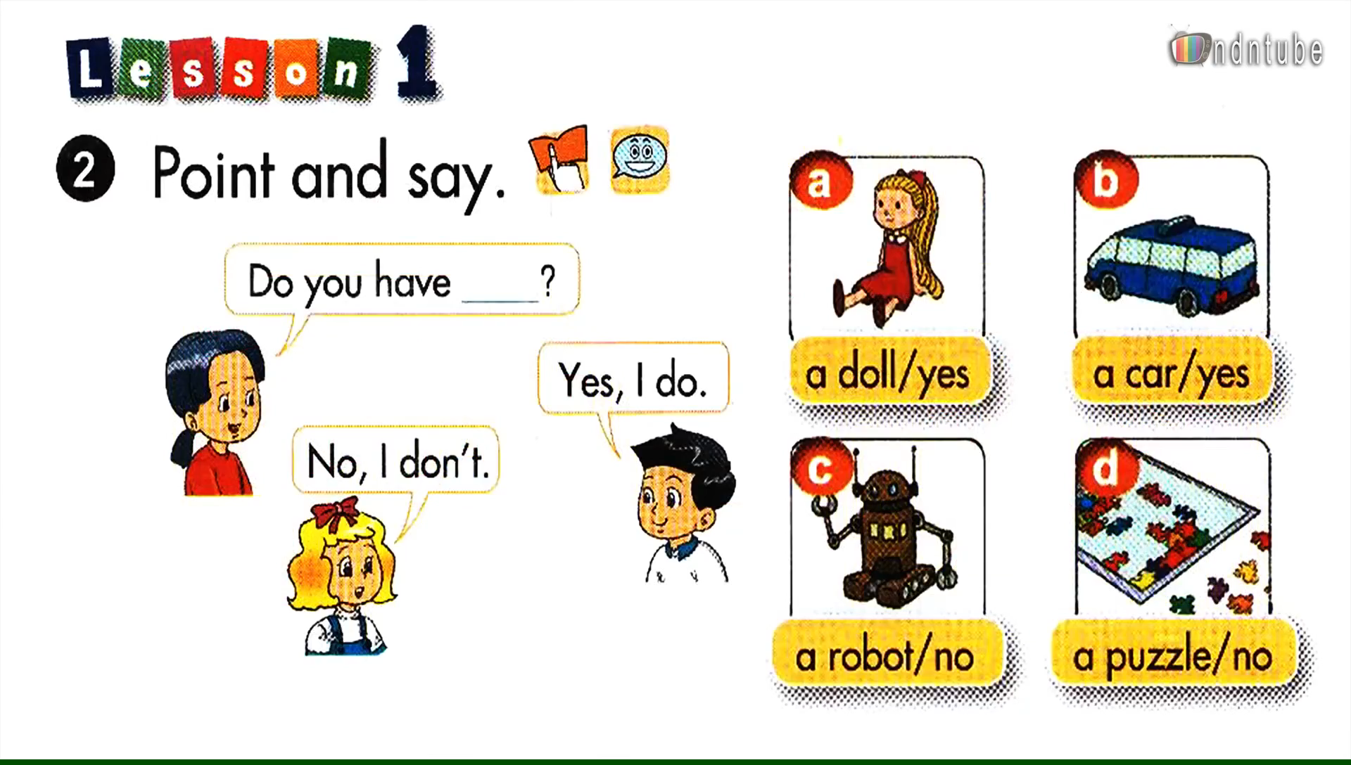

Slide 64


It
a doll
Do you have _______ ?
It
Yes, I do.

Slide 65

It
Do you have ________ ?
a puzzle
It
No, I don’t.

Slide 66
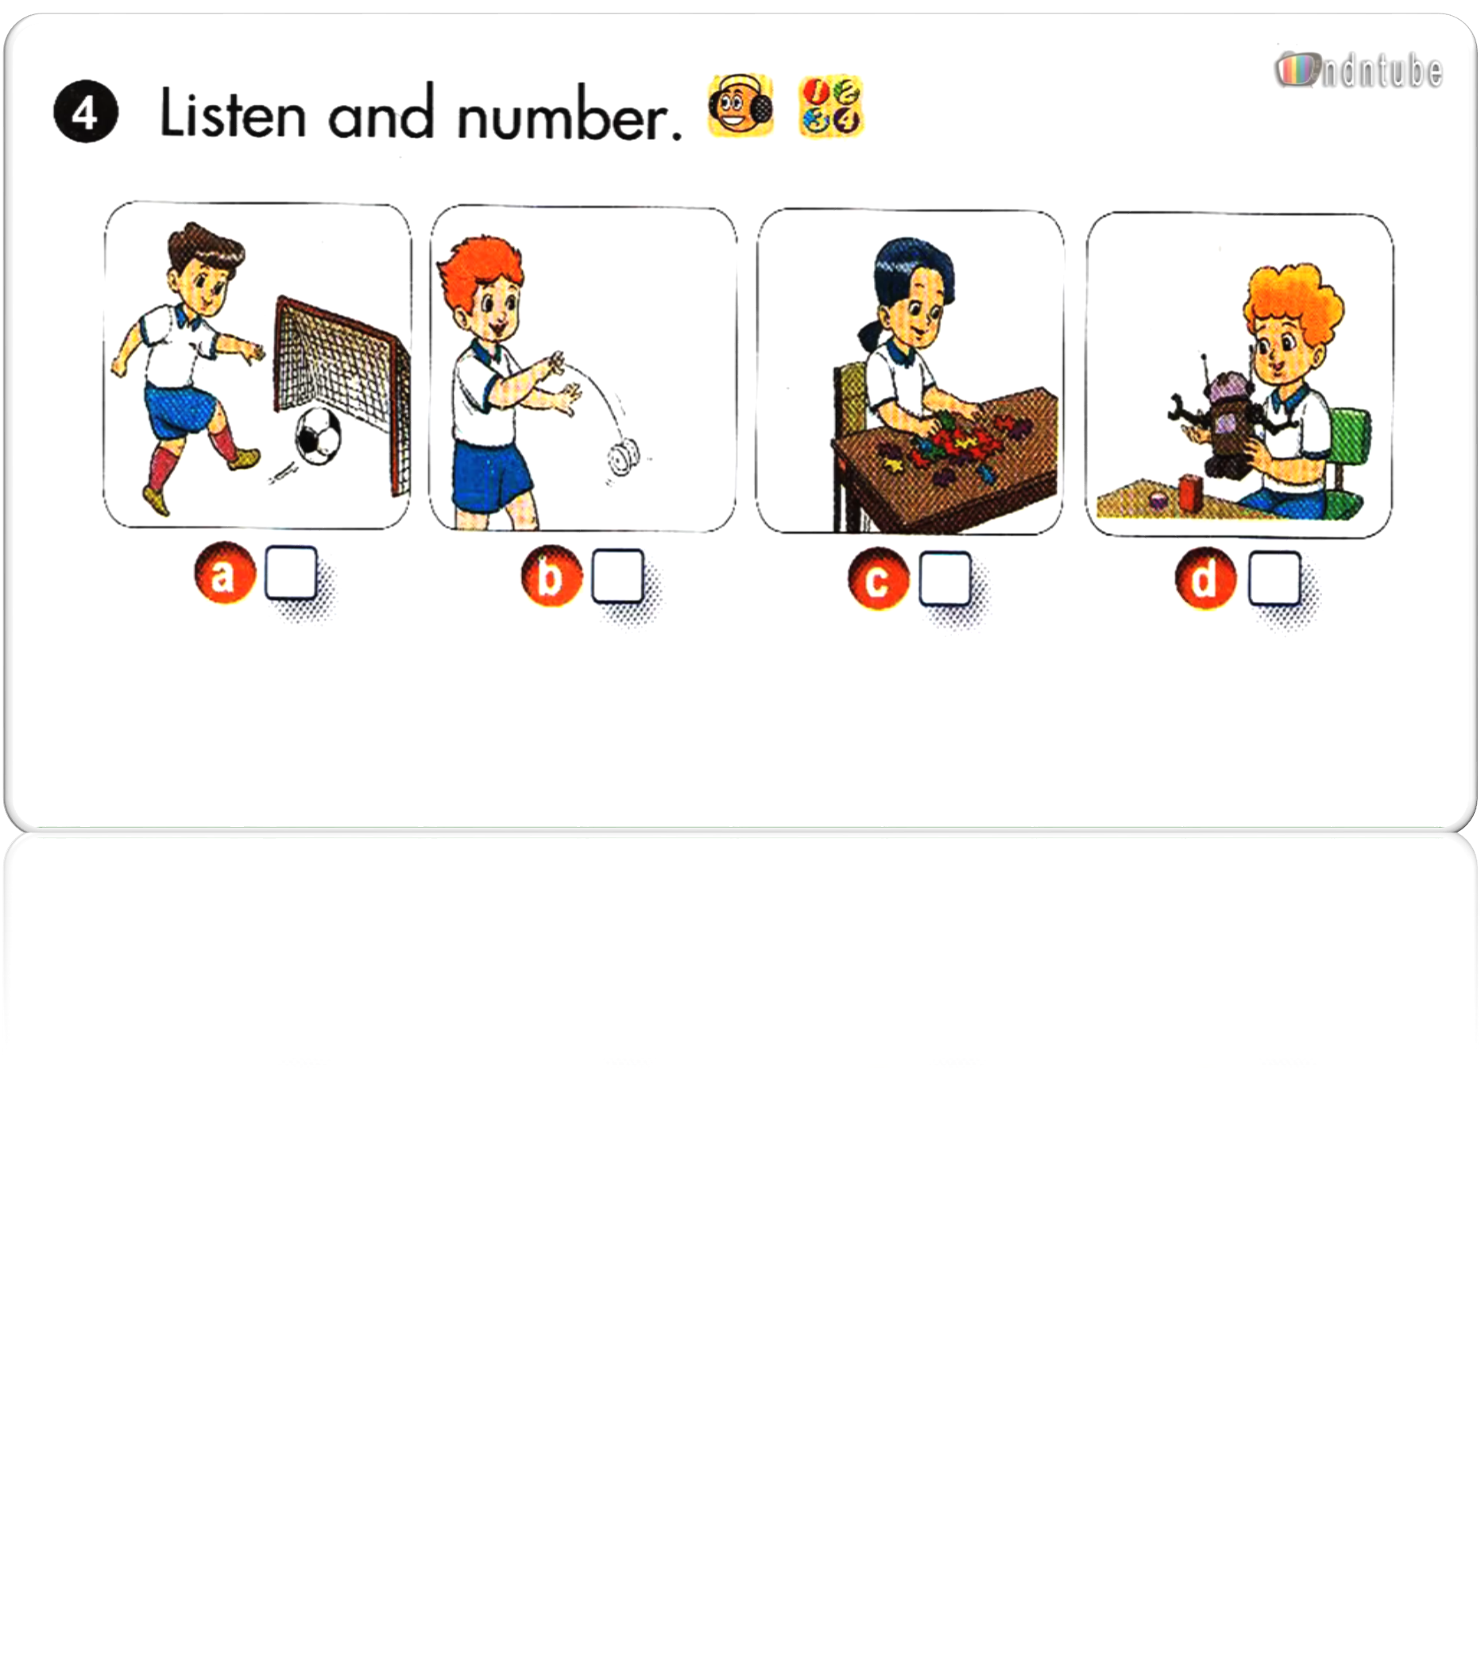


Slide 67
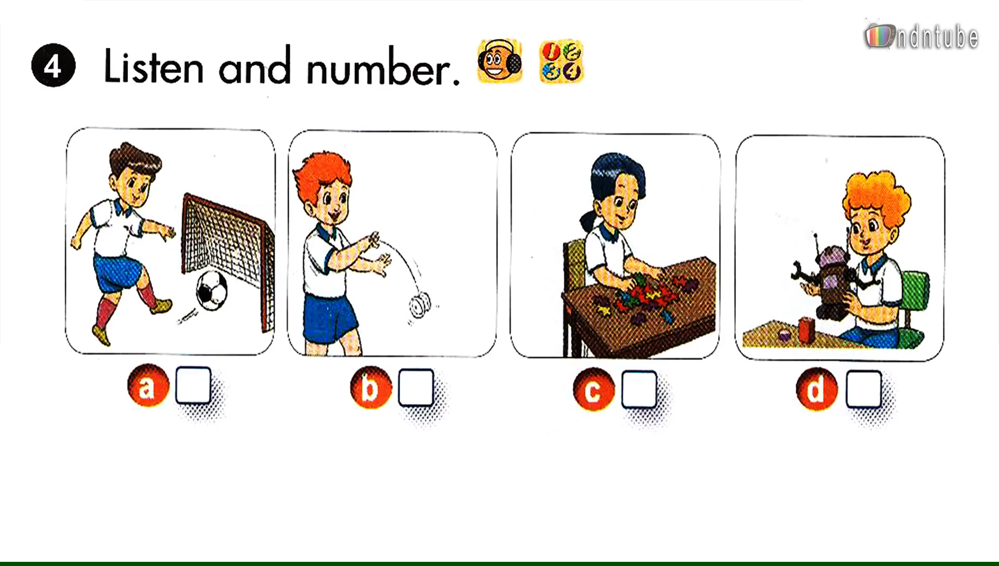

Slide 68
01
SOME VOCABULARY
(doll, ball, teddy bear, puzzle, car, robot)
02
GRAMMAR
(Do you have….?)
03
LISTENING & SPEAKING
04
GAMES

Slide 69
WRAP-UP:
1. New words:
doll puzzle
car teddy bear
yo-yo robot
2. New sentences:
Do you have a puzzle?
- Yes, I do. / No, I don’t.

Slide 70
* Learn new words and sentences.
Home-link
* Practice on OLM.VN
* Prepare for Unit 15 Lesson 2+3.

Slide 71


Slide 72
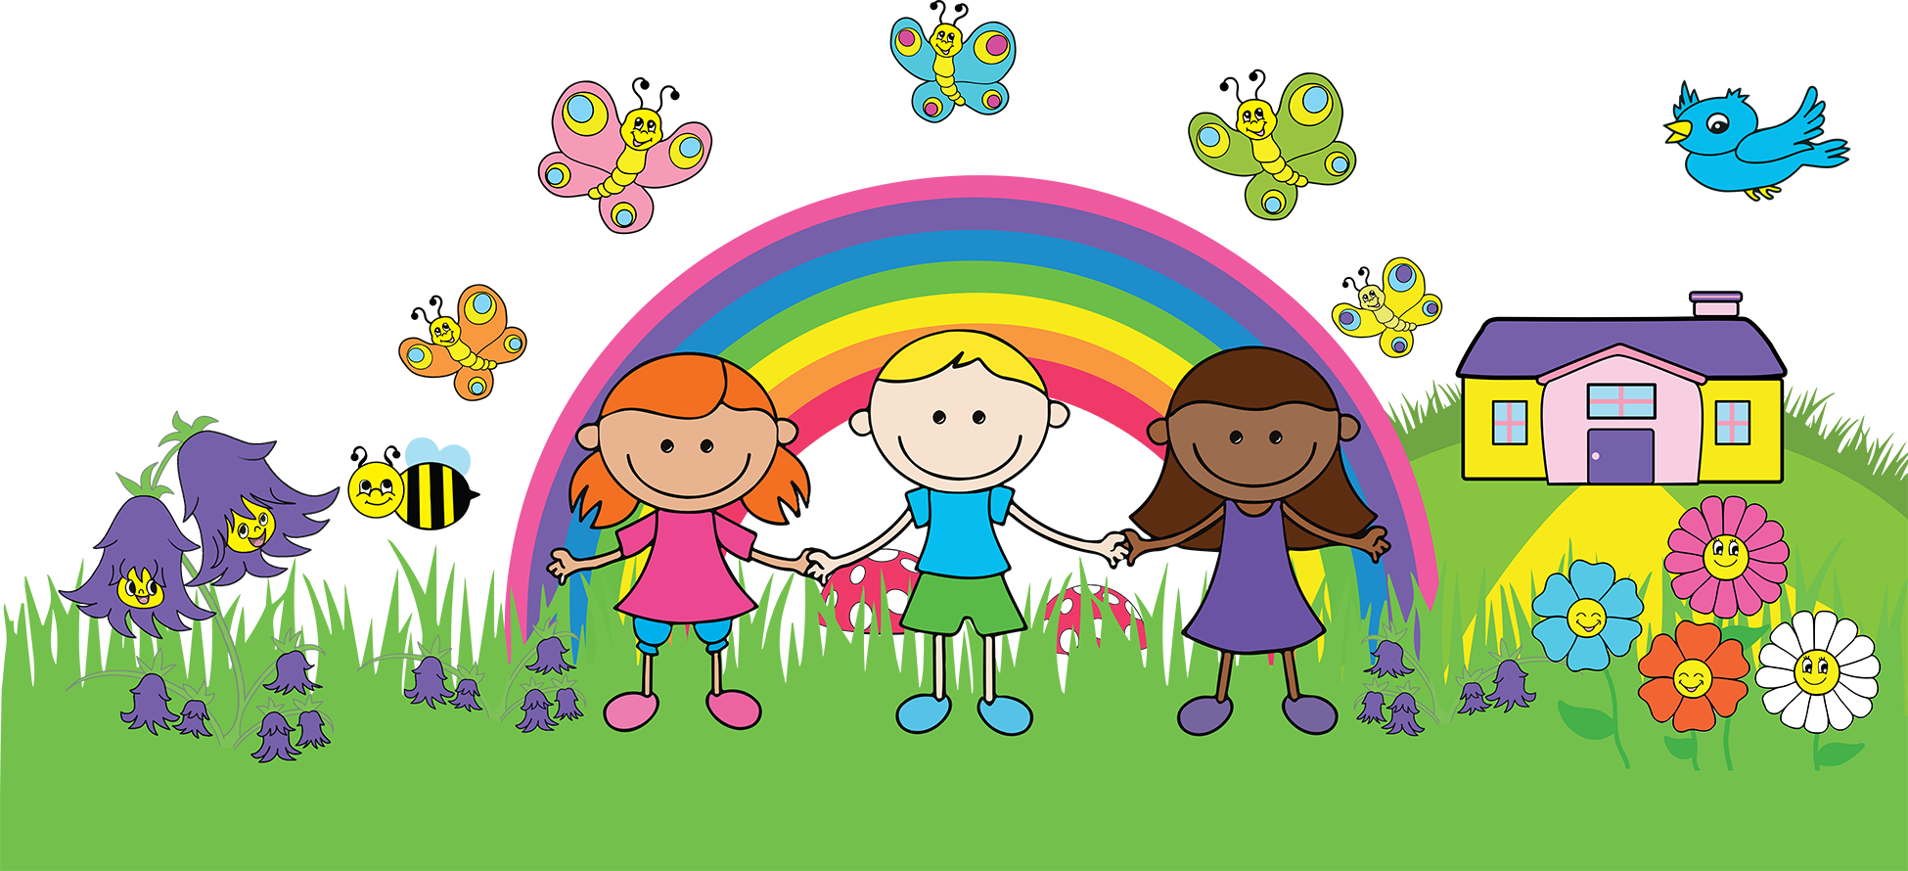
Thank you
for your attention!

