Slide 1
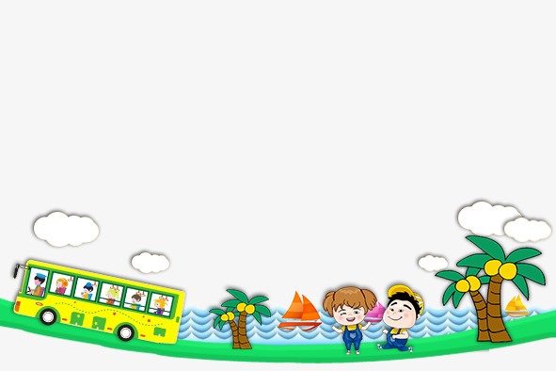
UNIT 5. WHERE WILL YOU BE
THIS WEEKEND?
LESSON 2

Slide 2


WARM UP

Slide 3
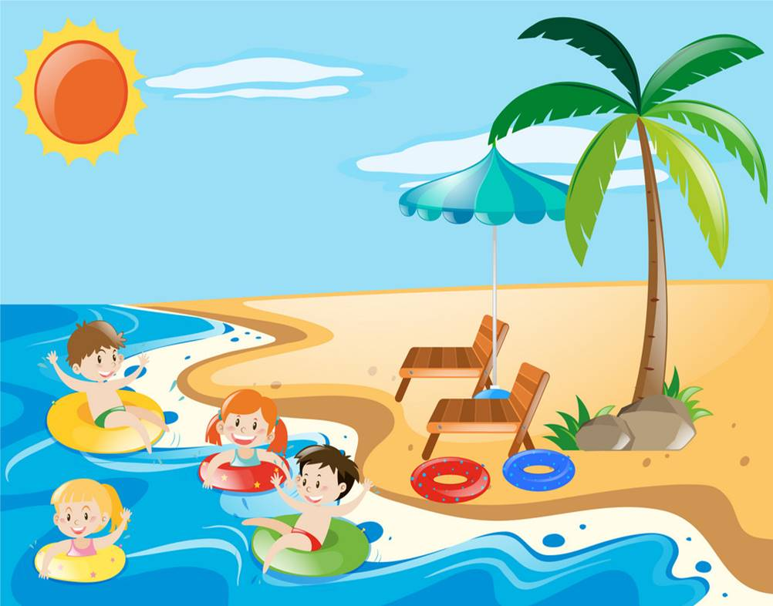
Swim in the sea

Slide 4
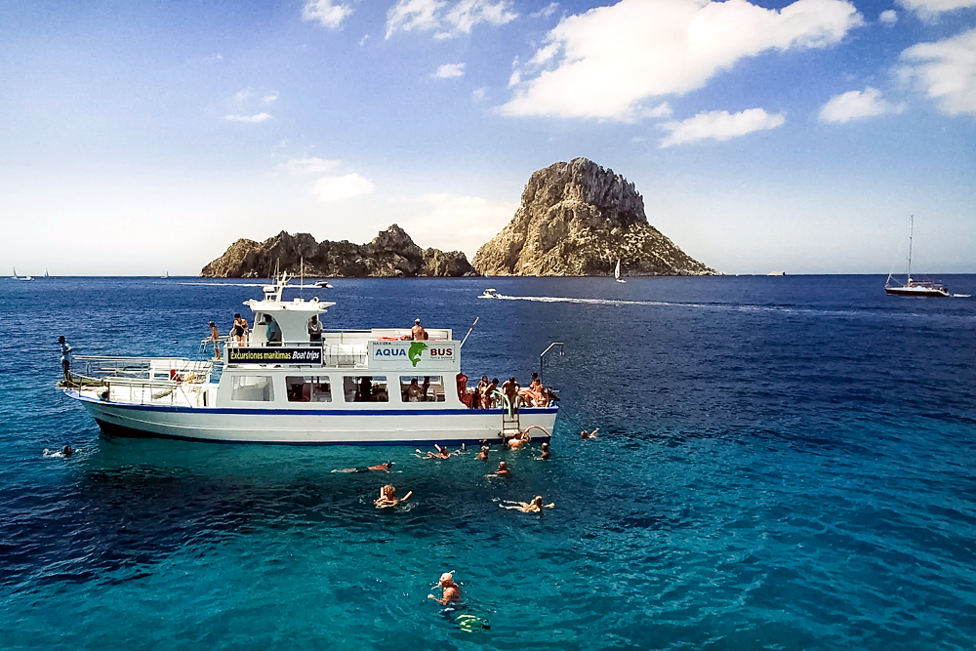
TAKE A BOAT TRIP

Slide 5
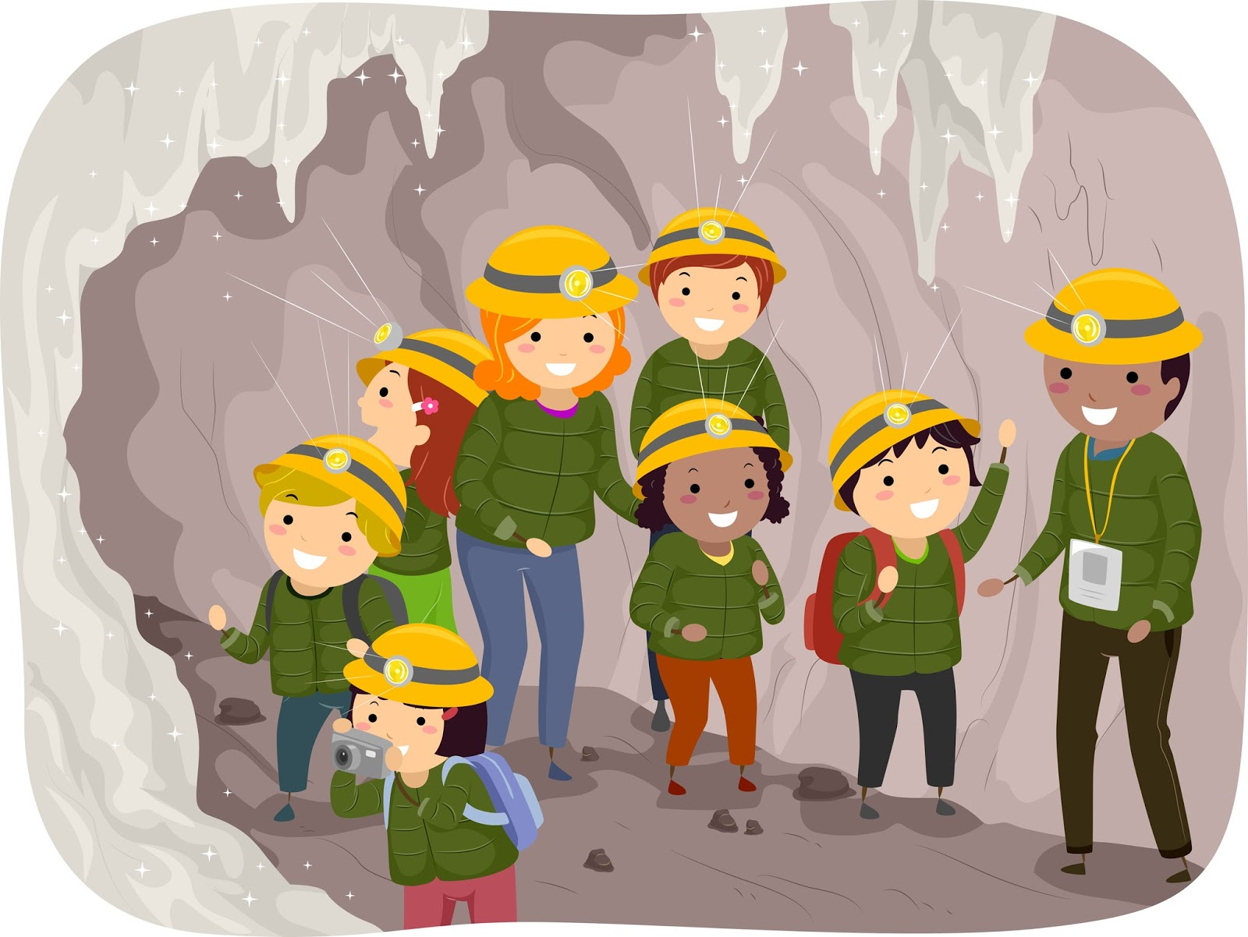
Explore the cave

Slide 6
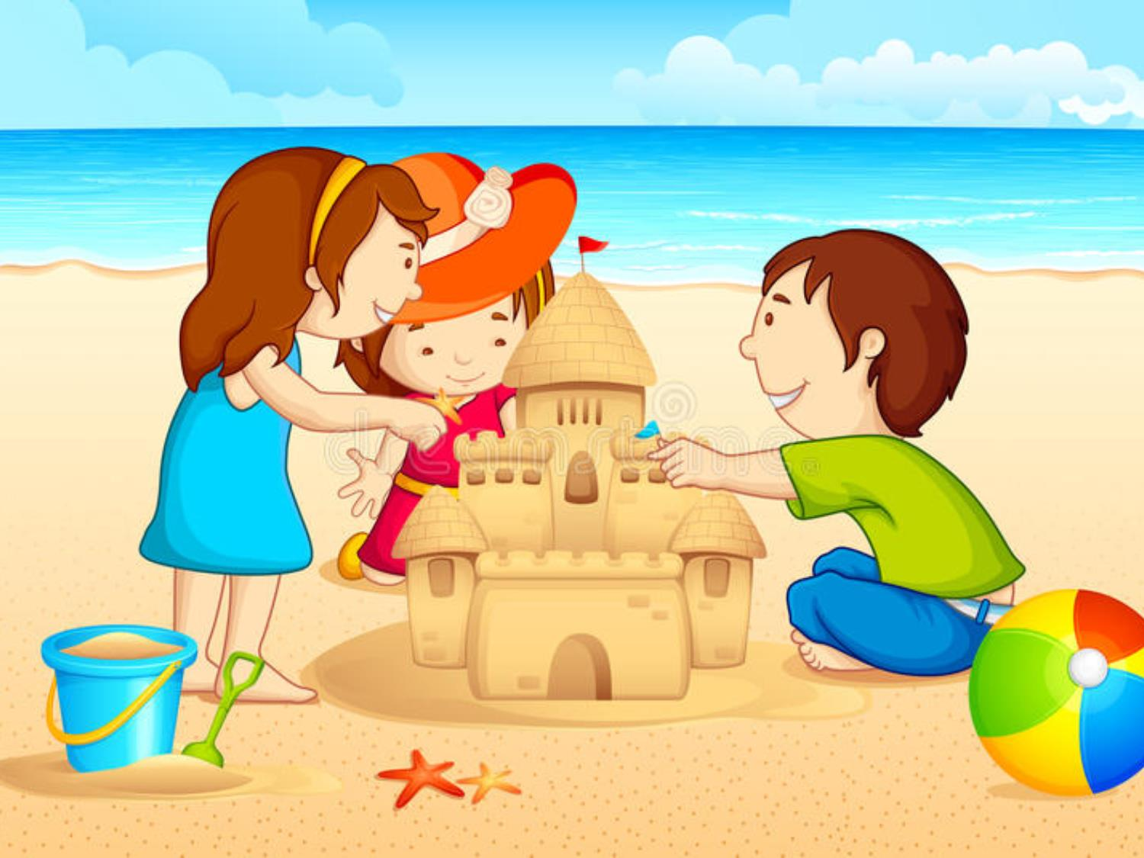
BUILD SANDCASTLES

Slide 7
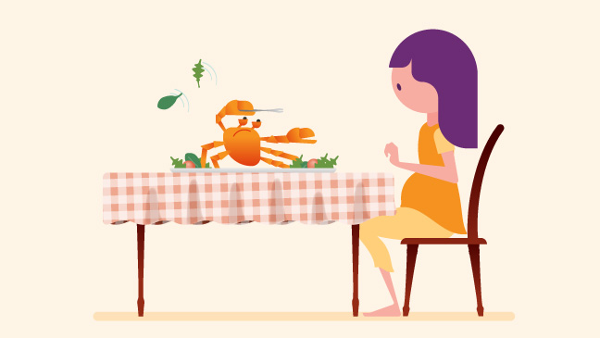
EAT SEAFOOD

Slide 8
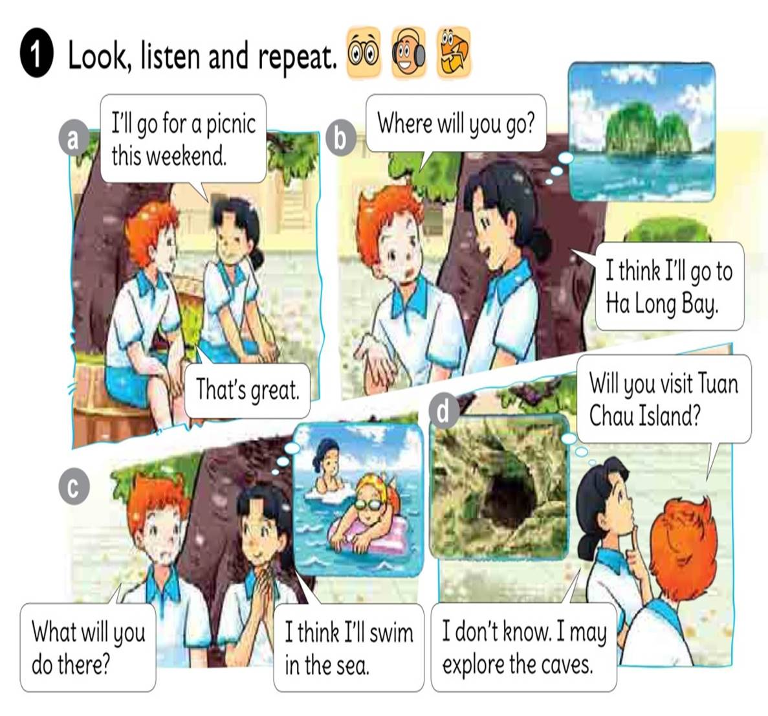




Slide 9
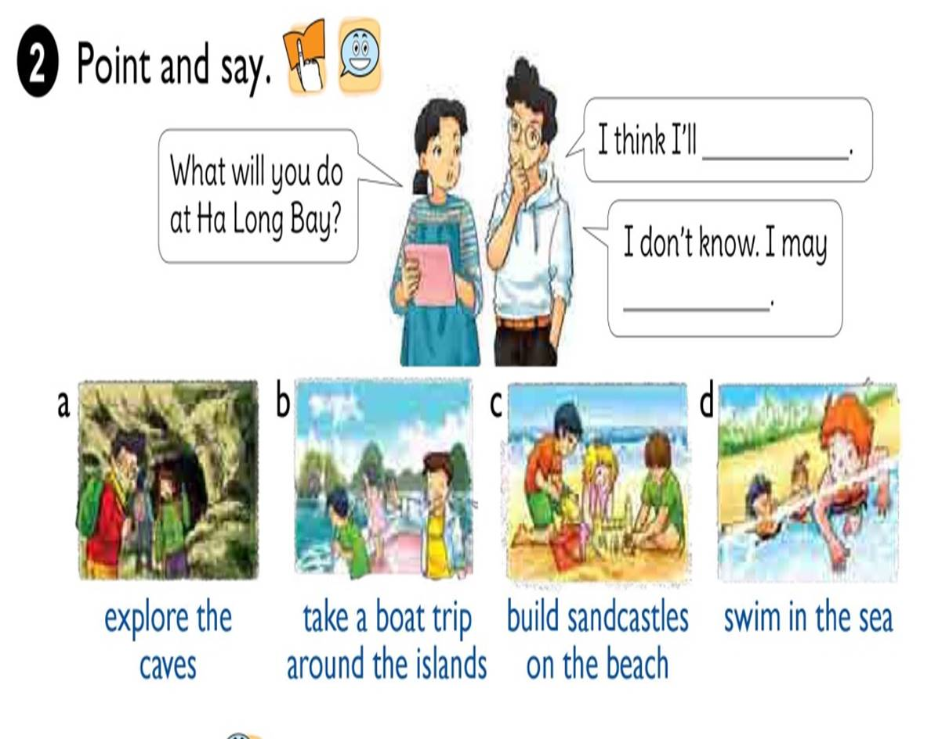

Slide 10
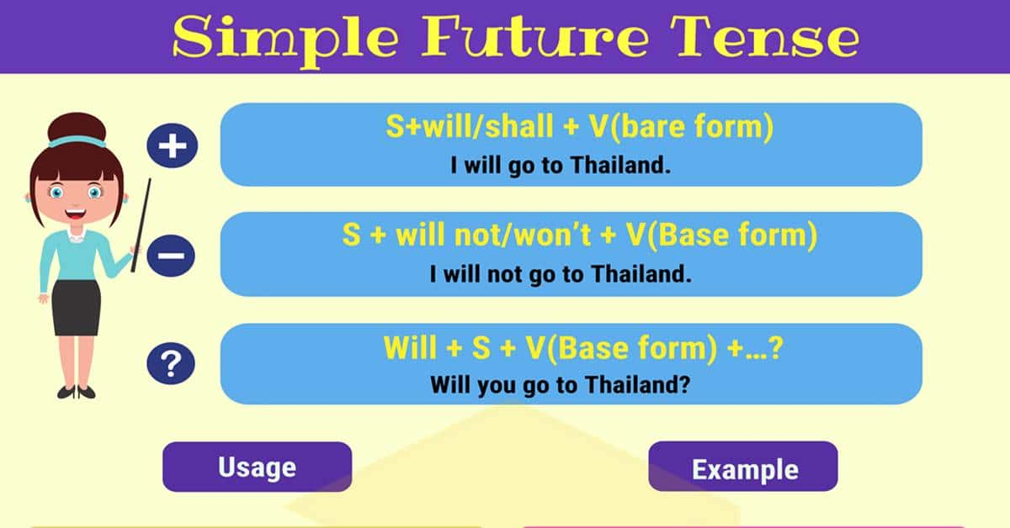

Slide 11



Where will you do at Ha Long Bay?
I think I’ll
explore the caves.
I don’t know. I may
explore the caves.

Slide 12
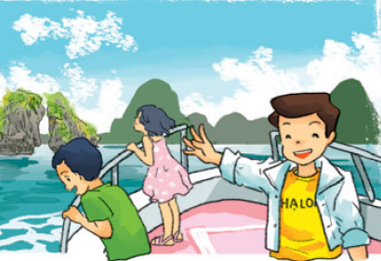
Where will you do at Ha Long Bay?
I think I’ll
take a boat trip.
I don’t know. I may
take a boat trip.

Slide 13
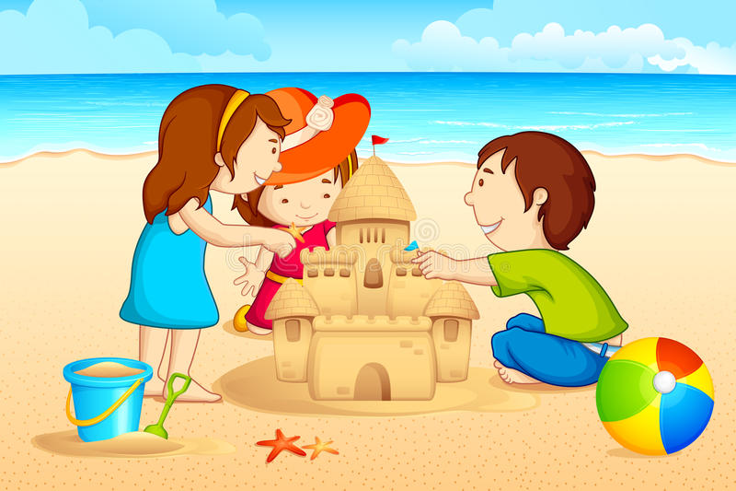
Where will you do at Ha Long Bay?
I think I’ll
build sandcastles on the beach.
I don’t know. I may
build sandcastles on
on the beach.

Slide 14
Where will you do at Ha Long Bay?
I think I’ll
swim in the sea.
I don’t know. I may
swim in the sea.

Slide 15

1. Vocabulary
- explore the caves
- take a boat trip
- build sandcastles
- swim in the sea
- eat seafood
2. Model sentence
Where will you do at Ha Long Bay?
I think I’ll swim in the sea.

Slide 16
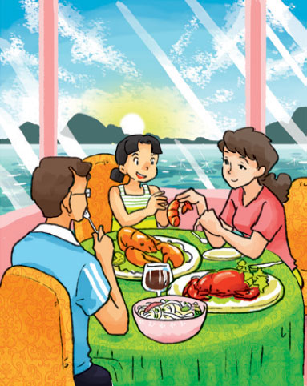
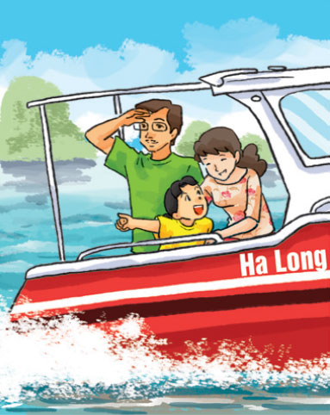

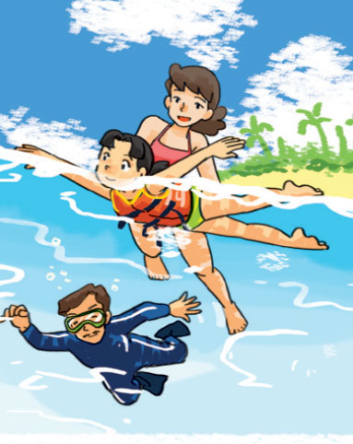
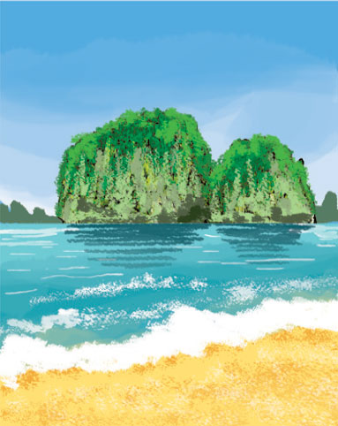
1
2
3
4
LISTEN AND NUMBER
2
a
3
b
4
c
1
d

Slide 17

WRITE ABOUT YOU
1. Where will you be tomorrow?
→
2. What will you do?
→
I think I’ll be in the school library.
I think I’ll be at school.

Slide 18
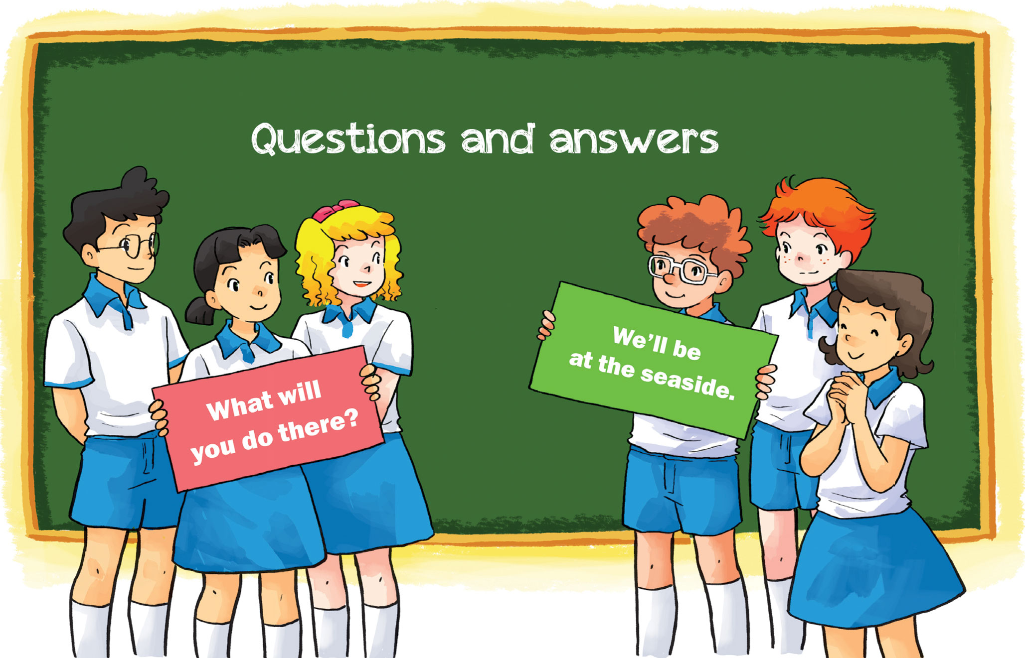

Slide 19


Slide 20
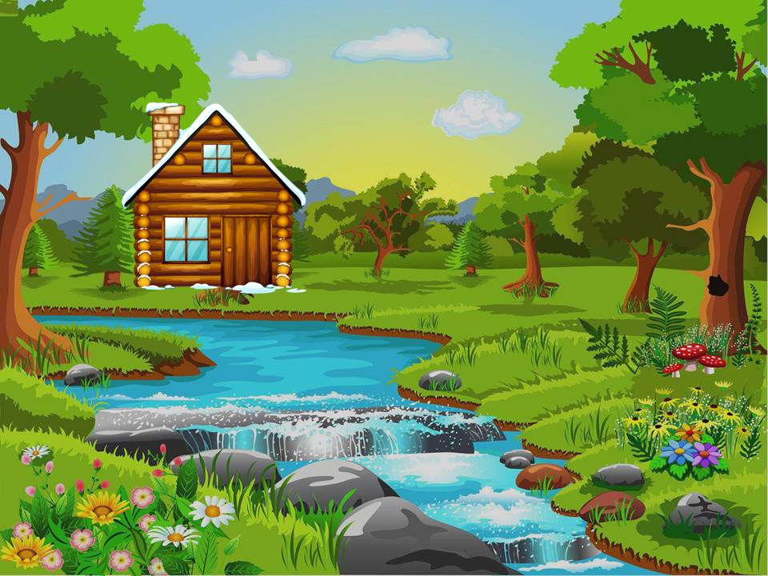



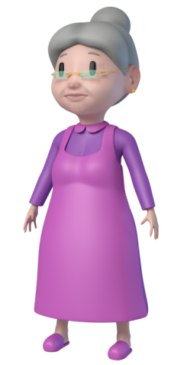


PLAY
Little
Red

Slide 21



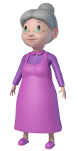








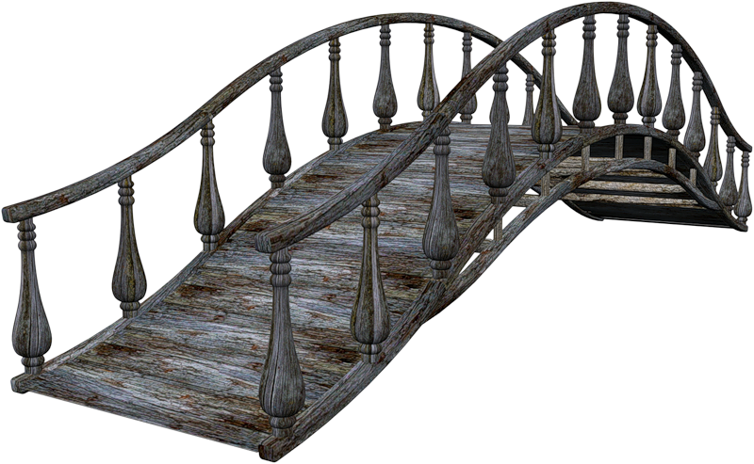






Slide 22
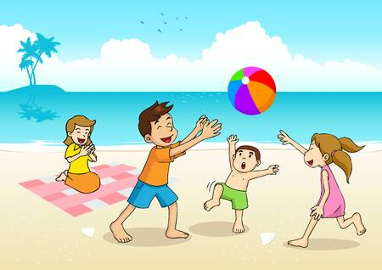

In the countryside
In the mountains
On the beach

Slide 23
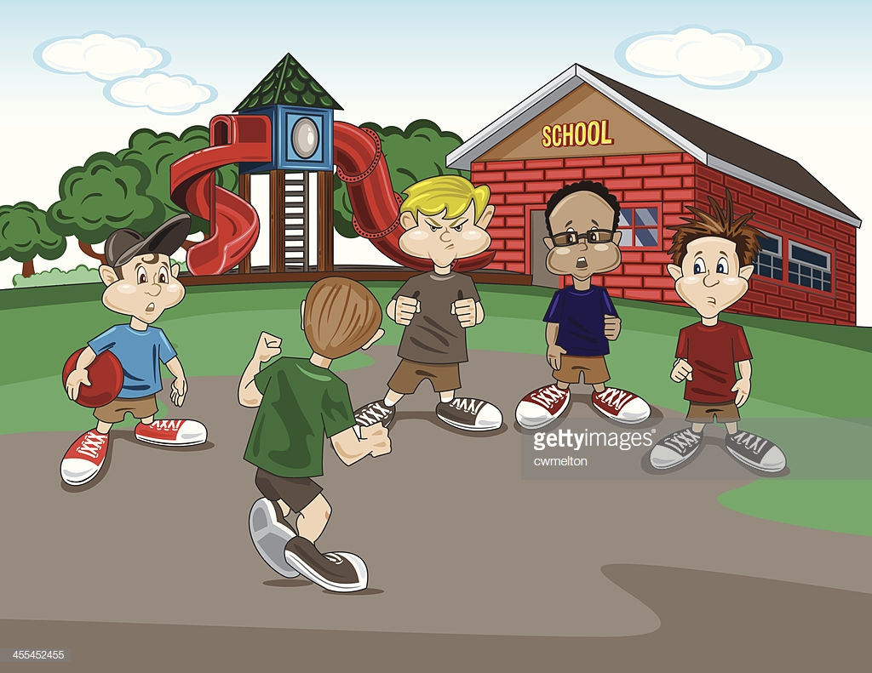
In the cinema
At the zoo
At school

Slide 24
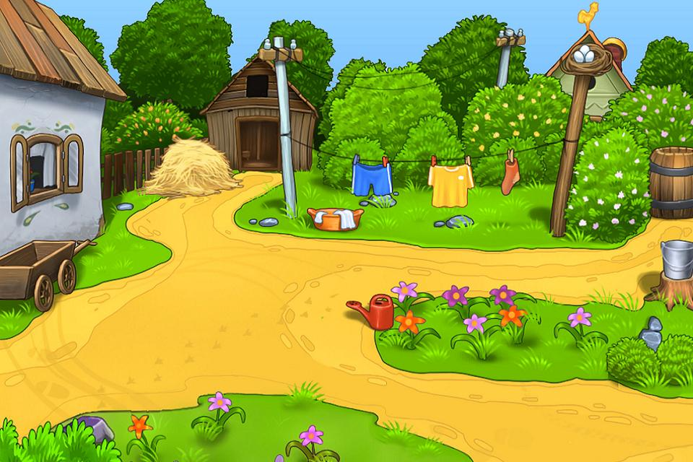
In the moutains
In the countryside
On the beach

Slide 25
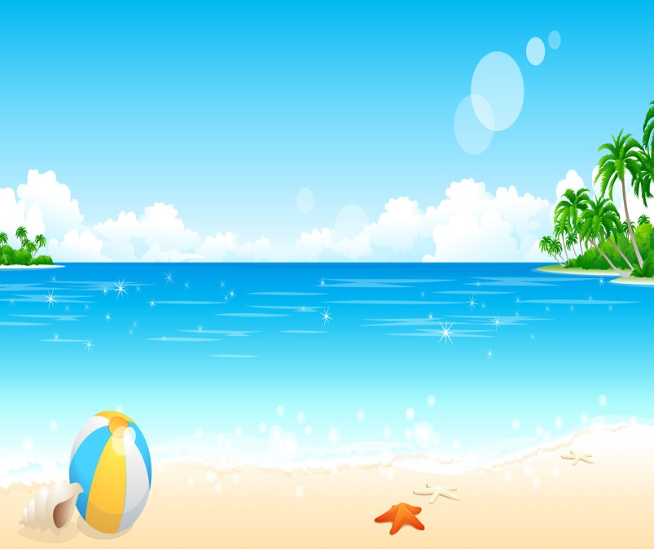
By the sea
In the city
In the mountains

Slide 26
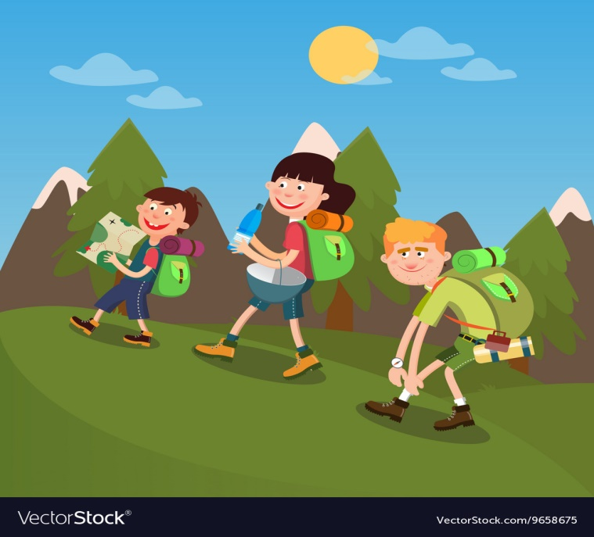
In the moutains
At school
On the beach

Slide 27

Swim in the sea
Take a boat trip
Explore the cave

Slide 28
Take a boat trip
Swim in the sea
Build sandcastles

Slide 29
Build sandcastles
Swim in the sea
Explore the cave

Slide 30
Explore the cave
Take a boat trip
Swim in the sea

Slide 31
Eat seafood
Swim in the sea
Take a boat trip

Slide 32
