Slide 1

UNIT 7. HOW DO YOU LEARN ENGLISH?
LESSON 2

Slide 2


WARM UP

Slide 3
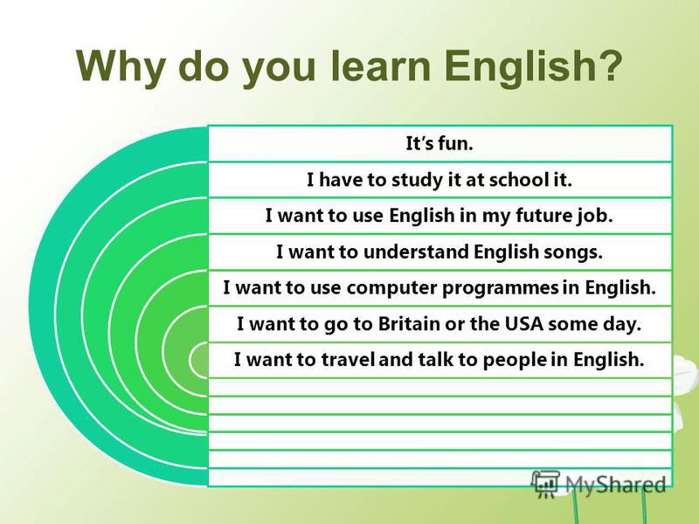

Slide 4


Slide 5
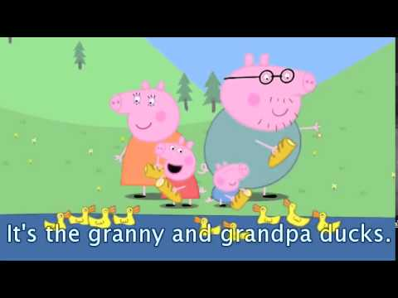
Watch English cartoon

Slide 6
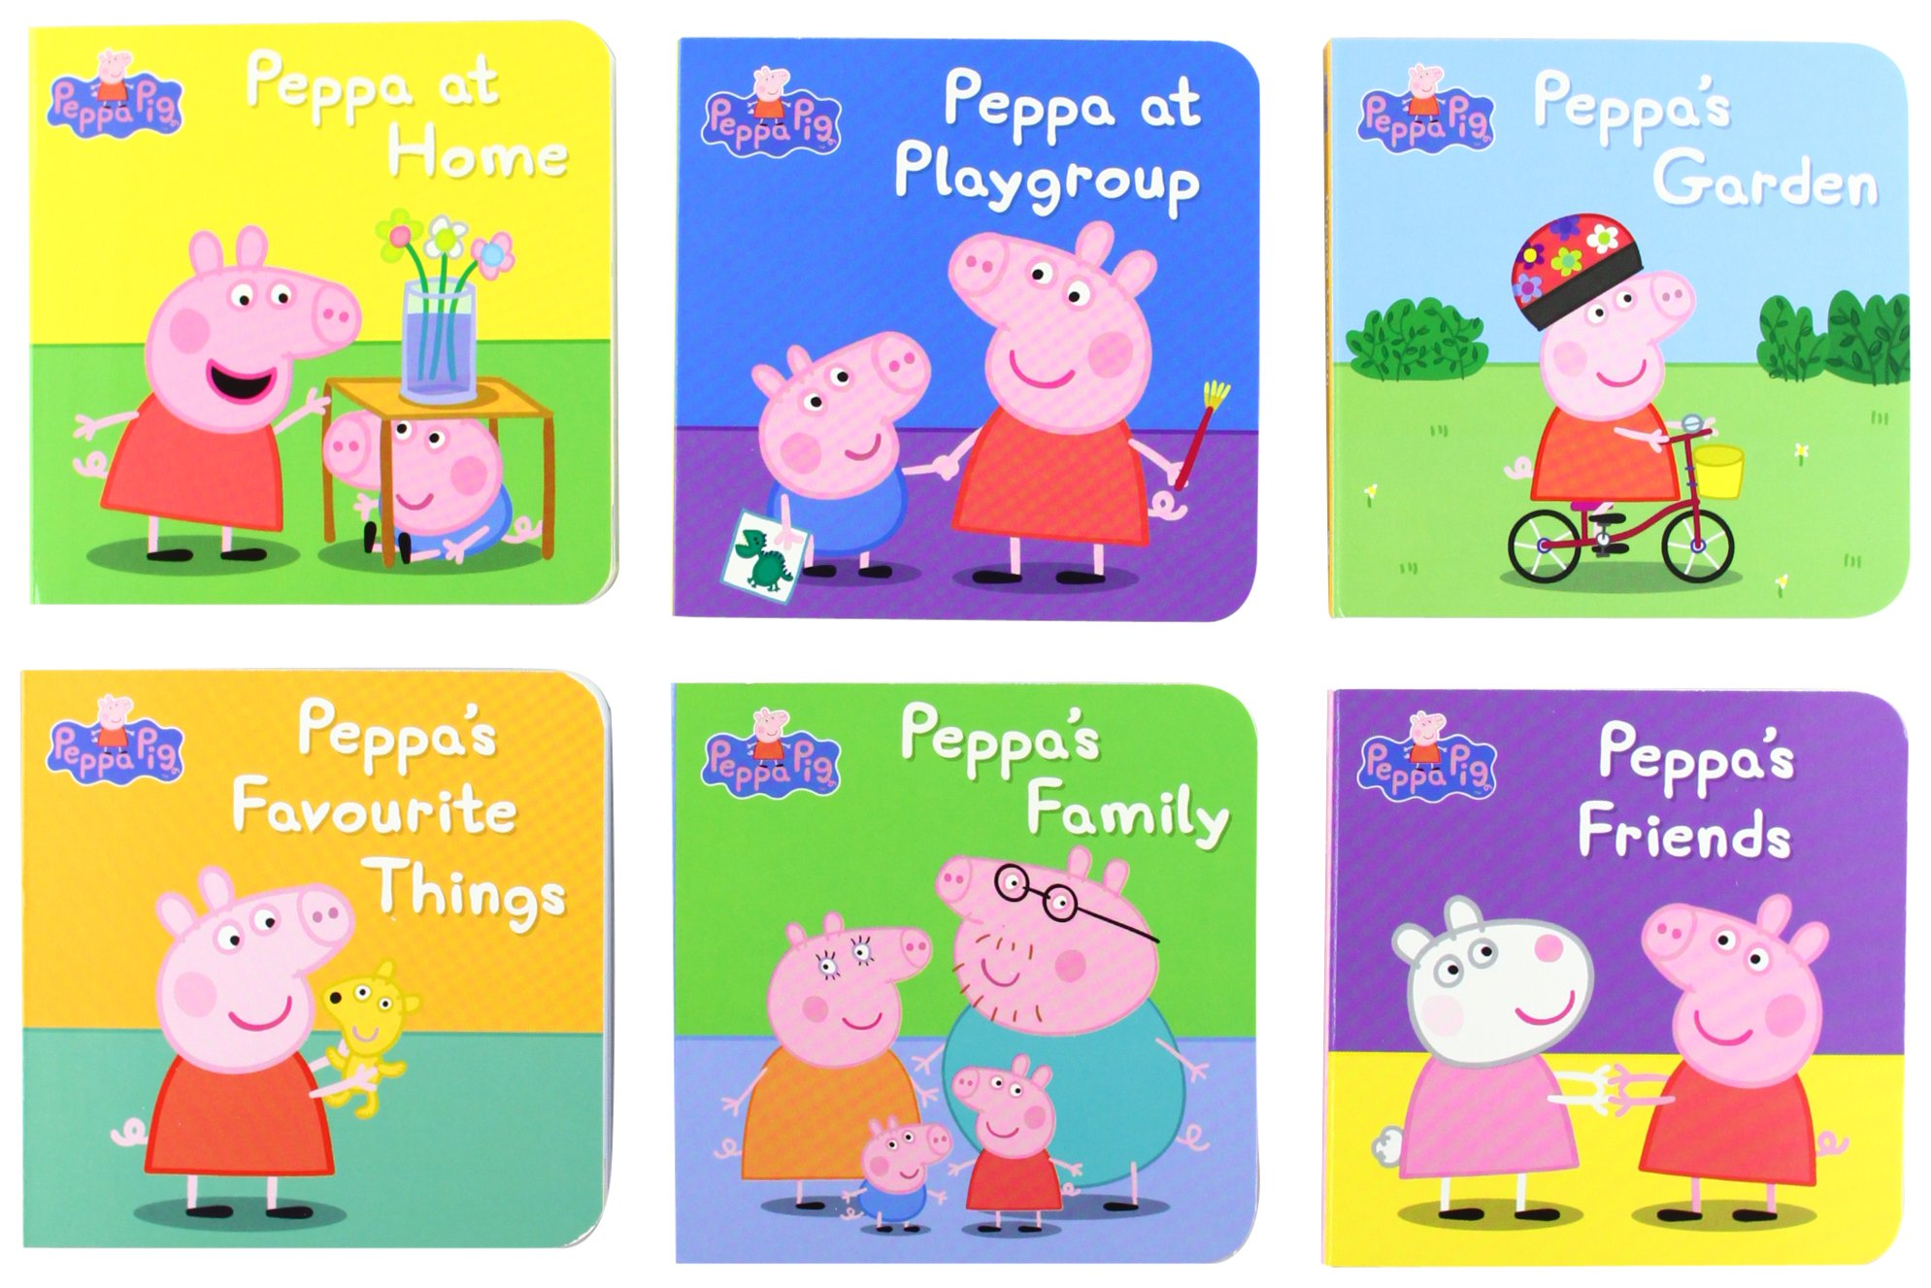
Read English comics books

Slide 7

Talk with foreign friends

Slide 8

Sing English songs

Slide 9






Slide 10
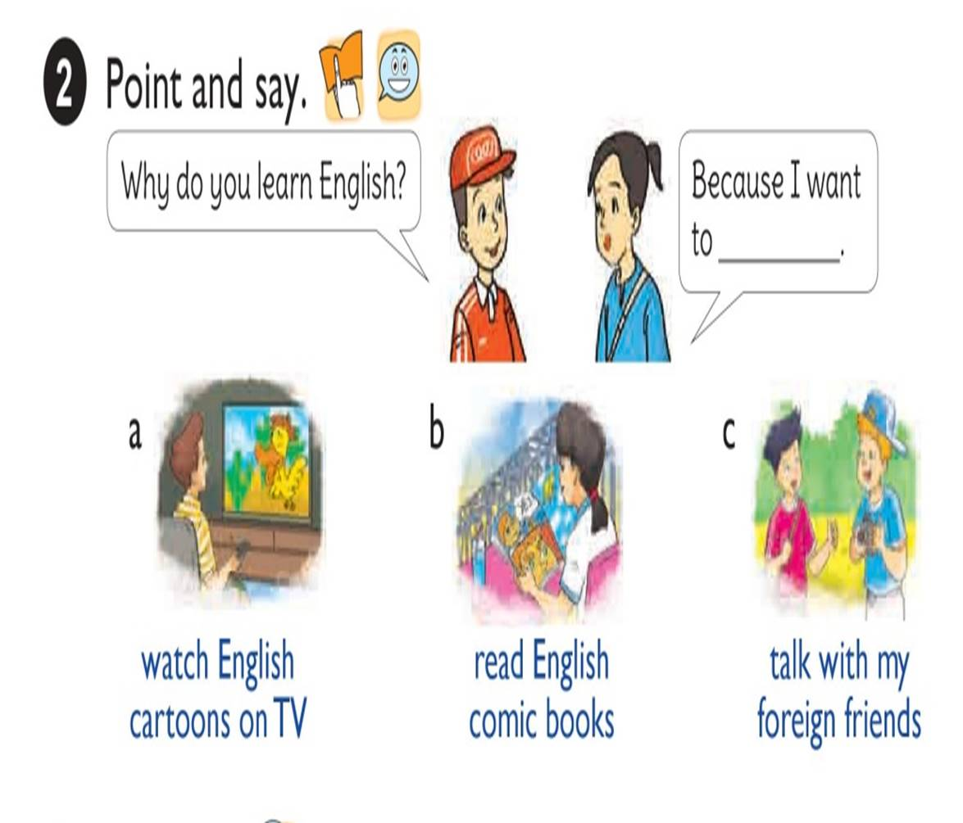

Slide 11


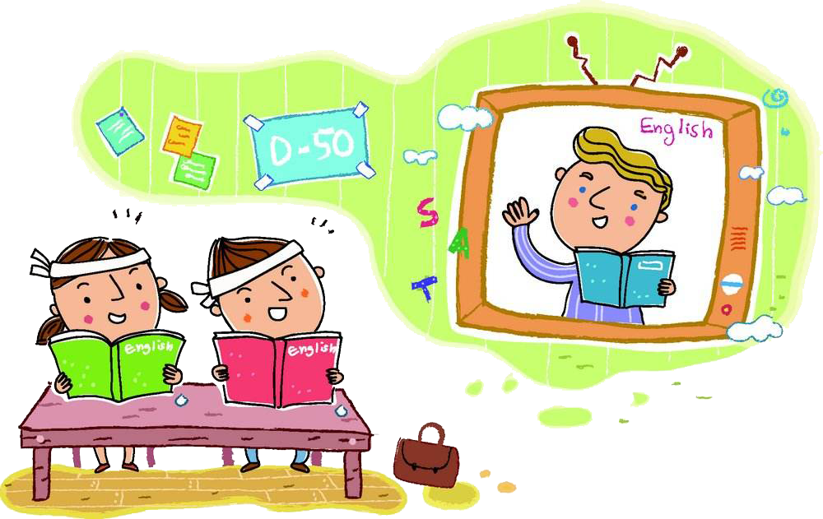
Why do you learn English?
Because I want to
Watch English
cartoons on TV.

Slide 12

Why do you learn English?
Because I want to
read English
comic books.

Slide 13
Why do you learn English?
Because I want to
talk with my
foreign friends.

Slide 14

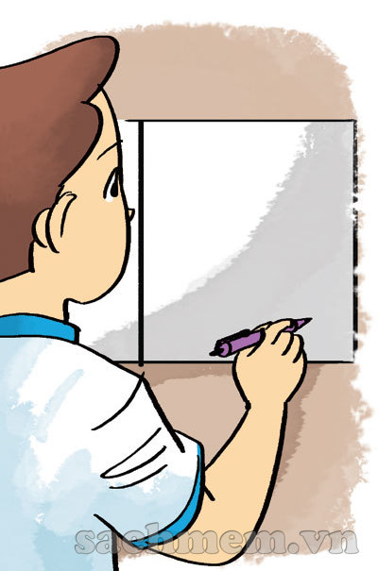

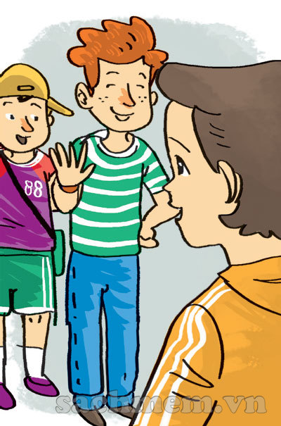
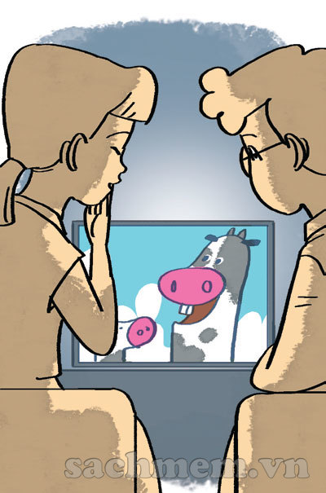
LISTEN AND NUMBER
1
2
3
4
2
a
4
a
1
a
3
a

Slide 15
WRITE ABOUT YOU
1. How do you practise speaking English?
2. How do you practise reading English?
3. How do you practise writing English?
4. How do you learn English vocabulary?
5. Why do you learn English?
I speak English every day with my friends.
I read English short stories.
I write emails to my friends every day.
I write these words in my notebook and
read them aloud.
Because I want to become an English teacher.

Slide 16
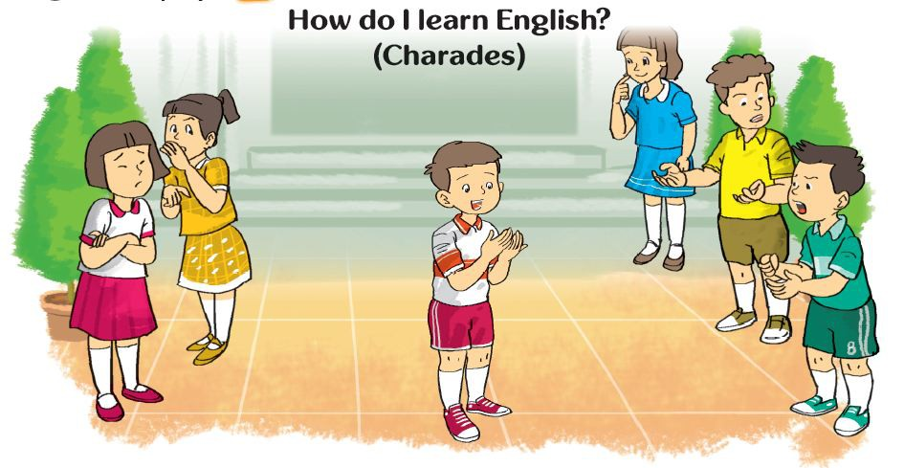


Slide 17


