Slide 2
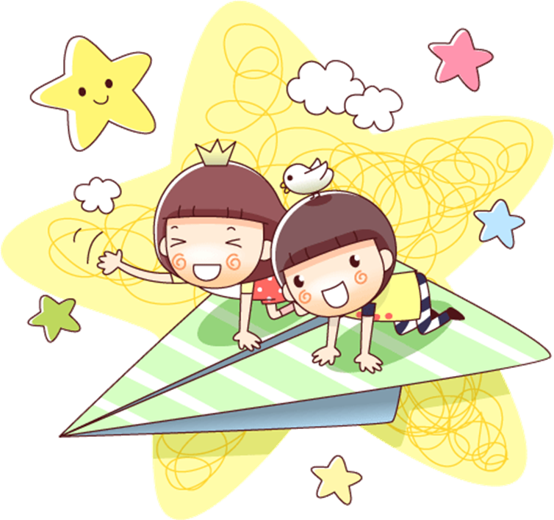
English 4
LE QUY DON PRIMARY SCHOOL
UNIT 1: NICE TO SEE YOU AGAIN
Lesson 3

Slide 5
3. Let’s chant

Slide 6
REINFORCE:
- Tell the new words we learnt today.
- What is the model sentences?

Slide 7
Thanks for your listening!
Goodbye. See you later!
Notes:
7

