Slide 1
Tuesday, September 7th 2021
Unit 2: I always get up early. How about you?

Slide 2
Unit 2: I always get up early. How about you?
Lesson 1

Slide 3
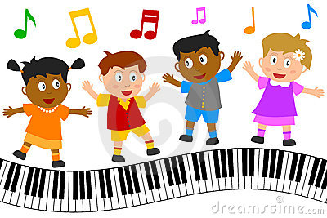
Let’s sing a song and dance
https://www.youtube.com/watch?v=eUXkj6j6Ezw

Slide 4
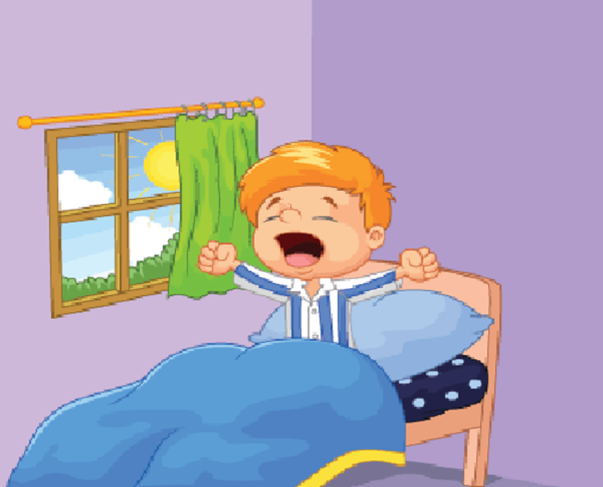
Unit 2: I always get up early. How about you?
Lesson 1

Slide 5
New words

Slide 6
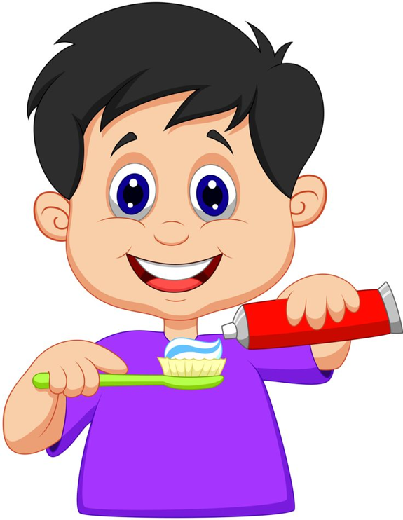
brush my teeth

Slide 7
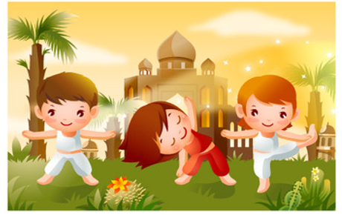
do morning exercise

Slide 8
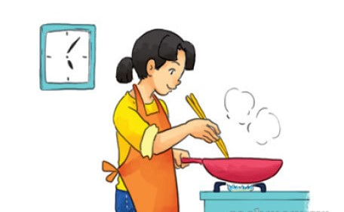
cook dinner

Slide 9
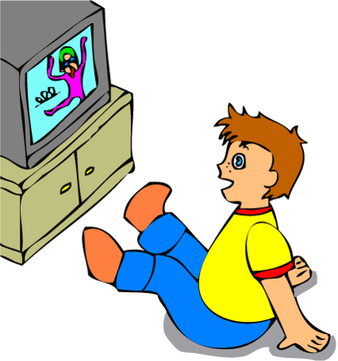
watch TV

Slide 10
get up

Slide 11
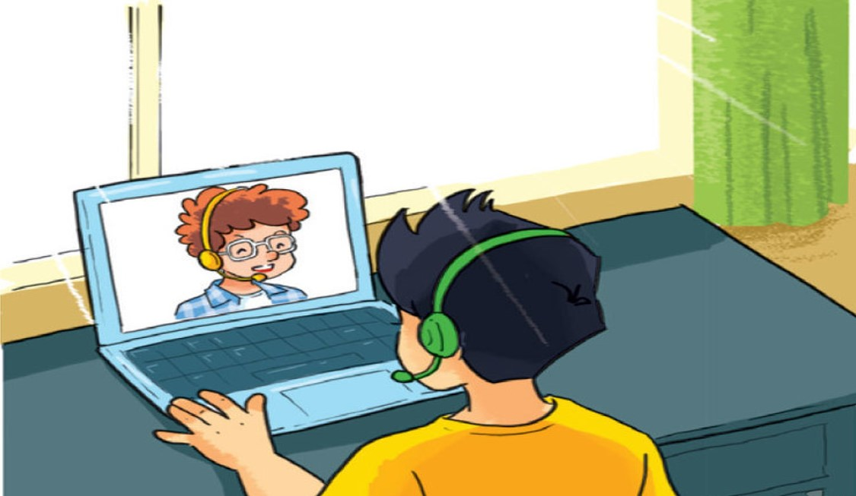
talk with friends online

Slide 12
Let’s play
a matching game

Slide 13
Match the English words in column 1 with their meanings in column 2
Column 1
Column 2
D
1. get up
A. xem ti vi
C
2. do morning excercise
B. nói chuyện trên mạng với bạn
A
3. watch TV
C. tập thể dục buổi sáng
B
4. talk with friends online
D. thức dậy
F
5. cook dinner
E. đánh răng
E
6. brush my teeth
F. nấu bữa tối

Slide 14
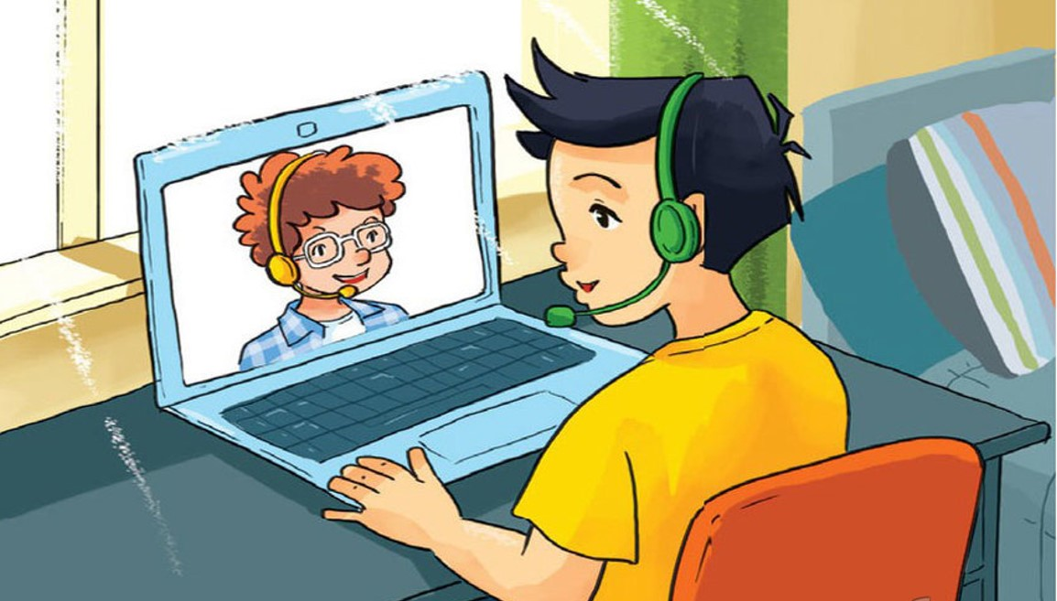
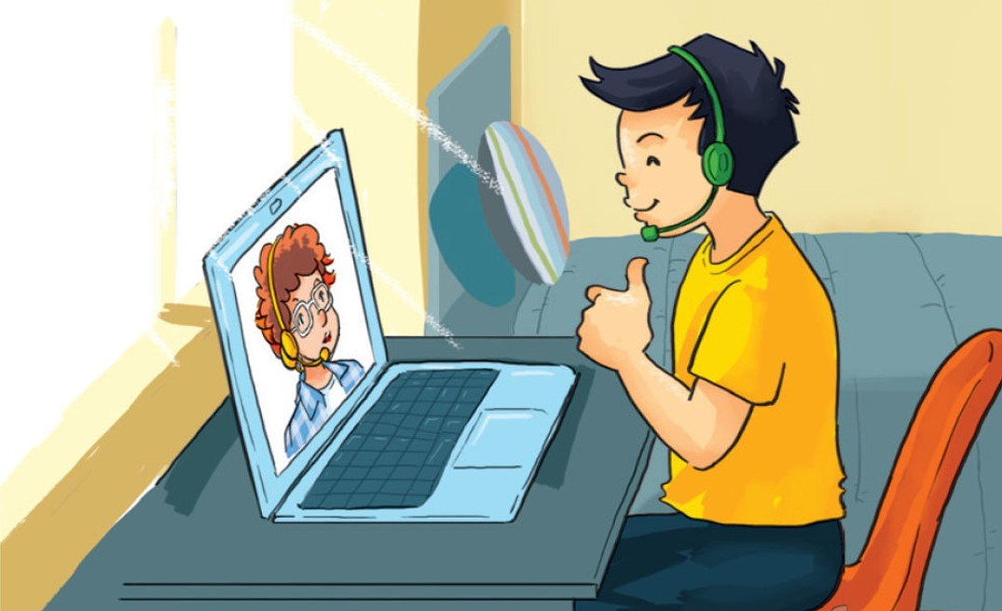
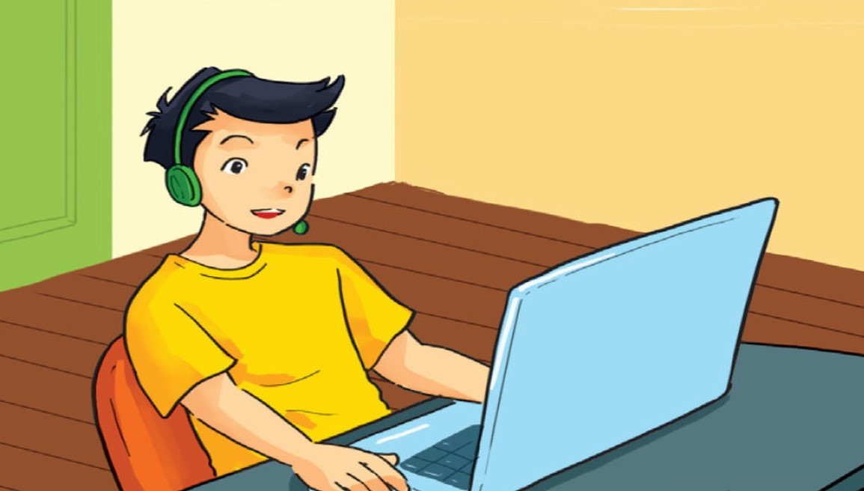
1. Look, listen and repeat

Slide 15
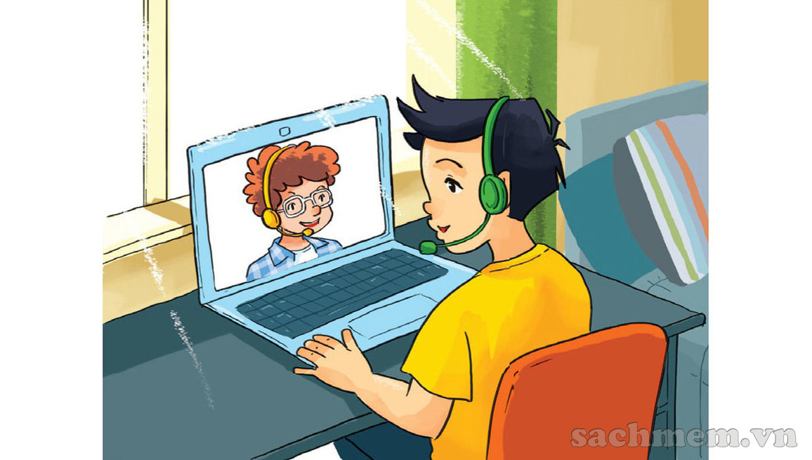

Hi, Quan! You’re up early.
Hi, Tom! Yes, I always get up early. How about you?

Slide 16
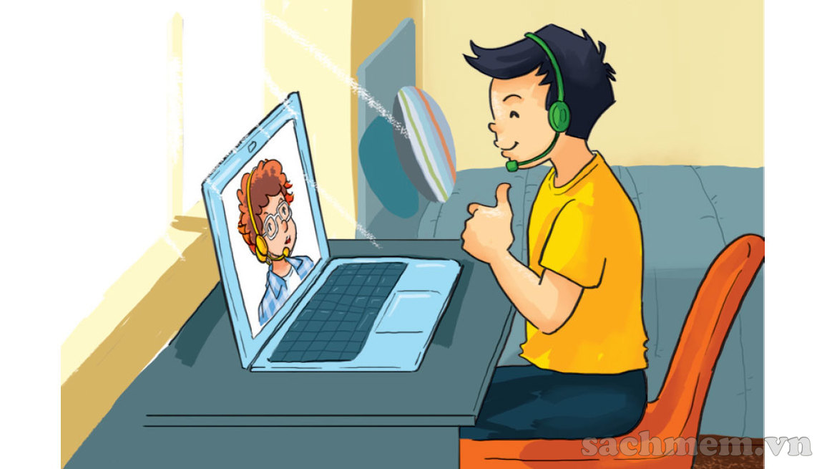
Me too. I get up early and I always have a big breakfast before I go to school.
Good idea!

Slide 17
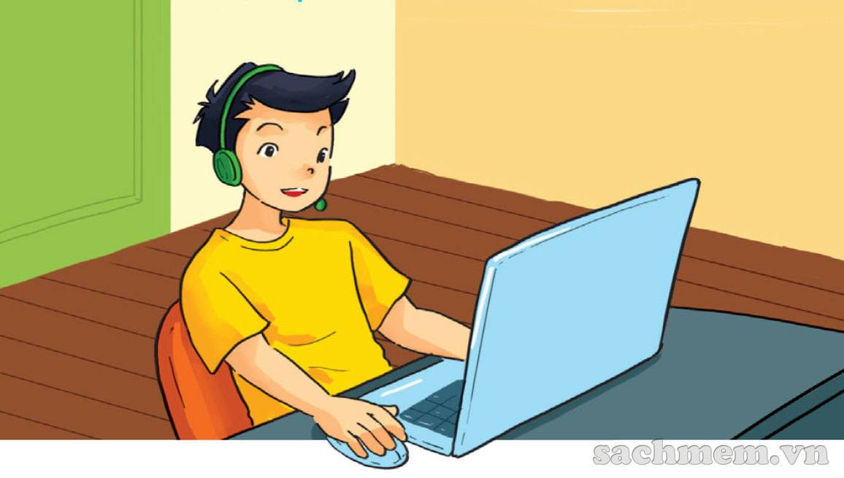
What do you do in the afternoon?
After school? I usually do my homework.

Slide 18
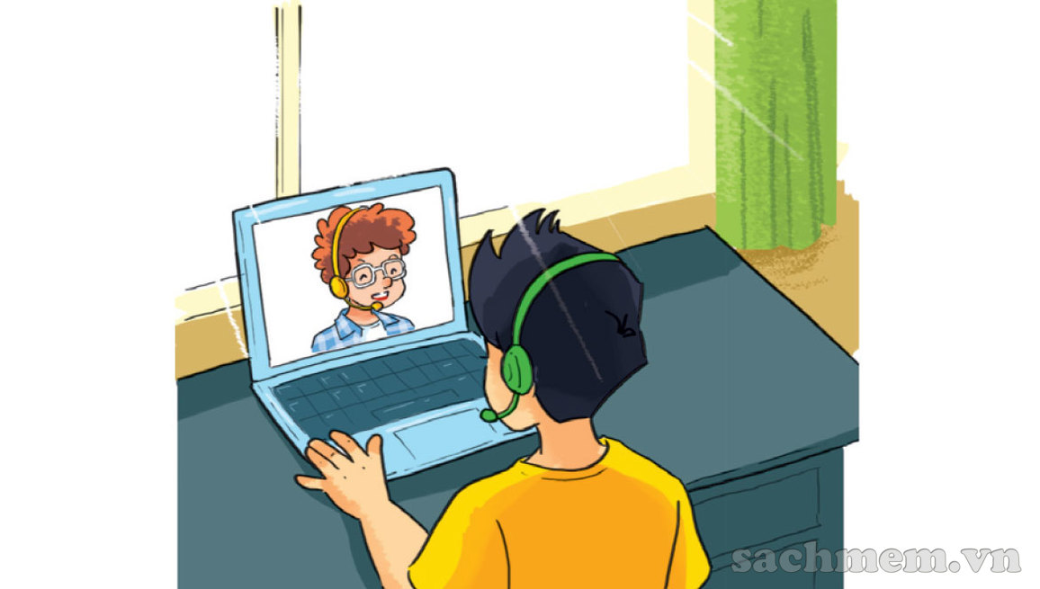
So do I. And I often talk with friends online.
I can see that, haha!

Slide 19
II. Model sentence:
What do you do in the afternoon?
I usually do my homework.

Slide 20
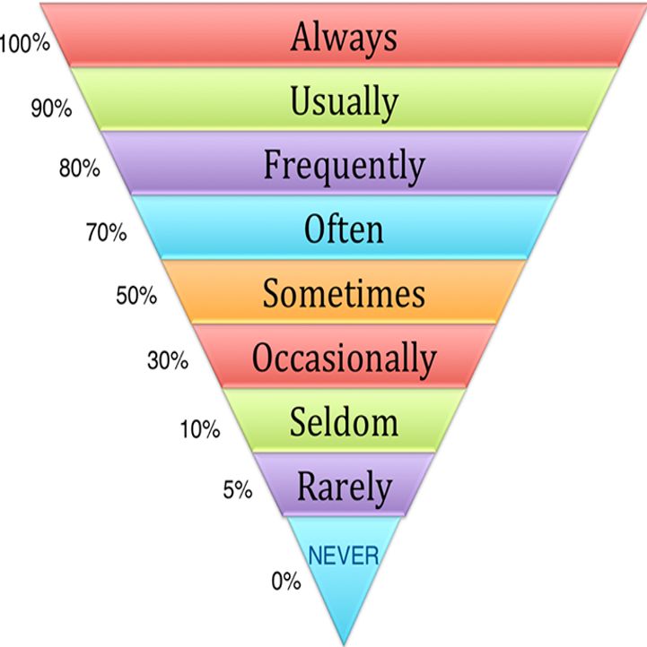
Adverbs of frequency
Adverbs of frequency
Luôn luôn
Thường xuyên
Thường xuyên
Thường
Thỉnh thoảng
Thi thoảng
Ít khi
Hiếm khi
Không bao giờ

Slide 21
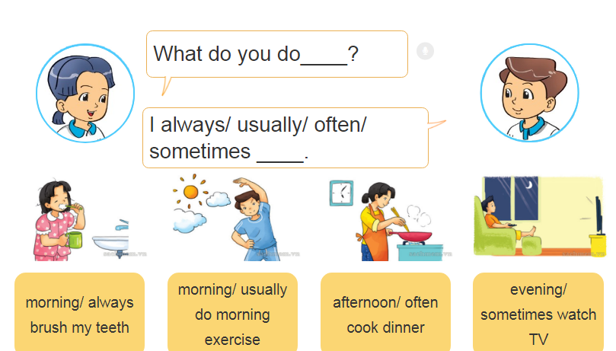
2. Point and say
What do you do in the.........?
I .........................
A
B
C
D

Slide 22
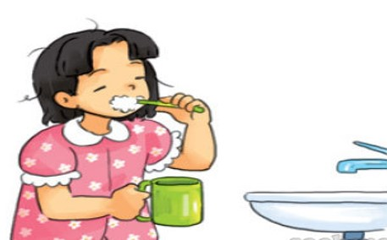
2. Point and say
morning/ always brush my teeth

Slide 23
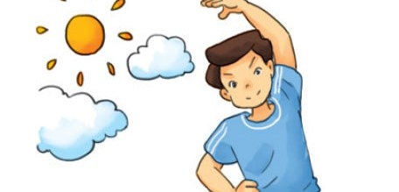
morning/ usually do morning exercise

Slide 24
afternoon/ often cook dinner

Slide 25
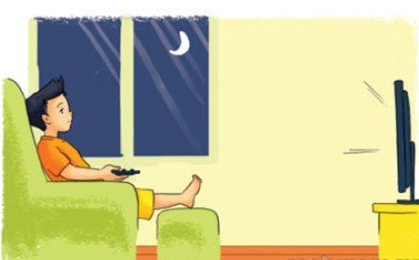
evening/ sometimes watch TV

Slide 26
Let’s talk
3
What do you do in the morning/ afternoon/ evening?
I always/ usually/ often/ sometimes……………

Slide 27
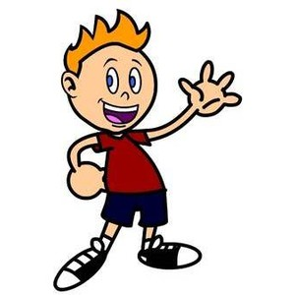
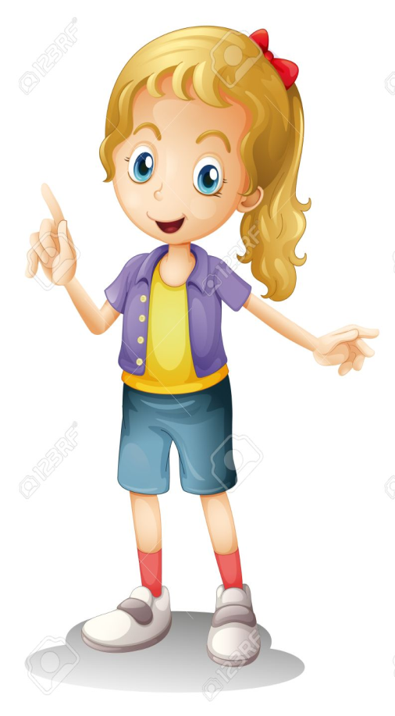
Model Sentence:
What do you do……….?
I always/ usually/ often/ sometimes......

Slide 28
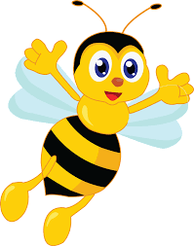

Example 1:
What do you do in the morning?
I often read books.

Slide 29
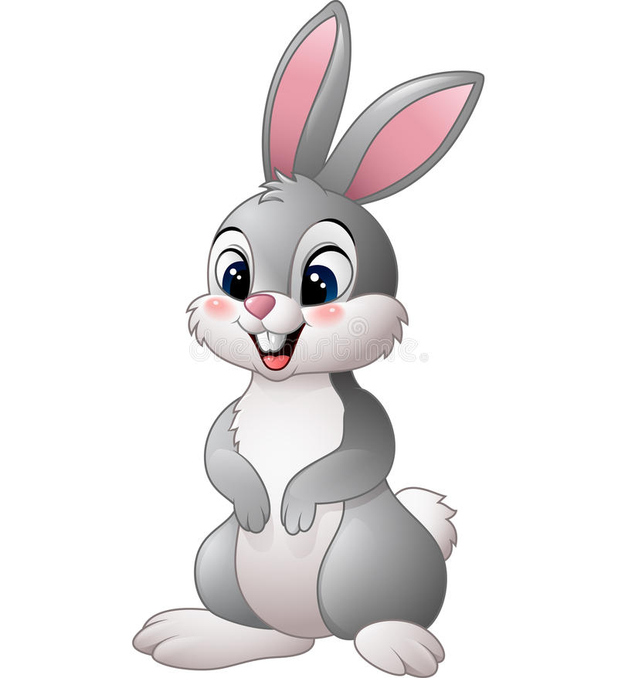
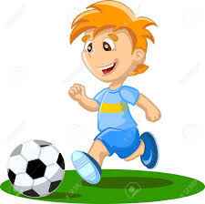
Example 2:
What do you do in the afternoon?
I usually play football.

Slide 30
Unit 2. I always get up early. How about you?
I. New words:
get up
talk with friends online
early late
cook dinner
brush my teeth
watch TV
do morning exercise
II. Model sentence
What do you do in the morning?
I often do morning exercise.
III. Homelink

Slide 31


Slide 32
Unit 2: I always get up early. How about you?
Lesson 2

Slide 33
New words

Slide 34
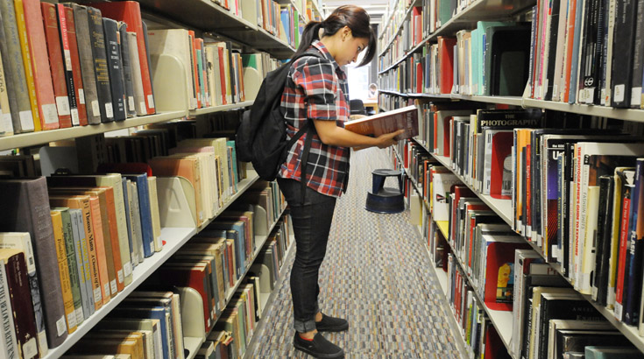
go to the library come to the library

Slide 35
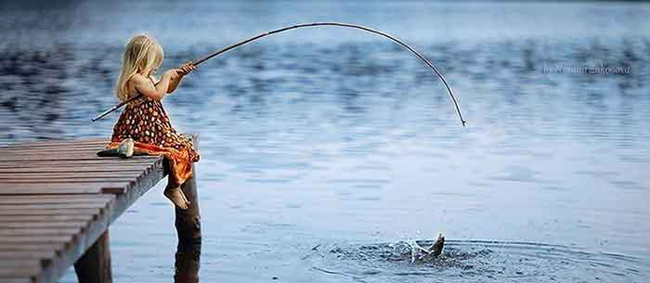
go fishing

Slide 36
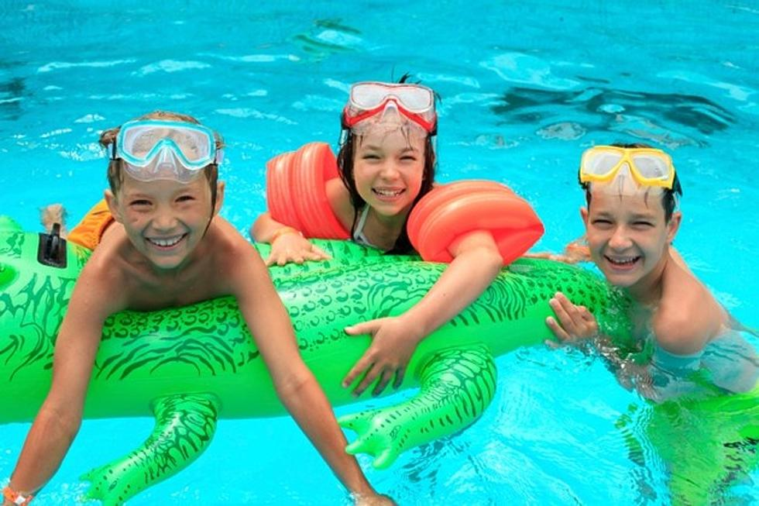
go swimming

Slide 37
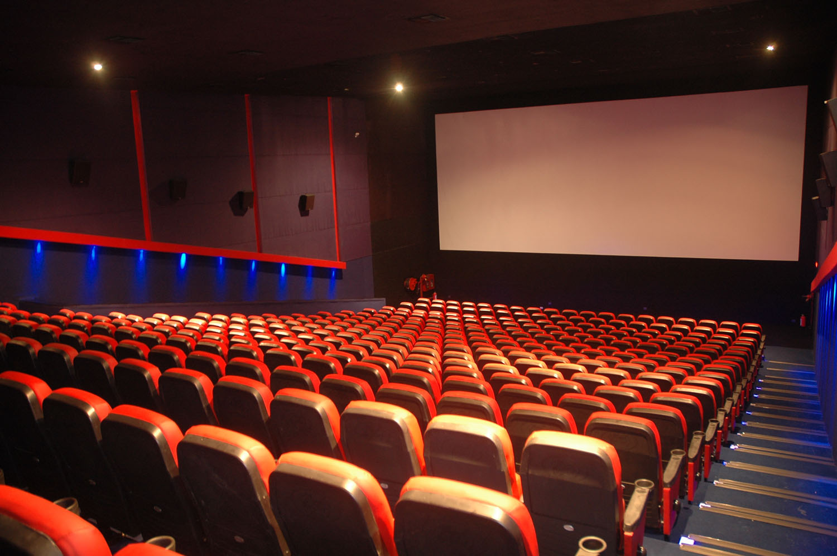
go to the cinema

Slide 38
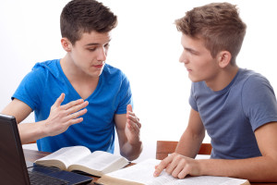
study with a partner

Slide 39
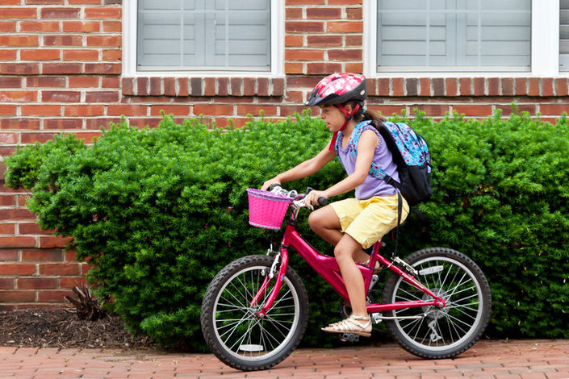
ride a bicycle to school

Slide 40
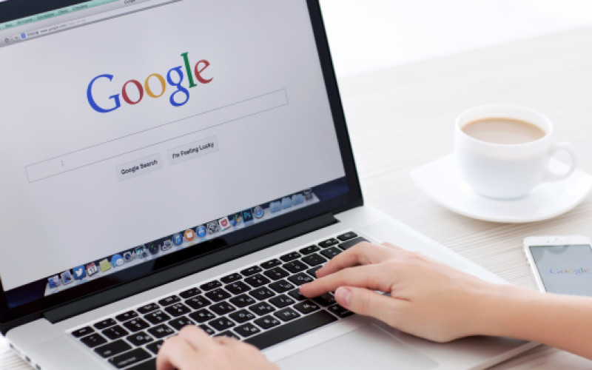
surf the Internet

Slide 41
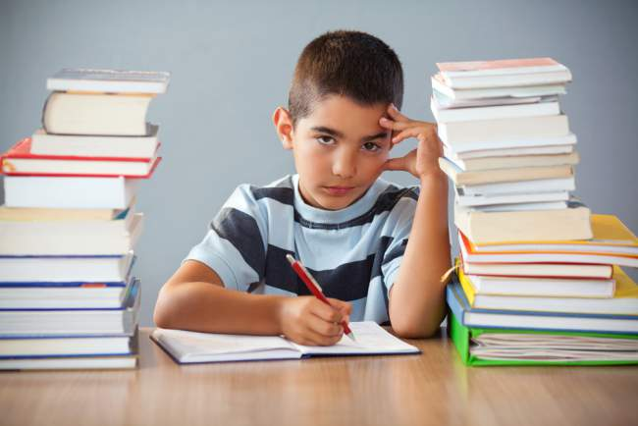
do my homework

Slide 42
MONDAY | TUESDAY | WEDNESDAY | THURSDAY | FRIDAY | SATURDAY | SUNDAY
√
Once a week
MONDAY | TUESDAY | WEDNESDAY | THURSDAY | FRIDAY | SATURDAY | SUNDAY
√
√
Twice a week

Slide 43
MONDAY | TUESDAY | WEDNESDAY | THURSDAY | FRIDAY | SATURDAY | SUNDAY
√
√
√
three times a week
MONDAY | TUESDAY | WEDNESDAY | THURSDAY | FRIDAY | SATURDAY | SUNDAY
√
√
√
√
four times a week

Slide 44
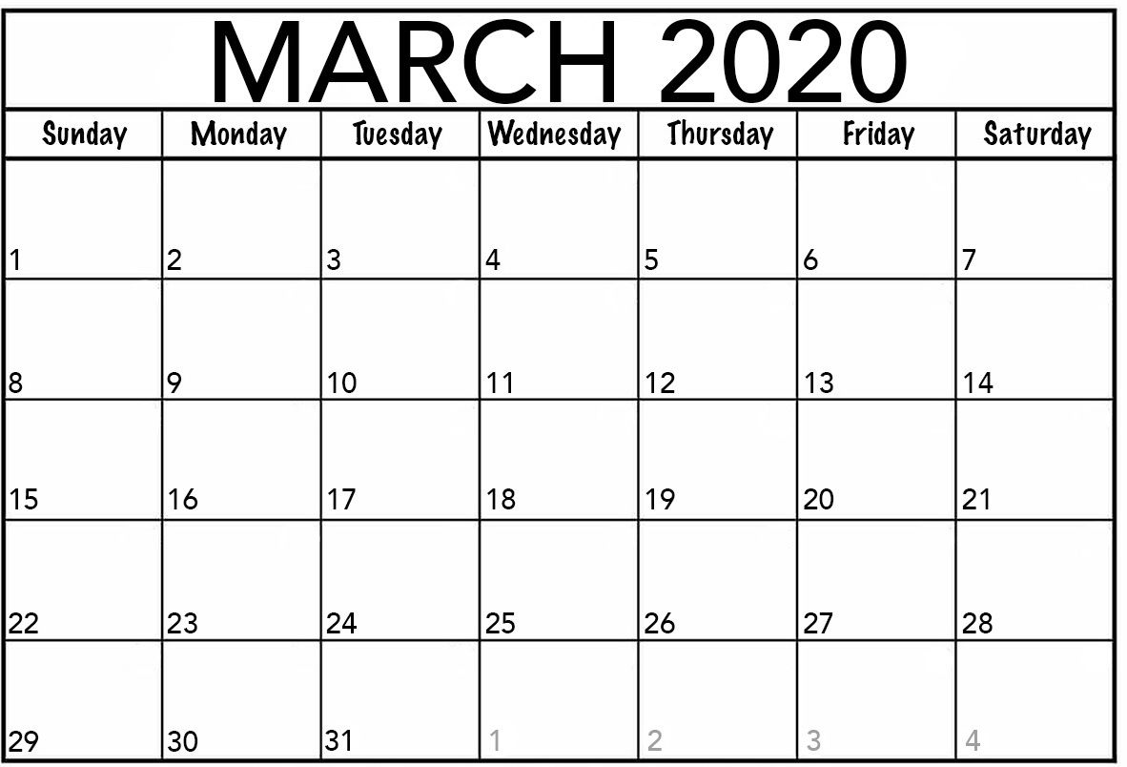
√
once a month

Slide 45
Choose the best answer

Slide 46
A. do my home work
B. surf the Internet
C. go shopping
B. surf the Internet

Slide 47
A. do my homework
B. go to the cinema
C. study with a partner
A. do my homework

Slide 48

A. go shopping
B. go to the cinema
C. study with a partner
B. go to the cinema

Slide 49
A. go swimming
B. go to the library
C. ride a bicycle to school
C. ride a bicycle to school

Slide 50
A. go swimming
B. go shopping
C. ride a bicycle to school
A. go swimming

Slide 51
A. do homework
B. go shopping
C. study with a partner
C. study with a partner

Slide 52
A. go fishing
B. go to the library
C. study with a partner
B. go to the library

Slide 53
A. go fishing
B. go to the library
C. study with a partner
A. go fishing

Slide 54




Slide 55
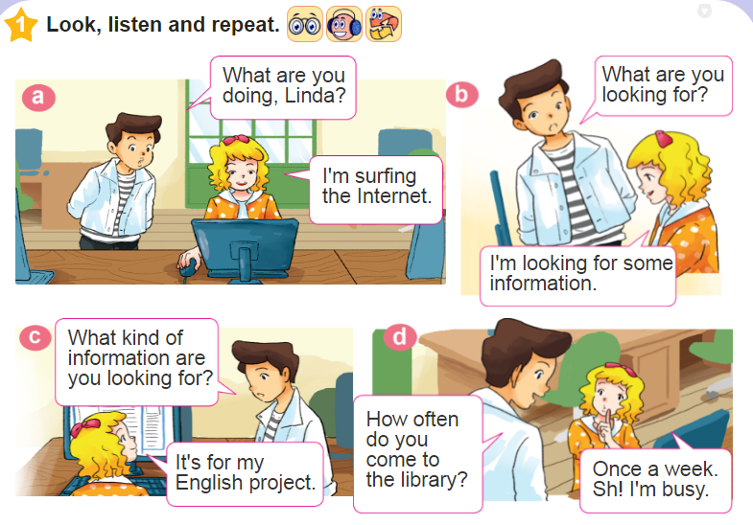

Slide 56
How often do you come to the library?
once a week

Slide 57
How often do you come to the library?
II. Model sentence:
I come to the library once a week.

Slide 58
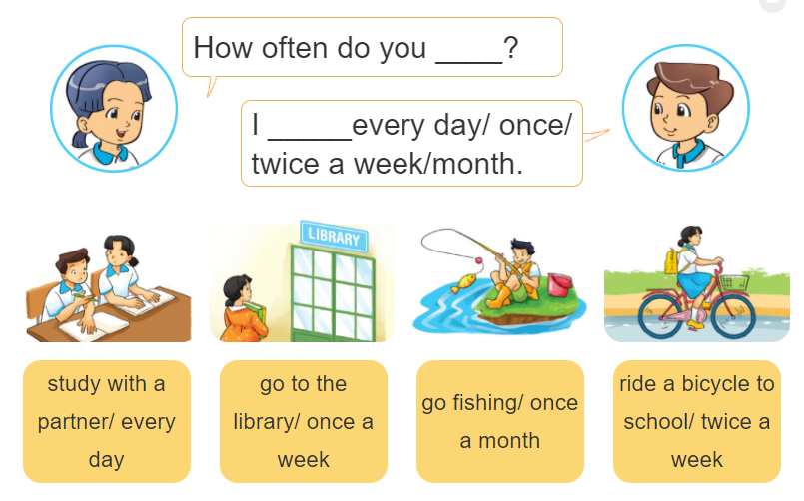
Point and say

Slide 59
How often do you go fishing?
I always/usually/often/
sometimes/never go fishing

Slide 60
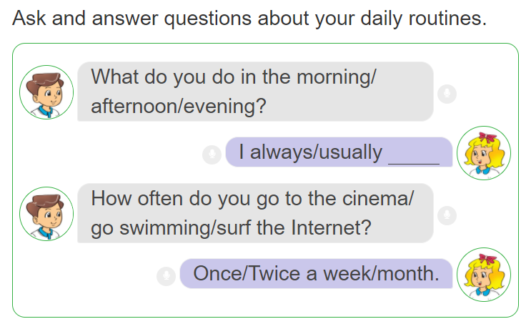
Let’s talk

Slide 61
How often do you….?

Slide 62
How often do you….?

Slide 63
How often do you….?

Slide 64
How often do you….?

Slide 65
How often do you….?

Slide 66
How often do you….?

Slide 67
How often do you….?

Slide 68
How often do you….?

Slide 69
Wednesday, September 15th 2021
Unit 2: Lesson 2
I. New words
II. New model
- surf the Internet
- study with a partner
- go swimming/ fishing
- go to the library/ cinema
- ride a bicycle to school
- do my homework
- look for information
- Once/ Twice a week
- Three/ Four times a week
- Once a month
- every day
How often do you go to the library?
I go to the library twice a week.
III. Homelink

Slide 70
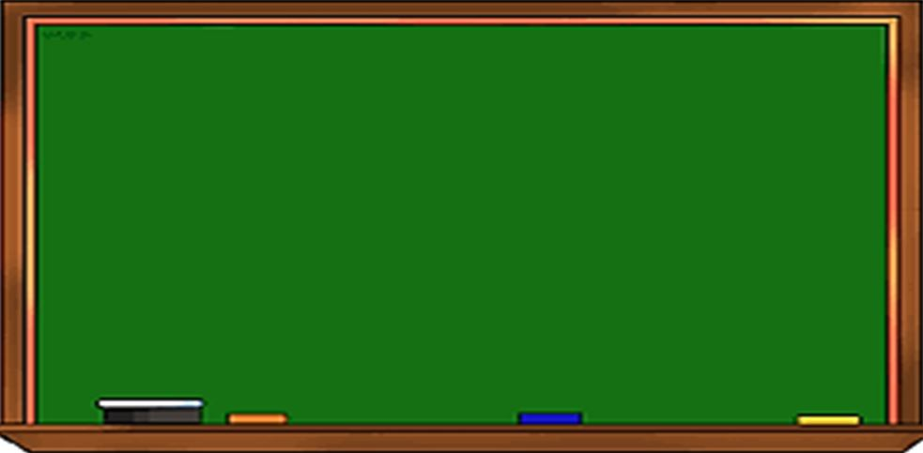
Wednesday, September 22nd 2021
Unit 2: I always get up early.
Lesson 1+2-P12-15
I. New words: từ mới
*Trạng từ tần suất:
-always: luôn luôn
-usually: thường xuyên
-often: thường
-sometimes: thỉnh thoảng
-never: không bao giờ
-once/ twice a week (month/year) : 1 lần/2 lần 1 tuần(tháng/năm)
-three/ four times a week : 3-4 lần 1 tuần
- every day: hàng ngày
-get up: thức dậy
-talk with friends online: nói chuyện với bạn online
-cook dinner: nấu bữa tối
-brush my teeth: đánh răng
-watch TV: xem tivi
-do morning exercise : tập thể dục
early >< late: sớm>< muộn
- surf the Internet: lướt mạng
- study with a partner: học với bạn
- go swimming/ fishing : đi bơi/câu cá
- go to the library/ cinema: đi thư viện
- ride a bicycle to school: đi xe đạp đi học
- do my homework: làm bài tập về nhà
- look for information: tìm kiếm thông tin
II. Model sentences: mẫu câu
1-What do you do in the morning?
I usually do morning exercise.
2-How often do you go to the library?
I go to the library twice a week.
1-Luyện nghe đọc hội thoại P12,14, viết từ mới 2 dòng+ Mẫu câu(2d) + PH kí + chụp bài vào nhóm
2- Làm SBT P8-10 + Làm OLM.VN
III. Homelink: BTVN

Slide 71
Unit 2: I always get up early. How about you?
Lesson 3

Slide 72











Listen and repeat

Slide 73

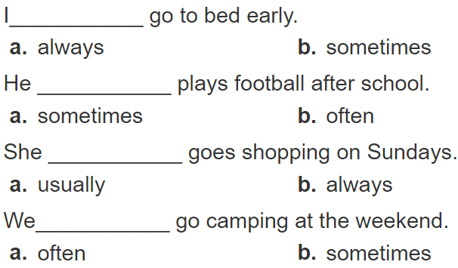
Listen and circle a or b. Then say the sentences aloud

Slide 74
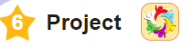
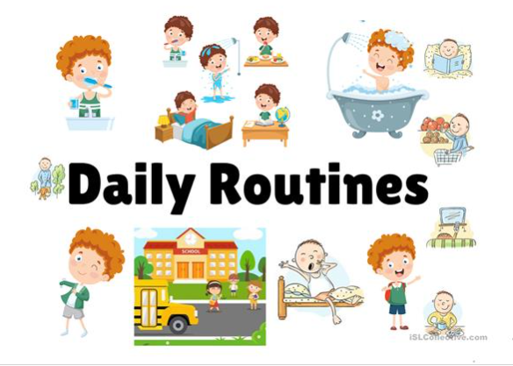
Interview two of your classmates about their daily routines.

Slide 75
Wednesday, September 15th 2021
Unit 2: Lesson 3
Homelink: https://quizizz.com/join/quiz/6112b7614764c7001b9ef823/start?studentShare=true

