Slide 1
UNIT 11. WHAT’S THE MATTER WITH YOU?
LESSON 3

Slide 2
WARM UP

Slide 5
LISTEN AND REPEAT
What’s the matter with you?
I have a headache
I have a toothache
I have a stomachache

Slide 6
LISTEN AND CIRCLE
1
2
3
4
1.What’s the matter with you? I have a ____________.
a.toothache b.headache
2.What’s the matter with you? I have a ____________.
a.bad toothache b.backache
3.What’s the matter with you? I have a ___________.
a.stomach ache b.headache
4.What’s the matter with you? I have a ___________.
a.pain in my stomach b.sore throat

Slide 7
LET’S CHANT

Slide 8
READ AND MATCH
HOW TO STAY HEALTHY
1. Wash your hand
a. your teeth twice a day.
2. Eat
b. a shower every day.
3. Do
c. short and clean.
4. Brush
d. healthy foods.
5. Keep your nails
e. morning exercise regularly.
6. Take
f. before having meals.

Slide 9
WRITE YOUR ADVICE
 | He/She should… | He/ She shouldn’t
1. Tony has a bad toothache.
2. Quan has a bad cold.
3. Phong has a stomach ache.
4. Phong has a sore throat.
Go to the dentist
Eat a lot of sweets
Take a rest
Go to school
Go to the doctor
Eat a lot of sweets
Go to the doctor
Drink cold water

Slide 10
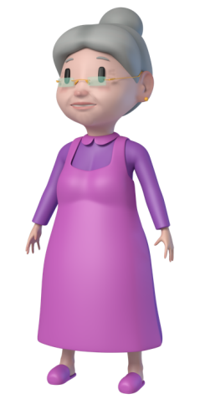
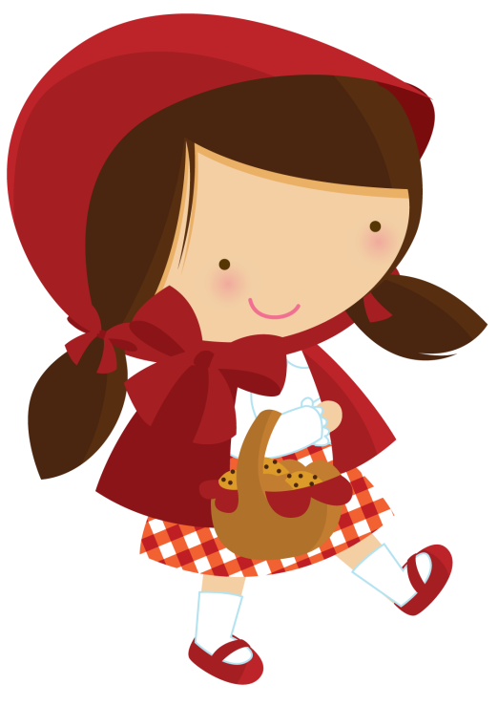
PLAY
Little
Red

Slide 11
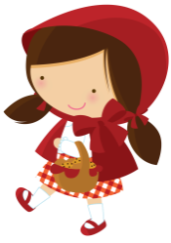
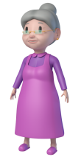
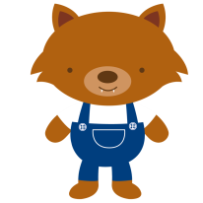
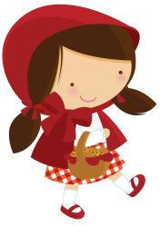
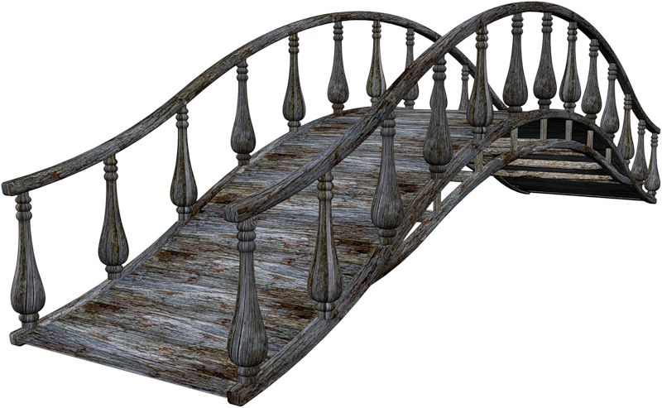
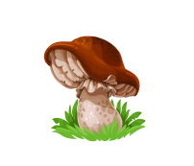

Slide 12
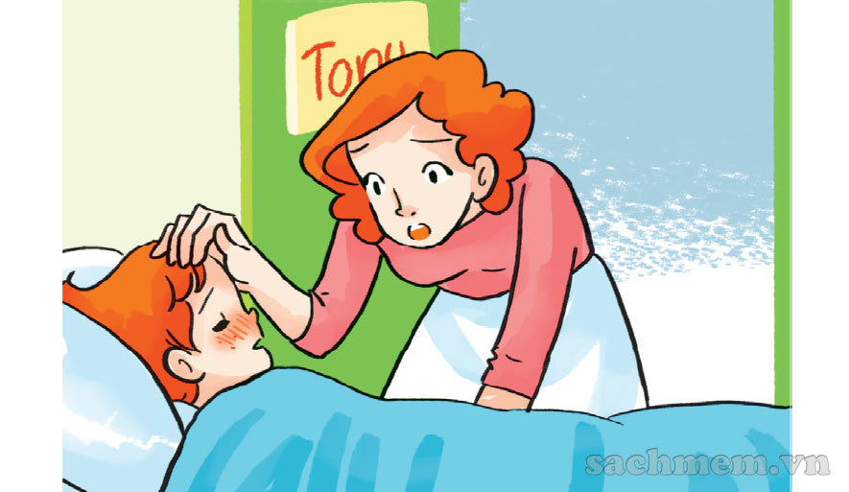
What’s the matter with you?
A toothache
A fever
An earache

Slide 13
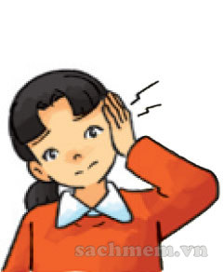
What’s the matter with you?
An earache
A stomach ache
A headache

Slide 14
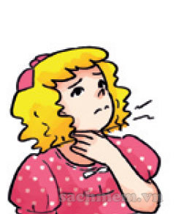
What’s the matter with you?
a backache
A toothache
A sore throat

Slide 15
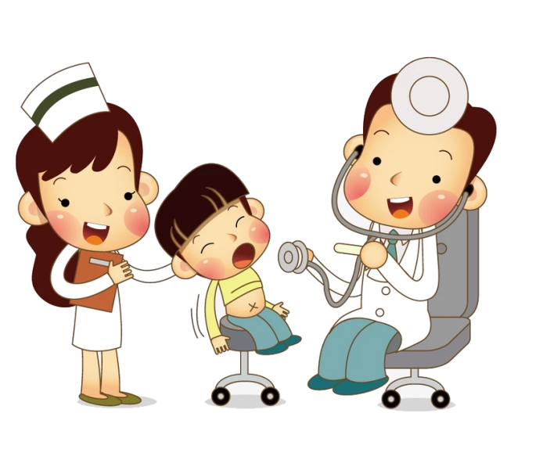
You should …
Eat a lot of fruit
Take a rest
Go to the doctor

Slide 16
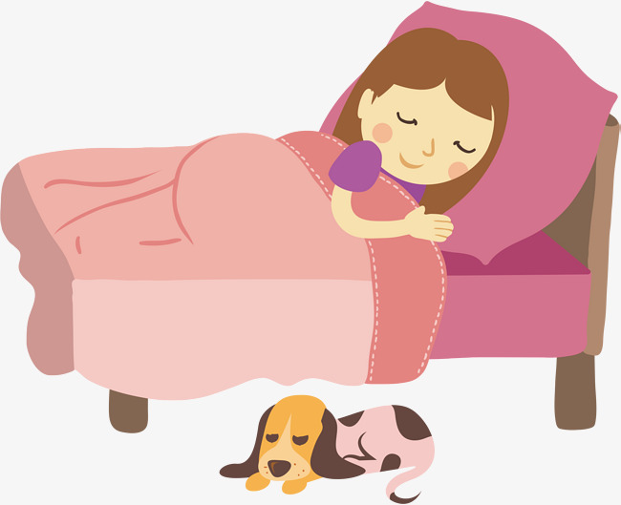
You should …
Carry heavy things
Take a rest
Eat a lot of sweet

Slide 17
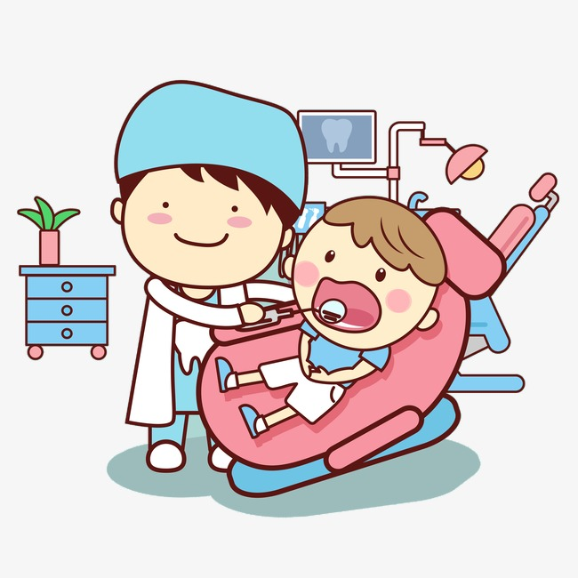
You shuld …
Go to the dentist
Take a rest
Eat a lot of fruit

Slide 18
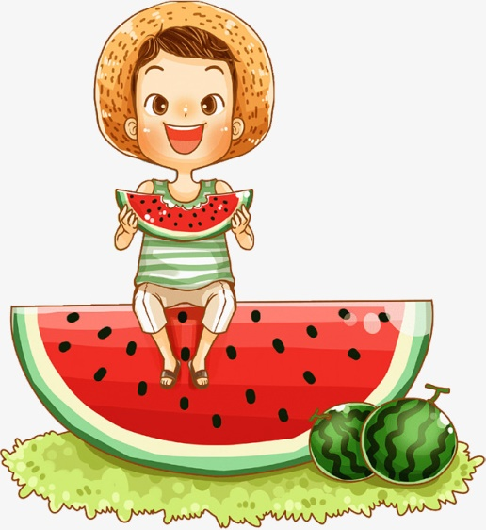
You should …
Eat a lot of fruit
Eat a lot of sweets
Take a rest

Slide 19
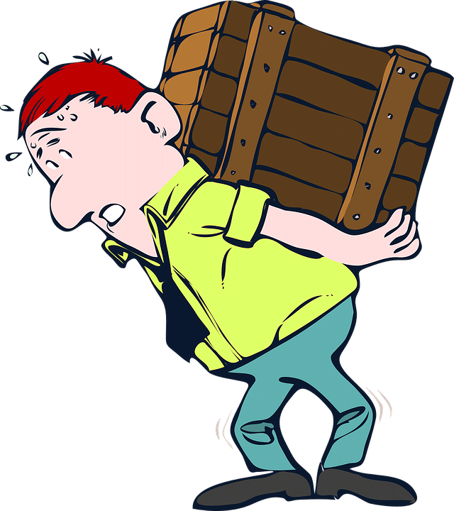
You shuldn’t …
Go to the dentist
Go to the doctor
Carry heavy things

Slide 20
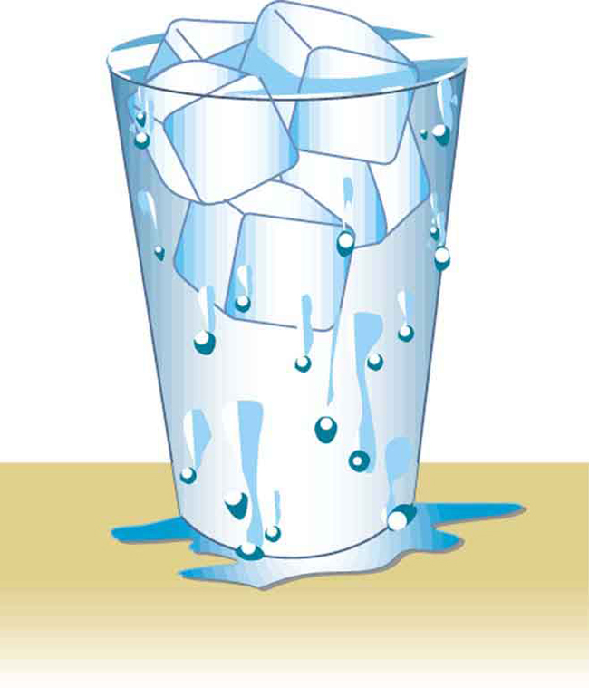
You shouldn’t …
Drink cold water
Go to the doctor
Take a rest

Slide 21
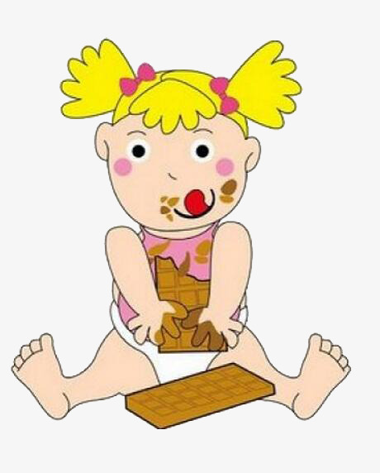
You shuldn’t …
Go to the dentist
Eat a lot of fruit
Eat a lot of sweets

