Slide 1
Welcome to our class
1A3

Slide 2
Bài 10: My room

Slide 3
door

Slide 4
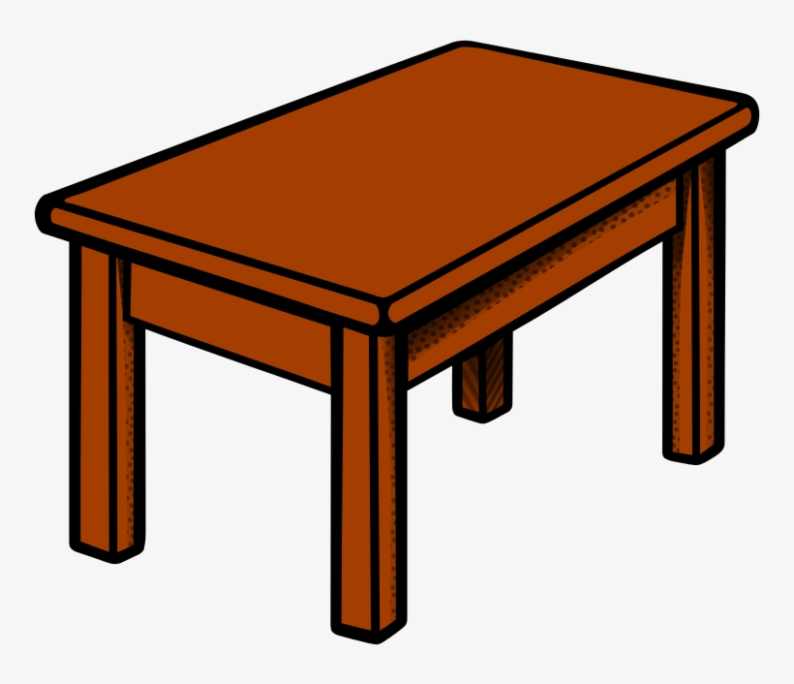
table

Slide 5
desk

Slide 6
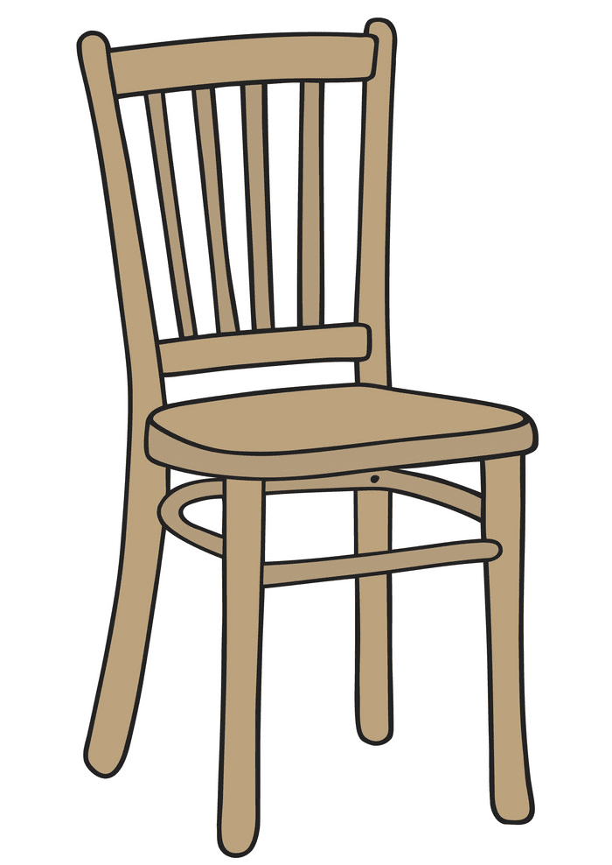
Chair

Slide 7
bed

Slide 8
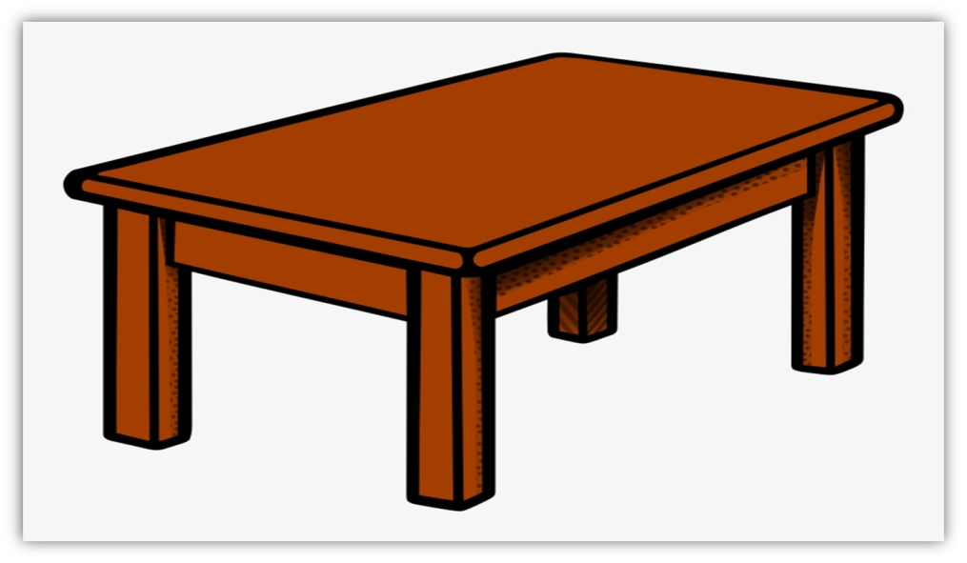
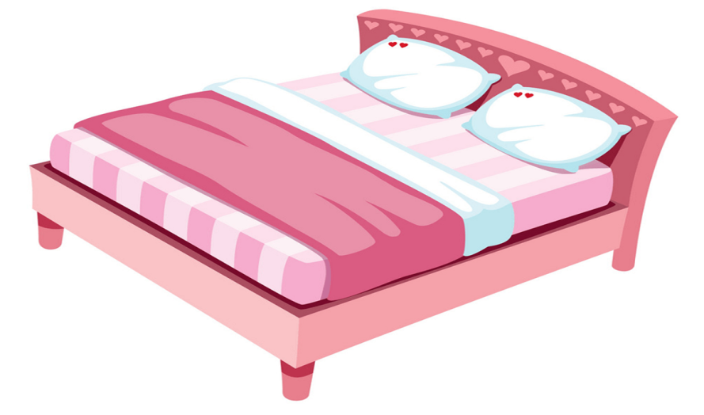
door
table
bed
desk
chair

Slide 9
Fishing Game

Slide 10
FISHING GAME
GO

Slide 11
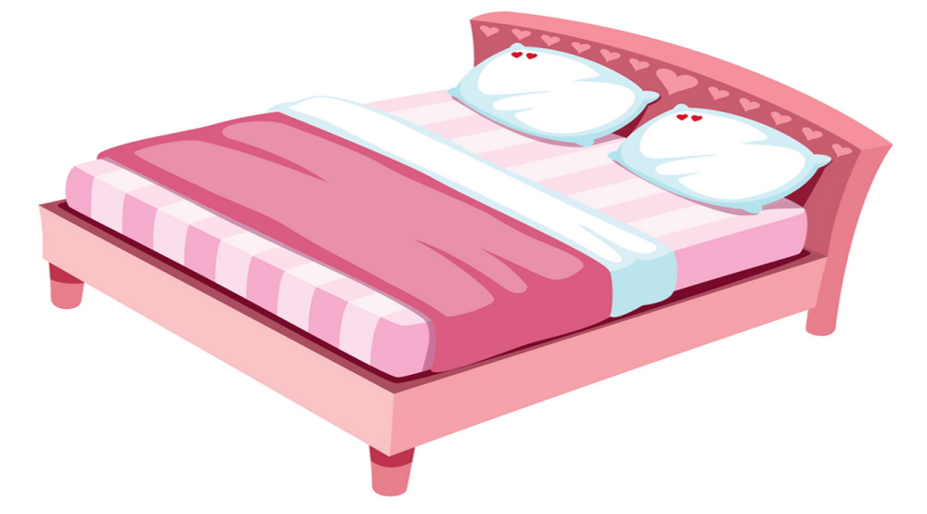
C. bed
NEXT
A. chair
D. desk
B. table
C. bed

Slide 12
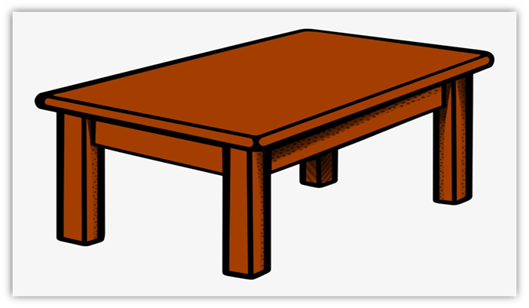
A. table
NEXT
A. table
D. chair
C. desk
B. bed

Slide 13
B. desk
NEXT
A. table
C. table
B. desk
D. door

Slide 14
NEXT
D. chair
A. door
C. table
D. chair
B. desk

Slide 15
C. door
NEXT
A. chair
D. table
B. bed
C. door

