Slide 1
Welcome to our class
2A1

Slide 2
Bài 14:Học phát âm phonic R

Slide 4
What shape is it ?

Slide 6
This is a BIG….

Slide 7
This is a SMALL…

Slide 8
R-r-Ruler

Slide 9
A short ruler A long ruler

Slide 10
R-r- robot

Slide 11
R-r-Round

Slide 12
R-r-rabbit

Slide 13
R-r-rocket

Slide 14
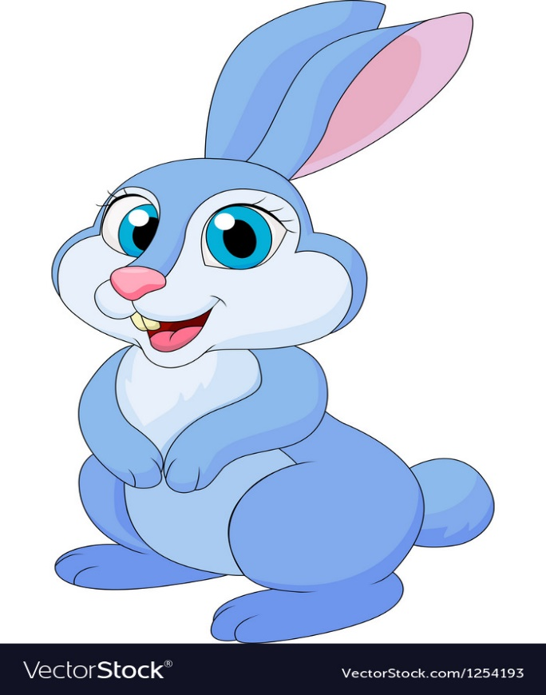
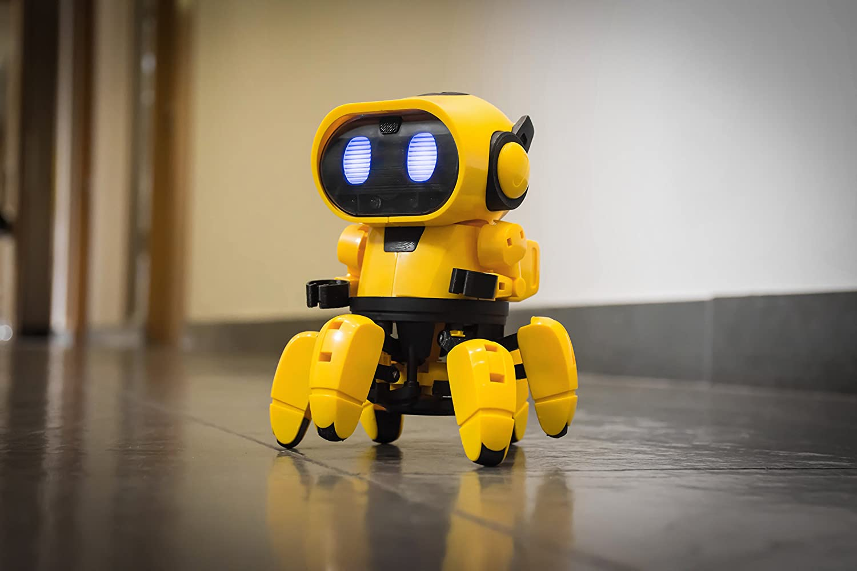
What’s this ?

Slide 16
FROG PRINCE

Slide 17
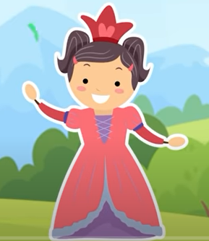

Slide 18
Round
Ruler
rabbit

Slide 19
ruler
round
rocket

Slide 20
Rabbit
Robot
Round

Slide 21
Round
Ruler
Rabbit

Slide 22
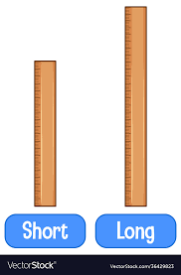
A ruler
A long ruler
A short ruler

Slide 23
round
robot
ruler

