Slide 1
Unit 1: My friends
Lesson 4.2
Page 20

Slide 2
Objectives
By the end of this lesson, ﻿students will be able to use polite greetings.
Vocabulary: hi, great, good.
Sentence patterns:
1. How are you?
=> I’m good.
2. It’s nice to meet you.
=> It’s nice to meet you, too.
﻿3. Thank you.
=> You're welcome.

Slide 3
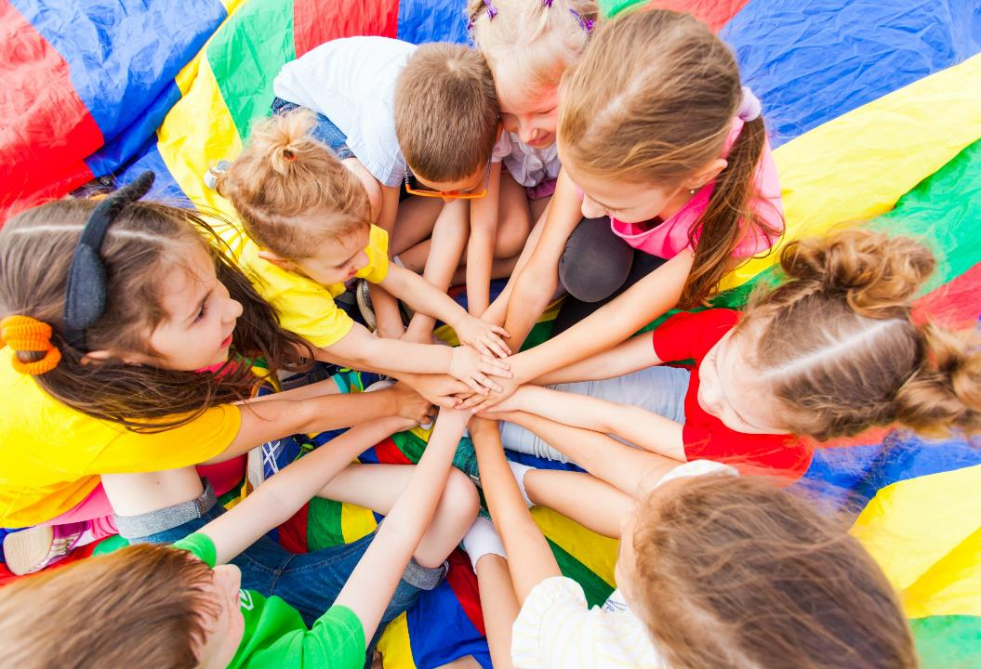
WARM UP

Slide 4
It’s time to learn …

Slide 5
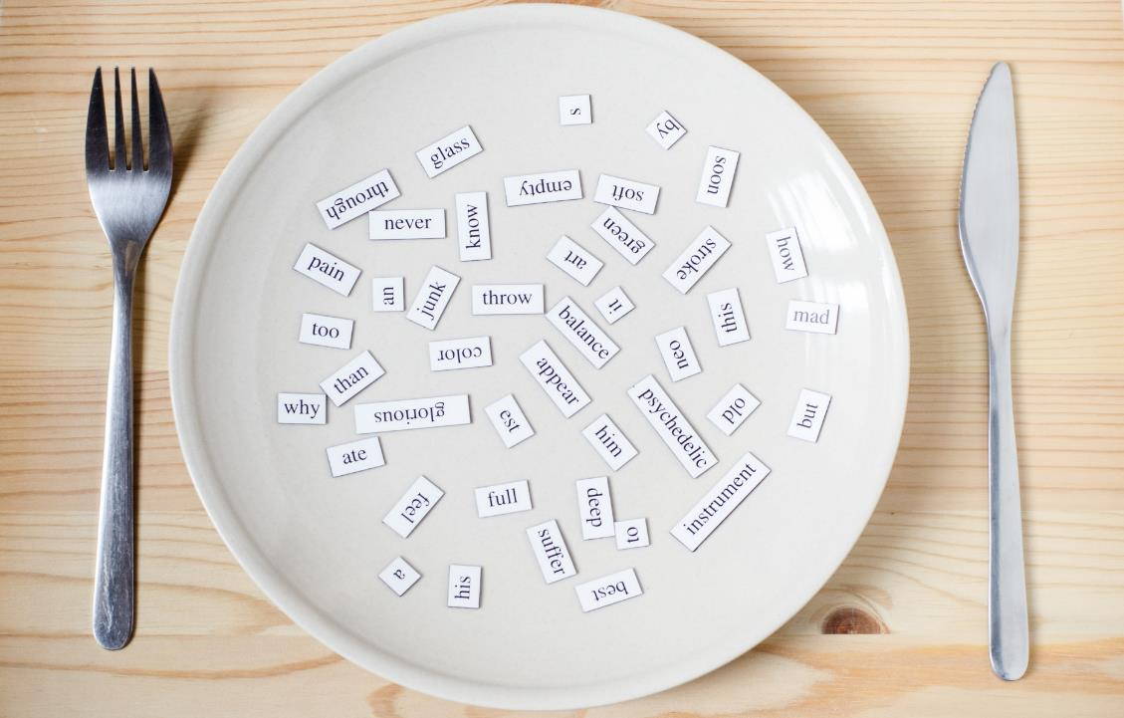
Structures
How are you?
I’m good, and you?
It’s nice to meet you.
It’s nice to meet you, too.
Thank you.
You’re welcome.

Slide 6
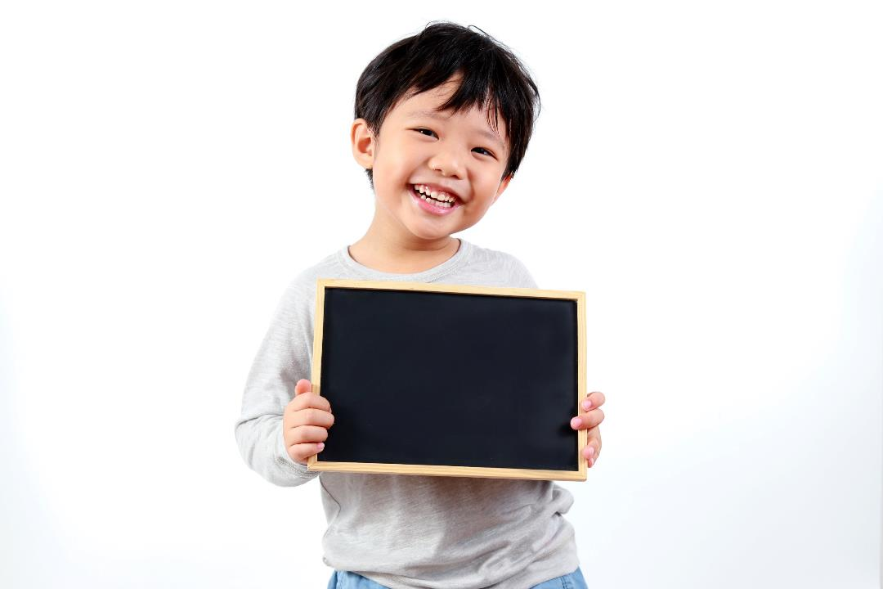
Practice

Slide 7
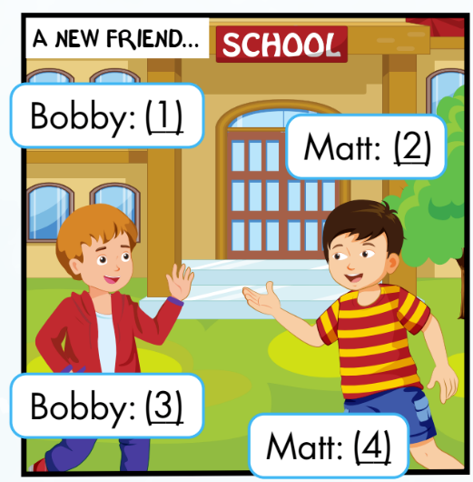
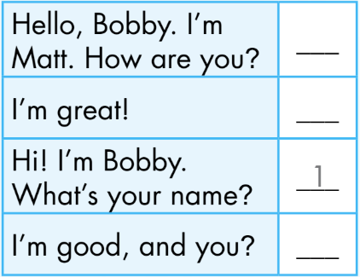
Activity 1
Click the numbers to show the answer
Hi! I’m Bobby.
What’s your name?
Hello, Bobby.
I’m Matt. How are you?
1
2
2
4
Matt
3
I’m good, and you?
I’m great!
4
3
Bobby
Notes:
Set context. Analyze picture.
Ask ss to guess ”what will say next?” and “what will he say?”
Show answer, practice with the whole class.
Explain the using of sentence patterns.
Ask ss practice in pairs and do the roleplay

Slide 8
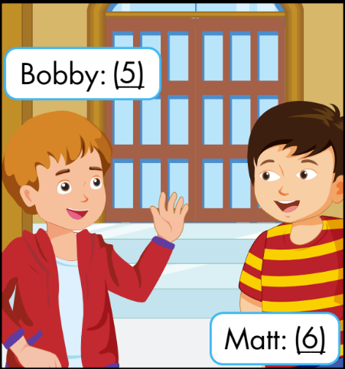
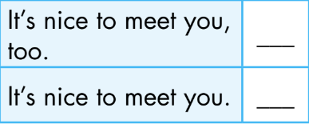
Activity 1
Click the numbers to show the answer
5
It’s nice to meet you.
6
It’s nice to meet you, too.
5
6
Notes:
Set context. Analyze picture.
Ask ss to guess ”what will say next?” and “what will he say?”
Show answer, practice with the whole class.
Explain the using of sentence patterns.
Ask ss practice in pairs and do the roleplay

Slide 9
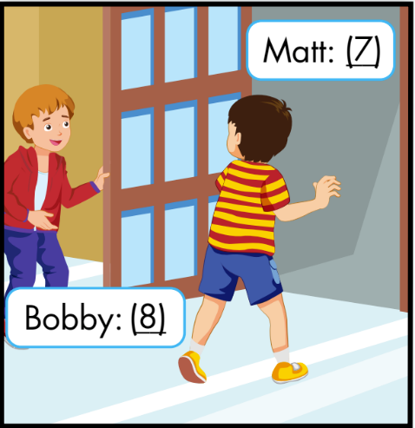
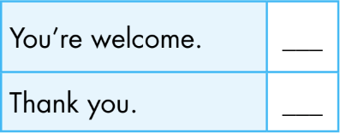
Activity 1
Click the numbers to show the answer
7
Thank you.
You’re welcome.
8
8
7
Notes:
Set context. Analyze picture.
Ask ss to guess ”what will say next?” and “what will he say?”
Show answer, practice with the whole class.
Explain the using of sentence patterns.
Ask ss practice in pairs and do the roleplay

Slide 10
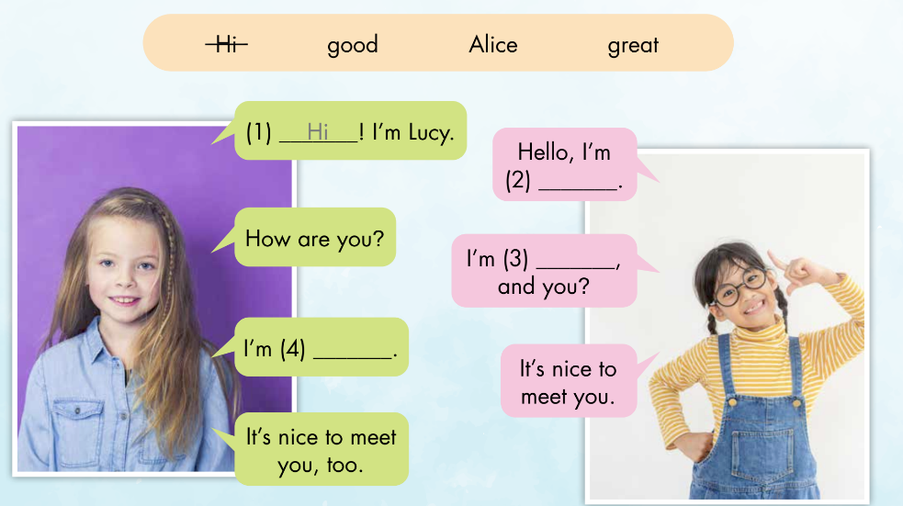
Activity 2
Alice
great
good
Notes:
Analyze pictures
Ask ss guess the words
Listen and check

Slide 11
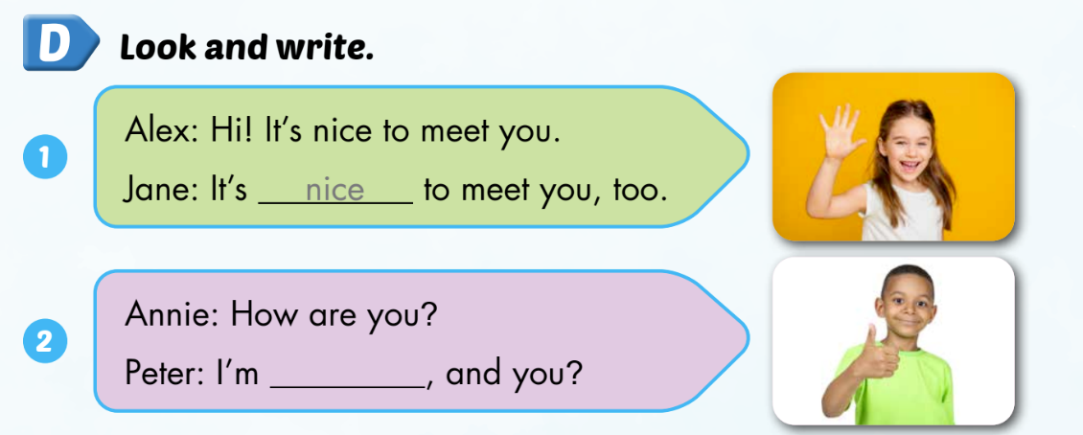
Extra activity
WB P. 15
good

Slide 12
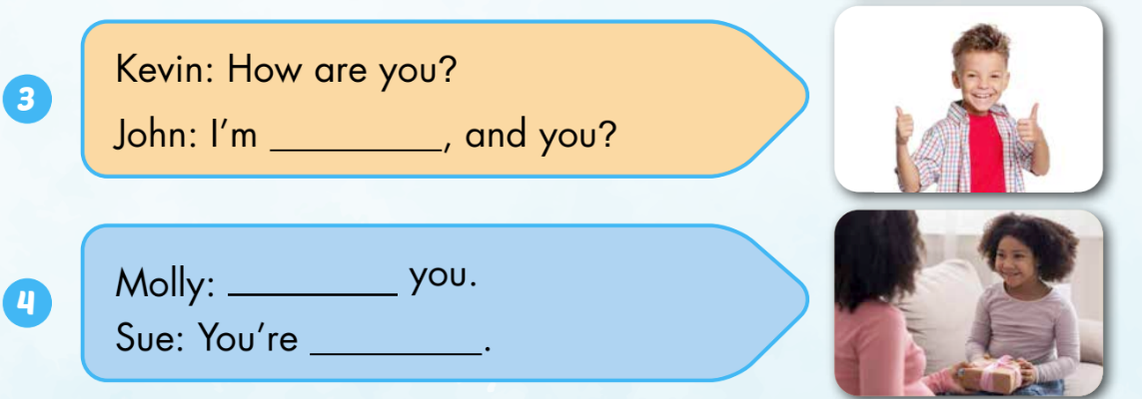
Extra activity
WB P. 15
great
Thank
welcome

Slide 13
CONSOLIDATION

Slide 14
Lesson 3
Homework
Practice vocabulary and structure. Make sentences using them.
Do the exercises in Tiếng Anh 3 i-Learn Smart Start Workbook (page 15)
Practice the vocabulary and structure in Tiếng Anh 3 i-Learn Smart Start Notebook (page 13)

Slide 15
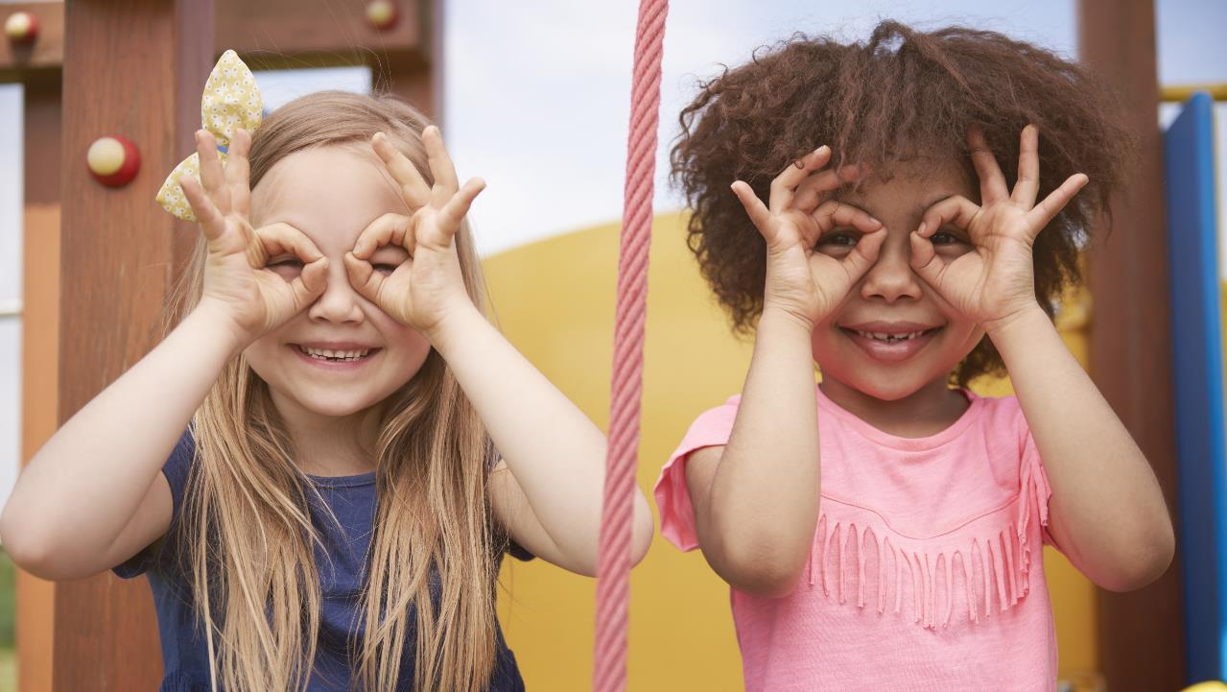
Enjoy your day!

