Slide 1
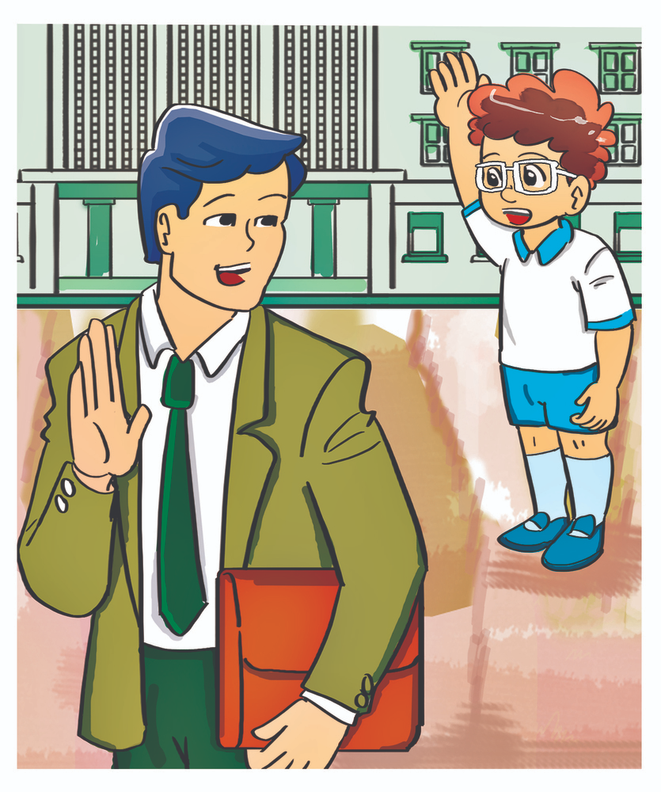
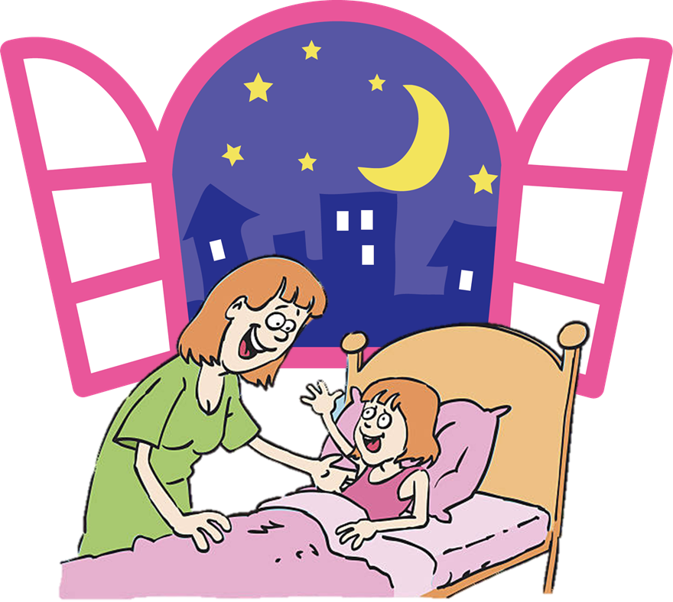
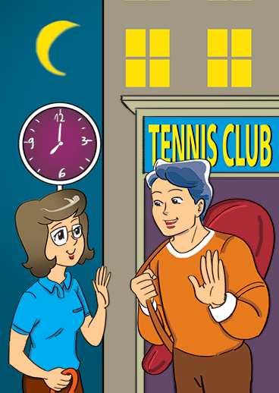
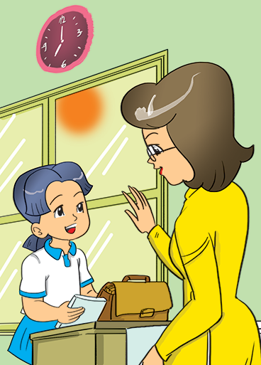
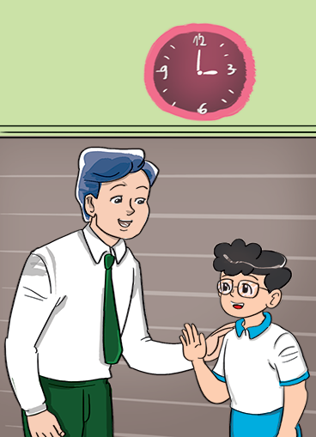
Unit 1
Good _________.
night
bye
evening
morning
afternoon

Slide 2
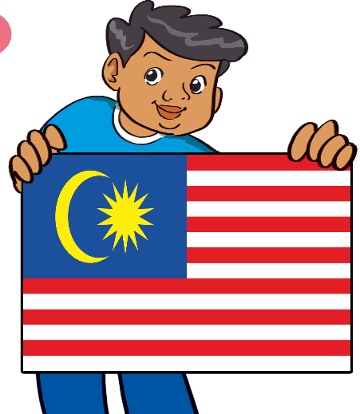
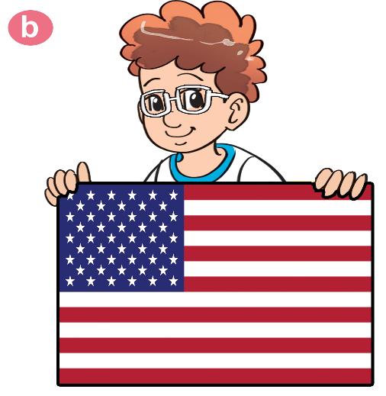
Unit 2
Where are you from?
I'm from _______.
Malaysia
America
Australia
England

Slide 3
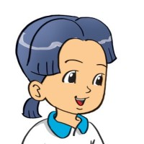
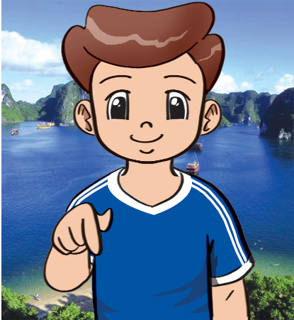
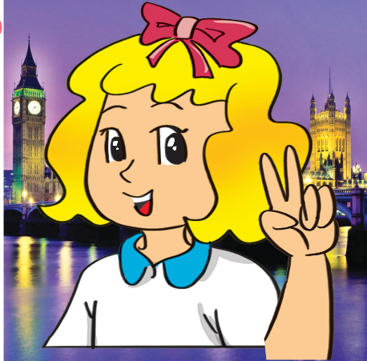
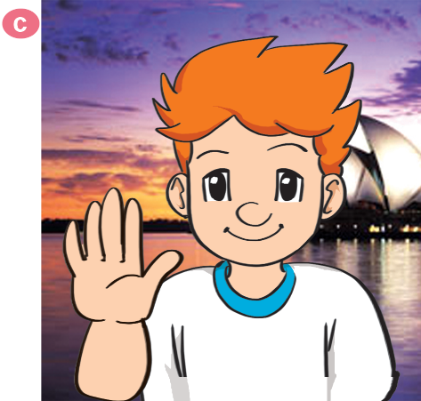
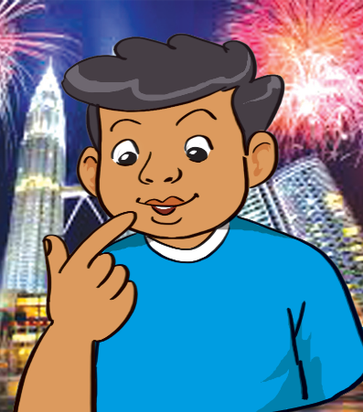
Unit 2
What nationality are you?
I'm ___________.
Vietnamese
English
Australian
Malaysian

Slide 4
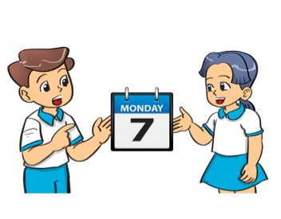
Unit 3
What day is it today?
It’s ___________.

Slide 5
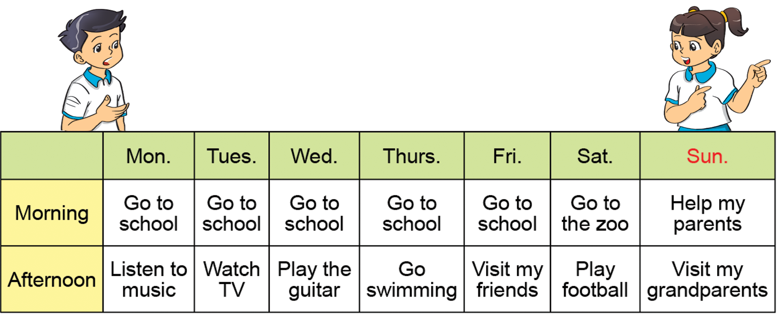
Unit 3
What do you do on ________ ?
I ________in the morning and _________in the afternoon.

Slide 6
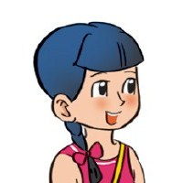
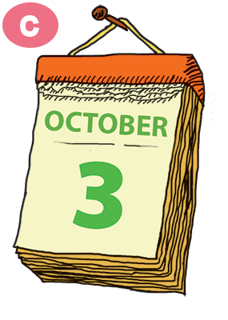
Unit 4
What is the date today?
It’s the ____ of _____.
thirty-first
first
twenty-second
second
third
fourteenth

Slide 7
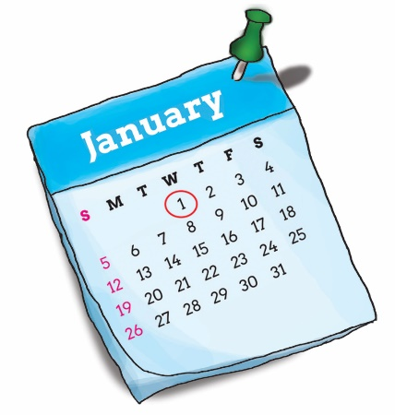
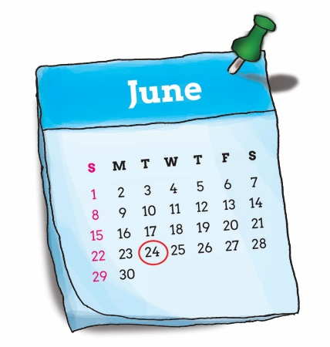
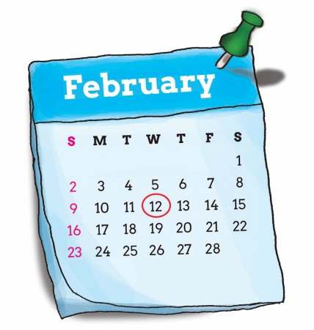
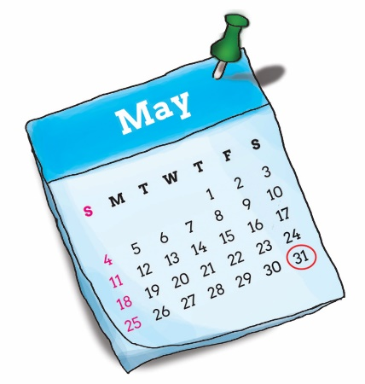
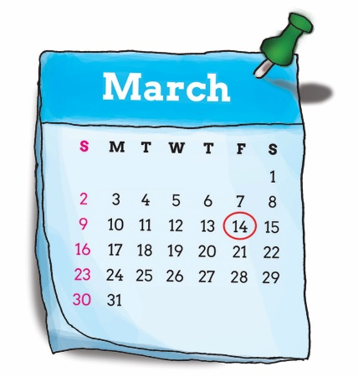
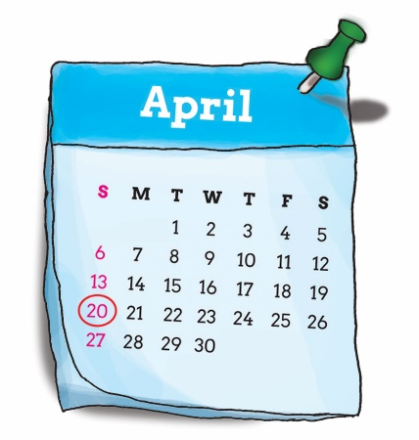
Unit 4
When’s your birthday?
It’s on the ____ of _____.
first
twenty-fourth
January
Twelfth
thirty-first
June
February
fourteenth
twentieth
May
March
April

Slide 8
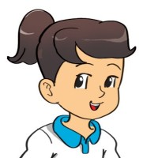
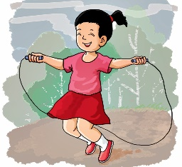
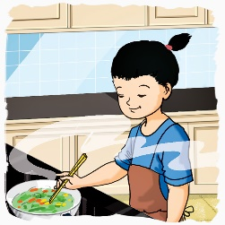
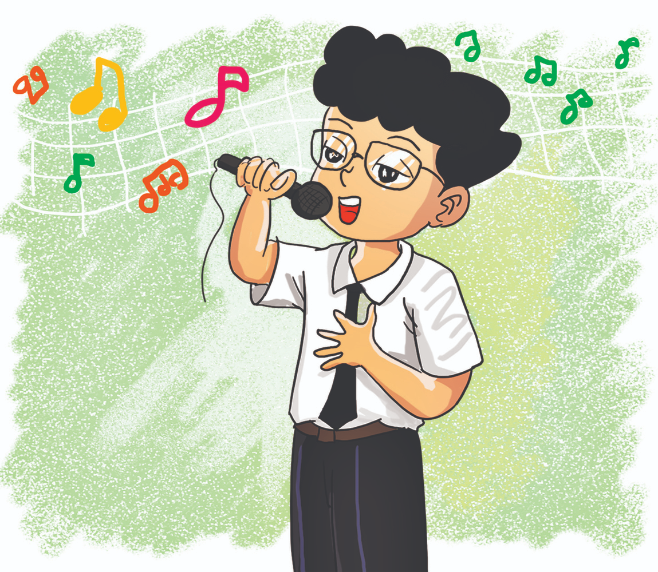
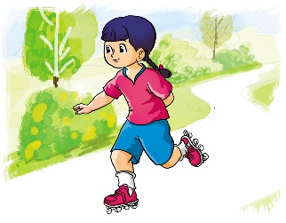
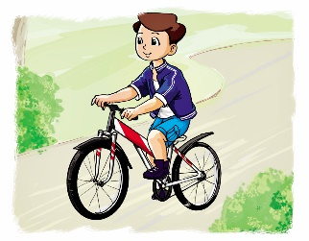
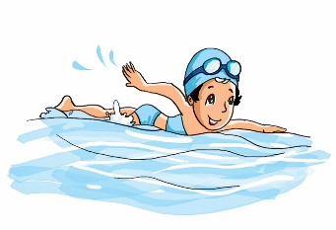
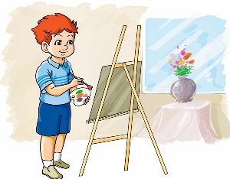
Unit 5
What can you do?
I can __________.
dance
skip
cook
sing
skate
ride a bike
draw
swim

Slide 9
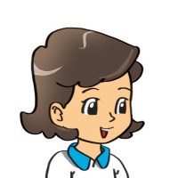
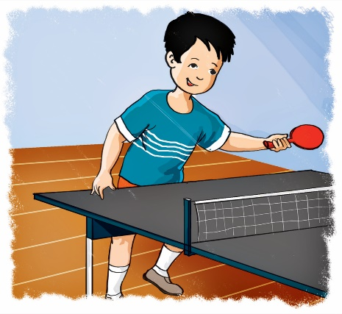
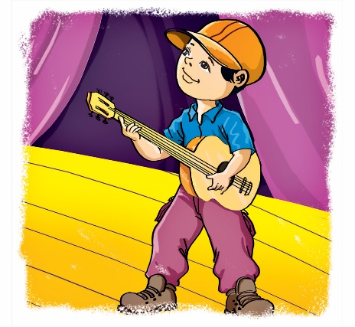
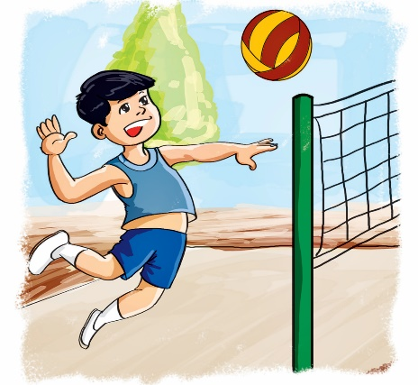
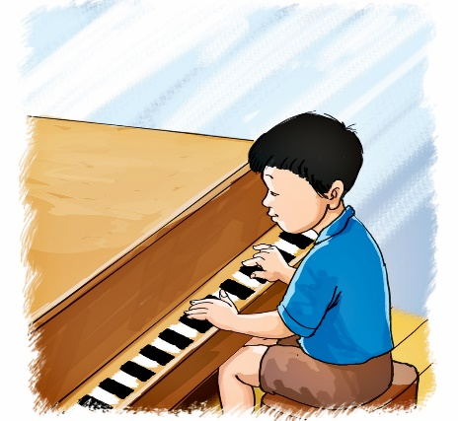
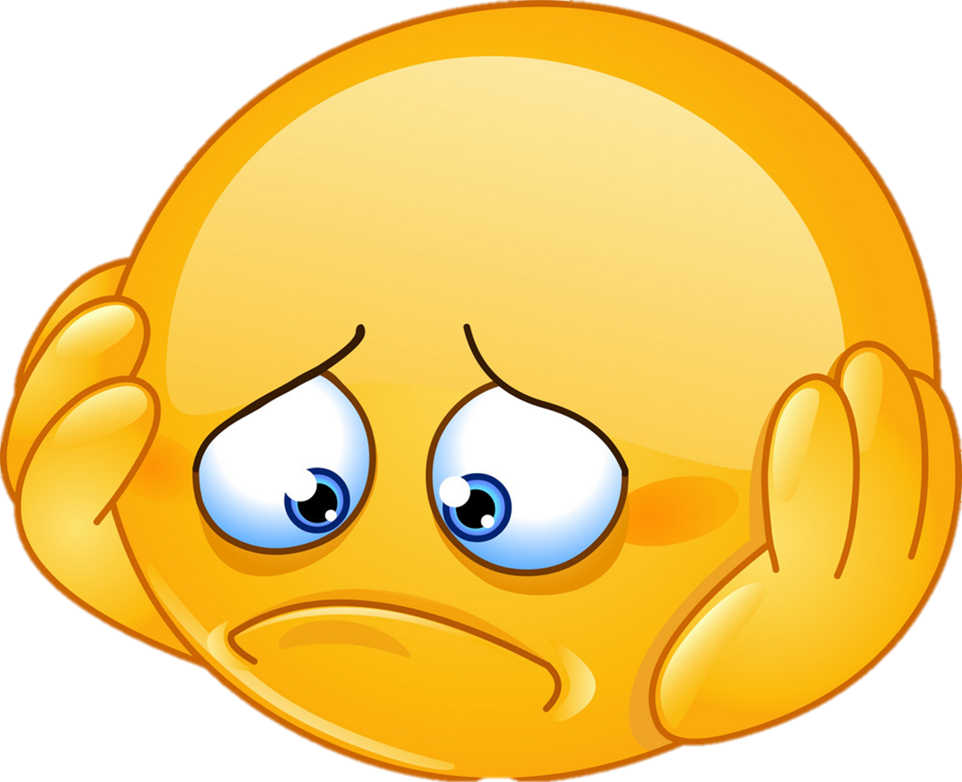
Unit 5
Can you ________?
play table tennis
play the guitar
Yes, I can.
play volleyball
No, I can’t.
play the piano
Yes, I can.
No, I can’t.

Slide 10
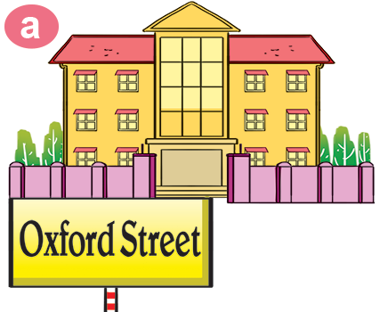
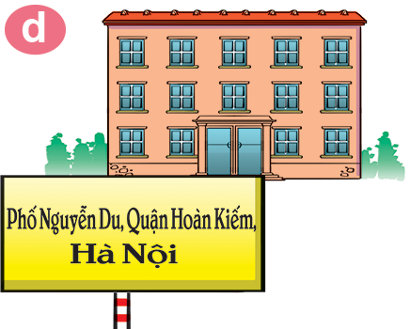
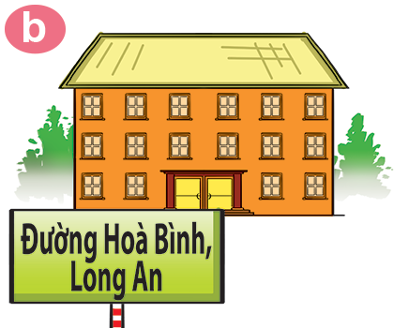
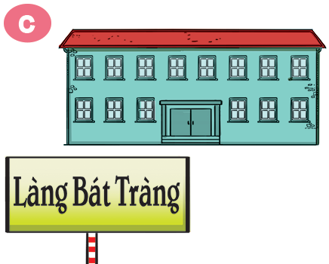
Unit 6
Where's your school?
It’s in ___________.
Oxford Street
Hoan Kiem District
Hoa Binh Street
Bat Trang Village
Ms. Huyền Phạm

Slide 11
B. Structures:
Hỏi và trả lời TÊN LỚP của bạn là gì:
What class are you in?
I’m in Class _______.
+Tên lớp
(Bạn học lớp nào?)
(Tớ học lớp ______.)
Hỏi và trả lời TÊN LỚP của cô ấy anh ấy là gì:
What class is she/he in?
(Cô ấy/anh ấy học lớp nào?)
She/He’s in Class ______.
+Tên lớp
(Cô ấy/anh ấy học lớp ______.)

Slide 12
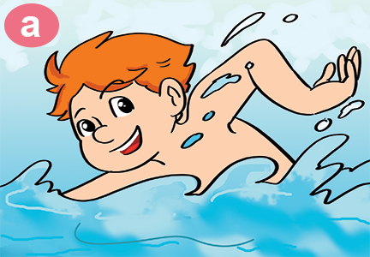
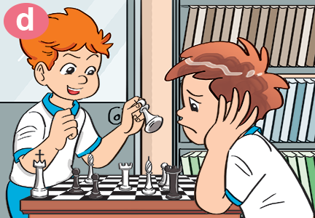
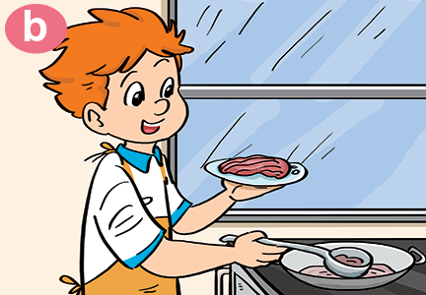
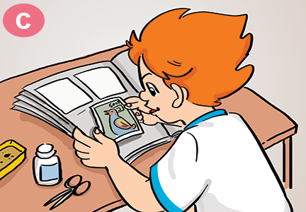
Unit 7
What do you like doing?
I like ___________.
swimming
playing
chess
cooking
collecting
stamps
Ms. Huyền Phạm

Slide 13
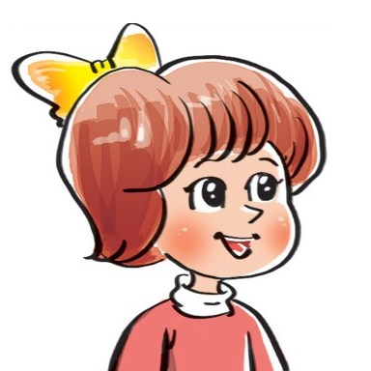
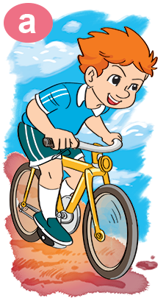
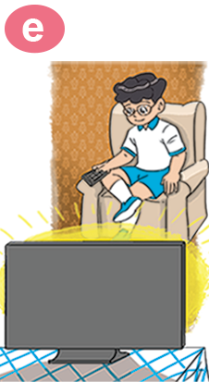
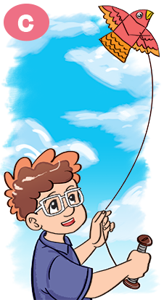
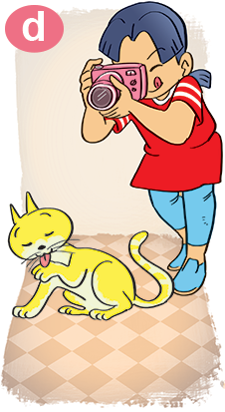
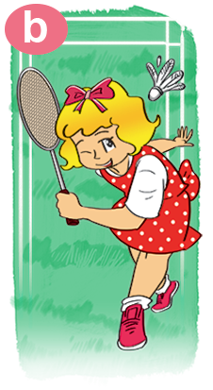
Unit 7
What's your hobby?
I like ___________.
watching TV
taking
photos
playing
badminton
flying a kite

Slide 14
Unit 8
What subjects do you have today?
I have ___________.
Sciences
Art
IT
Vietnamese
Ms. Huyền Phạm

Slide 15
Unit 8
When do you have __________?
I have it on ___________.

Slide 16
Unit 9
What's she / he doing?
She / he’s _________.
watching
a video
reading a text
listening to music
writing a dictation
Ms. Huyền Phạm

Slide 17
Unit 9
What are they doing?
They’re _________.
making paper planes
painting
mask
making puppet
playing badminton
Ms. Huyền Phạm

Slide 18
Unit 10
Where were you yesterday?
I was _________.
in the
school libray
at the zoo
on the beach
Ms. Huyền Phạm

Slide 19
Unit 10
What did you do yesterday?
I ________________.
played badminton
watered the flowers
painted a picture
Ms. Huyền Phạm

