Slide 1
Unit 16
Do you have any pets?
Lesson 1

Slide 2
VOCABULARY

Slide 3
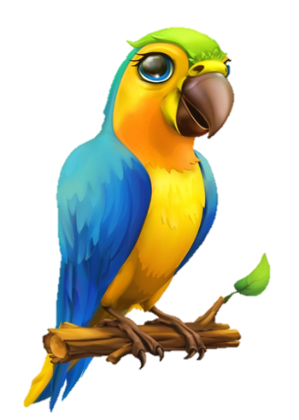
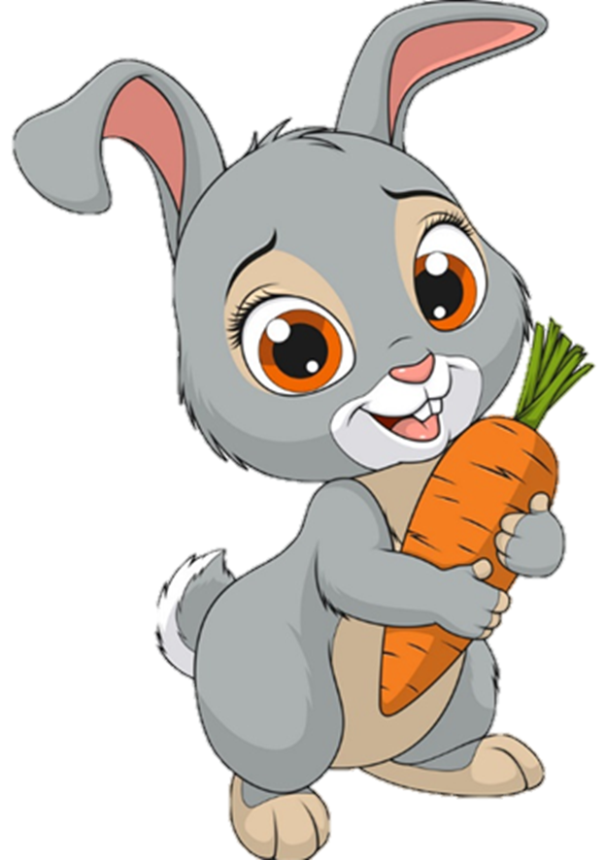
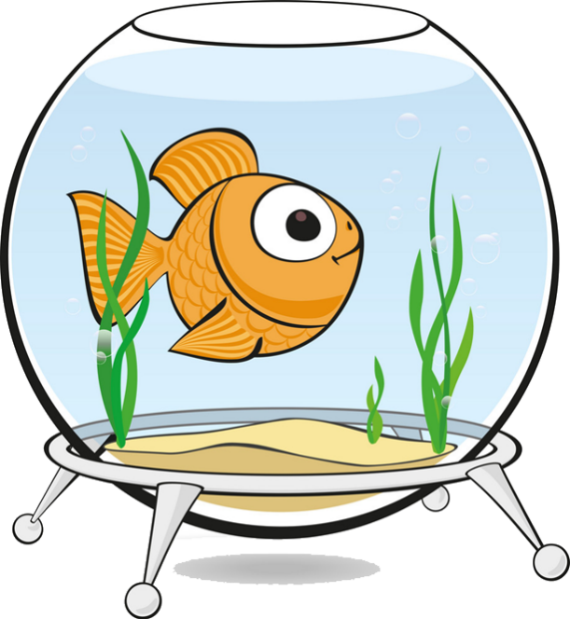
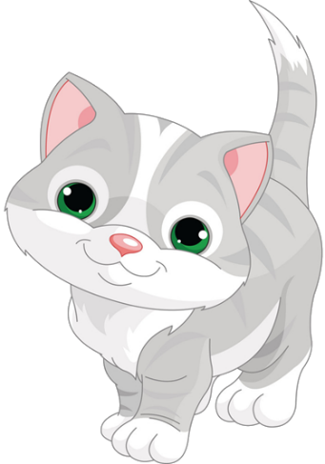
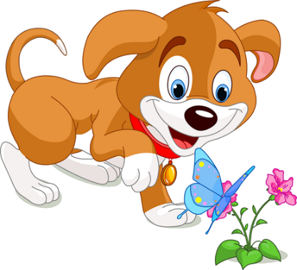
Vocabulary
pet
/pet/

Slide 4
Vocabulary
parrot
/ˈpærət/

Slide 5
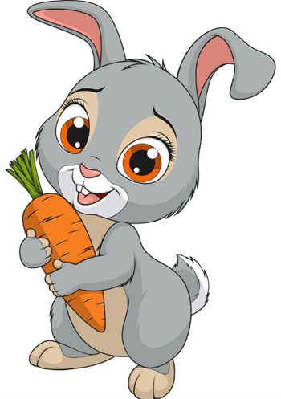
Vocabulary
rabbit
/ˈræbɪt/

Slide 6
Vocabulary
goldfish
/ˈɡəʊldfɪʃ/

Slide 7
Vocabulary
cage
/keɪdʒ/

Slide 8
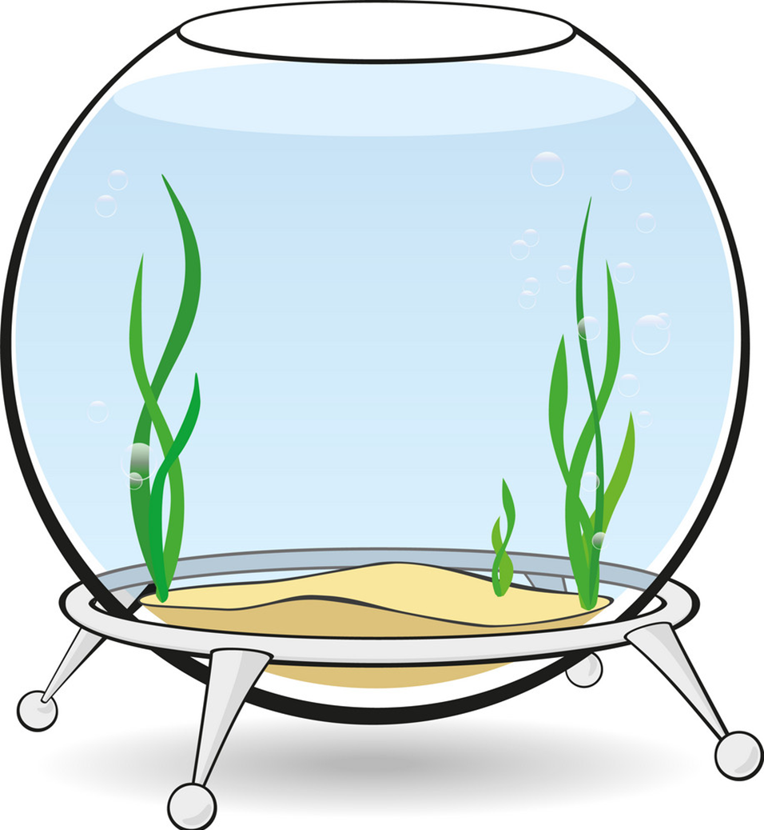
Vocabulary
tank
/tæŋk/

Slide 9
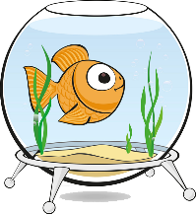
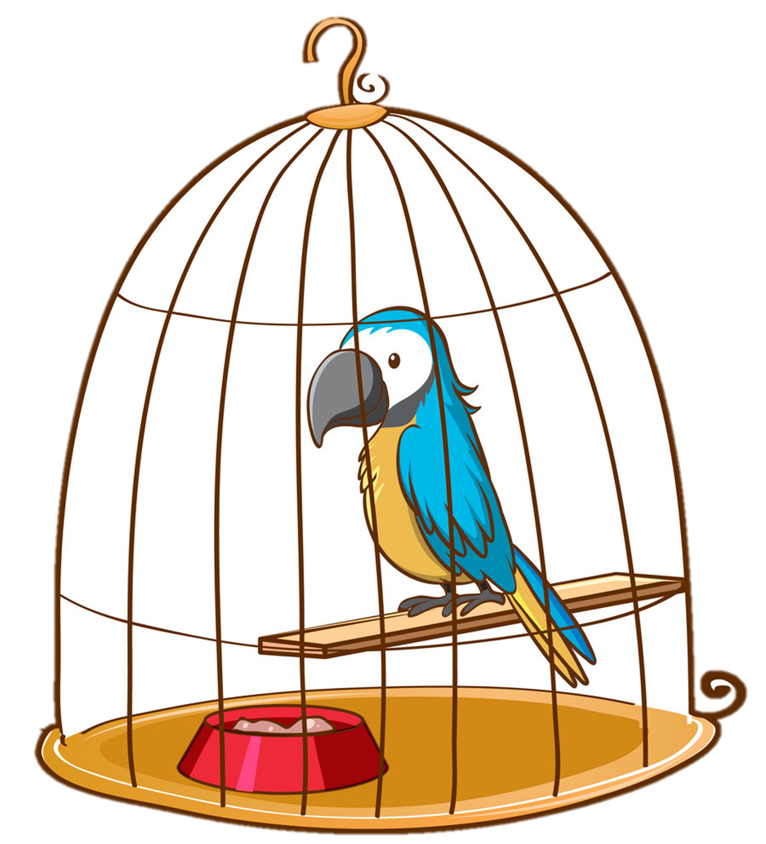
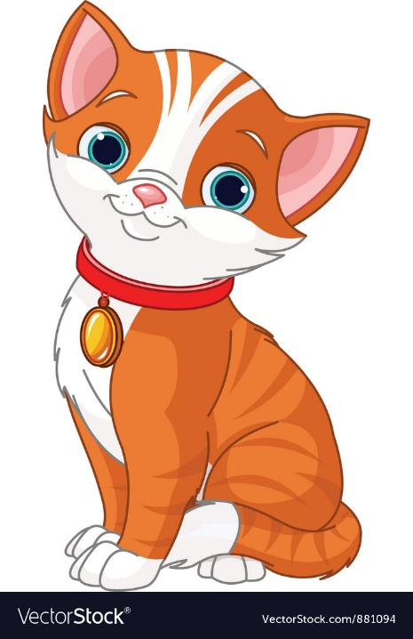
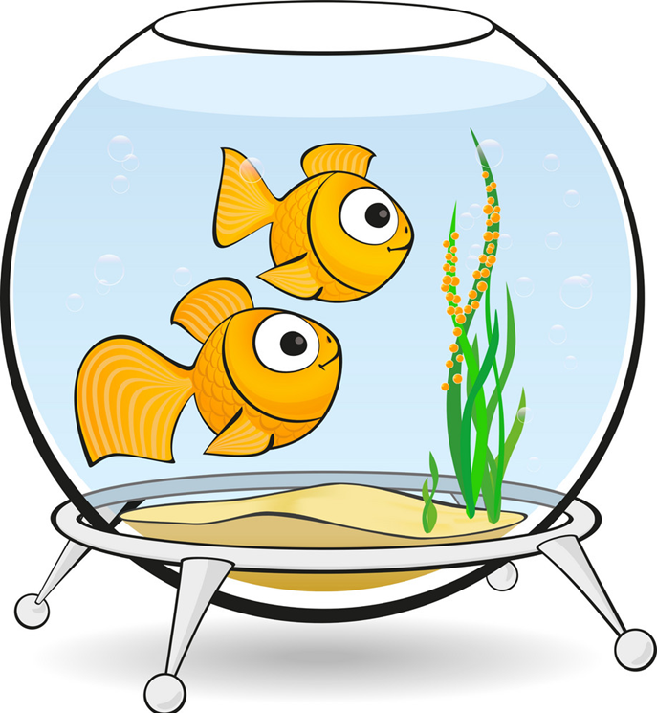
Vocabulary
1
2
3
parrot
rabbit
goldfish
4
5
6
tank
cage
pets

Slide 10
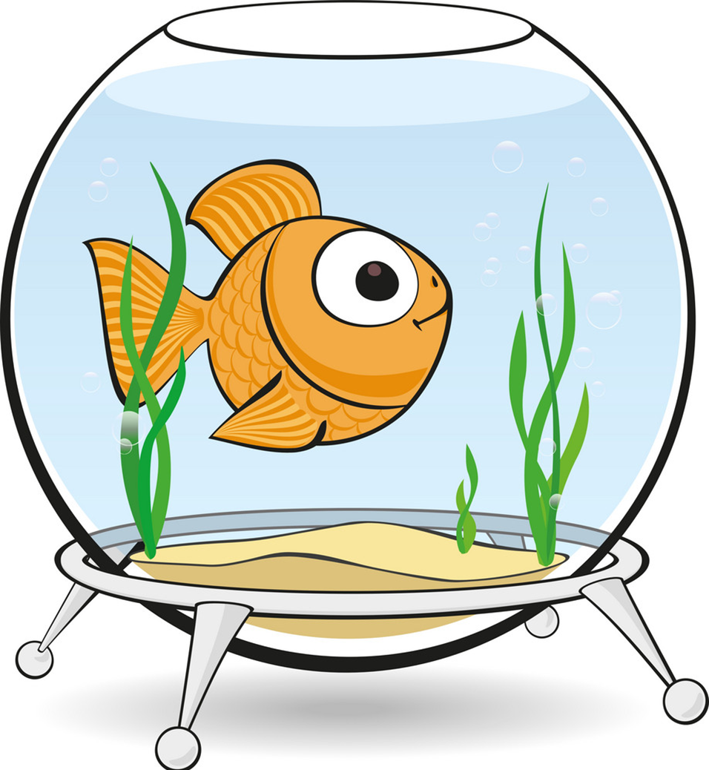
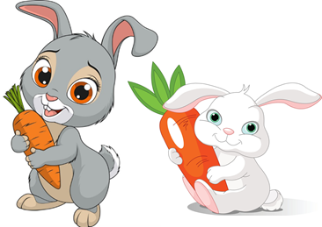
Vocabulary
parrot
parrots
a goldfish
goldfish
a
a rabbit
rabbits
a pet
pets

Slide 11
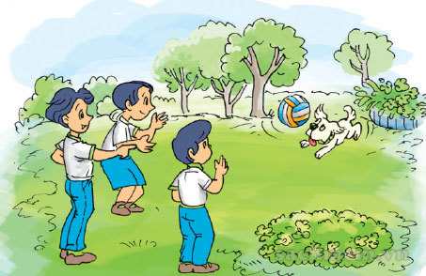
1. Look, listen and repeat
That's my dog.
Wow! He's cute!
Wow! He's cute!

Slide 12
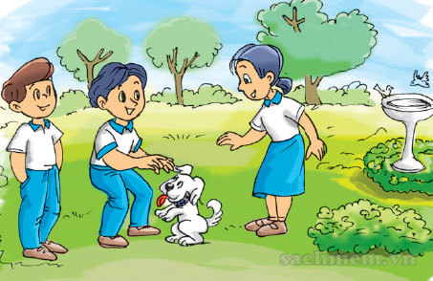
1. Look, listen and repeat
Do you have any pets?
Yes, I do. I have two dogs.

Slide 13
Model sentence
Yes, I do.
Do you have any _______?
No, I don’t.
pets
goldfish
parrots
rabbits
cats

Slide 14
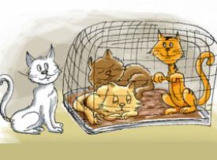
2. Point and say
cats
Do you have any __________?
Yes, I do.

Slide 15
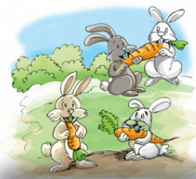
2. Point and say
rabbits
Do you have any __________?
Yes, I do.

Slide 16
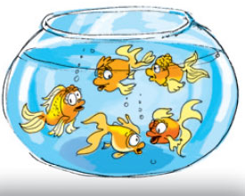
2. Point and say
goldfish
Do you have any __________?
No, I don’t.

Slide 17
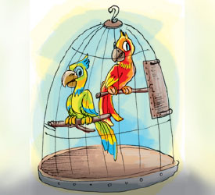
2. Point and say
parrots
Do you have any __________?
No, I don’t.

Slide 18
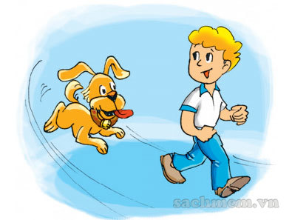
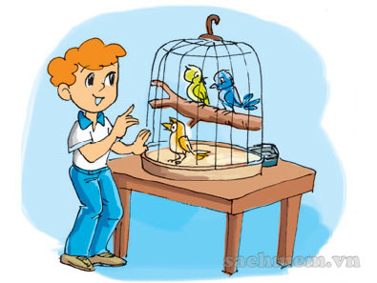
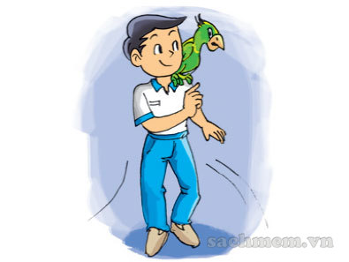
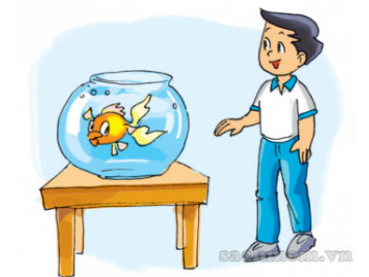
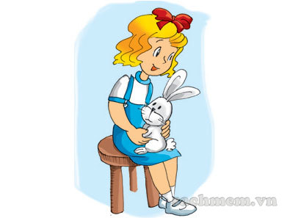
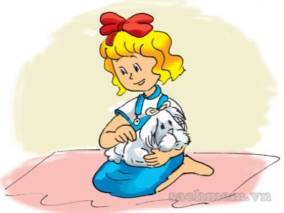
4. Listen and tick
a
b
1.
a
b
2.
a
b
3.
3
2

