Slide 2


Slide 3
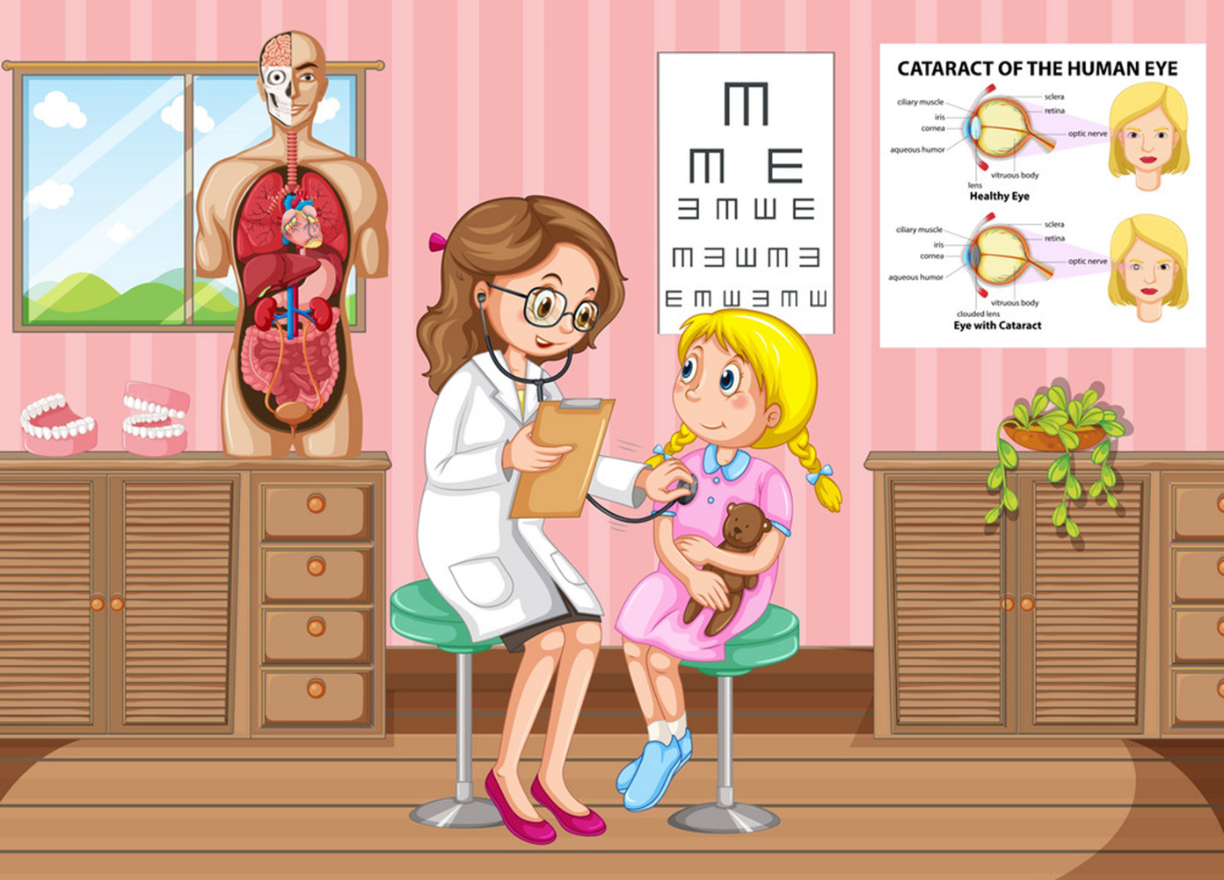
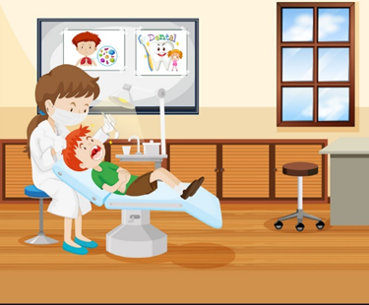
Friday, January 7th, 2022
Unit 11
What’s the matter with you?
Lesson 2 – p8,9

Slide 4


OBJECTIVES
(Mục tiêu của bài học hôm nay)
01
- Learn about some diseases ( Học về một số các căn bệnh thường gặp)
- Advise somebody should or shouldn’t do (Khuyên ai đó nên làm gì và ko nên làm gì)
02
03
- Practice speaking, listening, reading and writing skills.
(Luyện tập các kĩ năng nói, nghe và đọc hiểu.)
Notes:
Thanh Yến Trần 0967 255 149 zalo/ FB https://www.facebook.com/thanhyentrananhngutaymy/

Slide 5
Vocabulary

Slide 6
go to the doctor
/gəʊ tə ðə ˈdɒktər/

Slide 7
go to the dentist
/goʊ tə ðə ˈdɛntəst/

Slide 8

take a rest
/teɪk ə rɛst/

Slide 9
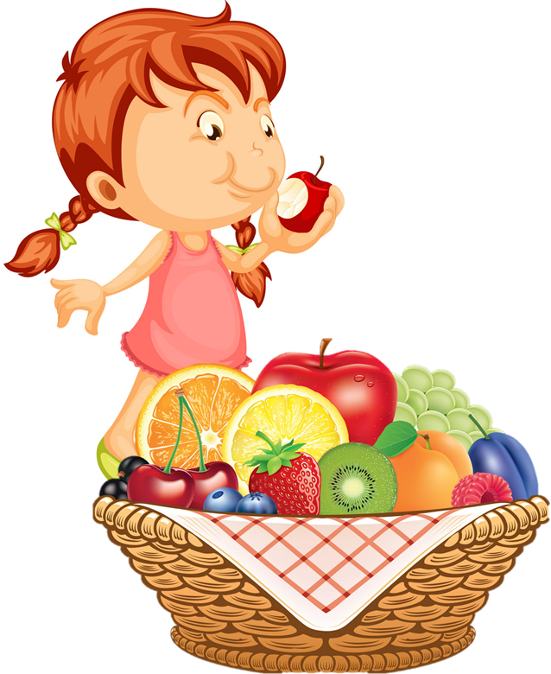
eat a lot of fruit
/iːt ə lɑ:t əv frut/

Slide 10

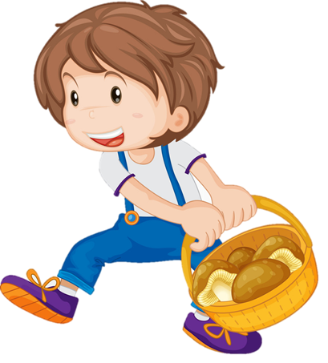
carry heavy things
/ˈkæri ˈhɛvi θɪŋz/

Slide 11
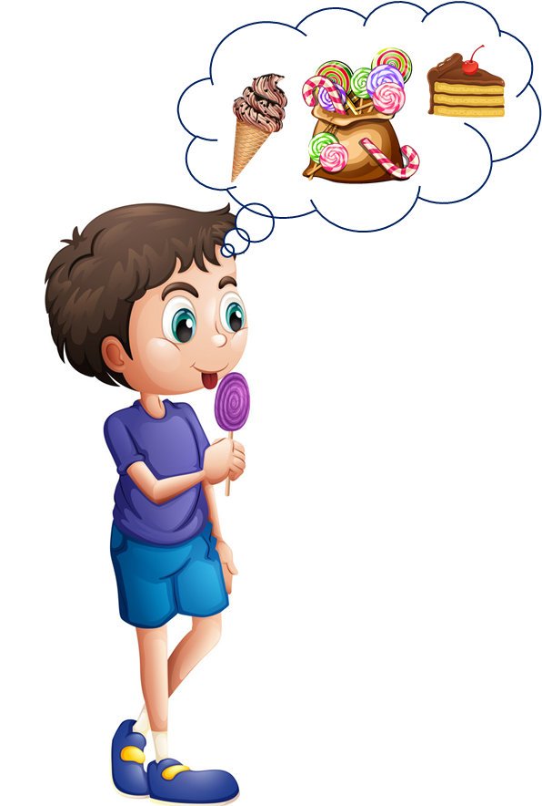
eat a lot of sweets
/i:t ə lɑ:t əv swi:ts/

Slide 12

Review
1
2
3
go to the doctor
go to the dentist
take a rest
4
5
6
eat a lot of sweets
eat a lot of fruit
carry heavy things

Slide 13

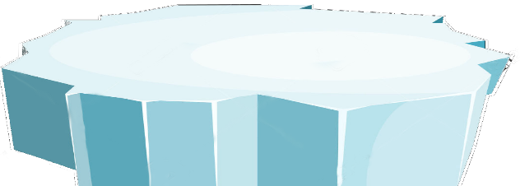




The little penguins
PLAY
Notes:
Ms Huyền Phạm - 0936.082.789 – YOUTUBE: MsPham. Facebook: Dạy và học cùng công nghệ.

Slide 14
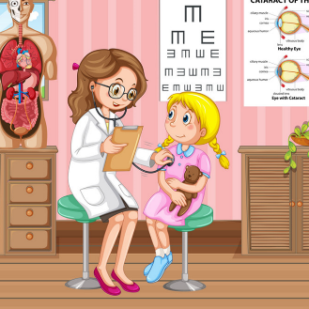
SURFING
NEXT
STOP
Go to the doctor
Notes:
Ms Huyền Phạm - 0936.082.789 – YOUTUBE: MsPham. Facebook: Dạy và học cùng công nghệ.

Slide 15
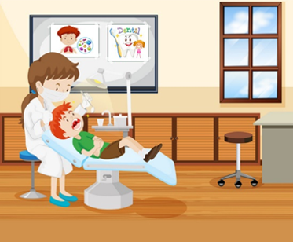
SURFING
NEXT
STOP
Go to the dentist
Notes:
Ms Huyền Phạm - 0936.082.789 – YOUTUBE: MsPham. Facebook: Dạy và học cùng công nghệ.

Slide 16
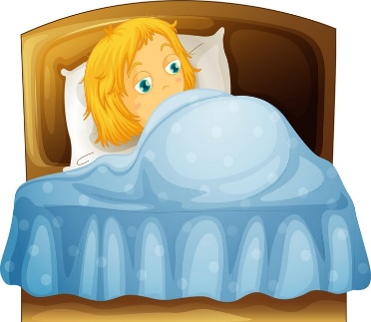
SURFING
NEXT
STOP
Take a
rest
Notes:
Ms Huyền Phạm - 0936.082.789 – YOUTUBE: MsPham. Facebook: Dạy và học cùng công nghệ.

Slide 17

SURFING
NEXT
STOP
Eat a lot
of fruit
Notes:
Ms Huyền Phạm - 0936.082.789 – YOUTUBE: MsPham. Facebook: Dạy và học cùng công nghệ.

Slide 18
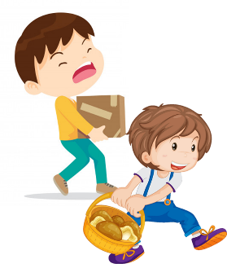
SURFING
NEXT
STOP
Carry
heavy things
Notes:
Ms Huyền Phạm - 0936.082.789 – YOUTUBE: MsPham. Facebook: Dạy và học cùng công nghệ.

Slide 19

SURFING
NEXT
STOP
Eat a lot
of sweet
Notes:
Ms Huyền Phạm - 0936.082.789 – YOUTUBE: MsPham. Facebook: Dạy và học cùng công nghệ.

Slide 20
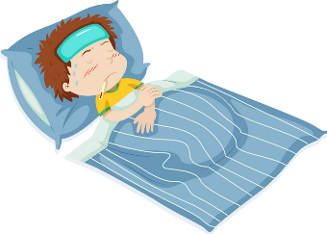
SURFING
NEXT
STOP
Flu
Notes:
Ms Huyền Phạm - 0936.082.789 – YOUTUBE: MsPham. Facebook: Dạy và học cùng công nghệ.

Slide 21
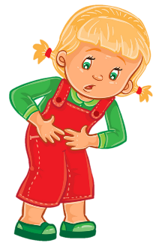
SURFING
NEXT
STOP
Stomach ache
Notes:
Ms Huyền Phạm - 0936.082.789 – YOUTUBE: MsPham. Facebook: Dạy và học cùng công nghệ.

Slide 22
SURFING
NEXT
STOP
Go to the doctor
Notes:
Ms Huyền Phạm - 0936.082.789 – YOUTUBE: MsPham. Facebook: Dạy và học cùng công nghệ.

Slide 23
SURFING
NEXT
STOP
Take a
rest
Notes:
Ms Huyền Phạm - 0936.082.789 – YOUTUBE: MsPham. Facebook: Dạy và học cùng công nghệ.

Slide 24
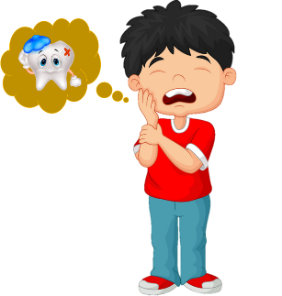
SURFING
NEXT
STOP
Toothache
Notes:
Ms Huyền Phạm - 0936.082.789 – YOUTUBE: MsPham. Facebook: Dạy và học cùng công nghệ.

Slide 25
SURFING
NEXT
STOP
Eat a lot
of fruit
Notes:
Ms Huyền Phạm - 0936.082.789 – YOUTUBE: MsPham. Facebook: Dạy và học cùng công nghệ.

Slide 26
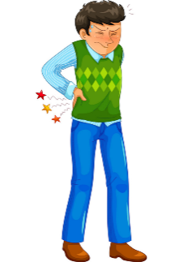
SURFING
NEXT
STOP
Backache
Notes:
Ms Huyền Phạm - 0936.082.789 – YOUTUBE: MsPham. Facebook: Dạy và học cùng công nghệ.

Slide 27
SURFING
NEXT
STOP
Eat a lot
of sweet
Notes:
Ms Huyền Phạm - 0936.082.789 – YOUTUBE: MsPham. Facebook: Dạy và học cùng công nghệ.

Slide 28
SURFING
NEXT
STOP
Go to the dentist
Notes:
Ms Huyền Phạm - 0936.082.789 – YOUTUBE: MsPham. Facebook: Dạy và học cùng công nghệ.

Slide 29
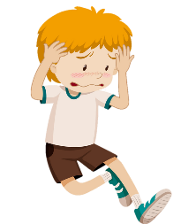
SURFING
NEXT
STOP
Headache
Notes:
Ms Huyền Phạm - 0936.082.789 – YOUTUBE: MsPham. Facebook: Dạy và học cùng công nghệ.

Slide 30
SURFING
NEXT
STOP
Carry
heavy things
Notes:
Ms Huyền Phạm - 0936.082.789 – YOUTUBE: MsPham. Facebook: Dạy và học cùng công nghệ.

Slide 31
Welldone!
EXIT
Notes:
Ms Huyền Phạm - 0936.082.789 – YOUTUBE: MsPham. Facebook: Dạy và học cùng công nghệ.

Slide 32
Grammar

Slide 33
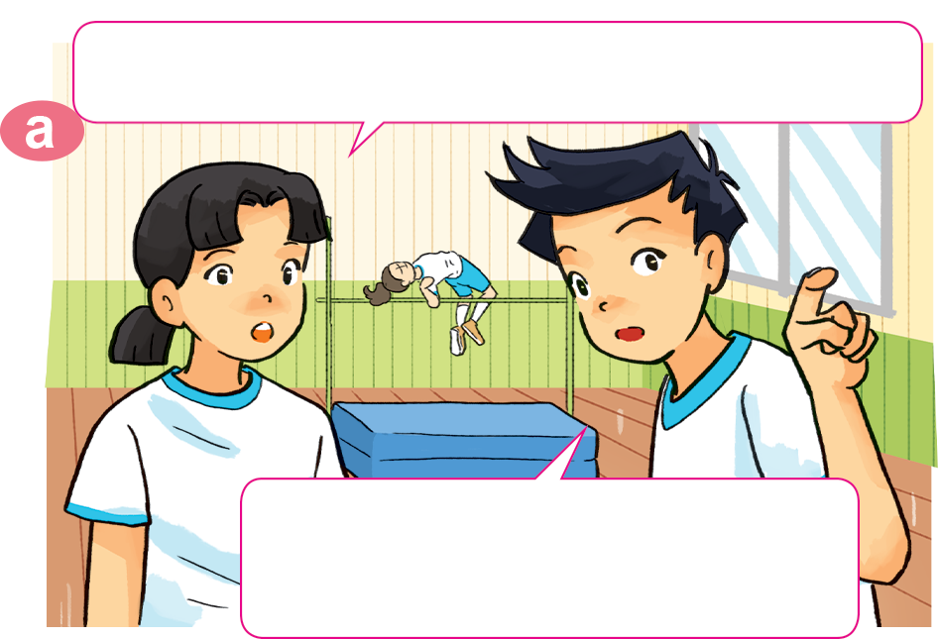
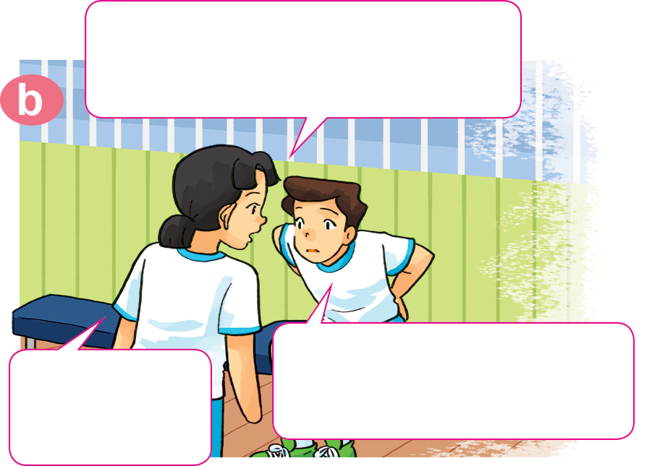
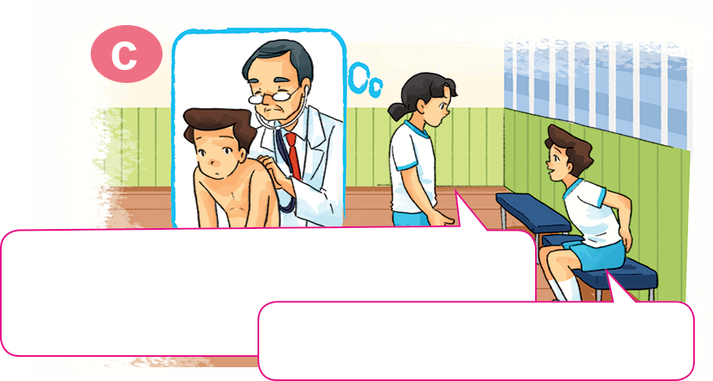
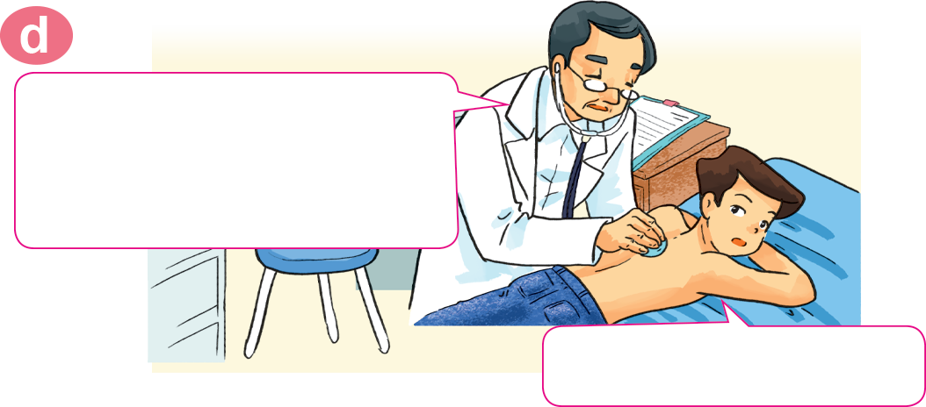
1. Look, listen and repeat.
Where's Nam? I can't see him here.
Hi, Nam. Why aren't you
practising karate?
I don't feel well.
I have a backache.
He's sitting over there,
in the corner of the gym.
Sorry to
hear that.
You should take a rest and shouldn't play
sports for a few days.
You should go to the doctor
now, Nam.
OK, I will. Thanks, Mai.
Thank you, doctor.

Slide 34
2. Point and say.
eat a lot of fruit
You should __________________.
Yes, I will. Thanks.

Slide 35
2. Point and say.
take a rest
You should __________________.
Yes, I will. Thanks.

Slide 36
2. Point and say.
go to the dentist
You should __________________.
Yes, I will. Thanks.

Slide 37
2. Point and say.
You shouldn’t ____________________.
eat a lot of sweets
Ok, I won’t. Thanks.

Slide 38
2. Point and say.
carry heavy things
You shouldn’t ____________________.
Ok, I won’t. Thanks.

Slide 39

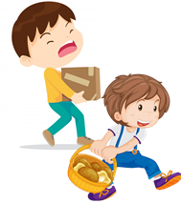
Temperature
/ˈtemprətʃər/
Model sentence
You should/shouldn’t _____________.
Yes, I will. Thanks.
OK, I won't. Thanks
go to the
doctor
take a rest
carry
heavy things
eat a lot of
sweets
go to the
dentist
eat a lot
of fruit
Earache
/ˈɪəreɪk/

Slide 40

4. Listen and complete.
 | Health problem | Should | Shouldn't
1. Quan
2. Tony
3. Phong
4. Mrs Green
go to
the doctor
stomach ache
fever
go to school
toothache
eat ice cream
carry
heavy things
backache

Slide 41
5. Read and complete.
Quan: Where's Phong?
Mai: He can't go to school today.
Quan: Why not? What's the (1) _________ with him?
Mai: He (2) _______ a bad cough and is going to see the (3) __________ this morning.
Quan: Oh, really? Poor him!
Mai: What's the matter with you, Tony?
Tony: I have a pain in my (4) __________ .
Mai: Oh, dear. You should take a (5) ______ now and go to the doctor later.
Tony: Yes, I will. Thanks, Mai.
stomach
doctor
matter
rest
has
matter
has
doctor
stomach
rest

Slide 42
Friday, January 7th , 2022
Unit 11: Lesson 2 – p8,9
Words
Go to the doctor
Eat a lot of fruit - take a rest
Carry heavy things - Eat a lot of sweets
2. Model sentence
A: You should/shouldn’t go to the doctor.
B: Yes, I will. Thanks./ Ok, I won’t. Thanks!
3. HomeLink
- Luyện đọc và viết từ mới mỗi từ 2 dòng
- WB(SBT): p46,47 - Xem trước Unit 11: Lesson 3

