Slide 1
Welcome to Our Class
5A5
Nguyen Bich Thom

Slide 3
Tuesday, November 23rd , 2021
Unit 7
How do you learn English?
Lesson 2

Slide 4
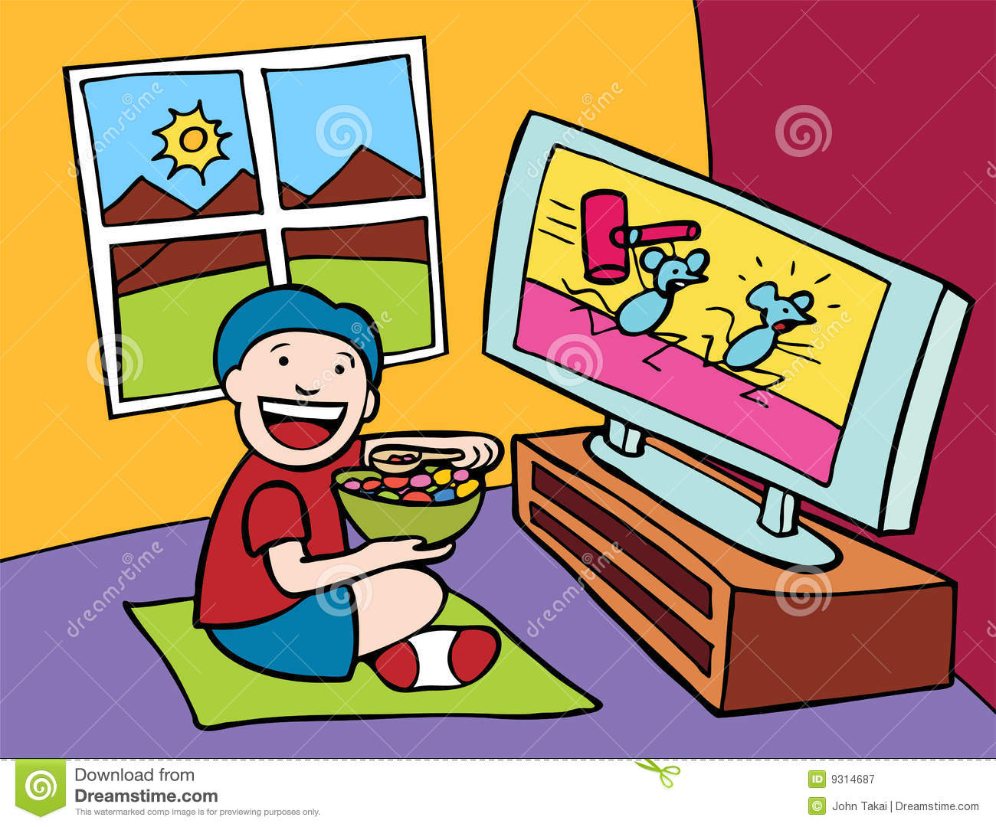

Slide 7
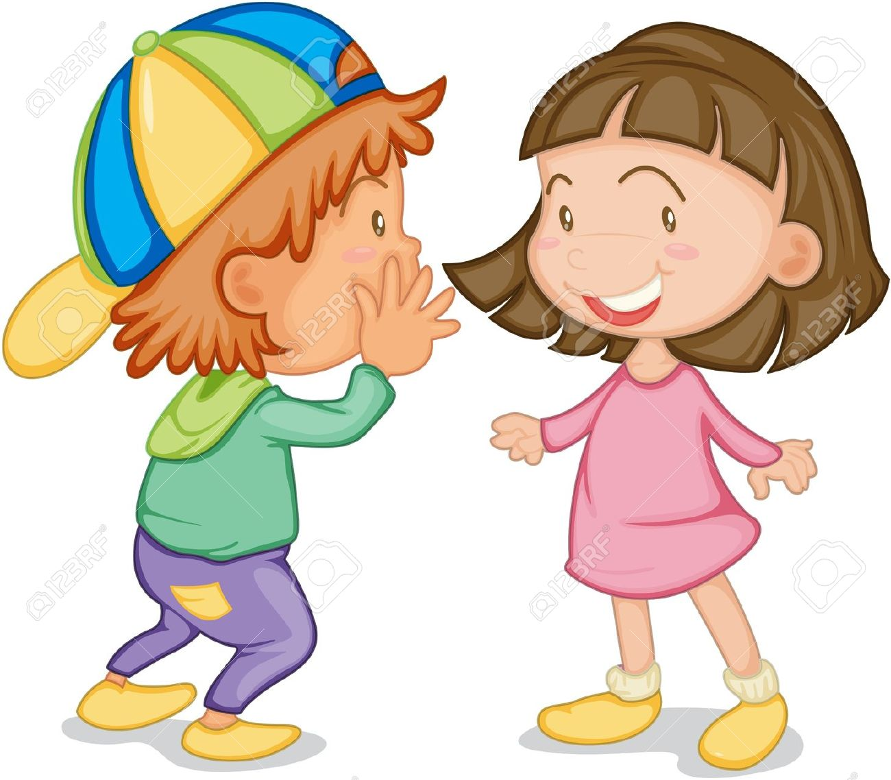

Slide 9
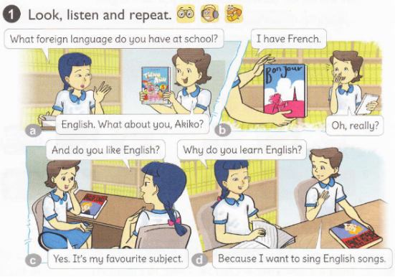

Slide 10
FORM
Why do you learn English?
Because I want to sing English songs.
Because I want to talk with foreign friend.

Slide 11
GAMETIME

Slide 12
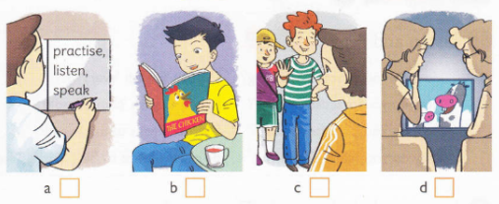
4
3
3
Check
3
1
1
2
2
3
3
4
4
1
1
2
2
3
3
4
4
1
1
2
2
3
3
4
4
1
1
2
2
3
3
4
4
2
1
3
3

Slide 13
Thanks for your attention!

